Slide 1
Visualizing Data
Matplotlib and Pygal

Slide 2
Generating Data

Slide 3
Install matplotlib
Open up your terminal and type:
$ sudo apt-get install python-matplotlib

Slide 4
Make a new file called:
mpl_squares.py

Slide 5
mpl_squares.py
import matplotlib.pyplot as plt
squares = [1, 4, 9, 16, 25]
plt.plot(squares)
plt.show()

Slide 6
Run it

Slide 7
Now, let’s add a title & set text size
plt.plot(squares, linewidth=5)
# Set chart title and label axes.
plt.title(“Joe’s Square Numbers”, fontsize=24)
plt.xlabel(“Value”, fontsize=14)
plt.ylabel(“Square of Value”, fontsize=14)
#Set size of tick labels.
plt.tick_params(axis=’both’, labelsize=14)

Slide 8
Run it

Slide 9
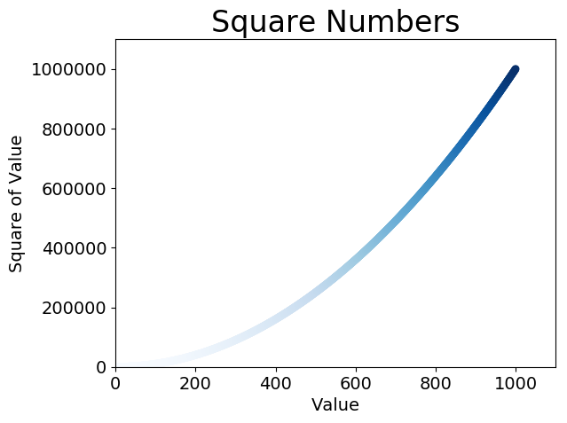
Saving Your Plots Automatically

Slide 10
import sys, pygame
pygame.init()
size = width, height = 600, 600
speed = [1, 1]
red = 130, 202, 154
screen = pygame.display.set_mode(size)
# ball = pygame.image.load("pygame_logo.gif")
ball = pygame.image.load("TechEmDogKoa1.jpg")
ballrect = ball.get_rect()
while 1:
for event in pygame.event.get():
if event.type == pygame.QUIT: sys.exit()
ballrect = ballrect.move(speed)
if ballrect.left < 0 or ballrect.right > width:
speed[0] = -speed[0]
if ballrect.top < 0 or ballrect.bottom > height:
speed[1] = -speed[1]
screen.fill(red)
screen.blit(ball, ballrect)
pygame.display.flip()

