Slide 1
Storing Data
JSON

Slide 2
A simple way to store data between two programs

Slide 3
We will write two short programs
One will store a set of numbers
And another that will read these numbers back into memory

Slide 4
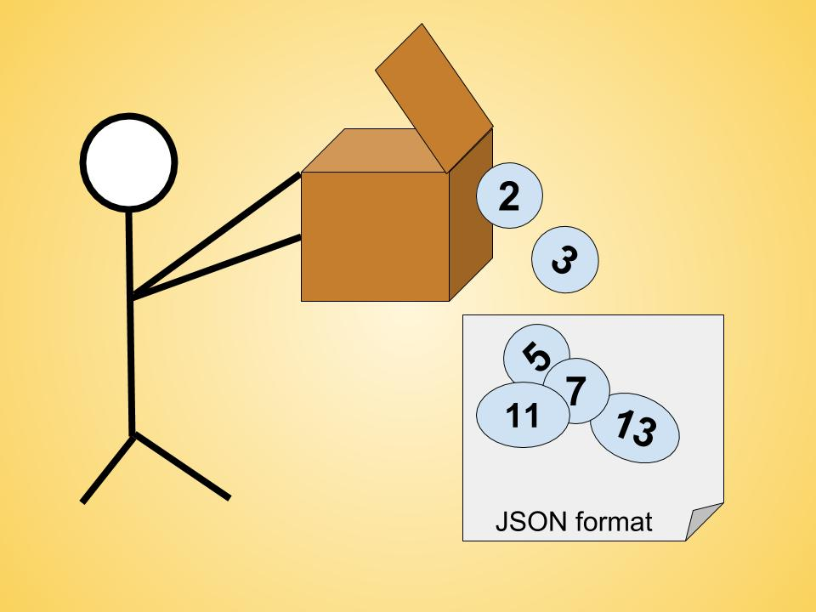
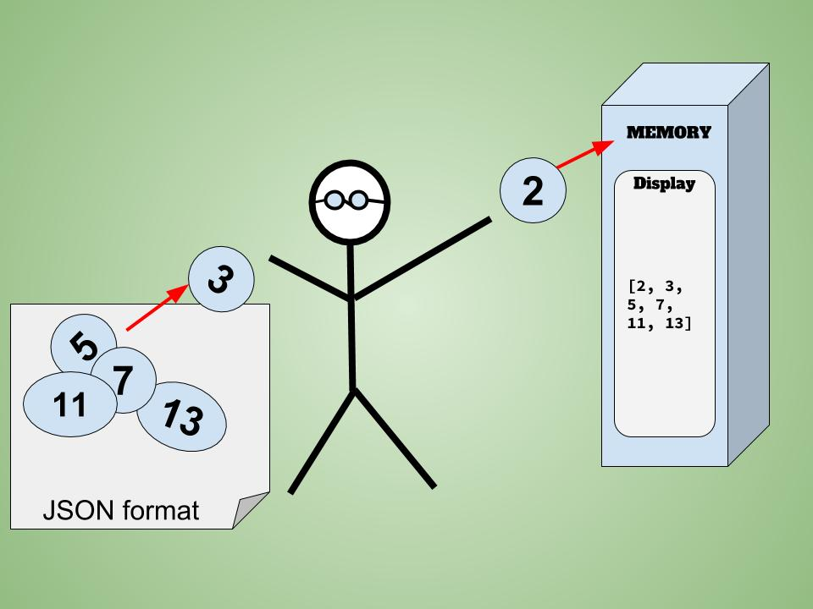
json.dump()
json.load()
Stores the set of numbers
Reads the numbers back into memory

Slide 5
json.dump()
number_writer.py

Slide 6
Short program that stores a set of numbers

Slide 7
number_writer.py
import json
numbers = [2, 3, 5, 7, 11, 13]
filename = ‘numbers.json’
with open(filename, ‘w’) as f_obj:
json.dump(numbers, f_obj)

Slide 8
import json
A list of numbers to work with:
numbers = [2, 3, 5, 7, 11, 13]
Choose a filename to store the list of numbers.
filename = ‘numbers.json’

Slide 9
We open the file in write mode, which allows json to write the data to the file.
with open(filename, ‘w’) as f_obj:
Then, we use the json.dump() function to store the list of numbers in the file numbers.json
json.dump(numbers, f_obj)

Slide 10
Open the new json file
This program does not output anything when you run
But, you can now open up a the new json file and read it

Slide 11
json.load()
number_reader.py

Slide 12
json.load() to read the list back into memory

Slide 13
number_reader.py
import json
filename = ‘numbers.json’
with open(filename) as f_obj:
numbers = json.load(f_obj)
print(numbers)
A simple way to share data between two programs

Slide 14
Saving and Reading User-Generated Data

Slide 15
Handling User-Generated Data
When you’re working with user-generated data, it is useful to save the data with json.
Otherwise, you’ll lose your user’s information when the program stops running.

Slide 16
Objectives
Prompt the user for their name the first time they run a program
Remember their name when they run the program again

Slide 17
remember_me.py

Slide 18
remember_me.py
import json
username = raw_input(“Tell me your name: “)
filename = ‘username.json’
with open(filename, ‘w’) as f_obj:
json.dump(username, f_obj)
print(“We’ll remember you when you’re back. “ +username+ “!”)

