Slide 1


Make a Movie Camp

Slide 2
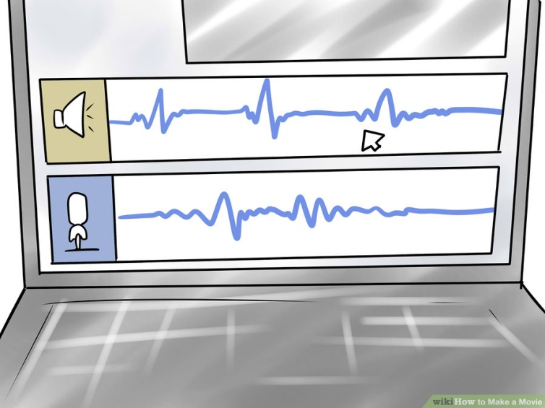

Goals
Create an awesome movie!
Timeline (total of 4 days)
Decide to work in group or individually
Come up with 3 movie ideas (try using idea maps)
Make a script and storyboard for your movie
Helps to have movie make sense
Film your movie
We will learn how to film using iMovie on iPads
Film each scene
Edit your movie
We will learn how to edit our movie using iMovie
Transition the scenes to make ‘fluid’
Have a showing of your movie!

Slide 3


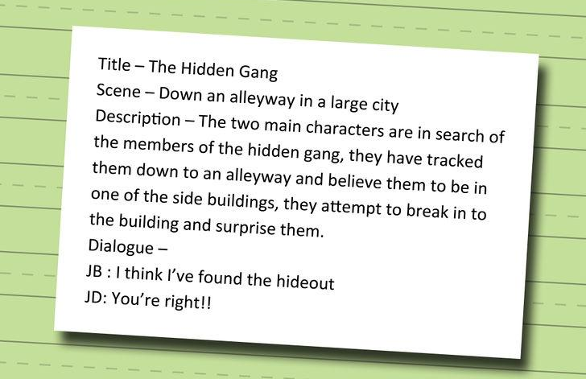
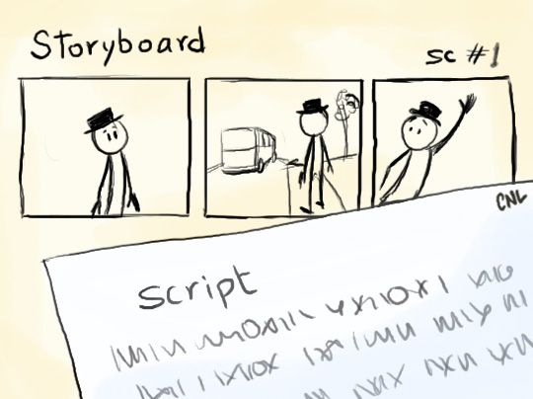

Brainstorm to Idea
Idea to Script
Script to Storyboard
Storyboard to Film
Film to Edit – to more Film & Edit
To Screening/Showing (Final Day)

Slide 4
Timeline
Total of four days
Day 1
Brainstorm to idea
Idea to script (story)
Script to Storyboard (story with pictures)
Day 2
Script to storyboard
Storyboard to film
Day 3
Film to edit
Day 4
Screening/Showing day
Last edits

Slide 5


What we will use to film & edit our movie
To Film:
iPads/iMovie
To Edit:
iMovie
Windows Movie Maker?

Slide 6
1. Brainstorm to Idea
Developing Ideas (brainstorming)
Work in teams or individually
Come up with at least THREE movie ideas
Consider:
Audience
Timeline
Resources

Slide 7
2. Idea to Script
Creating a Script/Story from idea
Think of it as writing a mini story
Many times, a stranger arrives and shakes up the normal way of things, or a hero departs and goes on a journey.
Generally has a Protagonist
Is the main character, the hero, the leading role
what does your protagonist want?
Could be a person or plant or thing
Antagonist
Shakes things up
Challenges the protagonist

Slide 8
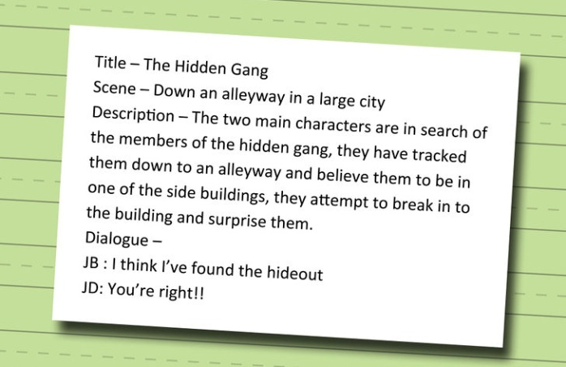
3. Script to Storyboard
How to make the video make sense
Drawing Scenes

Slide 9
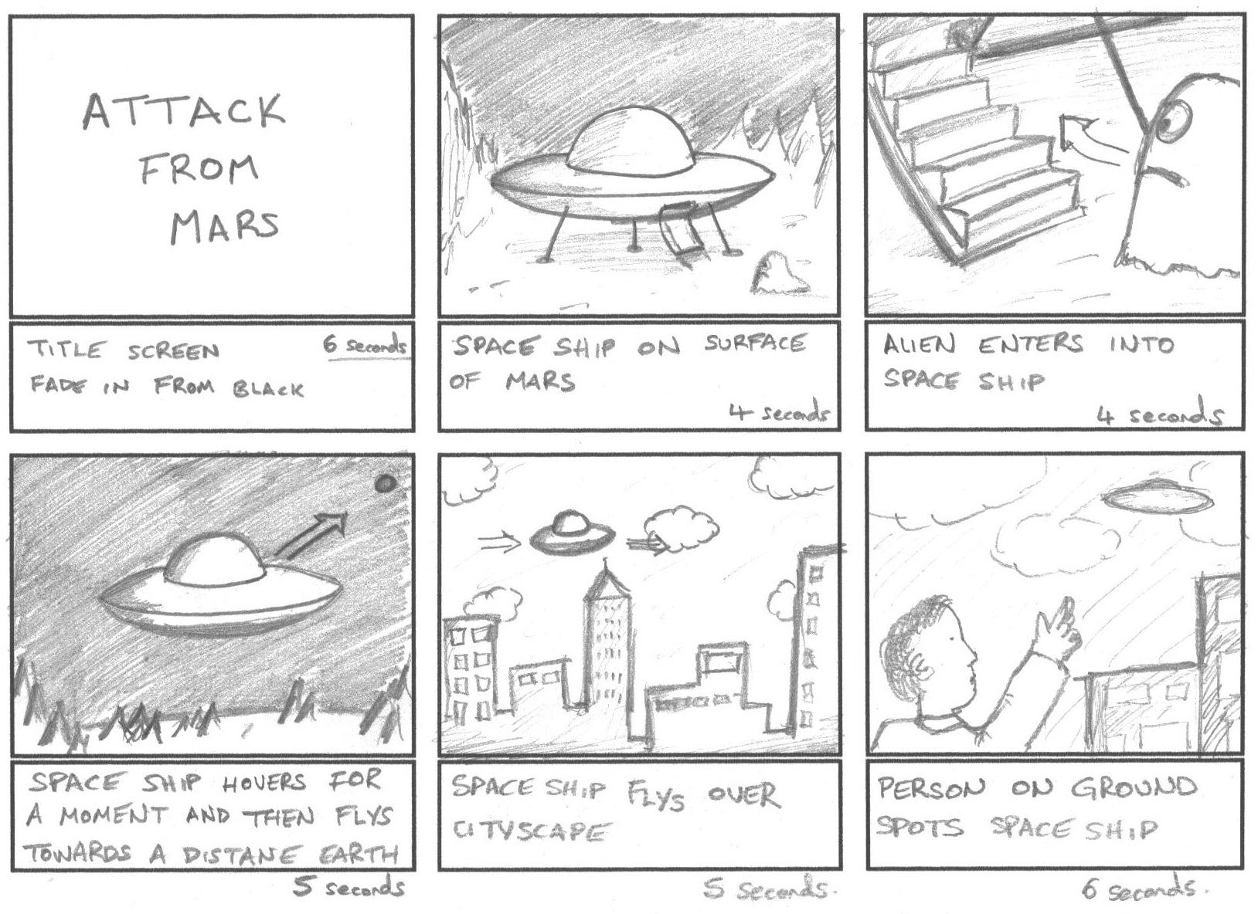
Example Storyboard
http://schoolwires.henry.k12.ga.us/Page/86920

Slide 10
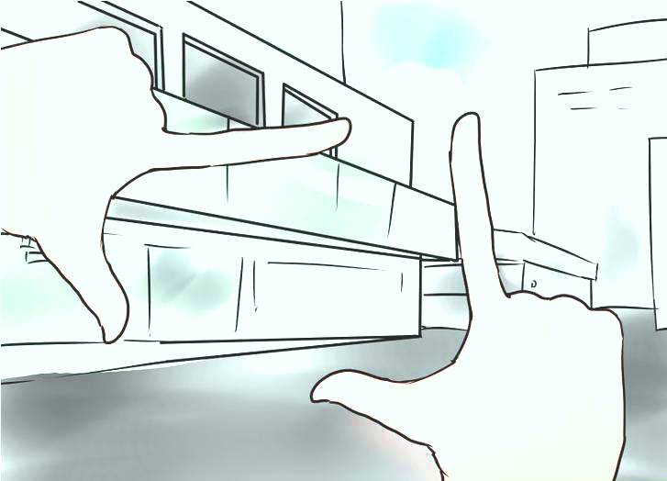
4. Storyboard to Film
Make your story come off the page!
Storyline
From script to storyboard
How to make the video make sense
Location Set-up/Where to film
Gathering materials

Slide 11
4. Storyboard to Film
Let’s film!
Implementing ideas and the storyboard
Using different angles and lighting
Lighting a scene and a person or object

Slide 12

5. Film to Edit to more film & edit!
Video Editing
Transitions
Focus on fluidity video (going from one scene to the next)
Working with audio
Garage Band app

Slide 13
To Screening/Showing
Let’s watch our movies!!!

