Slide 1


Bank of Baroda Hackathon - 2022
Technology Partner
Your Team Name :Team ‘RAMA’
Your team bio : Our team "RAMA" is constantly working to solve the complications that occur between the customers and the call center agency using the concept of AI/ML, Azure resources etc bringing tranformation and scaling up the tech in banking sector.
Date :19/09/22

Slide 2
Problem Statement: Contact Centre is a very important touch point for customer service. Customers interact with the contact center for variety of services fulfilment, information about products and services, complaints, feedback, and interactions. For enhancing the contact center service levels, the customer interactions need to be analyzed and need to be mapped with customer satisfaction. Bank want to automate the process with use of AI based techniques to measure and monitor various KPIs such as call data quality, customer sentiment, Call Hygiene, customer satisfaction etc.
Why did you decide to solve this Problem statement?
These days the interaction of the customers with the call center is not satisfactory at all.Users do belong to different regions of the country and have varying linguistics.
Call centers may sometimes find it difficult to understand them and may fail to address their issues.To properly analyse the users requirement as per their satisfcation and working to achieve it, is our primary goal.
We can design a solution to achieve this objective in the best possible way by making use of the Azure resources, tools and the concept of Artificial Intelligence and Machine Learning.
If customer (user) can be analysed using the modern ai/ml technique on configurations such as data quality, customer sentiment, call hygiene ,then we can adjust those parameters to the convenience of the call center who addresses the need of the users according to their satisfaction.

Slide 3

Azure tools and API'S Consumed
1) Azure Storage Account (Blob Storage) 2) Azure Durable Functions(with Fan Out/Fan in pattern used) 3) Azure Cognitive Services Text Analytics API(to apply sentiment analysis) 4) Azure Cognitive Services Computer Vision API(to apply OCR scan on PDF files) 5) Azure Video Indexer(to analyze audio and video content) 6) Azure Cosmos DB(to store analysis results as JSON documents) 7) Power BI (to visualize collected data in a form of report ) 8) Azure Application Insights to monitor solution and discover issues

Slide 4
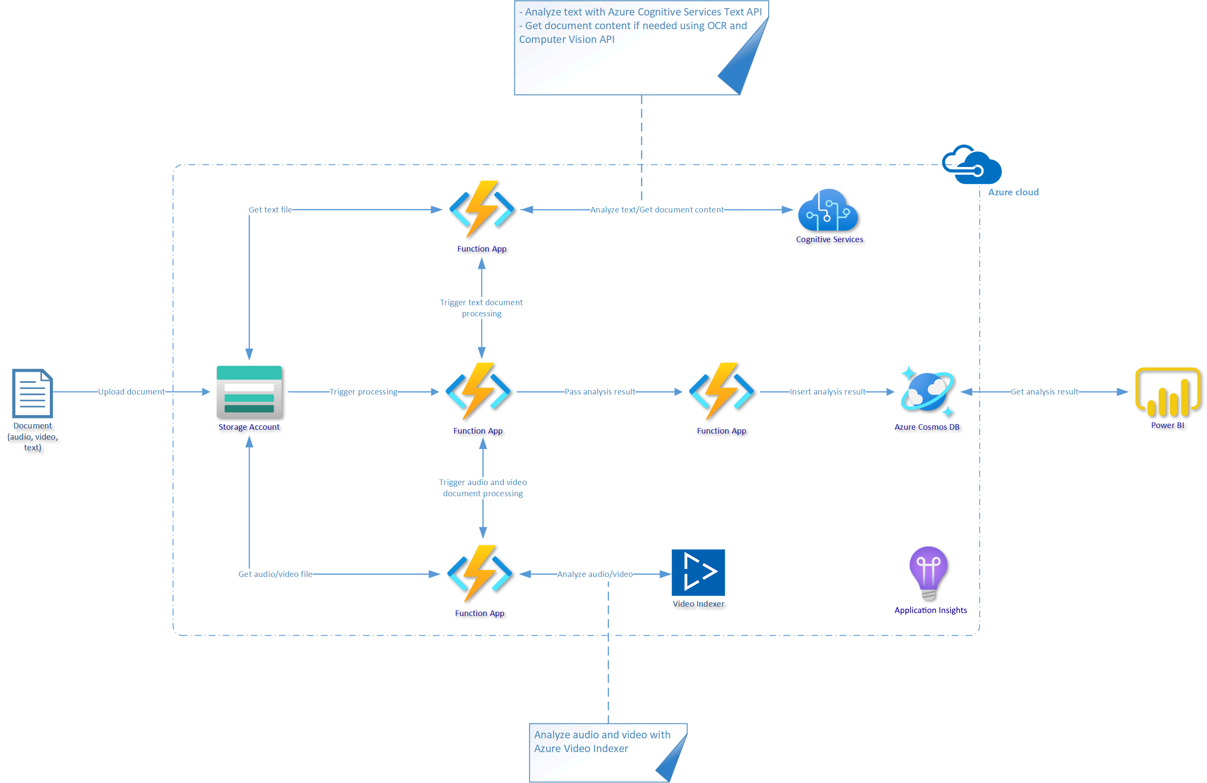
SOLUTION DIAGRAM

Slide 5
WORKFLOW EXPLANATION
We Feed the input file(word , pdf) to the storage account using blob storage with the help of two container. Then Scan it using OCR and Computer vision API. Once we have Content of the file we can extract insights about this content using text analytics API.
For audio/video input , We Invoke Azure Video Indexer Service API (Responsible For extracting insides about the audio/video files) like getting tags, detecting people in those videos or we can extract sentiment values and conversion of cost.
Storing those insides in the Azure Cosmos database. Using Power BI in the end we can connect to Azure Cosmos DB, get this data and create useful charts to display insights about those different types of conversations with customers.

Slide 6
Machine Learning Models AND Algorithms Used
Function name | Description
rxFastTrees | An implementation of FastRank, an efficient implementation of the MART gradient boosting algorithm.
rxFastForest | A random forest and Quantile regression forest implementation using rxFastTrees.
rxLogisticRegression | Logistic regression using L-BFGS.
rxOneClassSvm | One class support vector machines.
rxNeuralNet | Binary, multi-class, and regression neural net.
rxFastLinear | Stochastic dual coordinate ascent optimization for linear binary classification and regression.
rxEnsemble | Trains a number of models of various kinds to obtain better predictive performance than could be obtained from a single model.

Slide 7
What makes our solution highly feasible ?
1) The model is designed to eliminate the unguarded problems of the call centers of the banks.
2) The product is super scalable and high-end achievable making the full automation of telephony-based customer interactions, and provide accessibility across multiple channels.
3) Implemented various machine learning modules and azure services like text analytics (language crt) , azure cognitive resources, real-time conversion transcriptions, translator services, Entity recognition module, Speech recognition, Sentiment analysis and its highly efficacious blob storage features.
4) Our model can provide high end solutions to the customers and the agents across the centers at the same time helping to achieve cost effective and scalable enterprise environment which can be easily equipped and maintained by the BOB administrators.

Slide 8
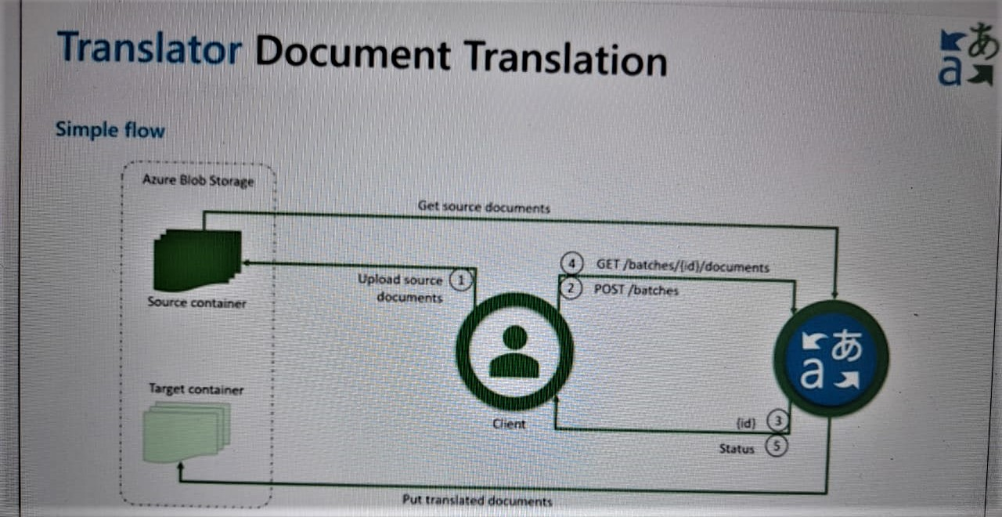
Use Case

Slide 9
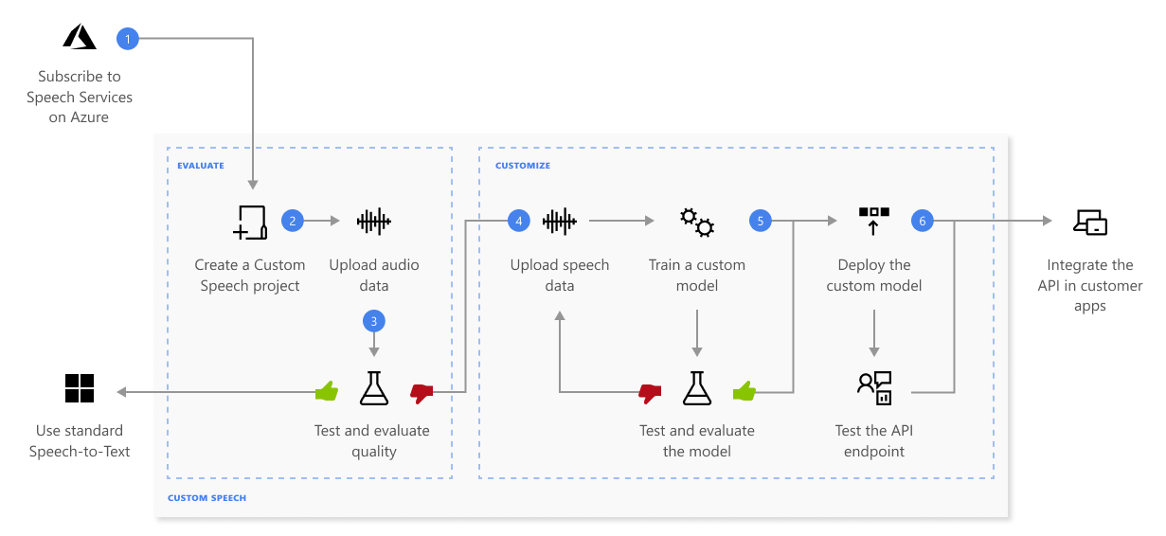
SPEECH SERVICE:

Slide 10
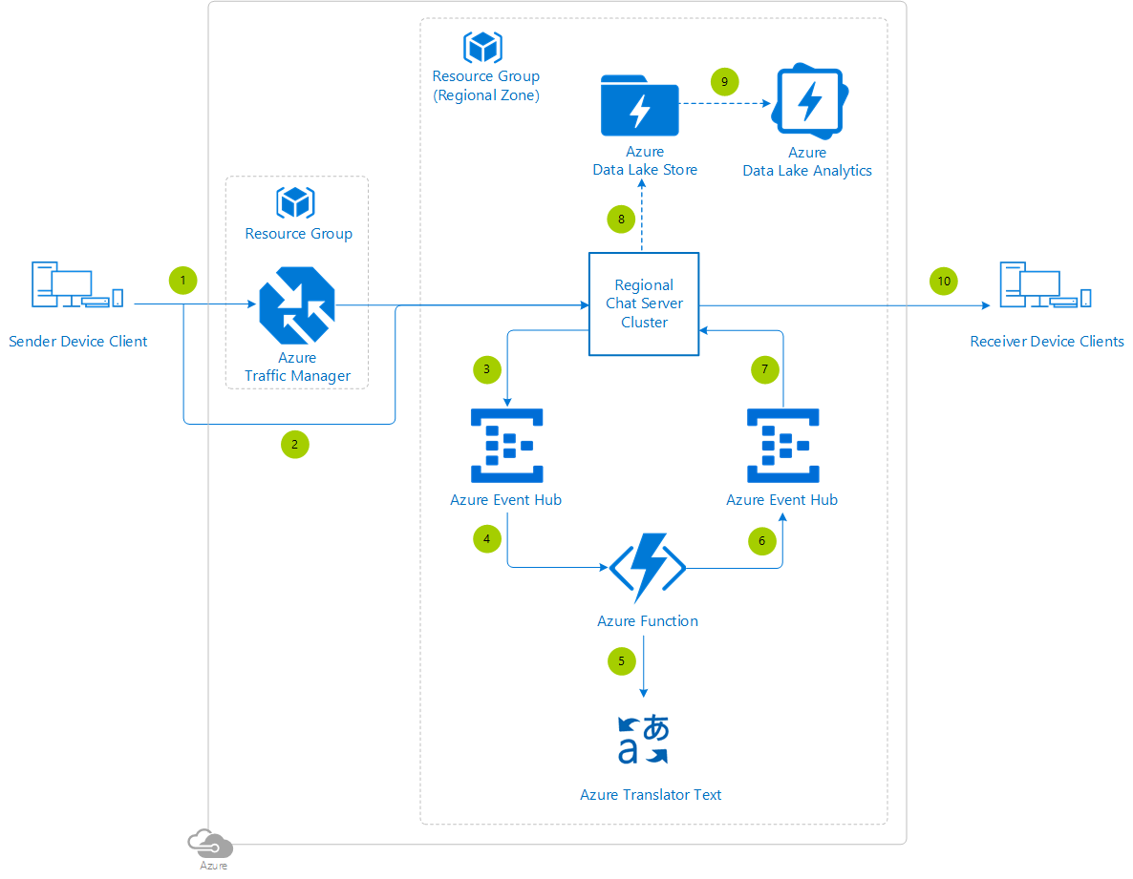
Text Translation

Slide 11
Thank You
Team members: Shubham Gupta (Lead)
: Vanshika Agarwal
: Vanshika Agrawal
: Sachin Gupta

