Slide 1
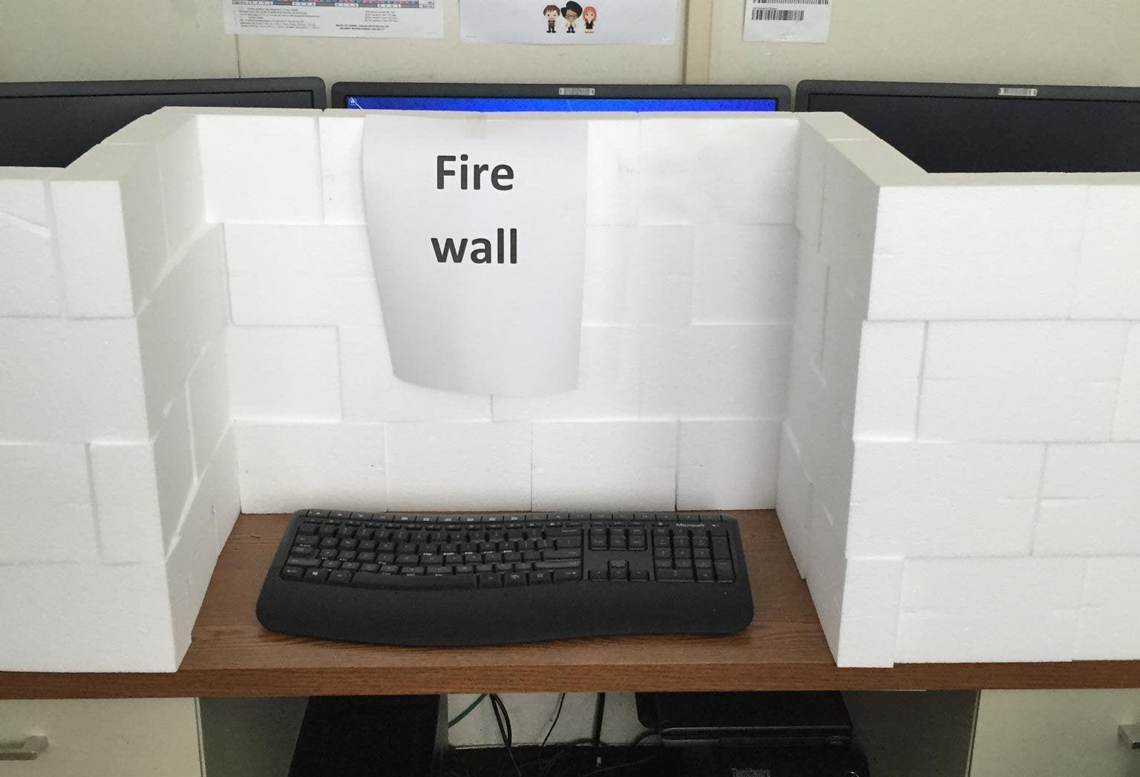
Presentation
Team Ubun-tutti Frutti
Shamim, Micha, Tim, Jeroen

Slide 2

Firewalls
The strong walls that defend our networks.
What are they and how do they work?
Types of firewall:
Stateful and Stateless
Hardware or Software based
Location within the network
In practice in the cloud

Slide 3

What is a firewall?
Prevents unauthorized access to the network.
Uses Access Control Lists and rulesets to make decisions.

Slide 4
Stateless Firewall
Examines each packet header based on preset rules
Source, destination IP, ports, protocols
Does not track state or context of network connection
Fast and cheap
Stupid

Slide 5
Statefull Firewall
Maintains awareness of the state or context of network connections
Can detect forged or unauthorized access
Slow and expensive
Sophisticated

Slide 6
Hardware vs Software
Hardware based:
A separate device
Build into other devices like routers
Is more complex, but also more secure
Software based:
Purely uses software
Is easier to use
Uncomplicated FireWall or IPTables in Linux
Windows Firewall
Can be optimized per application

Slide 7
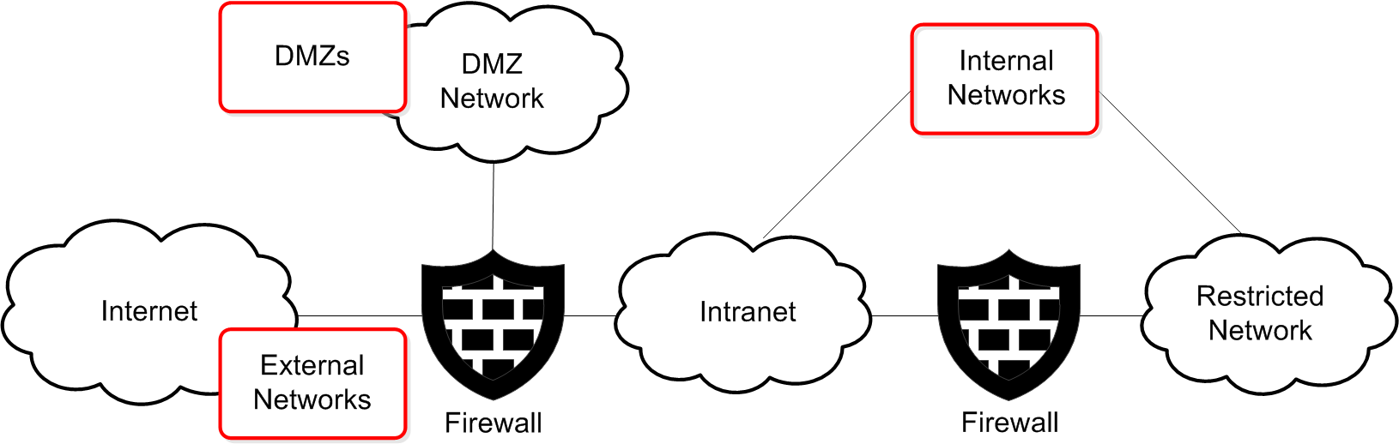
Firewall placement
Perimeter Firewall
Internal Firewall
Demilitarized Zone
Host-based Firewall

Slide 8
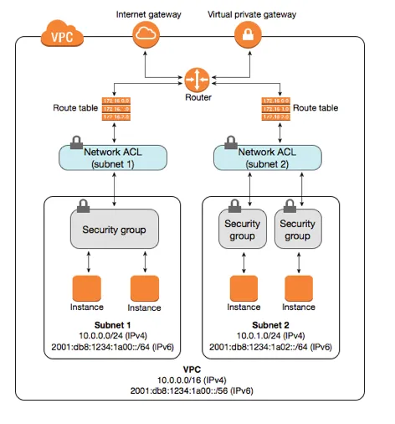
In practice:
Stateless (ACL) between router and subnet
Stateful (security group) between ACL and VM’s

Slide 9
In conclusion
Stateless: fast and cheap, but stupid
Stateful: slow and expensive, but sophisticated
Separate networks for public and private use
Hardware/software

