Slide 1

Article-Data Mining
Presented By- Shubham Chavan

Slide 2
Agenda
1)Introduction to Data Mining
2)What is data mining
3)Data Mining Architecture in data warehouse

Slide 3
Introduction to Data Mining
Today, data is being generated at a rapid pace. Every time we click, make a purchase or interact online we create valuable information which businesses are using to make smarter decisions, understand customer behavior and stay competitive in the market and this process is called data mining.

Slide 4
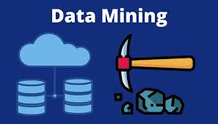
What is Data Mining?
Data mining is the process of extracting useful insights and knowledge from large datasets. It involves applying techniques from statistics, machine learning and database systems to find hidden patterns, relationships and trends. These insights can be used to solve business problems, improve processes and predict future outcomes. Common applications of data mining include customer segmentation, market basket analysis, anomaly detection and predictive modeling. It is widely used across industries like finance, healthcare, retail and telecommunications to make informed decisions.

Slide 5
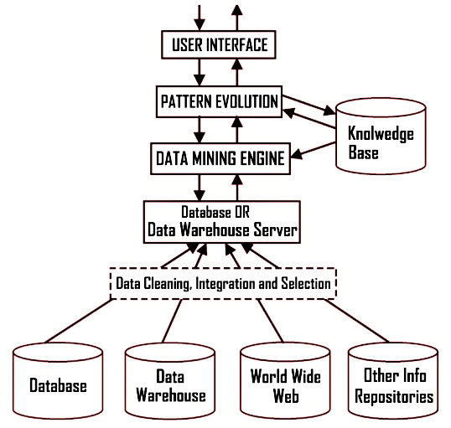

Slide 6


