Slide 1

BTP I MEMEC702 MID SEM EVALUATION
INPUT REPRESENTATION DOMINATES MODEL CHOICE IN
MACHINE-LEARNING MODULATION FORMAT IDENTIFICATION
2023UEA7232
Nitesh Kumar Yadav
2023UEA7225
Yash Mittal
2023UEA6603
Sajan
Under Supervision of
Dr. Manisha Khulbe
Department of Electronics and Communication Engineering
Netaji Subhas University of Technology, East Campus
Geeta Colony, New Delhi - 110031
Notes:
NITESH - 10 s
Greet, give the title once, name the three of us and the supervisor. Do not read the slide. Move on.

Slide 2
CONTENT
Introduction
Literature Review
Objectives
Methods/Materials
Experimentation/Modeling
Results
Conclusions
Publication (If any)
References
MEMEC702 MSE
1
Notes:
NITESH - 15 s
One sentence: "I'll cover the problem and the literature, Yash takes the method, Sajan takes the results." Then advance. Do not read nine bullets aloud.

Slide 3
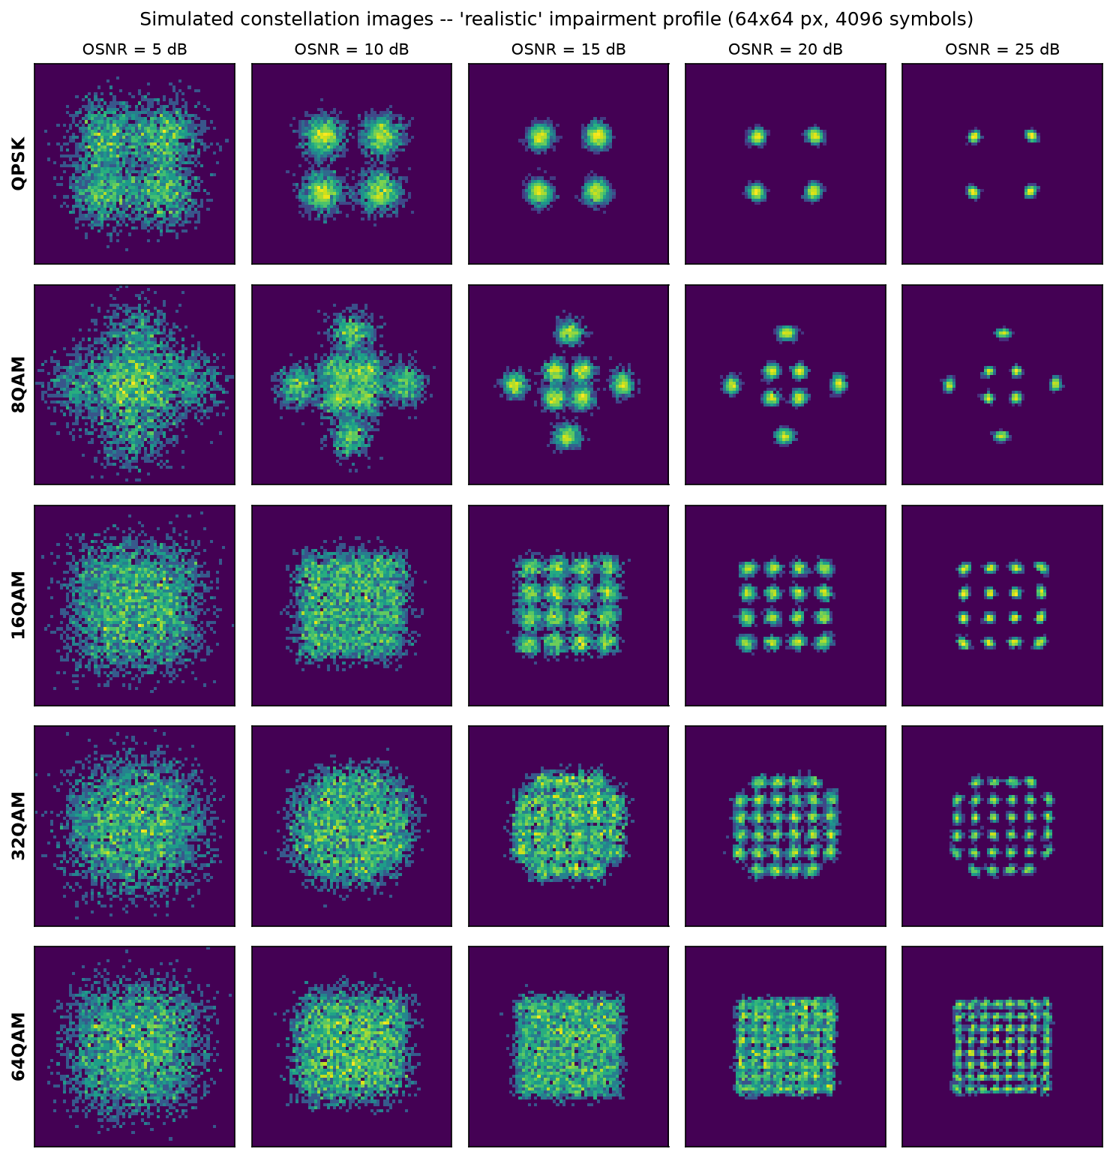
INTRODUCTION
Optical fibre carries data as light. Varying both amplitude and phase lets one pulse (a symbol) carry several bits.
The set of allowed (amplitude, phase) points is the modulation format; plotted on the I–Q plane it forms the constellation diagram.
Elastic optical networks switch format with link conditions — 64-QAM on a short clean link, QPSK on a long noisy one.
The receiver cannot demodulate until it knows which format arrived. Traditionally this is negotiated over a control channel.
Modulation Format Identification (MFI) infers the format from the received signal alone, with no control channel — a core function of Optical Performance Monitoring.
Five formats (rows) at decreasing OSNR (columns). At low OSNR the classes become indistinguishable.
MEMEC702 MSE
2
Notes:
NITESH - 65 s
Fibre carries data as light. Vary amplitude AND phase and one pulse carries several bits - that pulse is a symbol, the allowed set is the modulation format, and plotted on the I-Q plane it is the constellation diagram. Point at the picture: five formats down, noise decreasing to the right. Then the problem: modern networks switch format with link conditions, and the receiver cannot demodulate until it knows which one arrived. MFI works it out from the signal itself. PAUSE on the picture - it does the teaching for you.

Slide 4
LITERATURE REVIEW
Feature-based MFI: higher-order cumulants are the classical tool — Gaussian noise cancels at 4th order and above [2], [3].
Other hand-crafted representations: amplitude histograms [5], [15], Stokes-space PCA [12], [13], ANN with genetic feature selection [14].
Deep learning on constellation images: the intelligent constellation analyzer [4], joint OSNR + MFI [11], SVM on image texture [8], recent CNN case studies [16].
Wireless parallel: CNNs on raw I/Q [6]; Ge et al. [7] analysed representation effects in wireless AMC; Tian et al. [9] survey DL-AMC by data representation.
Gap: every optical comparison changes the model and the input together, so neither factor is isolated. No study asks whether the representation affects failure self-detection.
MEMEC702 MSE
3
Notes:
NITESH - 60 s
Four groups, one line each. Classical work uses cumulants because Gaussian noise cancels at fourth order and above. Others swapped in different hand-crafted representations. Then CNNs on constellation images, reported as a large gain. Wireless has asked a similar question - say that out loud, do not hide it. Land hard on the last bullet: every optical comparison changes the model and the input together, so nobody can say which caused the gain. That sentence sets up the whole talk.

Slide 5
OBJECTIVES
Determine whether the reported advantage of CNN-based MFI comes from the model or from the input representation.
Build a coherent optical link simulator with realistic impairments and validate it against exact analytic cumulants.
Derive three representations — raw I/Q, constellation image, 15 statistical features — from the same signal realisation.
Isolate the algorithm effect by running three different algorithms on identical features.
Isolate the representation effect by running trained neural networks on different inputs.
Quantify robustness under channel mismatch, and test whether each model can detect its own failure.
MEMEC702 MSE
4
Notes:
YASH - 40 s
Read the first objective properly; skim the rest. The point of this slide is that we set out to ANSWER a question, not to build a classifier. Twenty seconds on bullet one, twenty on the other five together.

Slide 6
METHODS / MATERIALS
Simulated coherent link, 32 GBaud, 5 formats (QPSK – 64-QAM), OSNR 5–25 dB in 1 dB steps, 63,000 captures of 4096 symbols.
Signal chain: symbols → residual chromatic dispersion → laser phase noise + frequency offset → carrier phase recovery → I/Q imbalance → AGC → ASE noise.
Simulation is required: no public optical constellation dataset exists, and the claim needs exactly controlled OSNR sweeps.
Validation: normalised 4th-order cumulant is an exact finite sum for a noiseless constellation. Simulator matches theory to within 0.004 for all five formats.
Three representations from the same realisation: raw I/Q (2×512), 64×64 constellation image (2-D histogram, log-scaled), 15 cumulant and amplitude features.
Split 70/15/15 stratified on (format, OSNR); three seeds (42, 43, 44); scaler fitted inside a Pipeline to prevent leakage.
MEMEC702 MSE
5
Notes:
YASH - 65 s
We simulate the link - no public optical constellation dataset exists, and we need exactly controlled OSNR sweeps. Walk the signal chain quickly, then stop on validation: the fourth-order cumulant of a noiseless constellation is exact algebra, and our simulator reproduces it to within 0.004 for all five formats. That is the answer to 'how do you know your simulator is right?', so say it before they ask. Finish on the three representations coming from the SAME signal realisation - that is what makes the comparison fair.

Slide 7
EXPERIMENTATION / MODELING
The comparison in the literature changes two variables at once. We separate them.
 | Shallow model | Deep model
15 hand-crafted features | SVM, k-NN | MLP ← the control nobody includes
64×64 constellation image | — | CNN
Moving across a row changes only the algorithm → the algorithm effect.
Moving down the deep-model column changes only the input → the representation effect.
The MLP is the critical control: a trained deep network that sees only the 15 features. If MLP ≈ SVM the representation matters; if MLP ≈ CNN the model matters.
Five classifiers in total: CNN (285,941 params), IQ-CNN (27,781), MLP (11,013), SVM, k-NN.
Seven experiments: main comparison, generalisation to unseen OSNR, architecture ablation, capture length, channel robustness, confidence calibration, impairment tolerance.
MEMEC702 MSE
6
Notes:
YASH - 70 s
This is the contribution slide. Spend the time. Walk the table out loud: across a row only the algorithm changes; down the deep-model column only the input changes. The MLP is the cell nobody fills - a trained deep network fed only the 15 features. Say why it settles the question either way: if it lands near the SVM, the representation matters; near the CNN, the model matters. Then the five classifiers and seven experiments in one breath.

Slide 8
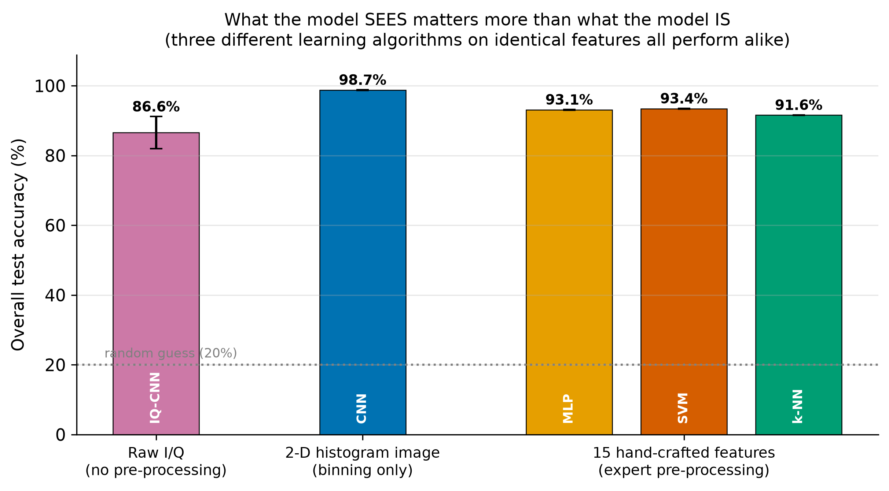
RESULTS — THE MAIN COMPARISON
Algorithm effect: 1.83 points — the spread across MLP, SVM and k-NN on identical features.
Representation effect: 5.32 points — the CNN over the strongest of them (the SVM). That is 2.9× larger.
The MLP, a deep network, finished below the SVM, a shallow one: depth on features bought nothing.
MEMEC702 MSE
7
Notes:
SAJAN - 65 s
Let them read the chart for three seconds before you speak. Three very different algorithms on identical features sit within 1.83 points of each other. The CNN on the image gains 5.32 over the strongest of them - 2.9 times as much. If asked why 5.32 and not 5.65: we compare against the BEST baseline, the SVM, because that is the harder test. Close on the MLP finishing below the SVM - depth on features bought nothing.

Slide 9
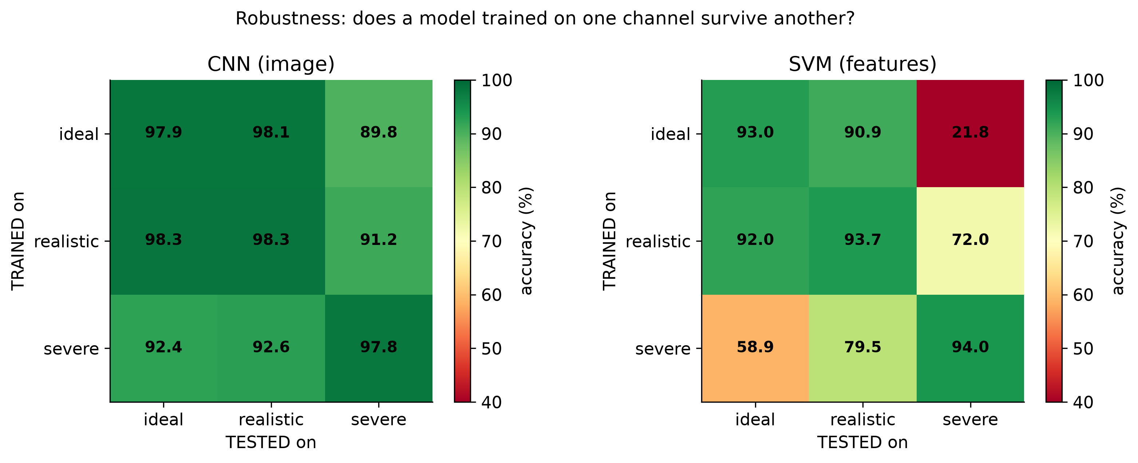
RESULTS — MARGIN AND ROBUSTNESS
Model | OSNR for ≥ 95 % | OSNR for ≥ 99 %
CNN | 7 dB | 10 dB
SVM | 14 dB | 18 dB
k-NN | 15 dB | 18 dB
A 7 dB OSNR margin — which converts directly into reach or amplifier count.
Trained on a clean channel, tested on a severe one: CNN holds 89.8 %, the SVM collapses to 21.8 % against a 20 % chance level.
Cumulants are statistics of an assumed signal model. Change the impairments and the learned boundaries stop meaning anything.
Failure self-detection: at a 90 % confidence gate the CNN still answers 86.9 % of inputs, the SVM answers 0.2 % — a 447× difference in usable coverage.
The feature-based monitor can be made accurate only by silencing it. This interaction has not, to our knowledge, been reported before.
Capture length: the CNN with 512 symbols (94.08 %) beats the SVM with 4096 (93.82 %).
MEMEC702 MSE
8
Notes:
SAJAN - 70 s
Two results here. First the margin: the CNN hits 95% at 7 dB where the SVM needs 14 - quote the margin, not the percentage, because it converts into reach or amplifier count. Then robustness, the strongest result: trained clean and tested severe, the CNN holds 89.8% while the SVM falls to 21.8% against a 20% chance level. Give the mechanism, not just the number - cumulants are statistics of an ASSUMED signal model. Then confidence: at a 90% gate the CNN still answers 86.9% of inputs, the SVM answers 0.2%.

Slide 10
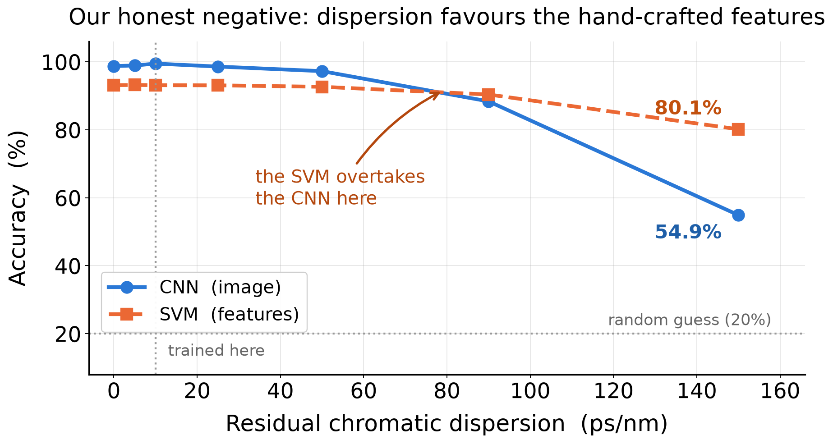
RESULTS — AN HONEST NEGATIVE
I/Q imbalance destroys the cumulant features: at 2.5 dB the SVM falls to 20.35 % while the CNN holds 95.48 %.
But residual chromatic dispersion inverts the headline. At 150 ps/nm the SVM scores 80.14 % and the CNN only 54.89 %.
We report this rather than bury it — it bounds the claim and points to a possible hybrid representation.
MEMEC702 MSE
9
Notes:
SAJAN - 50 s
Deliver this confidently, not apologetically. I/Q imbalance destroys the cumulant features. But dispersion inverts our own headline: at 150 ps/nm the SVM scores 80.1% and the CNN 54.9%. We report it because it bounds the claim. If asked why it happens, say honestly that we have a hypothesis we have not tested - dispersion smears the local image structure the CNN relies on, while cumulants are computed over the whole capture. Do not invent certainty.

Slide 11
CONCLUSIONS
The input representation, not the learning algorithm, is the dominant design variable in optical MFI — worth 2.9× as much on matched channels.
Three very different algorithms on identical features perform within 1.83 points of one another. Adding depth to the feature pipeline bought nothing.
The advantage widens sharply under channel mismatch: 89.8 % against 21.8 %, where 20 % is chance.
The representation also governs whether a confidence-gated monitor stays operational at all — 86.9 % coverage against 0.2 %.
The simulator is validated against exact analytic cumulants, and every reported number is recomputed from saved weights by an independent script.
Limits stated plainly: simulation only, single polarisation, linear channel, fixed symbol rate, five formats — and dispersion favours the hand-crafted features.
MEMEC702 MSE
10
Notes:
NITESH - 45 s
Six lines; read the first and the last properly. The representation is the dominant design variable; the gap widens under mismatch; it also decides whether a confidence-gated monitor stays usable at all. End on the limitations line - stating them yourself is worth more than being asked.

Slide 12
PUBLICATION
Manuscript complete in IEEE conference format: 8 pages, 9 figures, 10 references, compiles clean with zero overfull boxes.
Title: “Input Representation Dominates Model Choice in Machine-Learning Modulation Format Identification”.
Target venue: QPAIN 2027 — IEEE 3rd International Conference on Quantum Photonics, AI and Networking. Submission deadline 30 November 2026.
IEEE Photonics Society sponsored; indexed in IEEE Xplore and Scopus. Backup venue: PHOTOPTICS.
Status: not yet submitted. Remaining work is a trim from 8 pages to the 4–6 page limit.
Code and data-generation scripts are public at github.com/techi101/optical-mfi-representation; every number regenerates from a fixed seed.
MEMEC702 MSE
11
Notes:
NITESH - 25 s
Manuscript is complete and compiles clean; targeting QPAIN 2027, deadline 30 November. Be straight that it is not submitted yet and needs a trim to the page limit. Mention the code is public and every number regenerates from a fixed seed.

Slide 13
REFERENCES
[1] F. N. Khan, Q. Fan, C. Lu, A. P. T. Lau, “An optical communication’s perspective on machine learning and its applications,” J. Lightw. Technol., vol. 37, no. 2, pp. 493–516, 2019.
[2] A. Swami, B. M. Sadler, “Hierarchical digital modulation classification using cumulants,” IEEE Trans. Commun., vol. 48, no. 3, pp. 416–429, 2000.
[3] O. A. Dobre, A. Abdi, Y. Bar-Ness, W. Su, “Survey of automatic modulation classification techniques,” IET Commun., vol. 1, no. 2, pp. 137–156, 2007.
[4] D. Wang et al., “Intelligent constellation diagram analyzer using CNN-based deep learning,” Opt. Express, vol. 25, no. 15, pp. 17150–17166, 2017.
[5] F. N. Khan et al., “Modulation format identification in coherent receivers using deep machine learning,” IEEE Photon. Technol. Lett., vol. 28, no. 17, pp. 1886–1889, 2016.
[6] T. J. O’Shea, J. Corgan, T. C. Clancy, “Convolutional radio modulation recognition networks,” EANN 2016, CCIS vol. 629, Springer, pp. 213–226.
[7] Z. Ge, H. Jiang, Y. Guo, J. Zhou, “Accuracy analysis of feature-based AMC via deep neural network,” Sensors, vol. 21, no. 24, art. 8252, 2021.
[8] Z. Huang et al., “Modulation format identification based on signal constellation diagrams and SVM,” Photonics, vol. 9, no. 12, art. 927, 2022.
[9] X. Tian et al., “A survey on deep learning enabled AMC methods,” Signal Processing, vol. 242, art. 110444, 2026.
[10] H. Yang, R. Sahay, “An uncertainty quantification framework for deep learning-based AMC,” arXiv:2503.04142, 2025.
[11] F. N. Khan et al., “Joint OSNR monitoring and MFI in digital coherent receivers using DNNs,” Opt. Express, vol. 25, no. 15, p. 17767, 2017.
[12] H. Xu et al., “Blind and low-complexity MFI using PCA of Stokes parameters for elastic optical networks,” Opt. Express, vol. 28, no. 14, p. 20249, 2020.
[13] J. Jiang et al., “Blind modulation format identification based on PCA and SVD,” Electronics, vol. 11, no. 4, art. 612, 2022.
[14] S. Zhang et al., “MFI in heterogeneous fiber-optic networks using ANNs and genetic algorithms,” Photonic Netw. Commun., vol. 32, no. 2, pp. 246–252, 2016.
[15] T. Wang, X. Liu, “A novel modulation format identification based on amplitude histogram space,” Front. Optoelectron., vol. 12, no. 2, pp. 190–196, 2019.
[16] M. Leblebici, A. Çalhan, M. Cicioğlu, “Deep learning-based modulation recognition with constellation diagram: a case study,” Phys. Commun., vol. 63, art. 102285, 2024.
MEMEC702 MSE
12
Notes:
ANY - 5 s
Do not read these. Leave the slide up and say 'happy to take questions.' Keeping it on screen during Q&A lets you point at a reference if challenged.

