Slide 1

BTP I MEMEC702 MID SEM EVALUATION
INPUT REPRESENTATION DOMINATES MODEL CHOICE IN
MACHINE-LEARNING MODULATION FORMAT IDENTIFICATION
2023UEA7232
Nitesh Kumar Yadav
2023UEA7225
Yash Mittal
2023UEA6603
Sajan
Under Supervision of
Dr. Manisha Khulbe
Department of Electronics and Communication Engineering
Netaji Subhas University of Technology, East Campus
Geeta Colony, New Delhi - 110031
Notes:
NITESH - 10 s
Greet, give the title once, name the three of us and the supervisor. Do not read the slide.

Slide 2
CONTENT
Introduction
Literature Review
Objectives
Methods/Materials
Experimentation/Modeling
Results
Conclusions
Publication (If any)
References
MEMEC702 MSE
1
Notes:
NITESH - 15 s
One sentence: 'I'll cover the problem and the literature, Yash takes the method, Sajan takes the results.' Then advance.

Slide 3
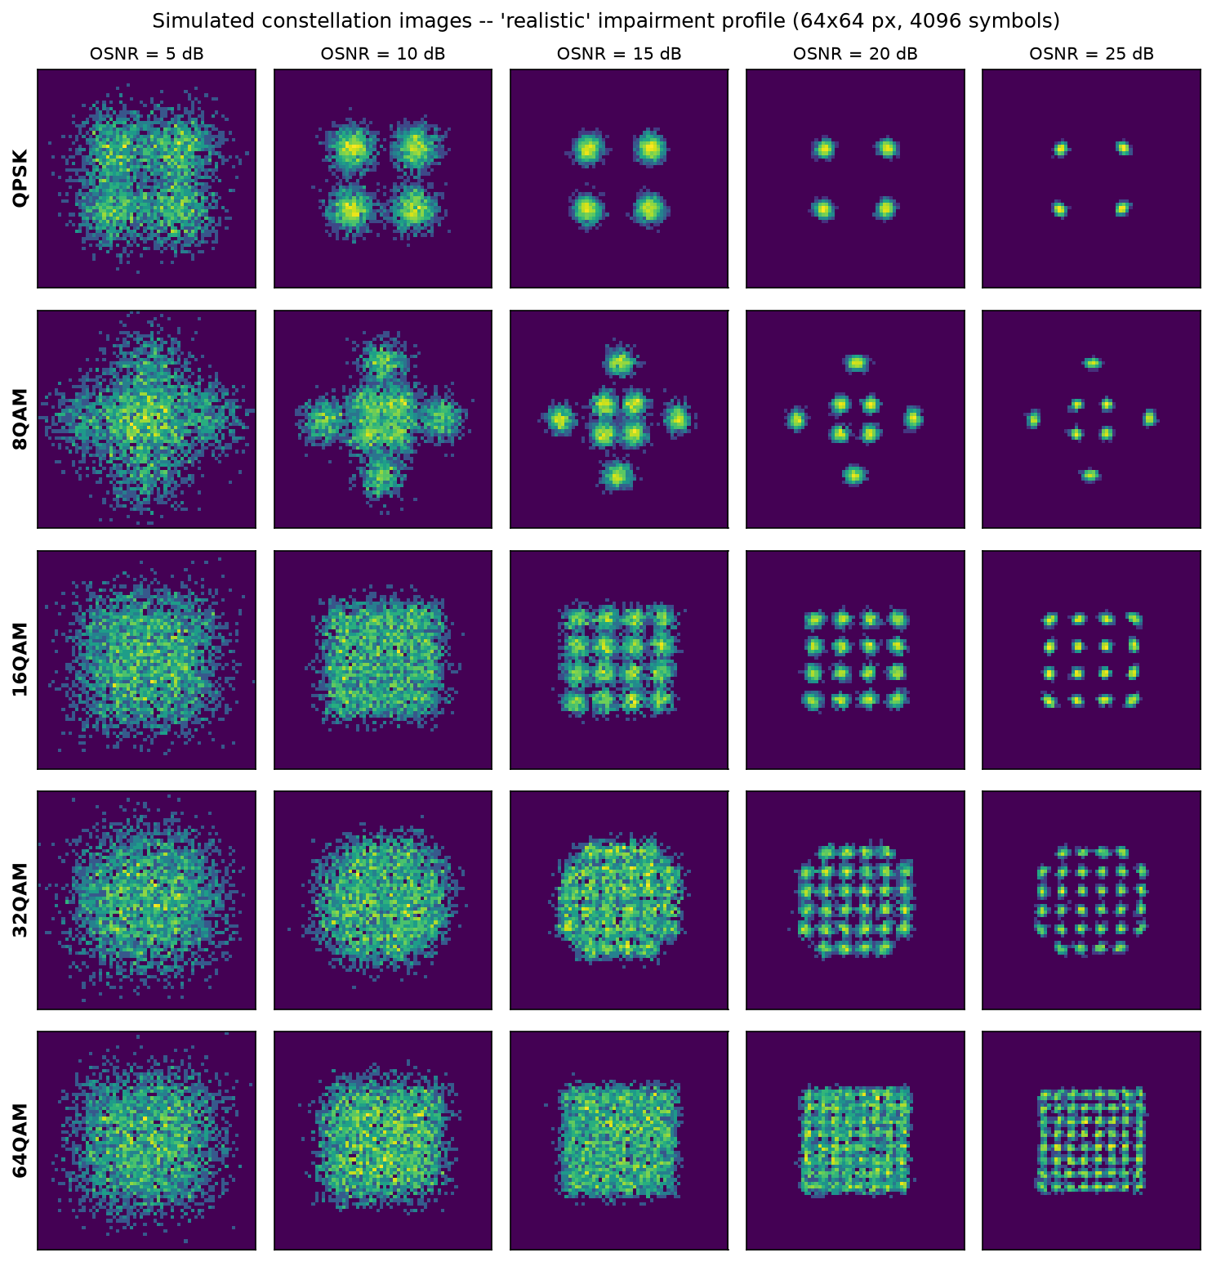
INTRODUCTION
Optical fibre carries data as light. Varying both amplitude and phase lets one pulse (a symbol) carry several bits.
The set of allowed (amplitude, phase) points is the modulation format; plotted on the I–Q plane it forms the constellation diagram.
Elastic optical networks switch format with link conditions — 64-QAM on a short clean link, QPSK on a long noisy one.
The receiver cannot demodulate until it knows which format arrived. Traditionally this is negotiated over a control channel.
Modulation Format Identification (MFI) infers the format from the received signal alone, with no control channel — a core function of Optical Performance Monitoring.
Five formats (rows) at decreasing OSNR (columns). At low OSNR the classes become indistinguishable.
MEMEC702 MSE
2
Notes:
NITESH - 65 s
Fibre carries data as light. Vary amplitude AND phase and one pulse carries several bits - that pulse is a symbol, the allowed set is the modulation format, and on the I-Q plane it is the constellation diagram. Point at the picture. Then the problem: networks switch format with link conditions, and the receiver cannot demodulate until it knows which arrived. PAUSE on the picture.

Slide 4
LITERATURE REVIEW
Feature-based MFI: higher-order cumulants are the classical tool — Gaussian noise cancels at 4th order and above [2], [3].
Other hand-crafted representations: amplitude histograms [5], [15], Stokes-space PCA [12], [13], ANN with genetic feature selection [14].
Deep learning on constellation images: the intelligent constellation analyzer [4], joint OSNR + MFI [11], SVM on image texture [8], recent CNN case studies [16].
Wireless parallel: CNNs on raw I/Q [6]; Ge et al. [7] analysed representation effects in wireless AMC; Tian et al. [9] survey DL-AMC by data representation.
Gap: every optical comparison changes the model and the input together, so neither factor is isolated. No study asks whether the representation affects failure self-detection.
MEMEC702 MSE
3
Notes:
NITESH - 60 s
Four groups, one line each. Cumulants are classical because Gaussian noise cancels at fourth order. Others swapped in different hand-crafted representations. Then CNNs on constellation images. Wireless has asked a similar question - say it out loud, do not hide it. Land hard on the last bullet: every optical comparison changes the model and the input together.

Slide 5
OBJECTIVES
Determine whether the reported advantage of CNN-based MFI comes from the model or from the input representation.
Build a coherent optical link simulator with realistic impairments and validate it against exact analytic cumulants.
Derive three representations — raw I/Q, constellation image, 15 statistical features — from the same signal realisation.
Isolate the algorithm effect by running three different algorithms on identical features.
Isolate the representation effect by running trained neural networks on different inputs.
Quantify robustness under channel mismatch, and test whether each model can detect its own failure.
MEMEC702 MSE
4
Notes:
YASH - 40 s
Read the first objective properly, skim the rest. The point: we set out to ANSWER a question, not build a classifier.

Slide 6
METHODS / MATERIALS
Simulated coherent link, 32 GBaud, 5 formats (QPSK – 64-QAM), OSNR 5–25 dB in 1 dB steps, 63,000 captures of 4096 symbols.
Signal chain: symbols → residual chromatic dispersion → laser phase noise + frequency offset → carrier phase recovery → I/Q imbalance → AGC → ASE noise.
Simulation is required: no public optical constellation dataset exists, and the claim needs exactly controlled OSNR sweeps.
Validation: normalised 4th-order cumulant is an exact finite sum for a noiseless constellation. Simulator matches theory to within 0.004 for all five formats.
Three representations from the same realisation: raw I/Q (2×512), 64×64 constellation image (2-D histogram, log-scaled), 15 cumulant and amplitude features.
Split 70/15/15 stratified on (format, OSNR); three seeds (42, 43, 44); scaler fitted inside a Pipeline to prevent leakage.
MEMEC702 MSE
5
Notes:
YASH - 65 s
We simulate - no public optical constellation dataset exists and we need exactly controlled OSNR sweeps. Walk the chain quickly, then stop on validation: the fourth-order cumulant of a noiseless constellation is exact algebra and we match it to within 0.004. That is the answer to 'how do you know your simulator is right?'. Finish on all three representations coming from the SAME realisation.

Slide 7
EXPERIMENTATION / MODELING
The comparison in the literature changes two variables at once. We separate them.
 | Shallow model | Deep model
15 hand-crafted features | SVM, k-NN | MLP ← the control nobody includes
64×64 constellation image | — | CNN
Moving across a row changes only the algorithm → the algorithm effect.
Moving down the deep-model column changes only the input → the representation effect.
The MLP is the critical control: a trained deep network that sees only the 15 features. If MLP ≈ SVM the representation matters; if MLP ≈ CNN the model matters.
Five classifiers in total: CNN (285,941 params), IQ-CNN (27,781), MLP (11,013), SVM, k-NN.
Seven experiments: main comparison, generalisation to unseen OSNR, architecture ablation, capture length, channel robustness, confidence calibration, impairment tolerance.
MEMEC702 MSE
6
Notes:
YASH - 70 s
The contribution slide. Spend the time. Across a row only the algorithm changes; down the deep column only the input changes. The MLP is the cell nobody fills. Say why it settles the question either way: near the SVM means representation matters, near the CNN means the model matters.

Slide 8
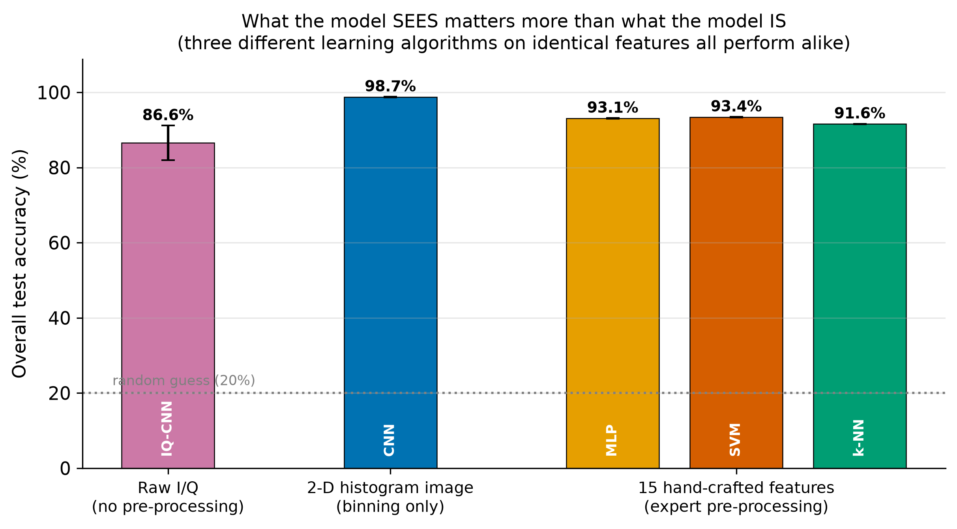
RESULTS
Algorithm effect: 1.83 points — the spread across MLP, SVM and k-NN on identical features.
Representation effect: 5.32 points — the CNN over the strongest of them. 2.9× larger.
A 7 dB OSNR margin: the CNN reaches 95 % at 7 dB where the SVM needs 14 dB.
Generalisation: 97.45 ± 0.16 % on OSNR levels withheld from training — it learned the physics, not the noise levels.
Capture length: the CNN with 512 symbols (94.08 %) beats the SVM with 4096 (93.82 %).
MEMEC702 MSE
7
Notes:
SAJAN - 90 s
Your only results slide, so give it room. Let them read the chart for three seconds first. Three different algorithms on identical features sit within 1.83 points. The CNN gains 5.32 over the strongest of them - 2.9 times as much. If asked why 5.32 and not 5.65: we compare against the BEST baseline because it is the harder test. Then the 7 dB margin, which converts into reach. Then generalisation - 97.45% on OSNR levels never seen, so it learned the physics not the noise levels. Then capture length - 512 symbols beats the SVM at 4096.

Slide 9
WORK IN PROGRESS AND NEXT STEPS
Four further experiments are complete; detailed analysis is in preparation for the end-semester review:
Channel robustness — under a channel it was not trained on, the feature-based classifier falls to 21.8 %, against a 20 % chance level.
Failure self-detection — at a 90 % confidence gate the two representations differ by roughly 447× in how many inputs they can still answer.
Impairment tolerance — including one case, residual chromatic dispersion, where the feature-based model outperforms the CNN.
Architecture ablation — accuracy is insensitive to model capacity across a 9.2× range in parameter count.
Planned work for the remainder of the project:
1. Fibre nonlinearity. Our robustness result already makes a falsifiable prediction here — nonlinear interference is not Gaussian, so the feature-based models should degrade further. We begin with this.
2. Polarisation-multiplexed signals, closing the principal realism gap against deployed systems.
3. Establishing the mechanism behind the chromatic dispersion case, where our own result inverts.
Phase 2 begins with the nonlinearity experiment; its design is already fixed by the Phase 1 result.
MEMEC702 MSE
8
Notes:
SAJAN - 60 s
This slide does two jobs. First: four further experiments ARE complete - say complete, not 'planned' - with analysis in preparation. One line each, no more. If anyone asks for a number, give it immediately; never look evasive. Second: state the Phase 2 plan with conviction. Do NOT ask them to choose. Say what you are doing and why nonlinearity is first. If they want to redirect you they will say so, and then you thank them and write it down. Asking a committee to pick for you invites the reading that you have not thought about it.

Slide 10
CONCLUSIONS
The input representation, not the learning algorithm, is the dominant design variable in optical modulation format identification — worth 2.9× as much.
Three very different algorithms on identical features perform within 1.83 points of one another. Adding depth to the feature pipeline bought nothing.
The advantage is not an artefact of training: 97.45 % on OSNR levels never seen, and it holds on captures eight times shorter.
The simulator is validated against exact analytic cumulants, and every reported number is recomputed from saved weights by an independent script.
Phase 1 has answered the question we set. Phase 2 examines where the advantage breaks down, and why.
MEMEC702 MSE
9
Notes:
NITESH - 45 s
Read the first and last bullets properly. The representation is the dominant design variable. It is not an artefact of training. End on the Phase 1 / Phase 2 line - it frames everything that follows in December.

Slide 11
PUBLICATION
Manuscript complete in IEEE conference format: 8 pages, 9 figures, 10 references, compiles clean with zero overfull boxes.
Title: “Input Representation Dominates Model Choice in Machine-Learning Modulation Format Identification”.
Target venue: QPAIN 2027 — IEEE 3rd International Conference on Quantum Photonics, AI and Networking. Submission deadline 30 November 2026.
IEEE Photonics Society sponsored; indexed in IEEE Xplore and Scopus. Backup venue: PHOTOPTICS.
Status: not yet submitted. Remaining work is a trim from 8 pages to the 4–6 page limit.
Code and data-generation scripts are public at github.com/techi101/optical-mfi-representation; every number regenerates from a fixed seed.
MEMEC702 MSE
10
Notes:
NITESH - 25 s
Manuscript is complete and compiles; targeting QPAIN 2027, deadline 30 November. Be straight that it is not submitted. Mention the code is public and every number regenerates from a fixed seed.

Slide 12
REFERENCES
[1] F. N. Khan, Q. Fan, C. Lu, A. P. T. Lau, “An optical communication’s perspective on machine learning and its applications,” J. Lightw. Technol., vol. 37, no. 2, pp. 493–516, 2019.
[2] A. Swami, B. M. Sadler, “Hierarchical digital modulation classification using cumulants,” IEEE Trans. Commun., vol. 48, no. 3, pp. 416–429, 2000.
[3] O. A. Dobre, A. Abdi, Y. Bar-Ness, W. Su, “Survey of automatic modulation classification techniques,” IET Commun., vol. 1, no. 2, pp. 137–156, 2007.
[4] D. Wang et al., “Intelligent constellation diagram analyzer using CNN-based deep learning,” Opt. Express, vol. 25, no. 15, pp. 17150–17166, 2017.
[5] F. N. Khan et al., “Modulation format identification in coherent receivers using deep machine learning,” IEEE Photon. Technol. Lett., vol. 28, no. 17, pp. 1886–1889, 2016.
[6] T. J. O’Shea, J. Corgan, T. C. Clancy, “Convolutional radio modulation recognition networks,” EANN 2016, CCIS vol. 629, Springer, pp. 213–226.
[7] Z. Ge, H. Jiang, Y. Guo, J. Zhou, “Accuracy analysis of feature-based AMC via deep neural network,” Sensors, vol. 21, no. 24, art. 8252, 2021.
[8] Z. Huang et al., “Modulation format identification based on signal constellation diagrams and SVM,” Photonics, vol. 9, no. 12, art. 927, 2022.
[9] X. Tian et al., “A survey on deep learning enabled AMC methods,” Signal Processing, vol. 242, art. 110444, 2026.
[10] H. Yang, R. Sahay, “An uncertainty quantification framework for deep learning-based AMC,” arXiv:2503.04142, 2025.
[11] F. N. Khan et al., “Joint OSNR monitoring and MFI in digital coherent receivers using DNNs,” Opt. Express, vol. 25, no. 15, p. 17767, 2017.
[12] H. Xu et al., “Blind and low-complexity MFI using PCA of Stokes parameters for elastic optical networks,” Opt. Express, vol. 28, no. 14, p. 20249, 2020.
[13] J. Jiang et al., “Blind modulation format identification based on PCA and SVD,” Electronics, vol. 11, no. 4, art. 612, 2022.
[14] S. Zhang et al., “MFI in heterogeneous fiber-optic networks using ANNs and genetic algorithms,” Photonic Netw. Commun., vol. 32, no. 2, pp. 246–252, 2016.
[15] T. Wang, X. Liu, “A novel modulation format identification based on amplitude histogram space,” Front. Optoelectron., vol. 12, no. 2, pp. 190–196, 2019.
[16] M. Leblebici, A. Çalhan, M. Cicioğlu, “Deep learning-based modulation recognition with constellation diagram: a case study,” Phys. Commun., vol. 63, art. 102285, 2024.
MEMEC702 MSE
11
Notes:
ANY - 5 s
Do not read these. Leave the slide up and say 'happy to take questions.'

