Slide 1
Secure data hiding in image using steganography
CAPSTONE PROJECT
Presented By: Ravriya Parth Karman
College Name : Shri S’ad Vidya Mandal Institute Of Technology
Department : Computer Science And Engineering

Slide 2
OUTLINE
Problem Statement
Technology used
Wow factor
End users
Result
Conclusion
Git-hub Link
Future scope

Slide 3
Problem Statement
To develop a secure steganographic system for embedding and extracting sensitive information within digital images. The system aims to ensure the integrity and confidentiality of the hidden data while maintaining the visual quality of the cover image. Key challenges include developing an efficient algorithm for embedding and extracting data, ensuring the hidden data remains undetectable, and implementing security measures to protect the hidden data from tampering and unauthorized access. Various steganographic techniques, such as Least Significant Bit (LSB) manipulation, will be explored to evaluate their effectiveness in terms of security, capacity, and imperceptibility.

Slide 4
Technology used
Libraries : cv2, os , string.
Platform : VS Code
Programming Language : Python
Hardware : Intel core i5 12th gen , Nvidia geforce rtx 3050 6gb , 512gb ssd , 16gb ddr4 ram .
Operating System : Windows 11

Slide 5
Wow factors
Invisible Hiding
High Capacity
Strong Security
Versatile Formats
Fast Processing
Robust
Multiple Uses
Easy to Use
Future-Proof
Privacy Protection

Slide 6
End users
Government and Military : eg., Intelligence Agencies, Military Communications, etc.
Military Communications : eg., Financial Institutions, Healthcare Providers, etc.
Cybersecurity Professionals : eg., Security Analysts, Penetration Testers, etc.
Law Enforcement Agencies : eg., Investigators, Forensic Analysts, etc.
Intellectual Property Owners : eg., Inventors and Innovators, Patent Attorneys, etc.
Non-Governmental Organizations (NGOs) : eg., Human Rights Activists, Environmental Groups, etc.
Academic and Research Institutions : eg., Researchers in Cybersecurity, Students, etc.

Slide 7
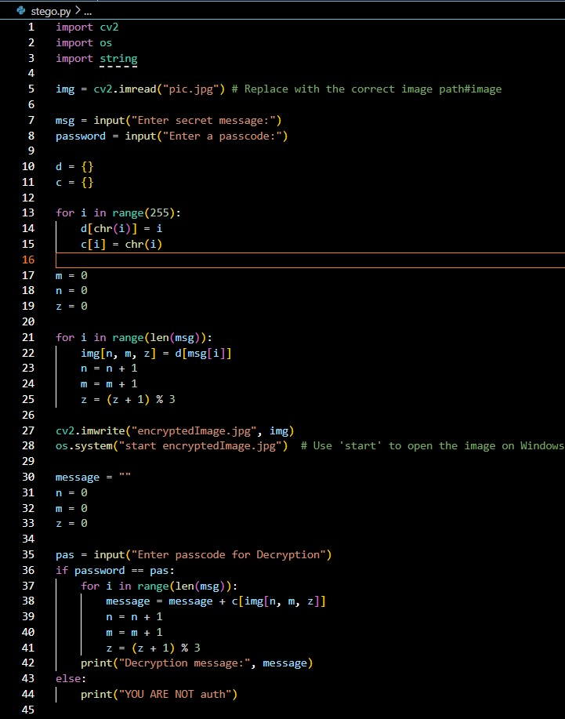
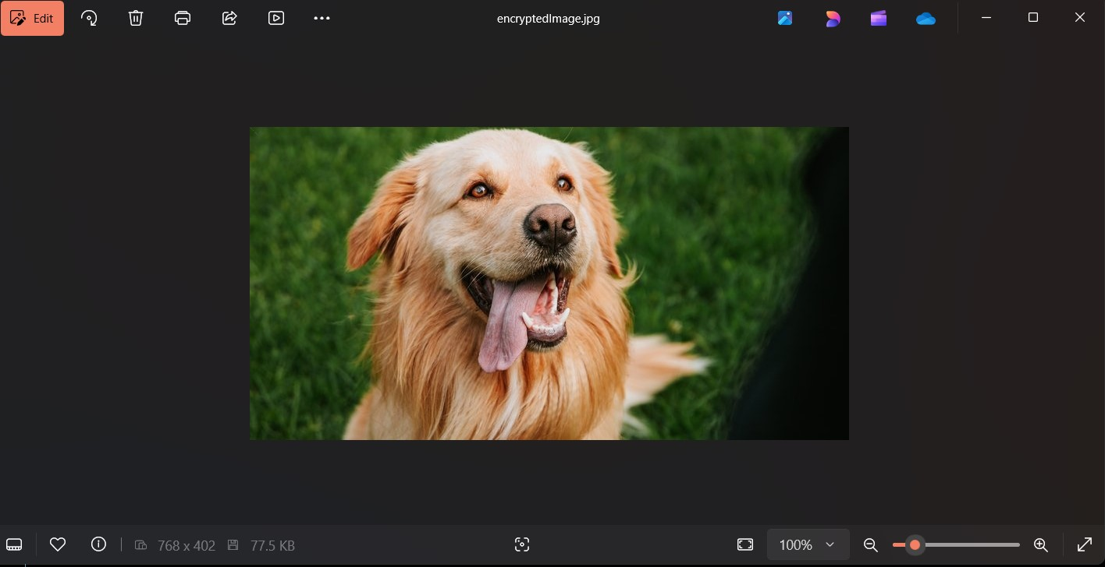
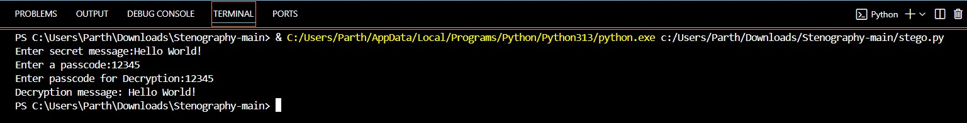
Results
Code :
Encrypted img :
Output :

Slide 8
Conclusion
In conclusion, we successfully developed a secure steganographic system that embeds and extracts sensitive information within digital images while maintaining the cover image's visual quality. We overcame key challenges in data integrity, confidentiality, and undetectability using techniques like Least Significant Bit (LSB) manipulation. Future work will focus on optimizing algorithms, exploring advanced steganographic methods, and applying the system in real-world scenarios.

Slide 9
GitHub Link
https://github.com/techie-05/Aicte_Project.git

Slide 10
Future scope
Enhanced Security: Combining steganography with advanced encryption and AI to create more robust and adaptive hiding techniques.
Improved Algorithms: Developing algorithms that adapt to image content and allow for reversible data hiding, ensuring original image integrity.
Broad Applications: Use in cybersecurity, military communications, healthcare for hiding patient data, and digital watermarking for intellectual property protection.
Standardization: Establishing industry standards and protocols to ensure interoperability and security.
Integration with Emerging Technologies: Combining steganography with blockchain and IoT for enhanced security and data protection.
Research and Development: Continued academic and industry collaboration to drive innovation and develop new steganographic solutions.

Slide 11
THANK YOU

