Slide 1
Naïve Bayes Classifier

Slide 2
Classifiers
Generative vs Discriminative classifiers: discriminative classifier models a classification rule directly based on previous data while Generative classifier makes a probabilistic model of data within each class
For example: a discriminative approach would determine differences in linguistic models without learning the language and then classify input data
On the other hand, a generative classifier would learn each language and then classify data using the knowledge.
Discriminative classifier include: k-NN, decision tree, SVM
Generative classifier include: naïve Bayes, model based classifiers
Notes:
Generative and discriminative can both be used for classification. Both can supervised methods but the way they both go about separating positive from the negatives is very different.
Generative would make a model of positive and a model for negative, so basically some characterization of the entire population. So basically what type of positives you are likely to see and what kind of positives you are not likely to see and the same for negatives. Thus it creates boundaries where one model is more likely than other and all this is based on probabilities. Thus most of them are probabilistic.
For example a discriminative model approach would determine differences in linguistic models without learning the language and then classify input data
On the other hand, a generative classifier would learn each language and then classify data using the knowledge.

Slide 3
Classifiers contd..
Generative model learns join probability distribution P(x,y)
Discriminative model learns conditional probability distribution P(x|y)
Consider following data in form of (x,y): (1,0), (1, 0), (2, 0), (2, 1)
P(x, y): P(x | y):
 | Y = 0 | Y = 1
X = 1 | 1/2 | 0
X = 2 | 1/4 | 1/4
 | Y = 0 | Y = 1
X = 1 | 1 | 0
X = 2 | 1/2 | 1/2

Slide 4
Bayes Theorem
Bayes theorem describes the probability of an event, based on prior knowledge of conditions that might be related to the event
Posterior = likelihood*Prior / Evidence
P(c | x) = P(x | c)*P(c) / P(x)
Discriminative Generative

Slide 5
Probabilistic model for discriminative classifier
To train a discriminative classifier, all training examples of different classes must be jointly used to make a single discriminative classifier.
For example, in case of a coin toss, we have 2 classes, head and tail and one of those can happen.
For a classifier of languages we will have classes of all available languages and input language will be classified into one of them
For a probabilistic classifier, each class will be given a probability to find whether input is classified in that class or not. Input is classified based on class with highest probability.
For a non-probabilistic classifier we do not label classes separately
P(c | x) c = c₁ . . . .c_{N} x = (x₁, …. x_{m})
Notes:
So how can we use concepts from probability to create a classifier?

Slide 6
Probabilistic model for generative classifier
For generative classifier, all models are trained independently on only the examples of the same class label.
The model outputs N probabilities for a given input with N models.
P(x | c) c = c₁ . . . .c_{N} x = (x₁, …. x_{m})

Slide 7
Maximum A Posterior (MAP) classification
For an input x (x₁. . . x_{N}), run discriminative probabilistic classifier and find class with largest probability.
We assign input x to label with the largest probability.
For generative classifier, we use Bayesian rule to convert into posterior probability
P(c | x) = P(x | c)*P(c) / P(x) → ~~ P(x | c)*P(c) (for c = 1. . . k)
(P(x) is common for all classes so we can disregard it using in the calculation)
Posterior = prior * likelihood / evidence

Slide 8
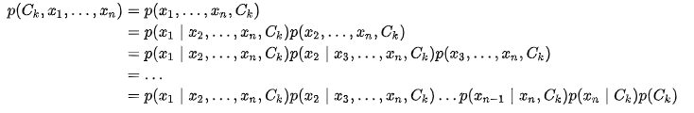
Naïve Bayes
P(x | c)*P(c) (for c = 1. . . k)
Here the formula is equivalent to joint probability model:
This can be rewritten as using chain rule:
Now, we make an assumption that all features in x are mutually independent, conditional on the category C_{k}

Slide 9

The mentioned assumption leads to the approximation that:
Thus the joint model can be expressed as:

Slide 10
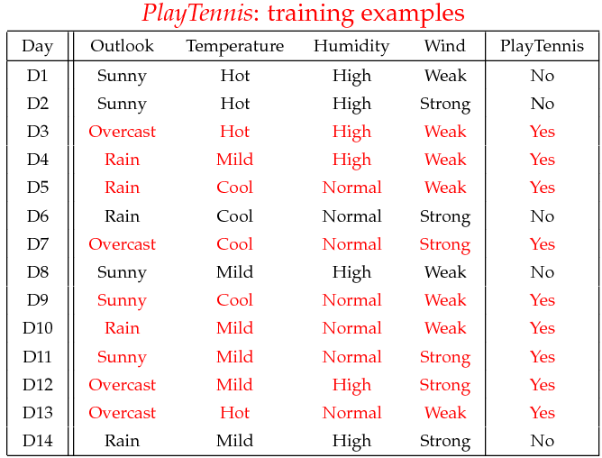
Example
To better understand the naïve Bayes classification, lets take an example:
P(Play = yes) = 9/14 P(Play = No) = 5/14

Slide 11
Example
Training of model based on original data
 | OUTLOOK
 | Yes | No
Sunny | 2/9 | 3/5
Overcast | 4/9 | 0/5
Rainy | 3/9 | 2/5
Total | 9/9 | 5/5

Slide 12
Example
 | TEMPERATURE
 | Yes | No
Hot | 2/9 | 2/5
Mild | 4/9 | 2/5
Cool | 3/9 | 1/5
Total | 9/9 | 5/5

Slide 13
 | HUMIDITY
 | Yes | No
High | 3/9 | 4/5
Low | 6/9 | 1/5
Total | 9/9 | 5/5

Slide 14
 | WIND
 | Yes | No
Strong | 3/9 | 3/5
Weak | 6/9 | 2/5
Total | 9/9 | 5/5

Slide 15
Example
Testing the classifier:
x = (Outlook = sunny, temperature = cool, Humidity = High, Wind = String)
We now need to apply the following formula that we derived:
P(c | x) = P(x | c)*P(c) / P(x) → ~~ P(x | c)*P(c) (for c = 1. . . k)
The above mentioned scenario can be classified as either ‘Yes’ or ‘No’
P(Outlook = sunny | play = yes) = 2/9
P(Temperature = cool | play = yes) = 3/9
P(Humidity = high | play = yes) = 3/9
P(Wind = strong | play = yes) = 3/9
P(play = yes) = 9/14

Slide 16
P(Outlook = sunny | play = no) = 3/5
P(Temperature = cool | play = no) = 1/5
P(Humidity = high | play = no) = 4/5
P(Wind = strong | play = no) = 3/5
P(play = no) = 5/14
Classification using MAP rule:
P(Yes|x) = [P(Sunny|Yes)P(Cool|Yes)P(High|Yes)P(Strong|Yes)]P(Play=Yes) = 0.0053
P(No|x) = [P(Sunny|No)P(Cool|No)P(High|No)P(Strong|No)]P(Play=No) = 0.0206
From the result we find that P(No | x) > P(Yes | x), thus we classify x = No

Slide 17
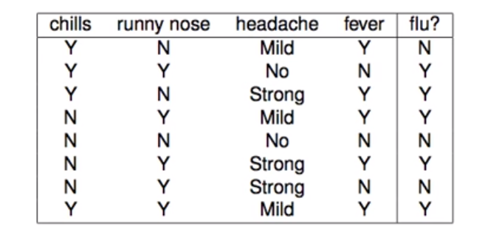
Given the data for symptoms and whether patient have flu or not, classify following:
x = (chills = Y, runny nose = N, headache = mild, fever = Y)

Slide 18
 | CHILLS
 | Flu = Yes | Flu = No
Yes | 3/4 | 1/4
No | 2/4 | 2/4

Slide 19
 | RUNNY NOSE
 | Flu = Yes | Flu = No
Yes | 4/5 | 1/5
No | 1/3 | 2/3

Slide 20
 | HEADACHE
 | Flu = Yes | Flu = No
Strong | 2/3 | 1/3
Mild | 2/3 | 1/3
No | 1/2 | 1/2

Slide 21
 | FEVER
 | Flu = Yes | Flu = No
Yes | 4/5 | 1/5
No | 1/3 | 2/3

Slide 22
P(Flu = Yes) = 5/8
P(Flu = No) = 3/8
P(chills = Y | Y) = 3/4
P(chills = Y | N) = 1/4
P(runny nose = N | Y) = 1/3
P(runny nose = N | N) = 2/3
P(headache = Mild | Y) = 2/3
P(headache = Mild | N) = 1/3
P(fever = Y | Y) = 4/5
P(fever = Y | N) = 1/5
P(Yes|x) = [P(chills=Y|Yes)P(runny nose=Y|Yes)P(headache=Y|Yes)P(fever=Y|yes)]P(flu=Yes) = 0.006
P(Yes|x) = [P(chills=Y|Yes)P(runny nose=Y|Yes)P(headache=Y|Yes)P(fever=Y|yes)]P(flu=Yes) = 0.018

Slide 23
Pros of Naïve Bayes
It is easy and fast to predict a class of test data set
Naïve Bayes classifier performs better compared to other models i.e. logistic regression and it needs less training data
It performs well in case of categorical input variables compared to numerical variables
Highly scalable, it scales linearly with number of predictors and data points
Handles continuous and discrete data
Not sensitive to irrelevant features

Slide 24
Cons of Naïve Bayes
If categorical variable has a category (in test data set) which was not observed in training data set, then model will assign a 0 probability and will be unable to make a prediction
This is often known as “zero frequency”. Can be solved by smoothing technique
One example of smoothing technique is Laplace estimation
Naïve Bayes makes assumption of independent predictors. In real life it is often hard to get set of predictors which are completely independent

Slide 25
Applications of Naïve Bayes Algorithms
Naïve Bayes fast and thus can be used for making real time predictions
It can predict probability of multiple classes of target variables
It can be used for text classification, spam filtering, sentiment analysis
Naïve Bayes and collaborative filtering together can help make recommendation systems to filter unseen information and predict whether user would like a given resource or not

