Slide 1
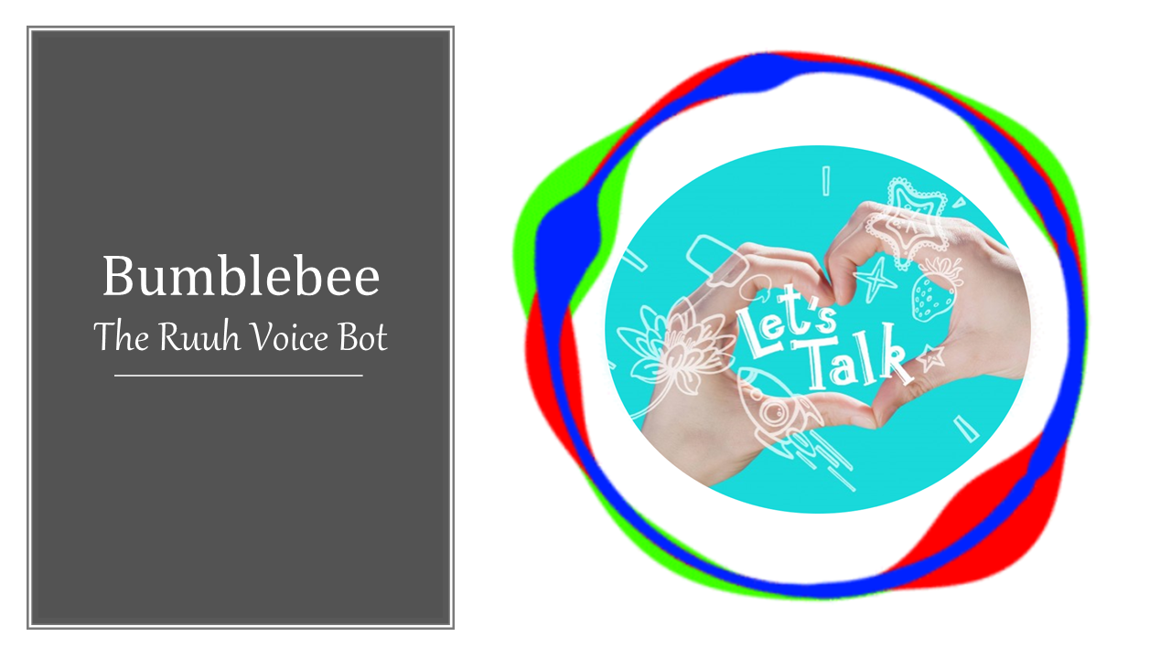

Slide 2
Why Ruuh Voice Bot?
In spite of having digital assistants like Google Assistant, Alexa, Cortana, Bixby, etc.……there are many small real-time problems that a human faces everyday and can be solved by a digital friend.
The main aim of Bumblebee – The Ruuh Voice Bot, is to fulfil the gaps that are made by digital assistants.

Slide 3
We wanted to integrate Ruuh with not only intelligent homes and gadgets, but also with hearts and minds of people so that Ruuh can be their <not virtual but a real>-friend.
We aim to do beyond a software’s capabilities and convert Ruuh into a single package of Application that is compatible for everyone.

Slide 4
As Microsoft Student Partners, we learnt that software should be useful not only to literate-smart-ish people, but also to the local, old and illiterate people.
So, this is what we did right now……..starting from here, long way ahead……we want to make this project a success in association with Microsoft Developers as a team.

Slide 5
Progress
Most important target – Making it available for global languages.
Yes, Ruuh Voice Bot supports all the languages in the world including Telugu, Hindi, Tamil, Malayalam, etc. Indian regional languages……..and of course English too.
We used Google’s Speech recognition and translation APIs for multi-language support. We used Google’s tools because it has major support for Indian regional languages.

Slide 6
Python programming is used to connect Facebook’s Ruuh and interface. Code supports hyperthreading and is optimized.
Right now, software supports both Windows and Mac.
Besides chatting with Ruuh, imagine talking to Ruuh more like your companion in your own regional language capturing ones attention.

Slide 7
Multi-Purpose
Until now, Ruuh served only entertainment purpose. Now she is ready to help the world.
We plan on adding a large number of features to Ruuh and triggering them with wake-word voice detection.
Each and every feature to be available to every person.

Slide 8
Our 1st major purpose application is designed for Visually Impaired.
Imagine Ruuh helping blind person to analyze their surroundings and act accordingly. They can now see everything while still being blind.
Ask Ruuh what is around you and she’ll tell all the things that are around you. We trained images and generally required things using Microsoft Custom Vision API as we faced problems with Tensorflow and Yolo.

Slide 9
Our 2nd major application is designed to avoid accidents being caused by drowsiness during driving. This technology already exists, but we want to use Machine Learning to learn when the driver is usually sleepy and take actions.
Now Ruuh will also take care of your driving safety.
Tell Ruuh to secure your drive and she’ll be there to prevent you from sleeping and feeling drowsy.

Slide 10
Future plans
In future, we aim to enable Ruuh to control your home devices (half-likely to be a digital assistant), interact and learn from you rapidly to integrate with human lives better (like a guardian).
Then Ruuh will also be able to perform very tiny tasks that can show a large impact in different sectors.
Ruuh should be able to help doctors, farmers, students, teachers, etc. in the most benefiting way possible.

Slide 11
Please have a look at the Demo Videos

Slide 12
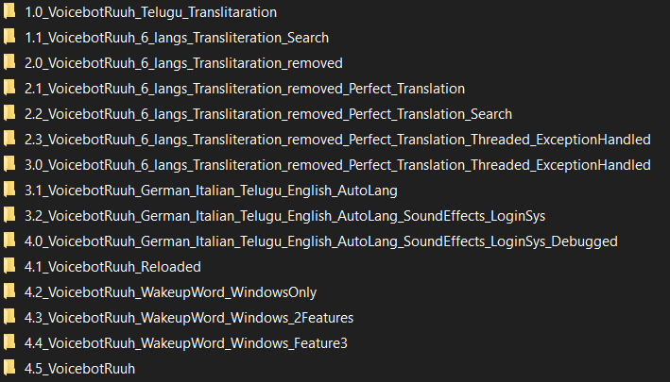
What we wish
We want to get an opportunity like an internship at Microsoft Hyderabad and get in contact with the Ruuh team there to proceed and take forward this project as a Microsoft Application.
Software is still under development. We are just at a small checkpoint.

Slide 13
Developers (Both MSPs and AI Rockstars)
K.V.R. Rajya Lakshmi
Iftekharuddin Mohammed
Mentor
→ Prof. Ramanamurthy Saripalli

Slide 14
Thank You!

