Slide 1



Team Name: Security Change Sandbox
Team ID:
HX4-PS13-04
Problem Statement Selected:
PS #13 – Security Digital Twin for Threat Vector Assessment
Theme:
CyberSecurity & Defence Systems

Slide 2

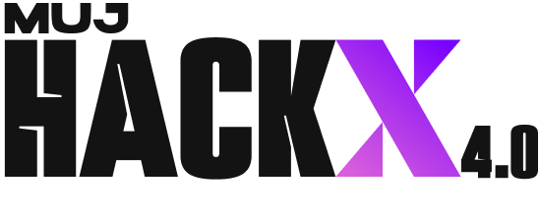

SECURITY CHANGE SANDBOX
!
The Problem
✓
Our Solution
Security teams deploy controls on gut feel. Two families of tools exist today, and each answers only half the Change Advisory Board's (CAB) question:
• Attack-path tools (BloodHound, XM Cyber, Wiz) show paths eliminated — never whether it breaks payroll, backups, or APIs.
• Cloud policy analyzers (Azure VNM, AWS IAM Sim) show packet drops — never any attacker path or risk score.
Nobody joins security benefit and business breakage on one model, for one proposed change.
A cyber digital twin that tells a change board, for any proposed security control, both what it stops the attacker doing AND what it breaks in production — before deployment.
• Core primitive: ServiceFlow — legitimate dependencies (e.g. payroll-api → prod-db, Crit 5) that must keep working. Criticality ≥ 4 breakage → instant BLOCK.
• Shows the attacker's re-planned route, cost delta, and recommended safe alternatives.
“Adaptive attacker modelling exists in research — MAL Simulator, CAGE. Control impact exists in cloud platforms — Azure. To our knowledge no product joins security benefit and business breakage on one model for a single proposed change, which is the decision a change board actually makes.”

Slide 3
TECHNICAL APPROACH
Model
Twin
Compile
ATT&CK Rules
Search Paths
(Alg A, cached)
Monte Carlo
Walk (Alg B)
Evaluate
Change
CAB
Verdict
Two Decoupled Algorithms (Never Merged)
The Verdict Engine & Dual Metrics
1. Algorithm A — Stateful DFS Search (runs once, cached):
Explores (node, frozenset(capabilities)). An edge is only traversable once prerequisites (credentials collected on earlier hops) are held. Capped at depth 8, 5,000 states. Discovers complete path inventory.
2. Algorithm B — Sampled Monte Carlo Agent Walk:
200–500 seeded trials for empirical statistics. Threat actor has local vision, not omniscience — when an edge is blocked, adaptation is emergent as agent pivots. Seeded RNG for 100% stage reproducibility.
Why we ship BOTH metrics (our pitch climax):
• naive_path_reduction_pct — industry-standard metric required by the brief. Assumes a passive attacker who gives up.
• honest_cost_increase_pct — how much harder the adaptive attacker works (+340% effort) when re-planning.
• p_success_delta with Wilson score 95% confidence interval.
• Actionable Verdict: DEPLOY / REVIEW / BLOCK with broken flows, explainable rationale, and automated safe alternatives.
• MITRE Grounding: 10 techniques in decoupled YAML (techniques.yaml).

Slide 4
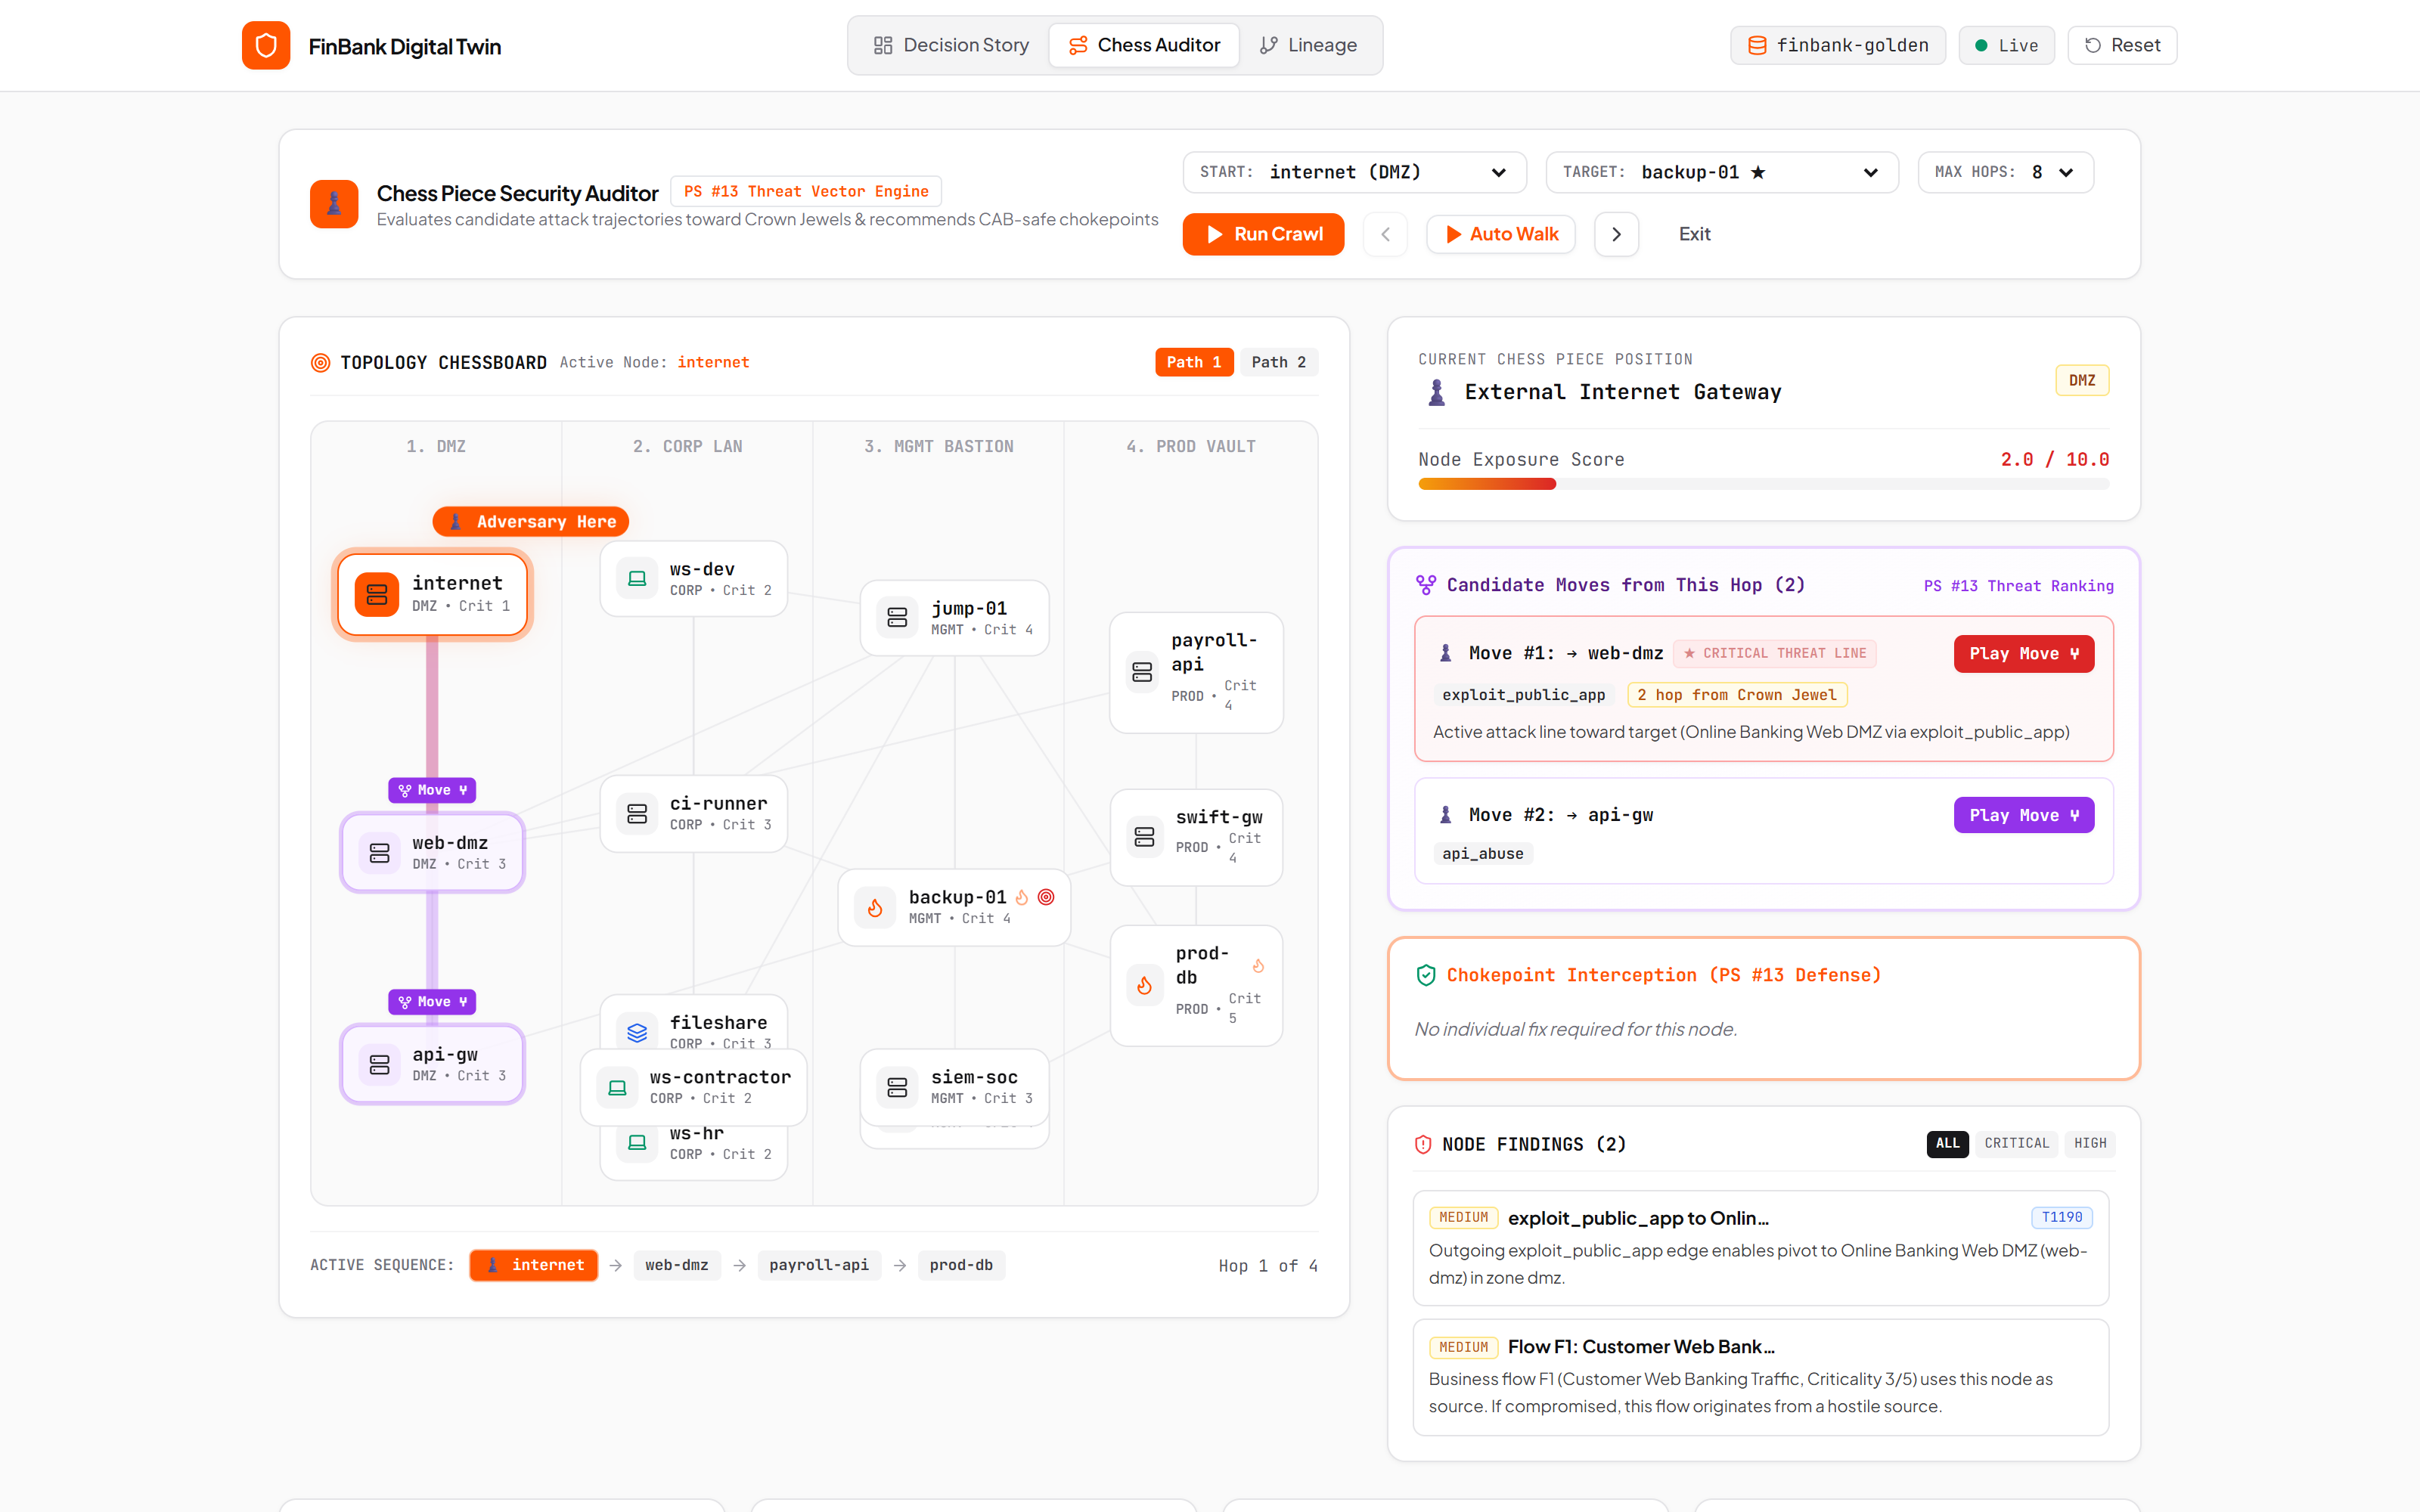
USER EXPERIENCE & DESIGN
1
Decision Story (Keys 1–5)
Keyboard-driven presets: Baseline → Full Seg (BLOCK P1) → MFA (REVIEW) → Scoped Seg (DEPLOY) → Sync Drift.
2
4-Zone Topology Canvas
Hand-rolled SVG: DMZ → Corp → Bastion → Prod. Attack links in amber/red, active service flows in cyan, severed in red.
3
Breach Cascade & Blast Radius
Step-by-step falling-nodes animation with COMPROMISED / RE-PLAN badges; 1-click downstream blast-radius reachability.
4
Chess Piece Security Auditor
Adversary as a pawn walking the topology hop by hop, scoring candidate moves and computing chokepoint cut-sets.
5
Constrained Portfolio Optimizer
Budget slider ($1k–$8k) + criticality ceiling → constrained safe portfolio vs naive unconstrained (breaks payroll).

Slide 5
FEASIBILITY AND VIABILITY
Every algorithm is mathematically proven and already implemented — 278 automated tests pin exact stage numbers.
0–3h
3–10h
10–16h
16–20h
20–24h
24–36h
Contracts Frozen
Two Algorithms
Verdict Engine
Optimizer & Blast
Multi-Sector Sync
Judge UI & Harden
models.py + techniques.yaml locked; test fixtures written first
Alg A stateful DFS + Alg B Monte Carlo walk — 4 parallel branches
ServiceFlow severance contract, confidence scoring, metrics engine
Constrained knapsack portfolio + NetworkX blast-radius reachability
7 enterprise twins (Finance, Health, Cloud, Grid) + SHA-256 lineage
278 passing tests (<3s), live demo presets, rehearsal & packaging
278 Automated Tests Passing
Deterministic by Design
Zero AI Hallucination
Runs in 2.82s (pytest). Invariants asserted: control never increases attacker success; clone never mutates state; same seed → identical numbers.
Seeded RNG, seed in LRU cache key. Stage numbers match rehearsal numbers every time. Simulation latency <40ms.
Deterministic graph theory and seeded Monte Carlo only. Zero LLMs in the critical security loop — mandatory for CAB compliance.

Slide 6
IMPACT AND BENEFITS
★
Stops Costly P1 Outages Before Deployment
★
Exposes Attacker Re-Planning & Pivot Paths
Security teams often deploy rules that sever mission flows. Preset 2 shows full database isolation cuts 80% attack paths but severs Payroll (Crit 5) — caught and blocked before production.
Fewer paths does not mean safer. When MFA is put on human bastions, the twin proves the adversary pivots through automated CI/CD machine tokens (Route D) — rendered animated on the graph.
★
Multi-Sector Ingestion in Under 5 Minutes
★
Defense-Grade Confidence & Compliance
Not hardcoded to one topology. Bundles 7 validated digital twins: FinBank Core Banking, Healthcare Hospital (Epic EHR + Infusion Pumps), AWS Cloud SaaS, and DoE Critical Grid + live JSON import.
Every verdict ships with a Wilson score 95% confidence interval and evidence-weighted calibration (Observed 1.0, Inventory 0.9, Inferred 0.5) — ready for Change Board non-repudiation.

Slide 7
BUSINESS MODEL & SUSTAINABILITY
1
Enterprise CAB SaaS Subscriptions
2
MSSP & Consultancy White-Label Edition
Tiered licensing per digital twin / per-seat for enterprise cybersecurity and platform engineering teams running Change Advisory Boards in banking, healthcare, and defence.
Packaged for cybersecurity consulting firms and managed service providers to model, stress-test, and certify proposed client architecture changes before deployment.
3
Cloud Marketplace Integrations
4
Automated GRC & Compliance Lineage
AWS / Azure / GCP marketplace native app that connects via read-only IAM/VNet APIs to continuously reconstruct and update the infrastructure twin as changes occur.
Generates immutable cryptographic SHA-256 audit trails satisfying SOC 2 Type II, PCI-DSS v4.0, ISO 27001, and EU DORA change-management evidence requirements automatically.

Slide 8
RESEARCH AND REFERENCES
1
MITRE ATT&CK Grounding
2
FastAPI & Frozen Pydantic v2
10 real techniques in decoupled YAML (techniques.yaml) — T1566, T1190, T1003, T1021.001, T1078, T1041 with real preconditions, costs, and noise.
Immutable, content-addressed digital twin models (tuples, frozensets) with SHA-256 hashing and high-throughput LRU result caching.
3
NetworkX & Graph Theory
4
Seeded Monte Carlo & Wilson Score
State-space depth-first search (DFS) capped at depth 8 / 5,000 states; nx.descendants for blast-radius calculations and crown-jewel exposure.
200–500 seeded stochastic agent walks; Wilson score confidence intervals for binomial proportion uncertainty on small sample sizes.
5
Defensible Academic Positioning
6
React 18 & Hand-Rolled SVG Graph
Positioned accurately against MAL Simulator (KTH), CAGE / CybORG, BloodHound Enterprise, and Azure VNM rule impact analyzer.
Judge-first lean dashboard with 5 instant keyboard presets, falling-nodes breach animation, and the Chess Piece Security Auditor.

