Slide 1

Tool Action Recogntion LSTM & TCN Models with Contrastive Learning and Pseudo-Labeling
Presented By – Shashank, Monika Radhakisan Chavan, Taimoor Hussain
Supervisor - Dr. Dario Zanca, Naga Venkata Sai Jitin Jami
Date – 13 June, 2025

Slide 2
Agenda
01
Task Overview
02
Approach and Objectives
03
Model Architectures and Semi-Supervised Learning
04
Experimental Setup, Results and Analysis
05
Future Work

Slide 3
Task Overview
Action Classification – Given sensor data from a specific tool, recognize and classify the actions being performed.
Tool | Actions
Electric Screwdriver | Tightening, Untightening, Manual Motor Rotation, Shaking, Air Screwing Clockwise, Air Screwing Counter Clockwise, Double tightening
Pneumatic Rivet Gun | Riveting, Trigger pulled (no air), Trigger pulled with air (no rivet), Trigger held too long, Shaking, Tool hitting something,
Pneumatic Screwdriver | Tightening, Untightening, Shaking, Air Screwing Clockwise, Air Screwing Counter Clockwise, Double tightening, Tool hitting something

Slide 4
Approach & Objectives
Baseline Models -
LSTM (Long Short-Term Memory) — captures long-term dependencies
TCN (Temporal Convolutional Network) — models temporal patterns with convolution
Advanced methods - To leverage both labeled and unlabeled data, we applied semi-supervised learning methods:
Pseudo labeling: generating labels for unlabeled data based on confident model predictions
Contrastive learning: learning robust feature representations by distinguishing similar and dissimilar samples
Experiments & Analysis -
Compared model performances using different proportions of labeled vs. unlabeled data
Evaluated the impact of key hyperparameters in semi-supervised strategies
Goal: Identify which combination yields the best accuracy and robustness in tool action recognition

Slide 5
Model Architectures and Semi-Supervised learning

Slide 6
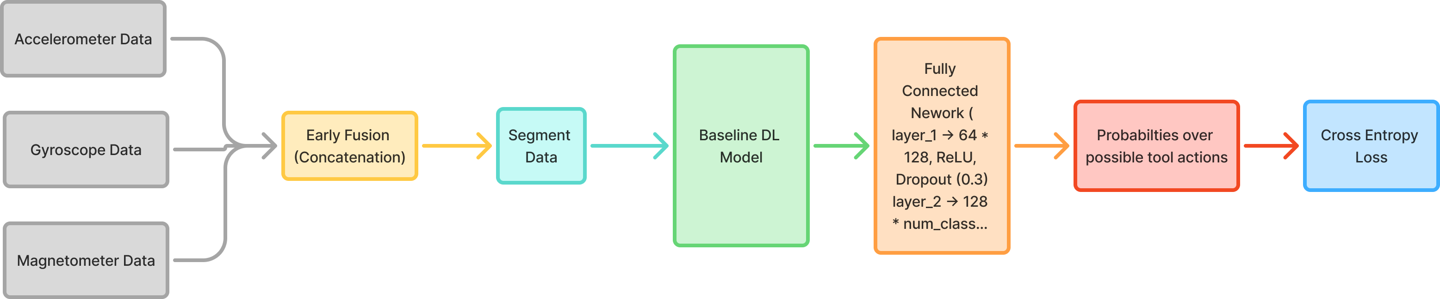
Classification Pipeline

Slide 7
Baseline Model Architectures
LSTM:
Number of layers - 1
Number of features in the hidden state - 64
TCN:
3 stacked layers with 64 filters each
Each filter has size 4
Dropout – 0.2
Weight Normalization
Activation - ReLU

Slide 8
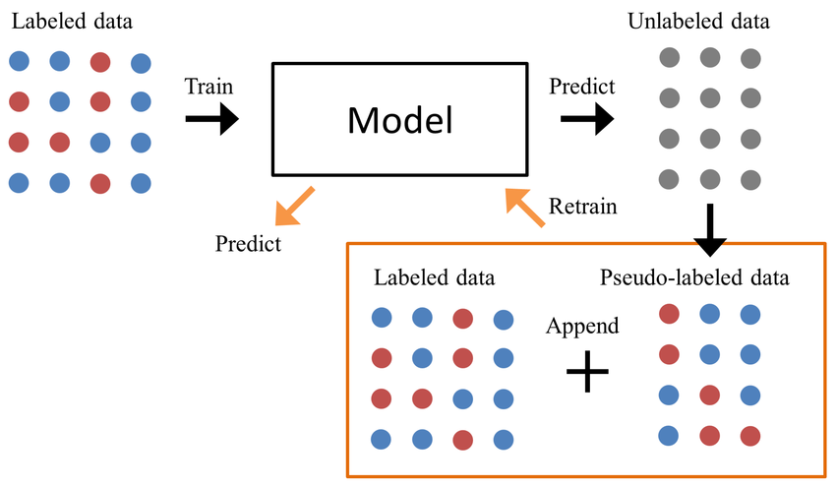
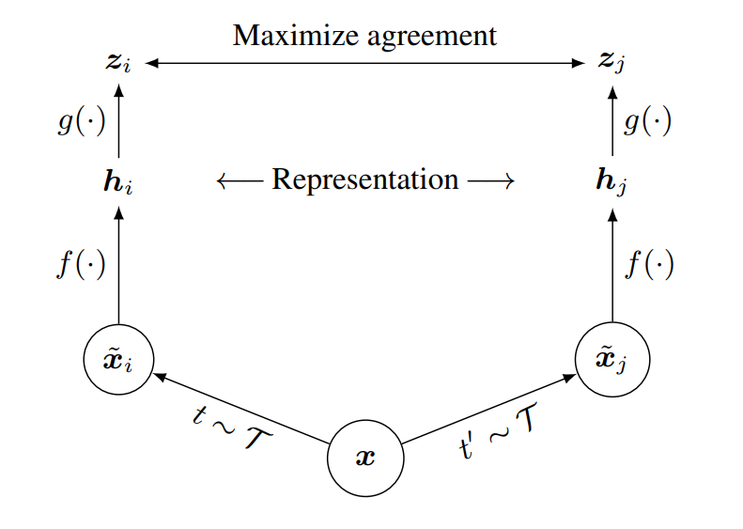
Semi-Supervised learning Strategies
Contrastive Learning (SimCLR):
NT-Xent (the normalized temperature-scaled cross entropy loss).
Augmentations - Applied random jitter (Gaussian noise) or random scaling (amplitude change) to sensor data.
Used projection head with hidden features = 256 and dimension projection = 128
Temperature = 0.5, Pretrain epochs = 10
Psuedo-Labeling:
Number of features in the hidden state – 64
Threshold = 0.9, Epochs = 10

Slide 9
Experimental Setup, Results and Analysis

Slide 10
Experimental Setup
Model Training :
LSTM & TCN trained with:
Supervised only
Semi-Supervised –
Pseudo Labeling
Contrastive Learning
Learning rate = 0.001
Batch size = 32
Epochs = 10
Hyperparameter Tuning –
Labeled vs Unlabeled dataset ratio
Pseudo-labeling threshold
Temperature in Contrastive loss
Evaluation Metrics –
Accuracy
Precision
Recall
F1-Score
Confusion Matrix

Slide 11
Results
Note: For Electric Screwdriver and only Accelerometer sensor data as input data
Model | Semi-Supervised Strategy | Labeled % | Accuracy % | Precision % | Recall % | F1 Score %
LSTM | None | 100 | 91.5 | 69.2 | 59.2 | 60.5
LSTM | None | 25 | 83.7 | 29.9 | 25.4 | 25.3
LSTM | Pseudo Labeling | 25 | 87.8 | 41.4 | 41.3 | 38.2
LSTM | Contrastive Learning | 25 | 86 | 37.4 | 32.6 | 30.9
TCN | None | 100 | 91.5 | 58.3 | 50.8 | 51.7
TCN | None | 25 | 86.4 | 37.1 | 35.81 | 35.6
TCN | Pseudo Labeling | 25 | 88.4 | 54 | 45 | 45.3
TCN | Contrastive Learning | 25 | 85.5 | 42.2 | 32 | 32.8

Slide 12
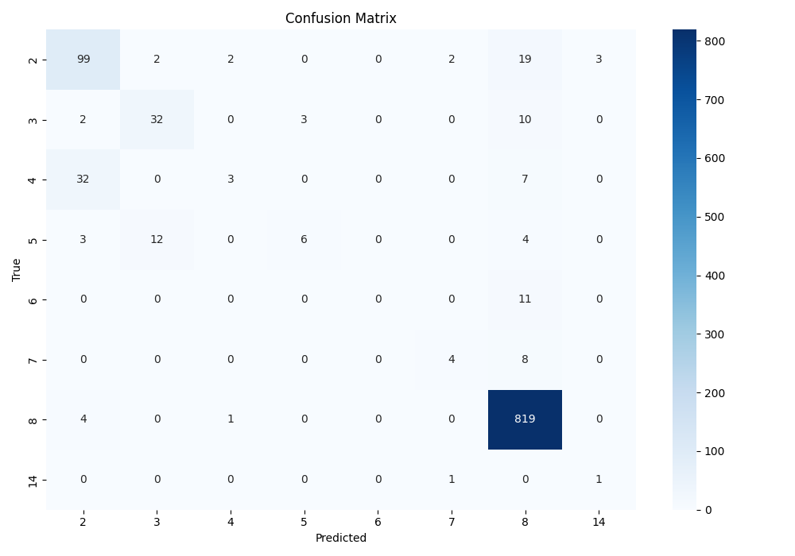

Confusion Matrix for top results
Supervised LSTM with 100% data
TCN with pseudo labeling using only 25% labeled data

Slide 13
Key Findings
Using 100% labeled data yields the best overall results (expected)
LSTM and TCN (100% labeled) both achieve 91.5% accuracy.
LSTM performs better in precision (69.2%) and F1 (60.5%) than TCN, suggesting better handling of class imbalance.
Performance drops significantly with only 25% labeled data (expected)
Accuracy and F1 drop by ~8%–35% when using just 25% of labeled data with no semi-supervised help.
Pseudo Labeling clearly improves performance
For both models, pseudo labeling gives the best F1 score among semi-supervised methods:
Contrastive learning helps, but less than pseudo labeling
Some gains over no semi-supervision:
LSTM F1: 30.9% vs 25.3%
TCN F1: 32.8% vs 35.6% (slightly lower than baseline in TCN)
Useful, but not consistent
TCN + Pseudo Labeling (25%) gives the best semi-supervised results

Slide 14
Future Work
Early Fusion of different sensor data
Ablation studies for semi-supervised learning hyperparameters – Confidence threshold in pseudo labeling and temperature in NT-xent loss used in contrastive learning
Use better augmentations in contrastive learning – Time Warping and Random Masking
Good to have -
Fix Data Imbalance – class weighting, oversampling or undersampling, data augmentation
Model and training hyperparameter tuning to improve the results

Slide 15
Thank you
For your Attention!

