Slide 1

Few-Shot Continual Learning for Free-Text
Promptable 3D Medical Image Segmentation
Master’s Thesis Intro Talk
Supervisor – Prof. Dr.-Ing. habil. Andreas Maier, Dr.-Ing. Tomás Arias Vergara
Presented By – Shashank, 23391962
Date – 5th August, 2026

Slide 2
Agenda
01
Motivation & Problem Statement
02
Research Question & Thesis Scope
03
Related Work
04
Methodology
05
Experimental Evaluation
06
Results & Discussion

Slide 3
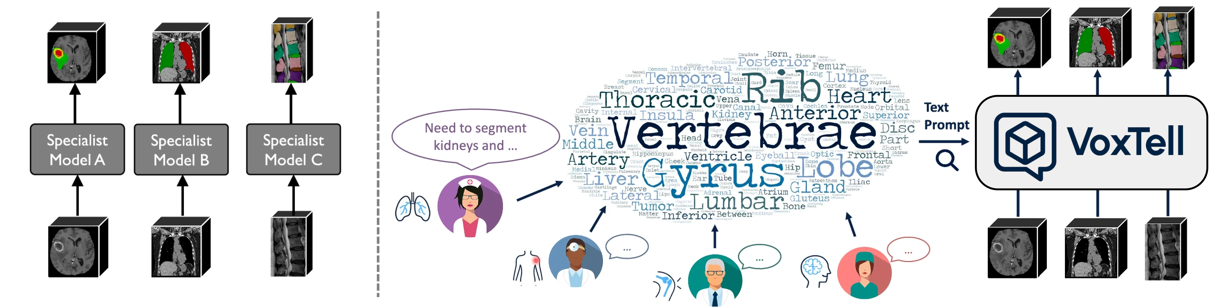
Evolution of Medical Image Segmentation
From task-specific models to free-text promptable foundation models
Source: Zhao, Ziheng, et al. (2025).
Promptable foundation models enable open-vocabulary medical segmentation by using free-text prompts to generalize to unseen anatomical structures

Slide 4
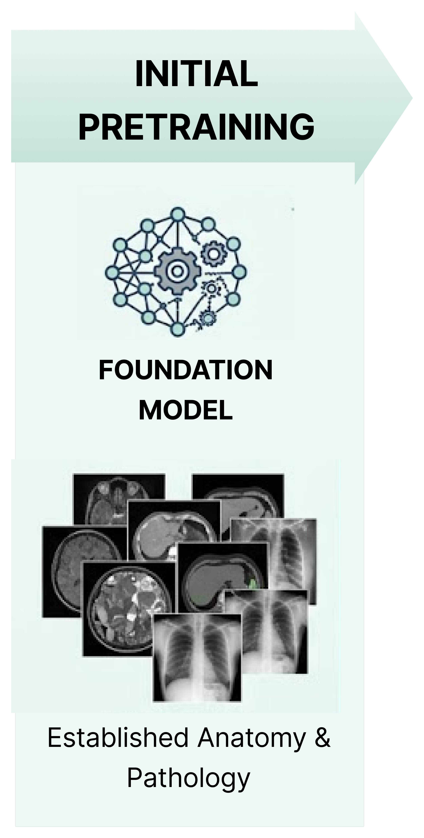
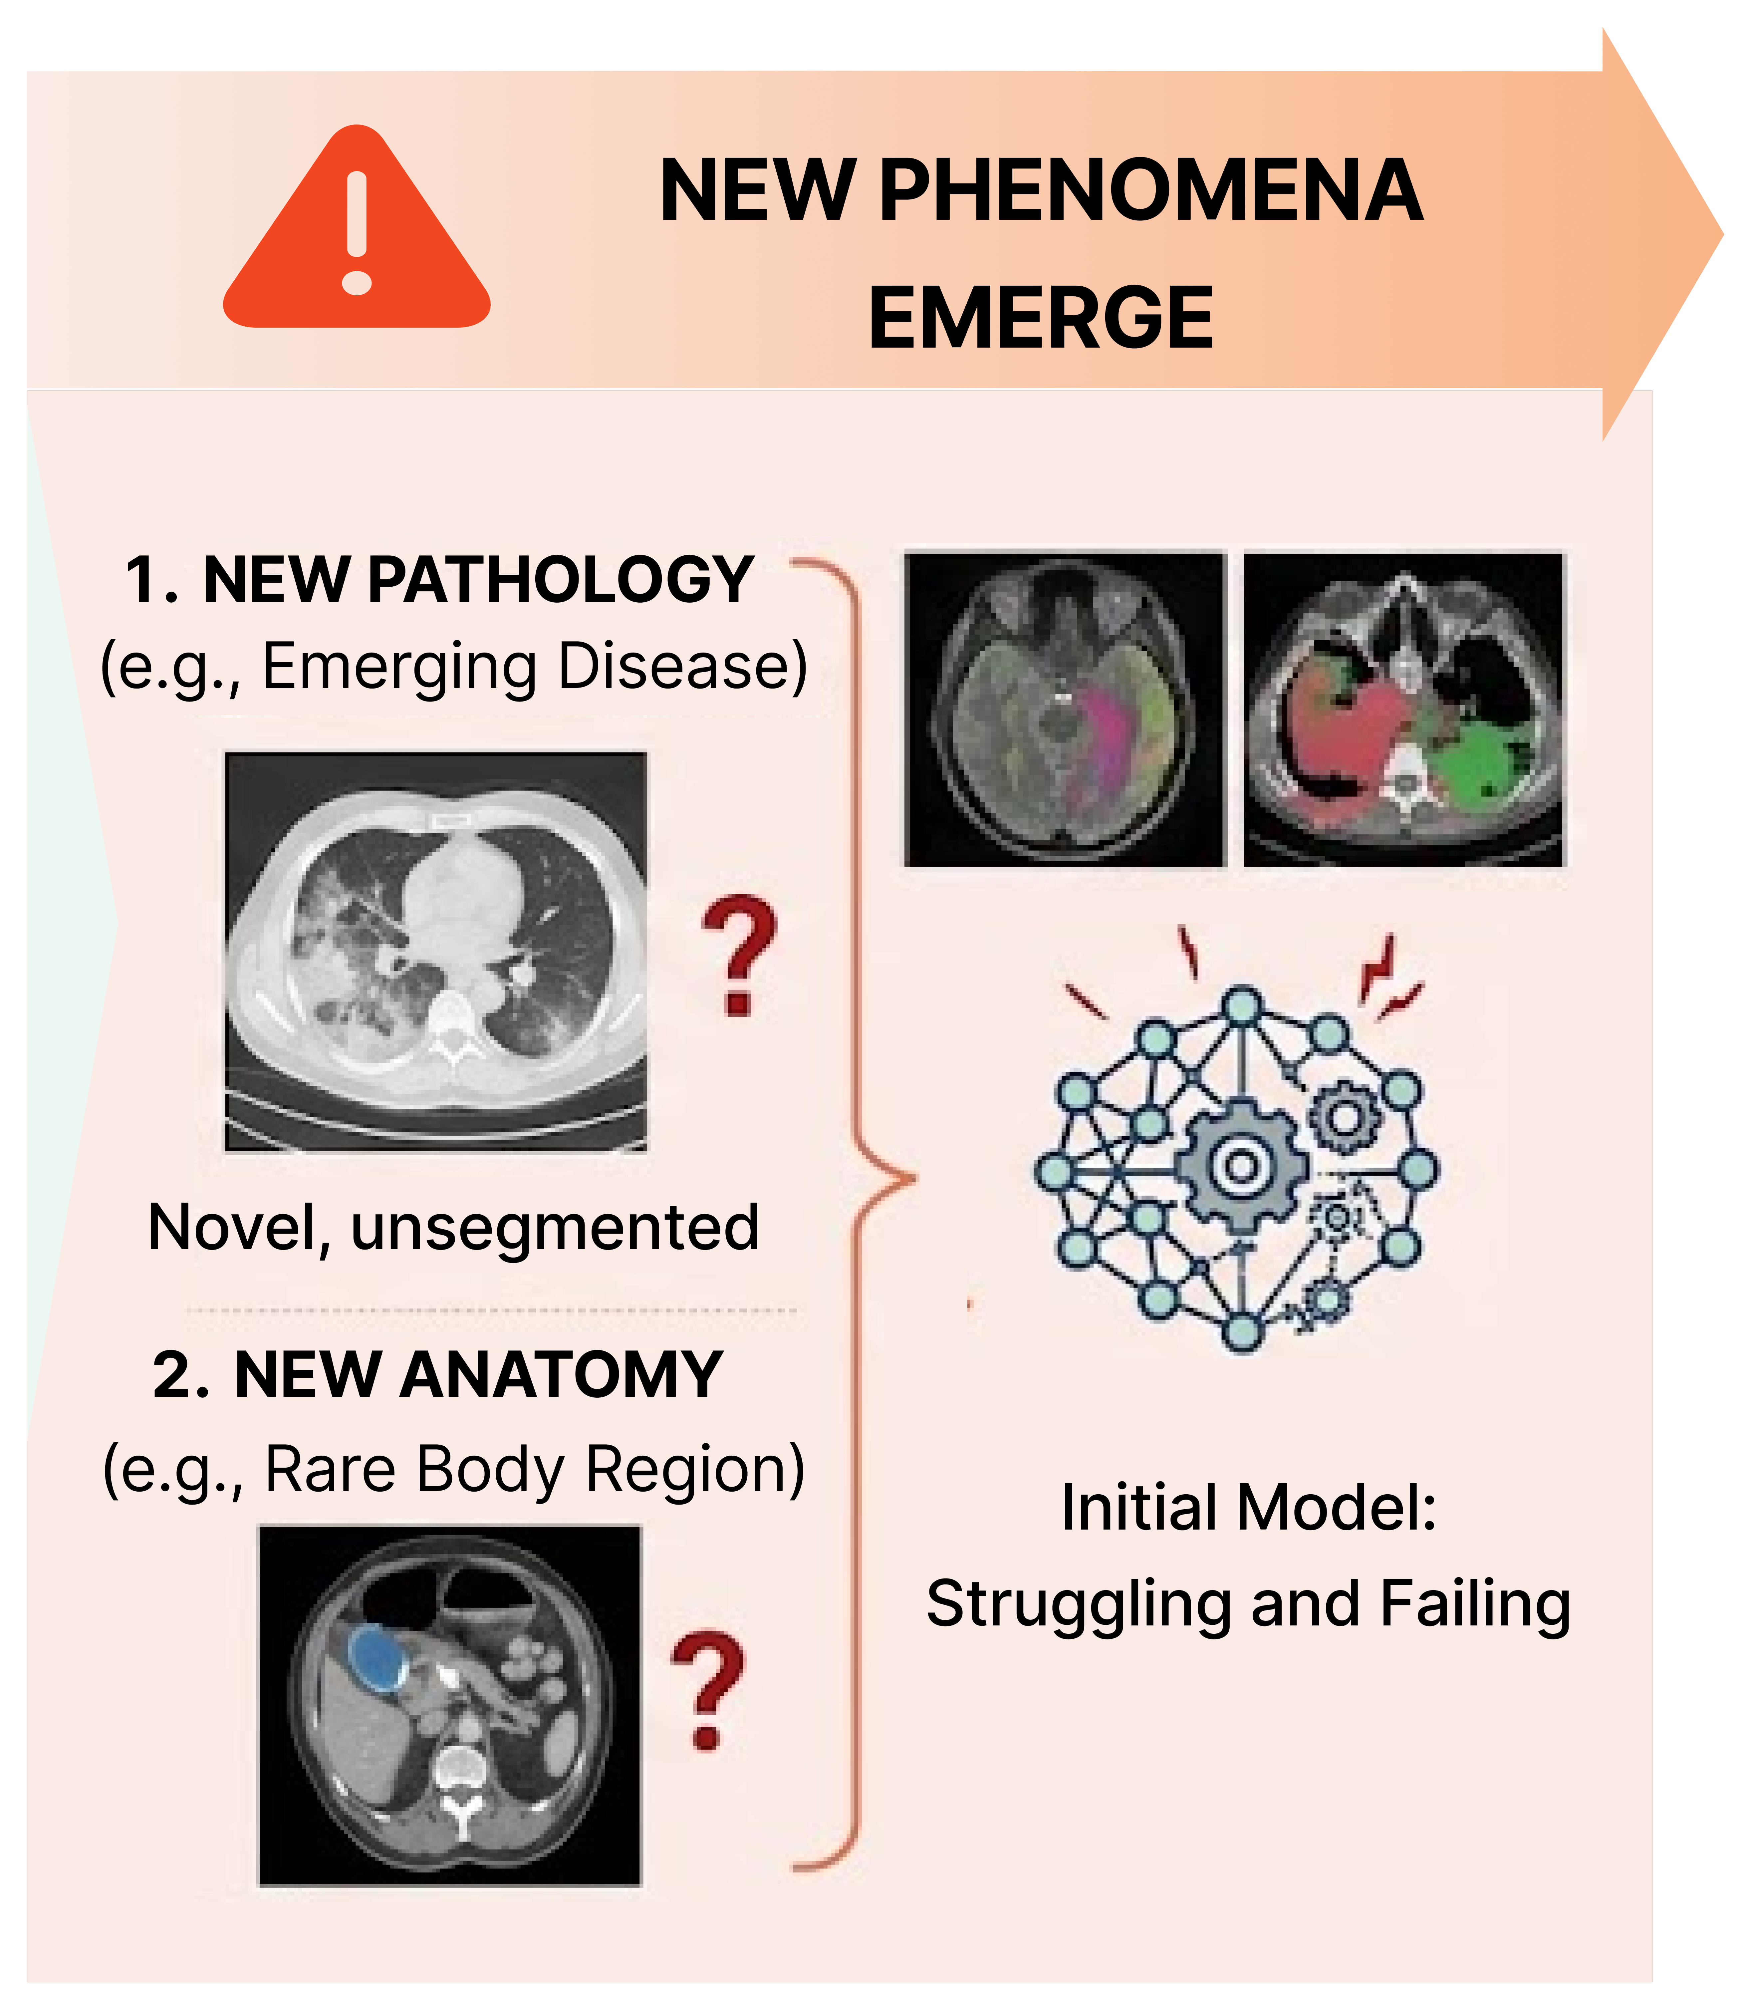
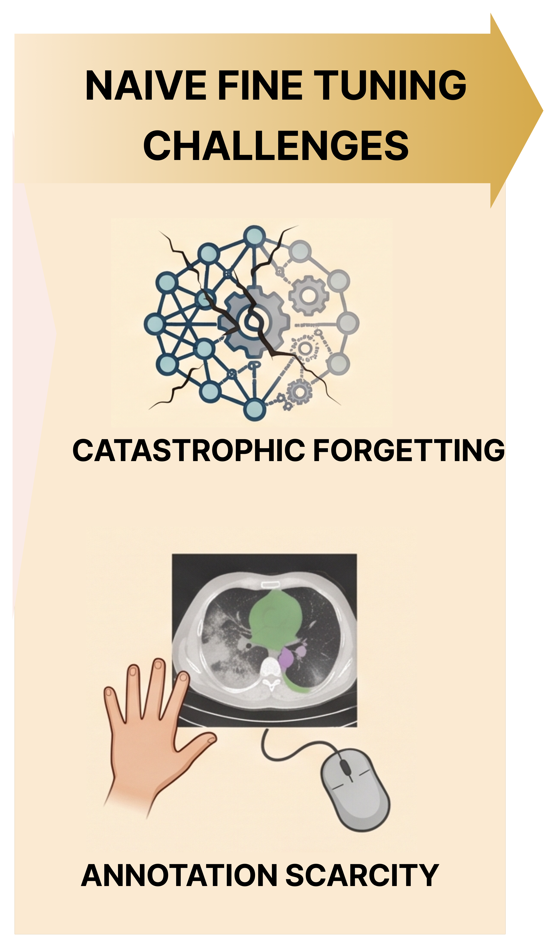
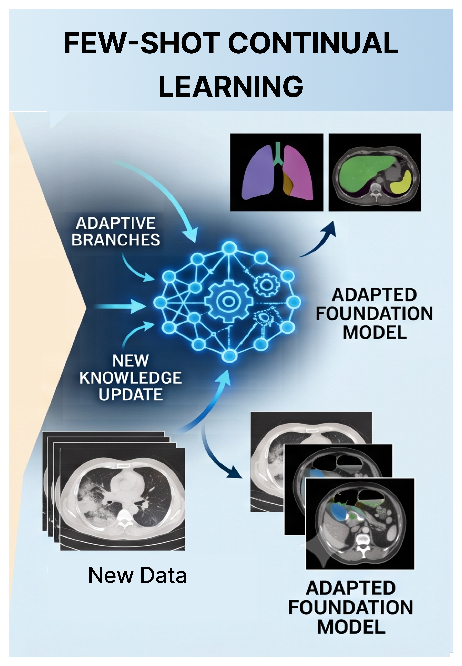
Real-World Adaptation Challenges
Why promptable segmentation models require continual few-shot adaptation?

Slide 5
Thesis Scope and Research Question
Systematic evaluation of continual learning for promptable 3D medical image segmentation
What’s Missing? | Thesis Scope
No benchmark for few-shot continual adaptation | Offline class-incremental benchmark with VoxTell
No systematic evaluation of CL strategies | FT • LoRA • CPE-CLIP • ZSCL
Unknown adaptation–forgetting trade-off | Quantitative comparison
Research Question
Which continual learning strategy provides the best trade-off between adaptation performance and catastrophic forgetting during few-shot adaptation of free-text promptable universal 3D medical image segmentation models?

Slide 6
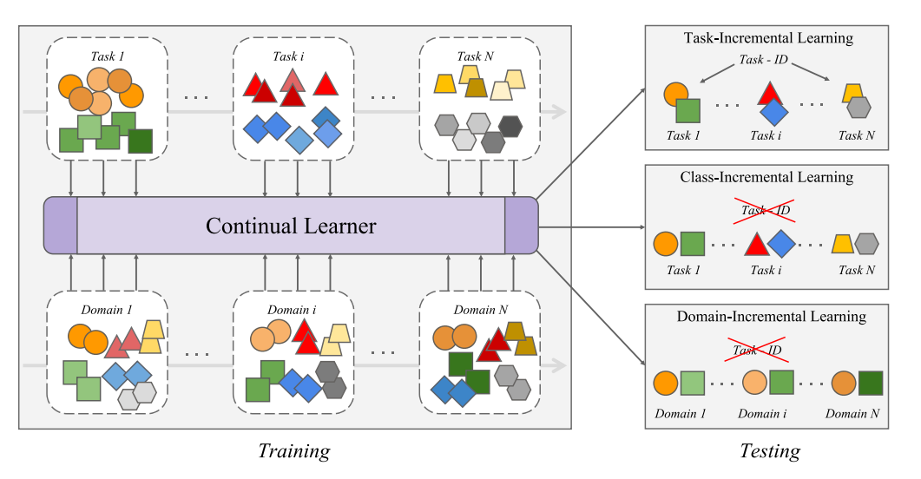
Continual Learning Settings
Task, domain, and class-incremental learning paradigms
Source: Yang, Yutao, et al. (2025)
Offline Continual Learning: Sequence of distinct tasks over time, with the data for each task provided as a complete, multi-epoch batch rather than a stream

Slide 7
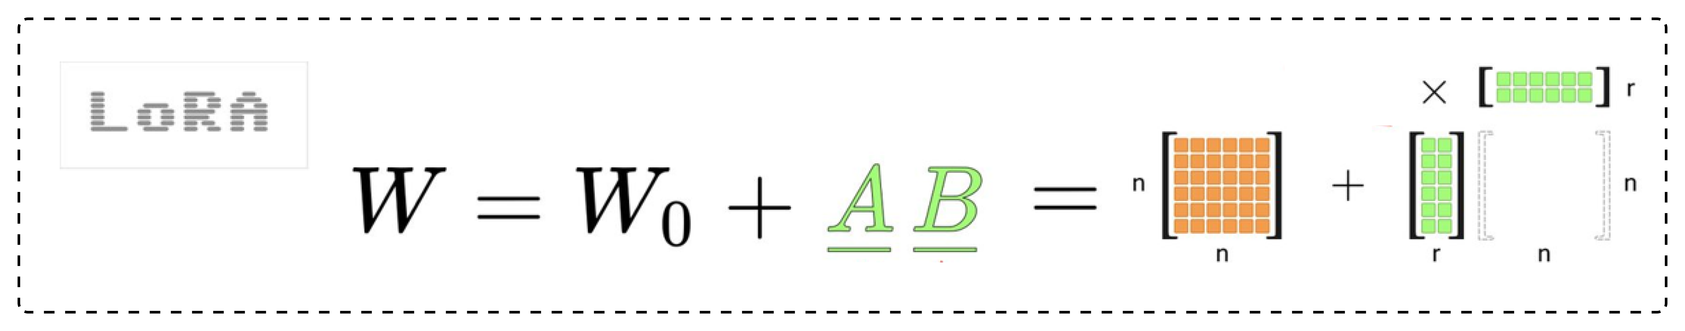
Multimodal Continual Learning Strategies
Representative approaches for mitigating catastrophic forgetting
Source: Liu, Yuyang, et al. (2026)
Source: Görner, Martin. (2025)

Slide 8
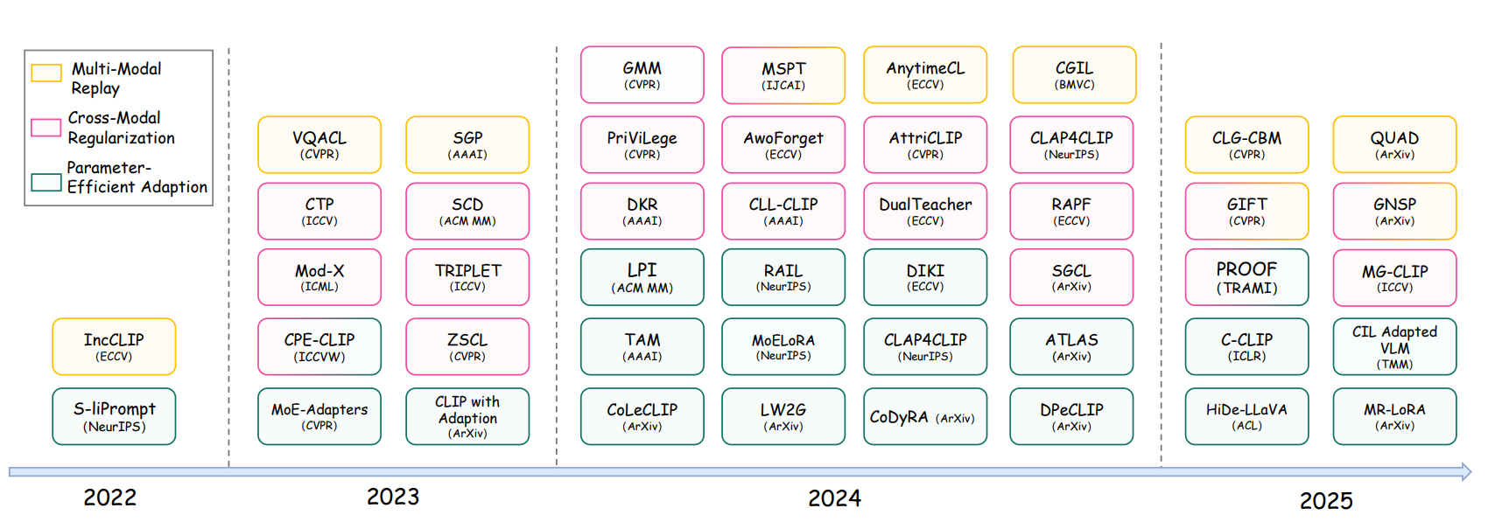
Evolution of Multimodal Continual Learning
Key developments leading to the methods evaluated in this thesis
Source: Liu, Yuyang, et al. (2024)
CPE-CLIP links layer-specific prompts by defining vision prompts as a function of language prompts.
ZSCL avoids alignment degeneration by matching the current model's cross-modal similarity with its initial state
C-CLIP and CoLeCLIP applied LoRA to the attention matrices inside Vision and language encoders.

Slide 9
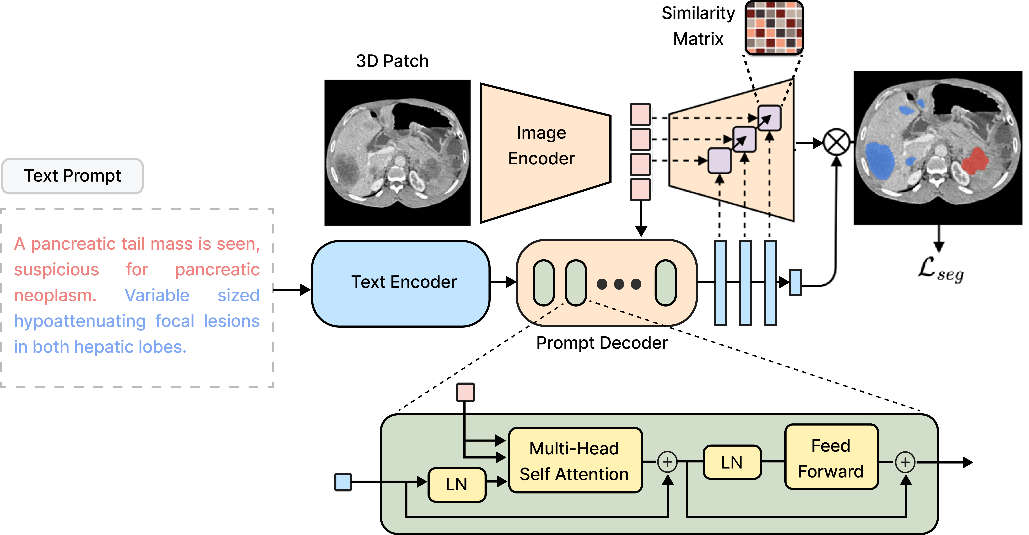
VoxTell Foundation Model
Free-text promptable 3D medical image segmentation architecture
Trained on 158 public sources with over 62k CT, MRI, and PET volumes spanning 1K+ anatomical and pathological classes
3D Vision-language model
Multi-stage vision–language fusion

Slide 10
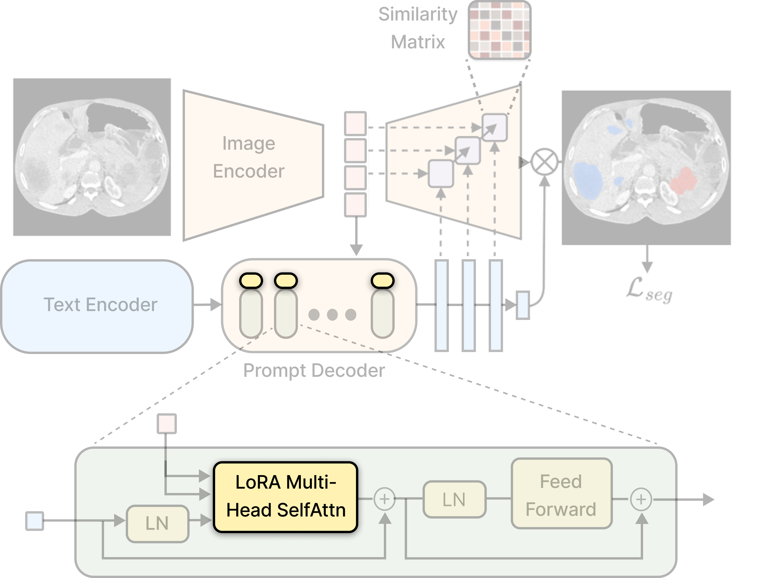
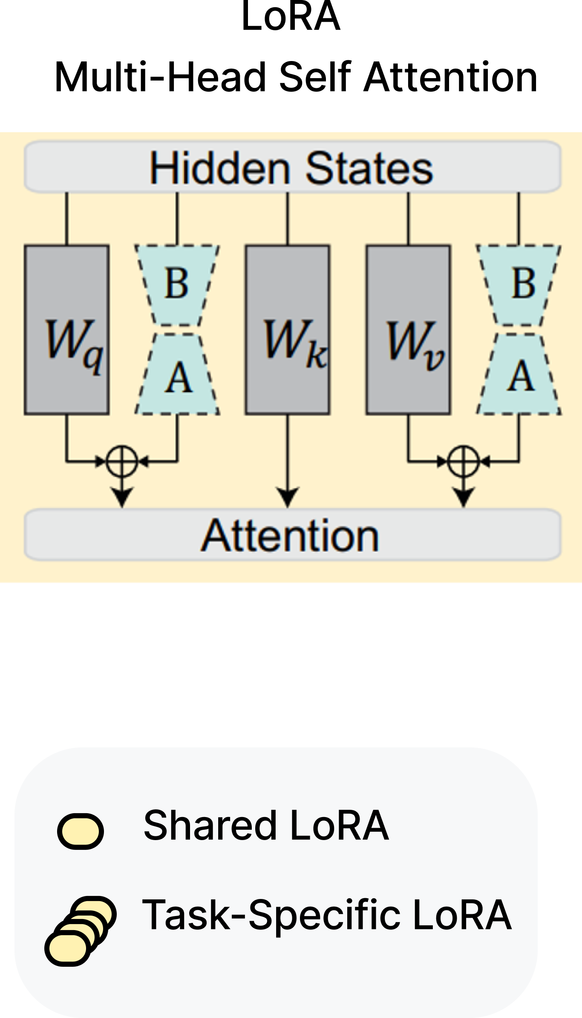
LoRA-based Continual Adaptation
Parameter-efficient adaptation of VoxTell using low-rank updates

Slide 11
Prompt-based Continual Adaptation
Prompt learning for continual adaptation of VoxTell

Slide 12
Regularisation-based Continual Adaptation
Knowledge-preserving optimization using Zero-Shot Continual Learning (ZSCL)

Slide 13
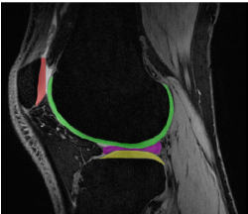
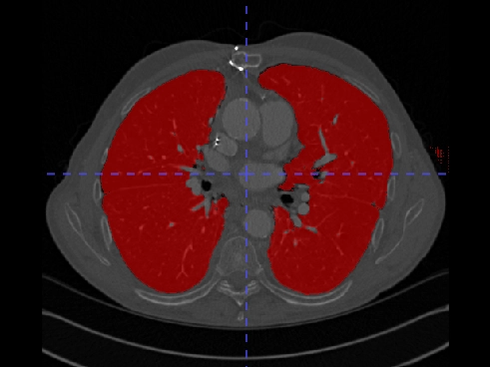
Datasets
Benchmark datasets for adaptation and retention evaluation
Training Dataset: Stanford Knee MRI Multi-Task Evaluation (SKM-TEA)
155 MRI knee scans with segmentations of six tissues as follows:
  Patellar Cartilage, Femoral Cartilage, Lateral Tibial Cartilage, Medial Meniscus, Lateral Meniscus, Medial Tibial Cartilage
~161 slices/volume on average (25,000 slices / 155 scans)
Source: Desai, Arjun D., et al. (2021)
Retention Dataset: AeroPath
27 CTs with corresponding airways and lung annotations
Used only Lung Annotations for the Retention Task

Slide 14
Experimental Protocol
Offline class-incremental benchmark and controlled training protocol
Continual Learning Task Order (SKM-TEA Dataset):
  Lateral Tibial → Medial Tibial → Femoral → Patellar → Medial Meniscus
Retention Task: AeroPath Dataset
Methods Compared:
Sequential Fine-tuning (baseline)
Task Incremental LoRA
Class Incremental LoRA (Shared LoRA)
Class Incremental LoRA with replay
Prompt-based
Regularisation-based
Configuration | Setting
Train / Val / Test Split | 108 / 23 / 24 volumes (Random)
Epochs | 10
Patch Size | 192 x 192 x 192

Slide 15
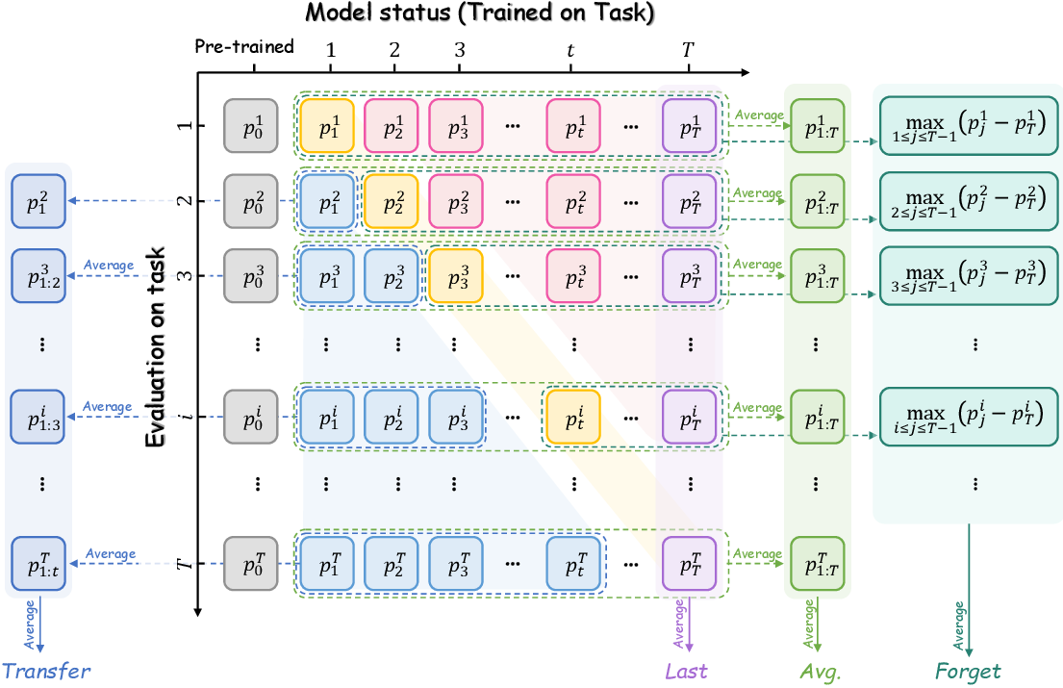
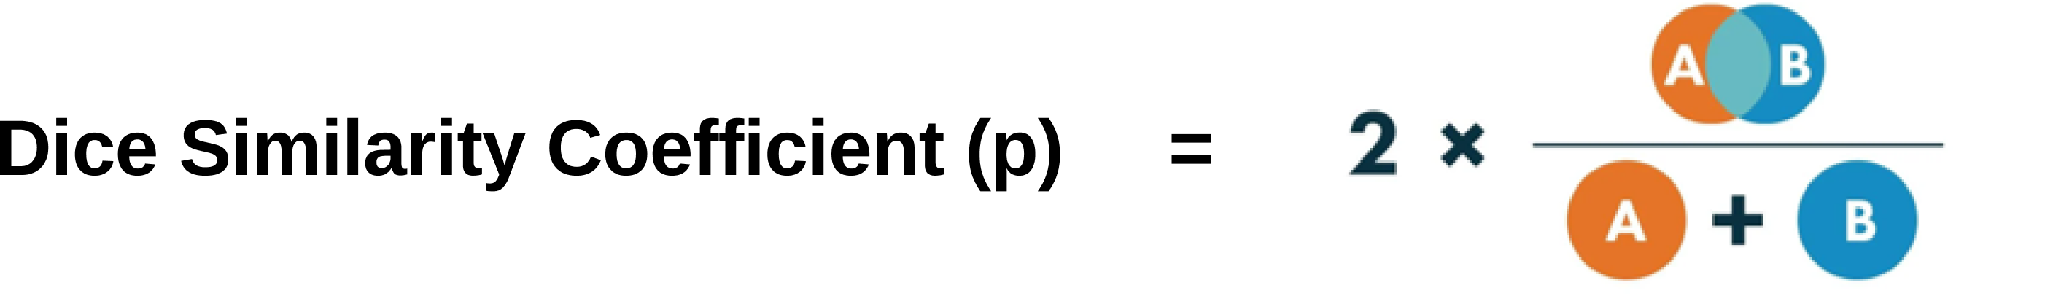
Evaluation Metrics
Quantifying adaptation, forgetting, transfer and retention drop
Metric | Measures | Goal
Dice Similarity Coefficient | Segmentation accuracy | ↑
Final Average Performance | Average Performance at the last task | ↑
Final Forgetting | Knowledge loss over time | ↓
Zero-Shot Transfer | Generalization to unseen tasks | ↑
Retention Drop | Degradation of pretrained capability | ↓
Source: Liu, Yuyang, et al. (2026)

Slide 16
Baseline Performance: Sequential Fine-Tuning
Establishing the reference for continual learning evaluation
✗
Task Order | Final Average Performance | Forgetting | Transfer | Retention Drop
Original | 0.130 | 0.812 | 0.002 | 1.0
Reverse | 0.135 | 0.794 | 0.002 | 1.0
High Forgetting
Poor Zero-shot Transfer
Poor Pre-trained Knowledge Retention
✗
✗

Slide 17
Task Incremental LoRA
TIL-LoRA has best performance but requires Task ID during Evaluation
✓
Zero Forgetting
High Performance at rank = 8
Full Pre-trained Knowledge Retention
Low Task Order Sensitivity (Nearly same results for Reverse order as well)
Requires Task ID during Evaluation
Storage space linearly scales with number of tasks (LoRA with rank=8 has 393k parameters)
✓
✓
✓
✗
✗

Slide 18
Class-Incremental LoRA
Shared LoRA Shows Severe Performance Collapse
Configuration | Final Average Performance | Forgetting | Transfer | Retention Drop
Fine-Tuning | 0.130 | 0.812 | 0.002 | 1.0
Rank 16 (Original) | 0.000 | 0.731 | 0.091 | 1.0
Rank 128 (Original) | 0.000 | 0.670 | 0.202 | 1.0
Rank 128 (Reverse) | 0.178 | 0.443 | 0.102 | 1.0
Rank 128 (Best Order) | 0.195 | 0.569 | 0.201 | 0.774
Key Findings:
Last-task degeneration
Strong task-order sensitivity
Increasing rank improves performance and transfer

Slide 19

CIL-LoRA Failure Analysis
Shared LoRA updates overwrite previous task knowledge, causing task interference
Dice coefficient heatmap evaluation matrix for CIL-LoRA (rank 128) with Original Task Order
 | Pretrained | Lateral Tibial | Medial Tibial | Femoral | Patellar | Medial Meniscus
Lateral Tibial | 0.000 | 0.426 | 0.296 | 0.108 | 0.001 | 0.000
Medial Tibial | 0.000 | 0.240 | 0.537 | 0.175 | 0.001 | 0.000
Femoral | 0.684 | 0.638 | 0.410 | 0.734 | 0.006 | 0.000
Patellar | 0.000 | 0.001 | 0.000 | 0.001 | 0.984 | 0.000
Medial Meniscus | 0.000 | 0.041 | 0.043 | 0.082 | 0.001 | 0.000
Aeropath (Retention) | 0.979 | 0.974 | 0.881 | 0.957 | 0.219 | 0.000
$$\frac{{\left\|ΔW\right\|}_{F}}{{\left\|W\right\|}_{F}}$$
Original
Reverse

Slide 20
Replay-based Mitigation of CIL LoRA Interference
Reducing parameter drift by preserving previous task information
✓
Eliminates Last-task degeneration
✓
Reduces Forgetting
✓
Improves Pre-trained Knowledge Retention
✗
Slight decrease in Transfer
Task Order | Final Average Performance | Forgetting | Transfer | Retention Drop
Original | 0.353 | 0.363 | 0.129 | 0.545
Reverse | 0.516 | 0.158 | 0.114 | 0.255

Slide 21
Evaluation of Alternative Continual Learning Strategies
Prompt-based and regularisation-based approaches provide limited improvement over fine-tuning
Configuration | Final Average Performance | Forgetting | Transfer | Retention Drop
Fine-Tuning | 0.130 | 0.812 | 0.002 | 1.0
Prompt-based | 0.115 | 0.753 | 0.044 | 1.0
Regularisation-based | 0.110 | 0.837 | 0.015 | 1.0
✓
Prompt-based adaptation provides marginal improvement over fine-tuning
✗
Regularisation-based approach does not prevent forgetting in this setting

Slide 22
Few-Shot Adaptation: Evaluating the Best Trade-off
Replay mitigates forgetting in the task-agnostic setting, but few-shot adaptation remains challenging

Slide 23
Overall Comparison of Continual Learning Approaches
Trade-off between performance, retention, and parameter efficiency across approaches
TIL-LoRA:
Best performance,
but requires task-specific adapters
CIL-LoRA:
Suffers from interference
CIL-LoRA + Replay:
Closes the gap while maintaining a shared adapter

Slide 24
Limitations & Future Work
Limitations:
Few-shot CIL remains challenging
Limited replay exploration
Limited task and sequence diversity
Computational constraints limited broader hyperparameter exploration
Future Work:
Improve few-shot CIL adaptation: Investigate replay strategies specifically designed for highly data-constrained adaptation.
Adaptive replay strategies: Dynamic allocation of replay samples rather than using a fixed replay fraction
Larger and more diverse task sequences
Explore adaptive LoRA allocation, dynamic adapters, or mixture-of-LoRA approaches

Slide 25
Conclusion
Key Findings:
TIL-LoRA: Strong adaptation and no forgetting, but requires task ID.
CIL-LoRA: Task-ID independent, but suffers from severe interference and forgetting.
CIL-LoRA + Replay: Best adaptation–retention trade-off in the full-data setting.
Few-shot CIL: Replay improves retention but does not maintain strong adaptation performance.
Answer to Research Question
Parameter-efficient adaptation combined with replay is a promising approach for task-ID-independent continual adaptation of free-text promptable 3D medical segmentation models, but further work is required to achieve robust few-shot performance. <Mention the further work>

Slide 26
Thank you
For your Attention!

Slide 27
Baseline Performance: Sequential Fine-Tuning
Establishing the reference for continual learning evaluation
Full-dataset baseline results: Dice coefficient heatmap matrix for sequential fine-tuning across trained (rows) and tested (columns) tasks.
Train / Test | Pretrained | Lateral Tibial Cartilage | Medial Tibial Cartilage | Femoral Cartilage | Patellar Cartilage | Medial Meniscus
Lateral Tibial Cartilage | 0 | 0.712 | 0.007 | 0.003 | 0.000 | 0
Medial Tibial Cartilage | 0 | 0 | 0.803 | 0.004 | 0.000 | 0.008
Femoral Cartilage | 0.684 | 0.001 | 0.003 | 0.752 | 0.002 | 0.003
Patellar Cartilage | 0.000 | 0.001 | 0.000 | 0.003 | 0.993 | 0.000
Medial Meniscus | 0 | 0 | 0.015 | 0.003 | 0.001 | 0.641
Aeropath (Retention) | 0.979 | 0.002 | 0.001 | 0.006 | 0.217 | 0.000
A_{Medial Meniscus} = 0.13
F_{Medial Meniscus} = 0.812
Avg. Transfer = 0.002
Avg Retention Drop = 0.934

Slide 28
Baseline Performance: Sequential Fine-Tuning
Establishing the reference for continual learning evaluation
Full-dataset baseline results: Dice coefficient heatmap matrix for sequential fine-tuning across trained (rows) and tested (columns) tasks (Reversed)
Train / Test | Pretrained | Medial Meniscus | Patellar Cartilage | Femoral Cartilage | Medial Tibial Cartilage | Lateral Tibial Cartilage
Medial Meniscus | 0.000 | 0.814 | 0.000 | 0.001 | 0.014 | 0.000
Patellar Cartilage | 0.000 | 0.000 | 0.998 | 0.003 | 0.001 | 0.001
Femoral Cartilage | 0.684 | 0.003 | 0.002 | 0.707 | 0.002 | 0.008
Medial Tibial Cartilage | 0.000 | 0.011 | 0.000 | 0.001 | 0.670 | 0.002
Lateral Tibial Cartilage | 0.000 | 0.000 | 0.000 | 0.002 | 0.006 | 0.666
Aeropath (Retention) | 0.979 | 0.000 | 0.261 | 0.000 | 0.000 | 0.000
A_{Medial Meniscus} = 0.135
F_{Medial Meniscus} = 0.794
Avg. Transfer = 0.002
Avg Retention Drop = 0.927

Slide 29
Task Incremental LoRA CL Performance
Evaluation matrix and results for Task-specific LoRA for Voxtell
Dice coefficient heatmap matrix for Task Specific LoRA (rank=8) CL across trained (rows) and tested (columns) tasks
Train / Test | Pretrained | Lateral Tibial Cartilage | Medial Tibial Cartilage | Femoral Cartilage | Patellar Cartilage | Medial Meniscus
Lateral Tibial Cartilage | 0.000 | 0.523 | 0.090 | 0.000 | 0.001 | 0.002
Medial Tibial Cartilage | 0.000 | 0.261 | 0.516 | 0.001 | 0.001 | 0.093
Femoral Cartilage | 0.684 | 0.598 | 0.488 | 0.748 | 0.006 | 0.619
Patellar Cartilage | 0.000 | 0.000 | 0.000 | 0.000 | 0.980 | 0.000
Medial Meniscus | 0.000 | 0.029 | 0.077 | 0.000 | 0.001 | 0.526
Aeropath (Retention) | 0.979 | 0.925 | 0.899 | 0.980 | 0.229 | 0.915
A_{Medial Meniscus} = 0.248
F_{Medial Meniscus} = 0.513
Avg. Transfer = 0.208
Avg Retention Drop = 0.190

Slide 30
Task Incremental LoRA CL Performance
Evaluation matrix and results for Task-specific LoRA for Voxtell
Dice coefficient heatmap matrix for Task Specific LoRA (rank=128) CL across trained (rows) and tested (columns) tasks
Train / Test | Pretrained | Lateral Tibial Cartilage | Medial Tibial Cartilage | Femoral Cartilage | Patellar Cartilage | Medial Meniscus
Lateral Tibial Cartilage | 0.000 | 0.024 | 0.020 | 0.000 | 0.001 | 0.014
Medial Tibial Cartilage | 0.000 | 0.024 | 0.198 | 0.000 | 0.001 | 0.077
Femoral Cartilage | 0.684 | 0.696 | 0.683 | 0.714 | 0.006 | 0.687
Patellar Cartilage | 0.000 | 0.000 | 0.001 | 0.000 | 0.987 | 0.000
Medial Meniscus | 0.000 | 0.003 | 0.024 | 0.000 | 0.001 | 0.198
Aeropath (Retention) | 0.979 | 0.979 | 0.979 | 0.981 | 0.220 | 0.976
A_{Medial Meniscus} = 0.195
F_{Medial Meniscus} = 0.286
Avg. Transfer = 0.180
Avg Retention Drop = 0.152

Slide 31
Task Incremental LoRA CL Performance
Evaluation matrix and results for Task-specific LoRA for Voxtell
Dice coefficient heatmap matrix for Task Specific LoRA CL across trained (rows) and tested (columns) tasks (Reversed)
Train / Test | Pretrained | Medial Meniscus | Patellar Cartilage | Femoral Cartilage | Medial Tibial Cartilage | Lateral Tibial Cartilage
Medial Meniscus | 0.000 | 0.512 | 0.001 | 0.000 | 0.077 | 0.029
Patellar Cartilage | 0.000 | 0.000 | 0.980 | 0.000 | 0.000 | 0.000
Femoral Cartilage | 0.684 | 0.644 | 0.006 | 0.748 | 0.488 | 0.490
Medial Tibial Cartilage | 0.000 | 0.105 | 0.001 | 0.001 | 0.516 | 0.241
Lateral Tibial Cartilage | 0.000 | 0.003 | 0.001 | 0.000 | 0.090 | 0.599
Aeropath (Retention) | 0.979 | 0.960 | 0.229 | 0.980 | 0.899 | 0.943
A_{Medial Meniscus} = 0.271
F_{Medial Meniscus} = 0.499
Avg. Transfer = 0.096
Avg Retention Drop = 0.177

Slide 32
Class Incremental Shared LoRA CL Performance
Evaluation matrix and results for Task-specific LoRA for Voxtell
Full-dataset baseline results: Dice coefficient heatmap matrix for Shared LoRA (rank=16) across trained (rows) and tested (columns) tasks.
Train / Test | Pretrained | Lateral Tibial Cartilage | Medial Tibial Cartilage | Femoral Cartilage | Patellar Cartilage | Medial Meniscus
Lateral Tibial Cartilage | 0.000 | 0.671 | 0.446 | 0.114 | 0.001 | 0.000
Medial Tibial Cartilage | 0.000 | 0.142 | 0.510 | 0.137 | 0.001 | 0.000
Femoral Cartilage | 0.684 | 0.274 | 0.120 | 0.755 | 0.005 | 0.000
Patellar Cartilage | 0.000 | 0.000 | 0.000 | 0.001 | 0.988 | 0.000
Medial Meniscus | 0.000 | 0.010 | 0.021 | 0.060 | 0.001 | 0.000
Aeropath (Retention) | 0.979 | 0.197 | 0.034 | 0.630 | 0.224 | 0.000
A_{Medial Meniscus} = 0.0
F_{Medial Meniscus} = 0.731
Avg. Transfer = 0.091
Avg Retention Drop = 0.762

Slide 33
Class Incremental Shared LoRA CL Performance
Evaluation matrix and results for Task-specific LoRA for Voxtell
Full-dataset baseline results: Dice coefficient heatmap matrix for Shared LoRA (rank=32) across trained (rows) and tested (columns) tasks.
Train / Test | Pretrained | Lateral Tibial Cartilage | Medial Tibial Cartilage | Femoral Cartilage | Patellar Cartilage | Medial Meniscus
Lateral Tibial Cartilage | 0.000 | 0.654 | 0.437 | 0.128 | 0.001 | 0.000
Medial Tibial Cartilage | 0.000 | 0.163 | 0.511 | 0.140 | 0.001 | 0.000
Femoral Cartilage | 0.684 | 0.448 | 0.178 | 0.771 | 0.006 | 0.000
Patellar Cartilage | 0.000 | 0.000 | 0.000 | 0.001 | 0.975 | 0.000
Medial Meniscus | 0.000 | 0.021 | 0.038 | 0.075 | 0.001 | 0.000
Aeropath (Retention) | 0.979 | 0.712 | 0.257 | 0.868 | 0.238 | 0.000
A_{Medial Meniscus} = 0.0
F_{Medial Meniscus} = 0.728
Avg. Transfer = 0.128
Avg Retention Drop = 0.564

Slide 34
Class Incremental Shared LoRA CL Performance
Evaluation matrix and results for Task-specific LoRA for Voxtell
Full-dataset baseline results: Dice coefficient heatmap matrix for Shared LoRA (rank=64) across trained (rows) and tested (columns) tasks.
Train / Test | Pretrained | Lateral Tibial Cartilage | Medial Tibial Cartilage | Femoral Cartilage | Patellar Cartilage | Medial Meniscus
Lateral Tibial Cartilage | 0.000 | 0.545 | 0.314 | 0.104 | 0.001 | 0.000
Medial Tibial Cartilage | 0.000 | 0.254 | 0.544 | 0.151 | 0.001 | 0.000
Femoral Cartilage | 0.684 | 0.596 | 0.247 | 0.740 | 0.006 | 0.000
Patellar Cartilage | 0.000 | 0.000 | 0.000 | 0.001 | 0.978 | 0.000
Medial Meniscus | 0.000 | 0.032 | 0.030 | 0.086 | 0.001 | 0.000
Aeropath (Retention) | 0.979 | 0.952 | 0.572 | 0.928 | 0.221 | 0.000
A_{Medial Meniscus} = 0.0
F_{Medial Meniscus} = 0.702
Avg. Transfer = 0.178
Avg Retention Drop = 0.445

Slide 35
Class Incremental Shared LoRA CL Performance
Evaluation matrix and results for Task-specific LoRA for Voxtell
Full-dataset baseline results: Dice coefficient heatmap matrix for Shared LoRA (rank=128) across trained (rows) and tested (columns) tasks.
Train / Test | Pretrained | Lateral Tibial Cartilage | Medial Tibial Cartilage | Femoral Cartilage | Patellar Cartilage | Medial Meniscus
Lateral Tibial Cartilage | 0.000 | 0.426 | 0.296 | 0.108 | 0.001 | 0.000
Medial Tibial Cartilage | 0.000 | 0.240 | 0.537 | 0.175 | 0.001 | 0.000
Femoral Cartilage | 0.684 | 0.638 | 0.410 | 0.734 | 0.006 | 0.000
Patellar Cartilage | 0.000 | 0.001 | 0.000 | 0.001 | 0.984 | 0.000
Medial Meniscus | 0.000 | 0.041 | 0.043 | 0.082 | 0.001 | 0.000
Aeropath (Retention) | 0.979 | 0.974 | 0.881 | 0.957 | 0.219 | 0.000
A_{Medial Meniscus} = 0.0
F_{Medial Meniscus} = 0.670
Avg. Transfer = 0.202
Avg Retention Drop = 0.373

Slide 36
Class Incremental Prompt based CL Performance
Evaluation matrix and results for prompt-based learning for Voxtell
Dice coefficient heatmap matrix for Prompt based CL across trained (rows) and tested (columns) tasks.
Train / Test | Pretrained | Lateral Tibial Cartilage | Medial Tibial Cartilage | Femoral Cartilage | Patellar Cartilage | Medial Meniscus
Lateral Tibial Cartilage | 0.000 | 0.727 | 0.337 | 0.100 | 0.001 | 0.029
Medial Tibial Cartilage | 0.000 | 0.096 | 0.564 | 0.118 | 0.001 | 0.014
Femoral Cartilage | 0.684 | 0.105 | 0.029 | 0.774 | 0.004 | 0.004
Patellar Cartilage | 0.000 | 0.000 | 0.000 | 0.002 | 0.995 | 0.001
Medial Meniscus | 0.000 | 0.016 | 0.016 | 0.011 | 0.001 | 0.525
Aeropath (Retention) | 0.979 | 0.261 | 0.028 | 0.036 | 0.243 | 0.000
A_{Medial Meniscus} = 0.114
F_{Medial Meniscus} = 0.753
Avg. Transfer = 0.043
Avg Retention Drop = 0.866

Slide 37
Class Incremental Prompt based CL Performance
Evaluation matrix and results for prompt-based learning for Voxtell
Dice coefficient heatmap matrix for Prompt based CL across trained (rows) and tested (columns) tasks (Reversed)
Train / Test | Pretrained | Medial Meniscus | Patellar Cartilage | Femoral Cartilage | Medial Tibial Cartilage | Lateral Tibial Cartilage
Medial Meniscus | 0.000 | 0.621 | 0.001 | 0.003 | 0.013 | 0.019
Patellar Cartilage | 0.000 | 0.000 | 0.995 | 0.002 | 0.001 | 0.001
Femoral Cartilage | 0.684 | 0.350 | 0.005 | 0.754 | 0.062 | 0.013
Medial Tibial Cartilage | 0.000 | 0.021 | 0.001 | 0.027 | 0.289 | 0.341
Lateral Tibial Cartilage | 0.000 | 0.004 | 0.001 | 0.010 | 0.265 | 0.468
Aeropath (Retention) | 0.979 | 0.069 | 0.249 | 0.000 | 0.000 | 0.000
A_{Medial Meniscus} = 0.168
F_{Medial Meniscus} = 0.571
Avg. Transfer = 0.066
Avg Retention Drop = 0.916

Slide 38
Class Incremental Regularisation based CL
Evaluation matrix and results for regularisation-based learning for Voxtell
Dice coefficient heatmap matrix for Regularisation based CL across trained (rows) and tested (columns) tasks.
Train / Test | Pretrained | Lateral Tibial Cartilage | Medial Tibial Cartilage | Femoral Cartilage | Patellar Cartilage | Medial Meniscus
Lateral Tibial Cartilage | 0.000 | 0.771 | 0.019 | 0.004 | 0.000 | 0.001
Medial Tibial Cartilage | 0.000 | 0.045 | 0.780 | 0.003 | 0.000 | 0.005
Femoral Cartilage | 0.684 | 0.014 | 0.003 | 0.810 | 0.002 | 0.002
Patellar Cartilage | 0.000 | 0.000 | 0.000 | 0.001 | 0.996 | 0.002
Medial Meniscus | 0.000 | 0.000 | 0.012 | 0.001 | 0.001 | 0.540
Aeropath (Retention) | 0.979 | 0.000 | 0.001 | 0.001 | 0.253 | 0.000
A_{Medial Meniscus} = 0.110
F_{Medial Meniscus} = 0.837
Avg. Transfer = 0.014
Avg Retention Drop = 0.928

Slide 39
Next Steps
Set the correct focus – Task-Incremental or Class-Incremental or both
Ensure we do not need any further change in the method implementation
Hyperparameter Ablations
Task order Ablations
Selecting the best configuration
Few-shot evaluation (1 / 5 / 10 training samples)
Analysis and Discussion
Reliable implementations
↓
Hyperparameter ablations
↓
Select best configuration
↓
Few-shot evaluation
↓
Analysis and discussion

