Slide 1

What does Encapsulation Mean?
In Java, encapsulation means hiding things, by making them private, or inaccessible.
COMPLETE JAVA MASTERCLASS
Encapsulation, Part 1

Slide 2
Why hide things?
Why would we want to hide things in Java?
To make the interface simpler, we may want to hide unnecessary details.
To protect the integrity of data on an object, we may hide or restrict access to some of the data and operations.
To decouple the published interface from the internal details of the class, we may hide actual names and types of class members.
COMPLETE JAVA MASTERCLASS
Encapsulation, Part 1

Slide 3
What do we mean by interface here?
Although Java has a type called interface, that's not what we're talking about here.
When we talk about a class's public or published interface, we're really talking about the class members that are exposed to, or can be accessed by, the calling code.
Everything else in the class is internal, or private to it.
An application programming interface, or API, is the public contract, that tells others how to use the class.
COMPLETE JAVA MASTERCLASS
Encapsulation, Part 1

Slide 4
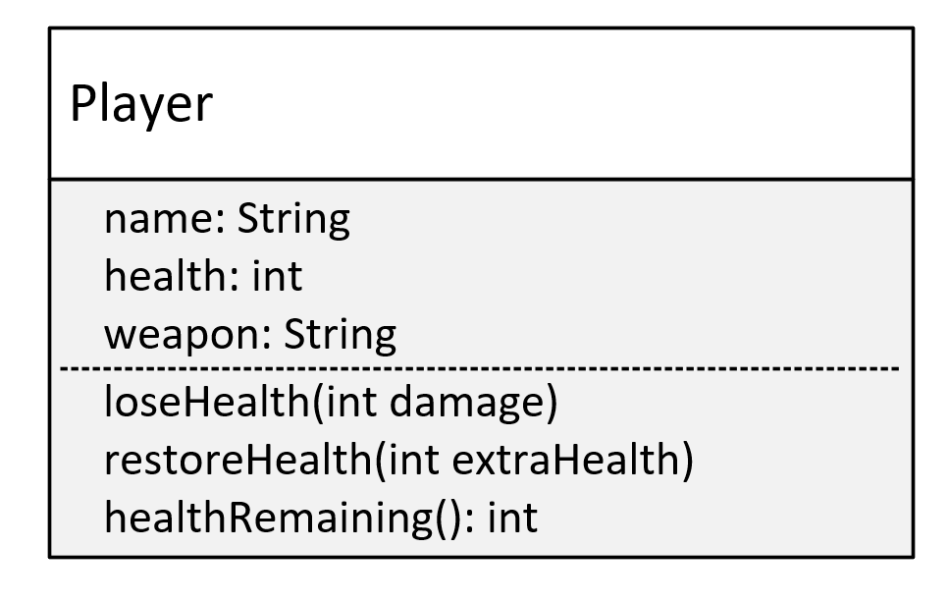
The Player Class
This is the model for a Player class.
The Player will have three variables: name, health, and weapon.
And this class will have three methods, loseHealth(), restoreHealth(), and healthRemaining(), which I'll explain in a bit.
And we're going to create this class without using encapsulation.
COMPLETE JAVA MASTERCLASS
Encapsulation, Part 1

Slide 5
Problem One
Allowing direct access to data on an object, can potentially bypass checks, and additional processing, your class has in place to manage the data.
COMPLETE JAVA MASTERCLASS
Encapsulation, Part 1

Slide 6
Problem Two
Allowing direct access to fields, means calling code would need to change, when you edit any of the fields.
COMPLETE JAVA MASTERCLASS
Encapsulation, Part 1

Slide 7
Problem Three
Omitting a constructor, that would accept initialization data, may mean the calling code is responsible for setting up this data, on the new object.
COMPLETE JAVA MASTERCLASS
Encapsulation, Part 1

