Slide 1
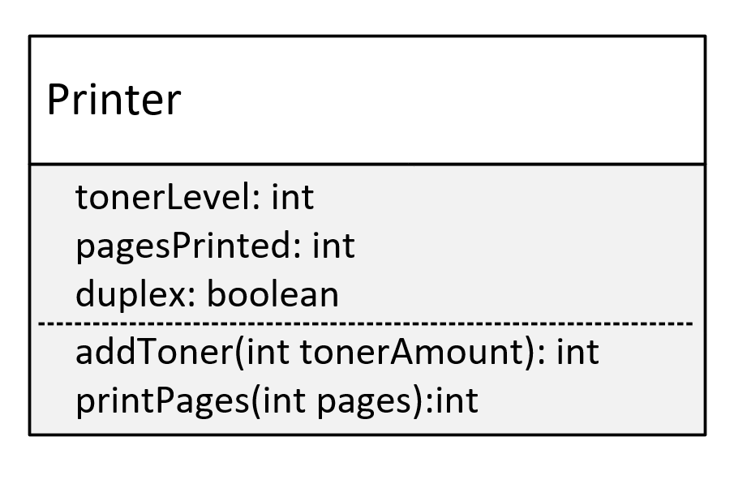

Encapsulation Challenge
In this challenge, you need to create a class named Printer.
The fields on this class are going to be:
tonerLevel, which is the percentage of how much toner level is left.
pagesPrinted, which is the count of total pages printed by the Printer.
duplex, which is a boolean indicator. If true, it can print on 2 sides of a single sheet of paper.
You'll want to initialize your printer, by specifying a starting toner amount, and whether the printer is duplex or not.
COMPLETE JAVA MASTERCLASS
Encapsulation Challenge

Slide 2
Encapsulation Challenge
On the Printer class, you want to create two methods, which the calling code should be able to access.
These methods are:
addToner() which takes a tonerAmount argument.
tonerAmount is added to the tonerLevel field.
The tonerLevel should never exceed 100 percent, or ever get below 0 percent.
If the amount being added makes the level fall outside that range, return a -1 from the method, otherwise return the actual toner level.
COMPLETE JAVA MASTERCLASS
Encapsulation Challenge

Slide 3
Encapsulation Challenge
printPages() which should take pages to be printed as the argument.
It should determine how many sheets of paper, will be printed based on the duplex value, and return this sheet number from the method.
The sheet number should also be added to the pagesPrinted variable.
If it's a duplex printer, print a message that it's a duplex printer.
COMPLETE JAVA MASTERCLASS
Encapsulation Challenge

