Slide 1

Polymorphism
Simply stated, polymorphism, means many forms.
How does this apply to code?
COMPLETE JAVA MASTERCLASS
Polymorphism, Part 1

Slide 2
Polymorphism
Polymorphism lets us write code to call a method, but at runtime, this method's behavior can be different, for different objects.
This means the behavior that occurs, while the program is executing, depends on the runtime type of the object.
And the runtime type, might be different from the declared type in the code.
The declared type has to have some kind of relationship to the runtime type, and inheritance is one way to establish this relationship.
There are other ways, but in this video, we'll talk about how to use inheritance, to support polymorphism.
COMPLETE JAVA MASTERCLASS
Polymorphism, Part 1

Slide 3
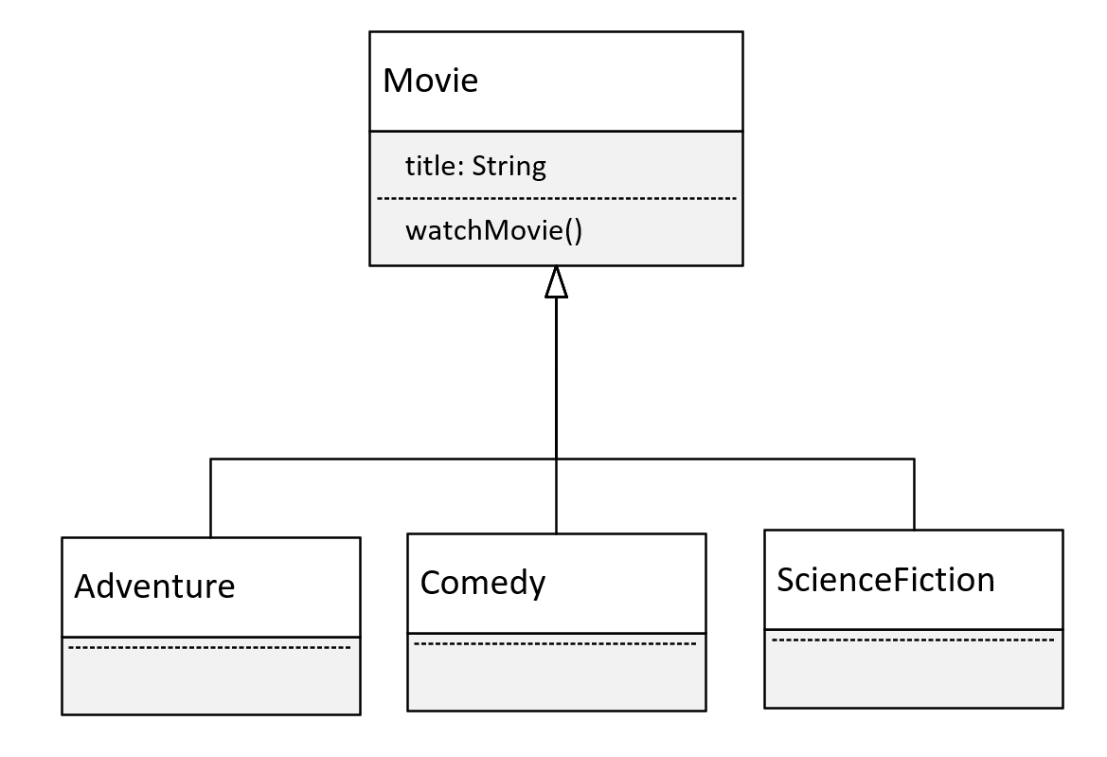
Movie Genres
This time, we're going to look at a polymorphism example, using movies.
We'll have a base class of Movie, which has the title of the movie.
And Movie will have one method, watchMovie.
COMPLETE JAVA MASTERCLASS
Polymorphism, Part 1

Slide 4
Movie Genres
We'll have 3 subclasses, each a different kind of movie.
We'll have an Adventure film, a Comedy, and a Science Fiction movie.
These are the different categories, so we'll use these as the subclasses.
All of these will override, and implement unique behavior, for the watchMovie method.
COMPLETE JAVA MASTERCLASS
Polymorphism, Part 1

