Slide 1


Scripting

Slide 2

PowerShell
An object-oriented automation engine and scripting language

Slide 3
agenda
What is PS
Power of PS
Getting help in PS
Difference between PS and Command language
Features as a language
Interesting examples
Function & Parameters
Module
PowerShell library
VS code Support

Slide 4
intro
PowerShell is a cross-platform task automation solution made up of a command-line shell, a scripting language, and a configuration management framework. PowerShell runs on Windows, Linux, and macOS.
Windows PowerShell is an object-oriented automation engine and scripting language.
Designed mainly for IT professionals and system administrators to control & automate the administration of Windows OS and other applications
PowerShell first version 1.0 was released in 2006. Today, PowerShell is at version 7.1.

Slide 5
As a script
As a scripting language, PowerShell is commonly used for automating the management of systems. It is also used to build, test, and deploy solutions, often in CI/CD environments. PowerShell is built on the .NET Common Language Runtime (CLR). All inputs and outputs are .NET objects. No need to parse text output to extract information from output.
The PowerShell scripting language includes the following features:
Extensible through functions, classes, scripts, and modules
Extensible formatting system for easy output
Extensible type system for creating dynamic types
Built-in support for common data formats like CSV, JSON, and XML

Slide 6
PowerShell vs command
PowerShell | Command Prompt
PowerShell deeply integrates with the Windows OS. It offers an interactive command line interface and scripting language. | Command Prompt is a default command line interface which provided by Microsoft. It is a simple win32 application that can interact and talk with any win32 objects in the Windows operating system.
PowerShell uses what are known as cmdlets. It can be invoked either in the runtime environment or the automation scripts. | No such features offer by command prompt.
PowerShell considers them as objects. So the output can be passed as an input to other cmdlets through the pipeline. | The output generated from Command Prompt command are just a stream of text but not collection of objects.
The PowerShell is very advanced regarding features, capabilities and inner functioning. | Command prompt is very basic.

Slide 7
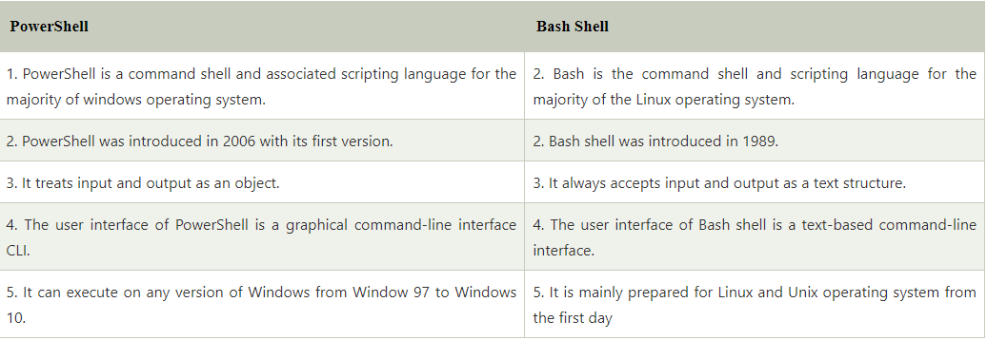
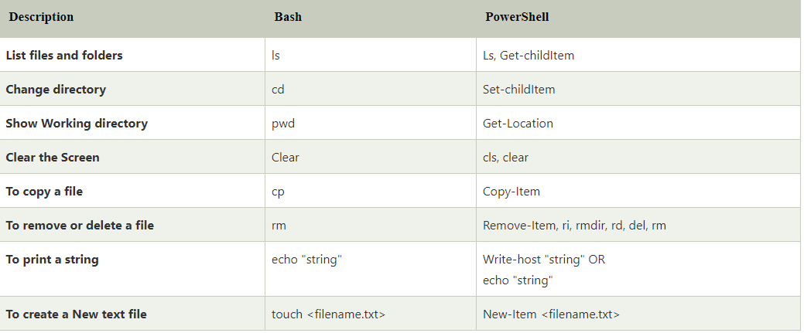
Difference between PowerShell and bash

Slide 8
Power of PowerShell
PowerShell allows complete access to all of the types in the .NET framework
Trusted by system administrators.
PowerShell is a simple way to manipulate server and workstation components
It's geared toward system administrators by creating an easier syntax
PowerShell scripts are really powerful and could do much stuff in fewer lines.
Variables are declared in the form $<variable>
Variables could be used to hold the output of command, objects, and values.
"Type" of a variable need not be specified.

Slide 9
cmdlet
Commands for PowerShell are known as cmdlets
Cmdlets are collected into PowerShell modules that can be loaded on demand.
Cmdlets can be written in any compiled .NET language or in the PowerShell scripting language itself.
Cmdlets are .NET Framework class objects
Cmdlets can construct from as few as a dozen lines of code
Cmdlets process works on objects.
Cmdlets are record-based as so it processes a single object at a time
Most of the PowerShell functionality comes from Cmdlet's which is always in verb-noun format and not plural.
Moreover, Cmdlet's return objects not text. A cmdlet is a series of commands, which is more than one line, stored in a text file with a .ps1 extension.

Slide 10
PowerShell verb
A cmdlet always consists of a verb and a noun, separated with a hyphen. Some of the verbs used in PowerShell is:
Get — To get something
Start — To run something
Out — To output something
Stop — To stop something that is running
New — To create something

Slide 11
Begin PowerShell
Load PowerShell Prompt
Start > Run = powershell
Get Version
(get-host).version
(get-host).version
Get all running processes
Get-Process
Start a process
Start-process calc
Get a Process
Get-Process –name Calculator
Get the process and stop
stop-process (get-process -name calculator) OR
(get-process -name calculator).kill()

Slide 12
PowerShell help command
Get Help on commands
get-help -name start-process
get-help -name *-process
get-help -name get-command
get-help -name write-verbose
To see the examples, type: "get-help New-Module -examples".
For more information, type: "get-help New-Module -detailed".
For technical information, type: "get-help New-Module -full".
For online help, type: "get-help New-Module -online"

Slide 13
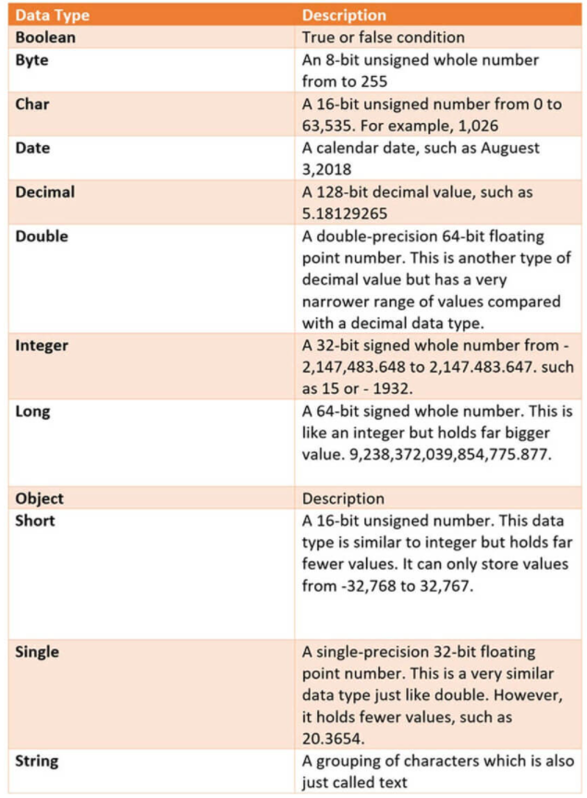
datatypes

Slide 14
Special variables
Variable can be created with “$” prefix. Data type is optional to specify.
$FName = “power”
$Lname = “shell”
“$LName , $FName”
Special Variable | Description
$Error | An array of error objects which display the most recent errors
$Host | Display the name of the current hosting application
$Profile | Stores entire path of a user profile for the default shell
$PID | Stores the process identifier
$PSUICulture | It holds the name of the current UI culture.
$NULL | Contains empty or NULL value.
$False | Contains FALSE value
$True | Contains TRUE value

Slide 15
Execution Policy
Restricted— No scripts are allowed. This is the default setting, so it will display first time when you run the command.
AllSigned— You can run scripts signed by a trusted developer. With the help of this setting, a script will ask for confirmation that you want to run it before executing.
RemoteSigned— You can run your or scripts signed by a trusted developer.
Unrestricted— You can run any script which you wants to run
Get-ExecutionPolicy
Set-executionpolicy unrestricted
Enter Y in the prompt
Get-ExecutionPolicy

Slide 16
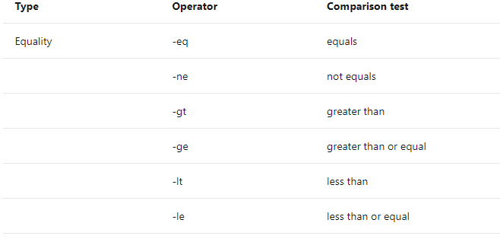
operators
($a -gt $b) -and (($a -lt 20) -or ($b -lt 20))

Slide 17
Find computer in the network and ping to test connection
$computers = 'ais-stage01', 'ais-stage02','dmqdb1'
foreach($computer in $computers)
{
write-host 'pinging....' $computer
#ping one time the computer and then select ipaddress of the computer
Test-Connection $computer -count 1 #| select address,ipvaddress
}
Notes:
//Loop
$num = 1..10
foreach($n in $num)
{
$res = $n*5
Write-Host $res
}
//If and Try catch
try
{
write-host ‘starting clculator’
start-process calc
if(!(get-process -name calculator))
{
$c = get-process -name calculator
$c1.kill()
'process closed'
}
else
{
write-warning ‘Calculator not found'
}
}
catch
{
write-error 'Exception killing [$c]’
}
//TO Run
.\psfilename.ps1

Slide 18
Guess game!!
$number = Get-Random -Minimum 1 -Maximum 10
do {
$guess = Read-Host -Prompt "your guess?"
if ($guess -lt $number) {
Write-Output 'low guess!'
}
elseif ($guess -gt $number) {
Write-Output 'high guess!'
}
}
until ($guess -eq $number)

Slide 19
Cmdlets | Cmdlet are build-command written in .net languages like VB or C#. It allows developers to extend the set of cmdlets by loading and write PowerShell snap-ins.
Functions | Functions are commands which is written in the PowerShell language. It can be developed without using other IDE like Visual Studio and devs.
Scripts | Scripts are text files on disk with a .ps1 extension
Applications | Applications are existing windows programs.
What if | Tells the cmdlet not to execute, but to tell you what would happen if the cmdlet were to run.
Confirm | Instruct the cmdlet to prompt before executing the command.
Verbose | Gives a higher level of detail.
Debug | Instructs the cmdlet to provide debugging information.
ErrorAction | Instructs the cmdlet to perform a specific action when an error occurs. Allowed actions continue, stop, silently- continue and inquire.
ErrorVariable | It specifies the variable which holds error information.
OutVariable | Tells the cmdlet to use a specific variable to hold the output information
OutBuffer | Instructs the cmdlet to hold the specific number of objects before calling the next cmdlet in the pipeline.

Slide 20
function
If you're writing PowerShell one-liners or scripts and find yourself often having to modify them for different scenarios, there's a good chance that it's a good candidate to be turned into a function that can be reused.
Using the PowerShellGet module, it's easy to share those modules in a NuGet repository.
When naming your functions in PowerShell, use a Pascal case name with an approved verb and a singular noun.
In owerShell, there's a specific list of approved verbs that can be obtained by running Get-Verb
Get-Verb | Sort-Object -Property Verb
To check if function is loaded into memory or not
Get-ChildItem -Path Function:\Check-ServiceHealth
To get Syntax or Parameters detail of a function
Get-Command –Name Check-ServiceHealth –Syntax
(Get-Command –Name Check-ServiceHealth).Parameters
Notes:
Get-Verb | Sort-Object -Property Verb
Get-ChildItem -Path Function:\Check-ServiceHealth

Slide 21
Advance function
[CmdletBinding()] #<<-- This turns a regular function into an advanced function
[CmdletBinding(SupportsShouldProcess)] #SupportsShouldProcess adds WhatIf and Confirm parameters.
Mandatory Parameter
Optional Parameter
Parameter from Pipeline
Verbose
Debug
ErrorAction
WarningAction
InformationAction
ErrorVariable
WarningVariable
InformationVariable
OutVariable
OutBuffer
PipelineVariable

Slide 22
Dot sourcing
Way to keep your functions modular
.\script.ps1
This creates a child scope for the script however once the script completes any objects create are discarded, for example any variables created.
Alternatively, you can dot source the script which will run in the current scope which means any variables etc will be maintained postscript execution, e.g.
. .\script.ps1 #notice space between dots

Slide 23
PowerShell module
Idea of multiple functions in a file and treat it like a library of functions
Find Default Path where module can be imported from
$env:PSModulePath –split ‘;’
#Navigate to PS Home directory
cd $PSHome
#Default folder for Modules
CD Modules
#Get All Modules from Default module folder
Dir | More
#Module Location for all users
cd $Env:ProgramFiles\WindowsPowerShell\Modules
#Module Location for current user
cd $Home\Documents\WindowsPowerShell\Modules
To get functions (exported/public) from a module
Get-Command -Module MyScriptModule

Slide 24
Module Manifest
The purpose of this manifest is to include additional information about the module, such as the author, other dependent modules, define system requirements, and what members to export from the module. The manifest file itself is a table of key:value pairs. The manifest file links to the module by naming the manifest the same as the module and storing them together in the module’s root directory.
#To create Module Manifest
New-ModuleManifest
#Give path (where the module is saved) along with file name with ext .psd1
Make required changes in the file
#To Test Module Manifest
#Locate the module directory
cd "C:\Program Files\WindowsPowerShell\Modules\CheckServiceHealth"
#Test
Test-ModuleManifest -Path .\CheckServiceHealth.psd1

Slide 25
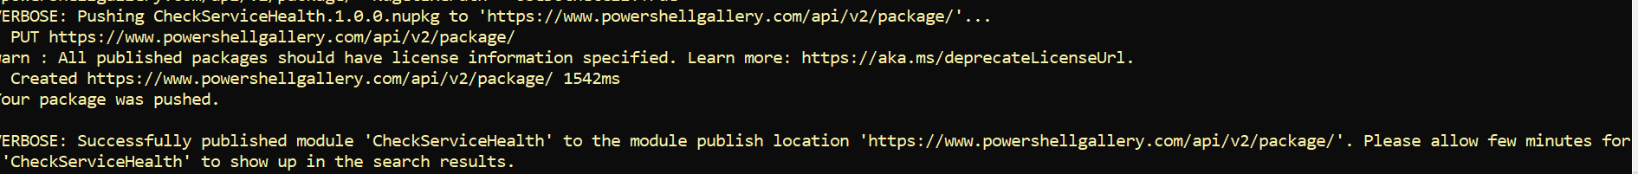
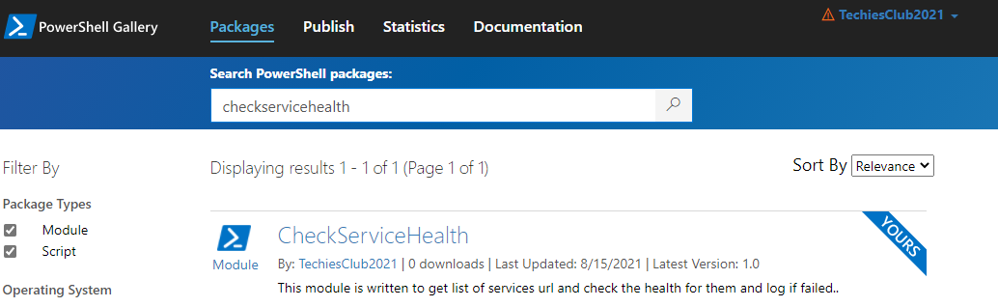
Deploy PowerShell module in PowerShell gallery
Shell Gallery (Create Account/sign in. Create API Key and copy)
https://www.powershellgallery.com/
User : TechiesClub2021
Pwd: Same as techies club gmail
Key Name: TechiesClubPSKey
#Download Analyzer module
Install-Module -Name PSScriptAnalyzer
#Run analyzer
Invoke-ScriptAnalyzer -Path "C:\Program Files\WindowsPowerShell\Modules\CheckServiceHealth\CheckServiceHealth.psm1"
$PSGalleryKey = “xxxxxxxxxxxxxxx"
#Publish the Module (use PS7. For me, PS5 was throwing weird error)
Publish-Module -Path "C:\Program Files\WindowsPowerShell\Modules\CheckServiceHealth\" -NuGetApiKey $PSGalleryKey -WhatIf -Verbose

