Slide 1
Excel: Shortcuts and Functions
By Kendall Kuzminskas

Slide 2


Overview
Keyboard shortcuts
Basic excel functions
Interactive

Slide 3
Download Practice Excel Sheet
Download excel_shortcuts_workbook from practice workbooks file

Slide 4



Navigation Shortcuts
 | PC | Mac
Switch between cells | Use the arrow keys | Use the arrow keys
Move to the end of a region
Move to the beginning of a row
Move to first cell in worksheet
Notes:
(Or Fn + Home if it isn’t a separate button)

Slide 5



Selection Shortcuts
 | PC | Mac
Select the entire row
Select the entire column
Select all
Notes:
Make it look like a table

Slide 6
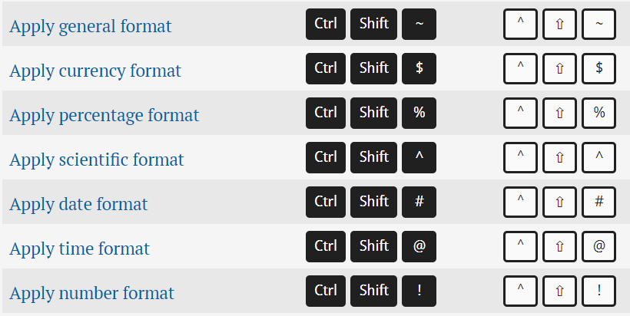
Applying Formatting
 | PC | Mac
Apply general format
Apply percentage format
Apply date format
Apply currency format
Notes:
Keep general format, percentage, date, currency

Slide 7
Functions
 | PC | Mac
Open the Insert function dialog box
Insert function arguments
Accept function with autocomplete

Slide 8
How did I create this Data?
Functions
RAND()
RANDBETWEEN()
DATE()
What are some other functions that you know?
What is the purpose of functions?

Slide 9
Functions: SUM
SUM:
Finds the sum of a value
Your turn:
Fill values in the profit column by:
Clicking on D2 and typing =SUM(C2, -B2)
Hit enter
Double Click on the small green box

Slide 10
Copying Values into a Column
Using only keyboard controls:
Copy the formula
Select the entire column
Paste
Keyboard controls vs. box double click
Key board controls copies it to the entire column
Box double click copies it to end of the data

Slide 11
Practice Functions
SUMIFS
IF
AND/OR
CHOOSE
VLOOKUP
HLOOKUP

Slide 12
SUMIFS
What does this function look like?
Uses one or more criteria
Format: =SUMIFS(sum_range, criteria1_range, criteria1,…)
Example:
Let’s sum up how much was spent on food in the month of January

Slide 13
SUMIFS-Money Spent
What we want:
A formula that only selects the amount spent for the category “Food” with a Date in January, that is an Expense
=SUMIFS(receipts!$B:$B, receipts!$D:$D, "Expense", receipts!$C:$C, C$1, receipts!$A:$A, ">=" & DATE(2019, $A2, 1), receipts!$A:$A, "<=" & EOMONTH(DATE(2019,$A2,1),0))

Slide 14
SUMIFS-Money Spent
What we want:
A formula that only selects the amount spent for the category “Food” with a Date in January, that is an Expense
=SUMIFS(receipts!$B:$B, receipts!$D:$D, "Expense", receipts!$C:$C, C$1, receipts!$A:$A, ">=" & DATE(2019, $A2, 1), receipts!$A:$A, "<=" & EOMONTH(DATE(2019,$A2,1),0))

Slide 15
SUMIFS-Money Spent
What we want:
A formula that only selects the amount spent for the category “Food” with a Date in January, that is an Expense
=SUMIFS(receipts!$B:$B, receipts!$D:$D, "Expense", receipts!$C:$C, C$1, receipts!$A:$A, ">=" & DATE(2019, $A2, 1), receipts!$A:$A, "<=" & EOMONTH(DATE(2019,$A2,1),0))

Slide 16
SUMIFS-Money Spent
What we want:
A formula that only selects the amount spent for the category “Food” with a Date in January, that is an Expense
=SUMIFS(receipts!$B:$B, receipts!$D:$D, "Expense", receipts!$C:$C, C$1, receipts!$A:$A, ">=" & DATE(2019, $A2, 1), receipts!$A:$A, "<=" & EOMONTH(DATE(2019,$A2,1),0))

Slide 17
SUMIFS-Money Spent
What we want:
A formula that only selects the amount spent for the category “Food” with a Date in January, that is an Expense
=SUMIFS(receipts!$B:$B, receipts!$D:$D, "Expense", receipts!$C:$C, C$1, receipts!$A:$A, ">=" & DATE(2019, $A2, 1), receipts!$A:$A, "<=" & EOMONTH(DATE(2019,$A2,1),0))

Slide 18
SUMIFS-Reimbursments
How can we alter the previous equation to sum up the reimbursements?
=SUMIFS(receipts!$B:$B, receipts!$D:$D, "Expense", receipts!$C:$C,C$1, receipts!$A:$A, ">=" & DATE(2019, $A2, 1), receipts!$A:$A, "<=" & EOMONTH(DATE(2019,$A2,1),0) )
Delete the red

Slide 19
SUMIFS-Reimbursements
How can we alter the previous equation to sum up the reimbursements?
=SUMIFS(receipts!$B:$B, receipts!$D:$D, “Reimbursement", receipts!$A:$A, ">=" & DATE(2019, $A2, 1), receipts!$A:$A, "<=" & EOMONTH(DATE(2019,$A2,1),0) )
Add the green

Slide 20
If-Overbudget
Use an IF statement to make Overbudget? Yes if your income is less than total spent and “No” otherwise
=IF(SUM($I2, -$H2) > 0, "No", "Yes")

Slide 21
And/Or - Bankrupt
Let’s say you go bankrupt if you are overbudget two months in a row. Use IF and AND functions to determine if you are bankrupt.
Bankrupt - OR
=IF(OR($J2 = "Yes",$J3 = "Yes"),"Yes","No")
Bankrupt - AND
=IF(AND($J2 = "Yes",$J3 = "Yes"),"Yes","No")

Slide 22
Functions
SUMIFS
IF
AND/OR
CHOOSE
VLOOKUP
HLOOKUP

Slide 23
Choose-Team Color
Say we want to add a team color to the vlookup spreadsheet, and that each person must be on team “Red”, “Orange”, or “Yellow”. Use the Choose function to select each person’s team color
=CHOOSE(MOD($A2,3)+1, "Yellow", "Red", "Orange")

Slide 24
Vlookup
If we want to look up the name of someone that had an ID number of 4, what would we do?
=VLOOKUP(E2,A2:B11, 2)

Slide 25
HLookup
If we want to look up the first item in the column given by the value under Name lookup, what would we do?
=HLOOKUP(G2,A2:B11,1)

Slide 26
Additional Resources:
AKPsi’s Github page!
techindustrynuakpsi

Slide 27
XNPV
XIRR

Slide 28
Resources
https://exceljet.net/keyboard-shortcuts
https://www.inc.com/larry-kim/top-10-excel-shortcuts-you-need-to-know.html
https://www.tutorialspoint.com/excel/excel_create_worksheet.html
https://www.businessinsider.com/excel-keyboard-shortcuts-windows-and-mac-2017-5#view-2

Slide 29
Appendix

Slide 30


Basic Shortcuts
 | PC | Mac
Create a new workbook

Slide 31
SUMIFS-Money Spent
What we want:
A formula that only selects the amount spent for the category “Food” with a Date in January, that is an Expense
SUMIFS( , ,
, ,
)
receipts!$B:$B
receipts!$D:$D, "Expense"
receipts!$C:$C, C$1
receipts!$A:$A, ">=" & DATE(2019, $A2, 1)
receipts!$A:$A, “<=" & EOMONTH(DATE(2019, $A2, 1))

Slide 32
Rate
Type in Box H2: =RATE(1,,-D2, D3)
Hit Enter
Copy it to the entire column by:
Double clicking the bottom box
OR using the keyboard commands
What does the RATE function do?
Notes:
The rate function calculates the % growth rate b/w a time period

