Slide 1
IBM University Engagement Project Submission
“Exploring the Power of Agentic AI with IBM Granite and IBM Cloud”

Slide 2
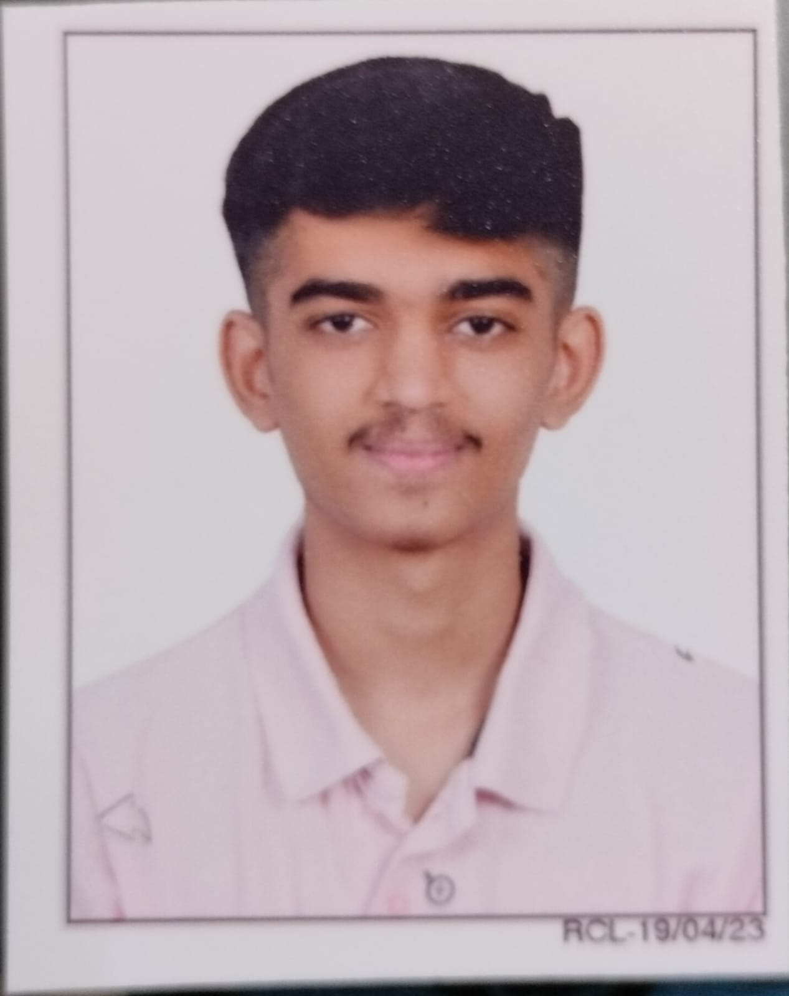
Project Title: Narmada Jal Nyay AI AI-Powered Equitable Canal Water Distribution & Monitoring Domain of project: Water Resource Management
Student Name | Recent Passport Photo | Email ID | Mobile number [WhatsApp]
Desai Jay |  | jaydesai18825@gmail.com | +91 9016156995

Slide 3
Problem Statement :
Problem Statement : Smart Narmada Canal Water Distribution & Equity Monitor The Challenge: Unequal and inefficient distribution of Narmada canal water across head-reach and tail-end farmers in Gujarat can lead to disputes, crop stress, and inefficient water usage, especially during peak irrigation seasons. The Objective: Develop an Agentic AI-powered water-management platform that monitors canal flow, optimizes equitable distribution schedules, and provides farmers with real-time water availability information. The system will: • Monitor canal flow, water levels and gate status. • Detect anomalies and potential shortages. • Generate fairness-aware irrigation schedules for head, middle and tail reaches. • Alert farmers about water availability, delays and irrigation slots. • Detect disputes and recommend transparent, evidence-based resolutions. • Provide an intelligent dashboard for canal authorities.

Slide 4
Proposed Solution :
Proposed Solution: Narmada Jal Nyay AI Narmada Jal Nyay AI is a multi-agent water-management platform designed to improve equitable distribution of canal water across Gujarat’s head, middle and tail reaches. The Canal Flow Monitoring Agent analyzes sensor or simulated flow data and identifies abnormal changes, shortages and possible leakage. The Equitable Distribution Scheduling Agent uses water availability, crop demand, land area, previous allocation and head-tail position to generate a fairness-aware irrigation schedule. The Farmer Water Availability Alert Agent provides expected water arrival times, irrigation slots, quantity and delay notifications. The Dispute Detection & Mediation Agent analyzes complaints together with allocation and sensor evidence and recommends fair resolutions. A centralized dashboard gives authorities real-time visibility into canal status, water equity, alerts and AI recommendations.

Slide 5
Technology Used:
IBM Bob – AI-assisted development of the application. IBM Granite – Natural-language understanding, reasoning, summarization and farmer-friendly explanations. IBM Cloud – Deployment, APIs, storage and cloud infrastructure. Python + FastAPI – Backend APIs, agent orchestration and business logic. React + Vite – Responsive authority and farmer dashboards. PostgreSQL / SQLite – Farmers, sensor readings, allocations, schedules and complaints. Machine Learning – Flow prediction and canal anomaly detection. Data Visualization – Flow, allocation, equity and shortage monitoring.

Slide 6
Agent Components Used :
1) Canal Sensor / Data Input – Receives flow rate, water level, gate status, rainfall and historical readings. 2) Canal Flow Monitoring Agent – Detects abnormal flow, shortage conditions and possible leakage. 3) Equitable Distribution Scheduling Agent – Calculates fair allocations and irrigation slots using water demand and previous distribution. 4) IBM Granite Agent Layer – Explains conditions, summarizes evidence, classifies complaints and generates farmer-friendly recommendations. 5) Farmer Alert Agent – Produces water-availability, delay and irrigation-slot notifications. 6) Dispute Detection & Mediation Agent – Analyzes complaints and recommends transparent, human-approved resolutions. 7) Dashboard / Database Component – Stores operational data and presents equity, alerts, schedules and AI insights.

Slide 7
Agentic AI workflow :
Canal Sensor / Data Input
Canal Flow Monitoring Agent
Shortage & Anomaly Detection
Equity Analysis
Distribution Scheduling Agent
IBM Granite – Explanation & Recommendations
Farmer Water Availability Alerts
Complaint / Feedback
Dispute Detection & Mediation

Slide 8
Architecture blueprint :
Frontend – React | Farmer Portal · Authority Dashboard
FastAPI Backend | Authentication · REST APIs · Agent Orchestrator
Agentic AI Layer
Canal Flow Monitoring Agent
Equitable Distribution Scheduling Agent
Farmer Water Availability Alert Agent
Dispute Detection & Mediation Agent
IBM Granite – AI Reasoning, Summarization & Explanations
Database | Farmers · Sensors · Allocations · Schedules · Complaints
IBM Cloud – Deployment & Infrastructure

Slide 9
Role of Agentic AI in the solution :
Role of Agentic AI in Narmada Jal Nyay AI: Agentic AI enables the platform to operate as a coordinated water-management system rather than a simple monitoring dashboard. Multiple specialized agents collaborate to continuously observe canal conditions, evaluate equity and take the next appropriate action. • Canal Flow Monitoring Agent detects abnormal flow and shortage conditions. • Equitable Distribution Scheduling Agent recalculates water allocation and irrigation slots using fairness constraints. • Farmer Water Availability Alert Agent converts system decisions into simple, timely farmer notifications. • Dispute Detection & Mediation Agent combines complaints, allocation history and sensor evidence to recommend fair resolutions. • Irrigation Efficiency Dashboard Agent summarizes operational conditions and highlights priority actions. IBM Granite provides language understanding, reasoning and explanations, while deterministic algorithms handle numerical allocation. Human authorities remain responsible for approving major operational actions.
HEAD REACH
MIDDLE REACH
TAIL REACH

Slide 10
AI Decision Example :
Before AI
After the AI Decision
BEFORE AI DECISION Canal flow: 100 units Head: 50 | Middle: 30 | Tail: 20 Tail-end deficit detected
AFTER AI RECOMMENDATION Fairness-aware reallocation Head: 40 | Middle: 30 | Tail: 30 Next irrigation slots adjusted Granite: “Tail-end farmers are prioritized because their actual receipt is below expected demand.”

Slide 11
Novelty and Uniqueness:
The proposed Narmada Jal Nyay AI stands out by combining Agentic AI, fairness-aware water scheduling and real-time farmer communication into one intelligent canal-management system. • Multi-Agent Water Intelligence – Specialized agents collaborate instead of relying on a single chatbot. • Head-Tail Equity Monitoring – Compares expected and actual water receipt across canal reaches. • Fairness-Aware Scheduling – Uses previous allocation and crop demand to avoid repeated upstream advantage. • Predictive Shortage Detection – Identifies unusual flow patterns before major distribution failures. • Farmer-First Alerts – Communicates water quantity, arrival time, irrigation slot and delays. • Evidence-Based Dispute Mediation – Combines complaints with sensor and allocation data. • Human-in-the-Loop Governance – Critical operational decisions remain under authority approval. • Explainable AI – IBM Granite converts complex outputs into understandable recommendations. This makes the platform a proactive water-equity system rather than a static canal monitoring dashboard.

Slide 12
Git Hub Link:
techjay18/Narmada-Jal-Nyay-AI

Slide 13
Future Scope :
1. Real IoT Sensor Integration – Connect live canal flow, water-level and gate sensors. 2. Advanced Flow Forecasting – Incorporate rainfall, weather and historical canal patterns. 3. Government Water-System Integration – Connect with authorized irrigation infrastructure where permitted. 4. Gujarati Farmer Notifications – Add verified Gujarati voice/SMS/WhatsApp alerts. 5. Digital Gate Automation – Support controlled gate recommendations and authorized actuation. 6. Village-Level Water Analytics – Provide anonymized equity and irrigation-efficiency trends. 7. Multi-Canal Expansion – Extend the framework to other irrigation systems.
·
·
·

Slide 14
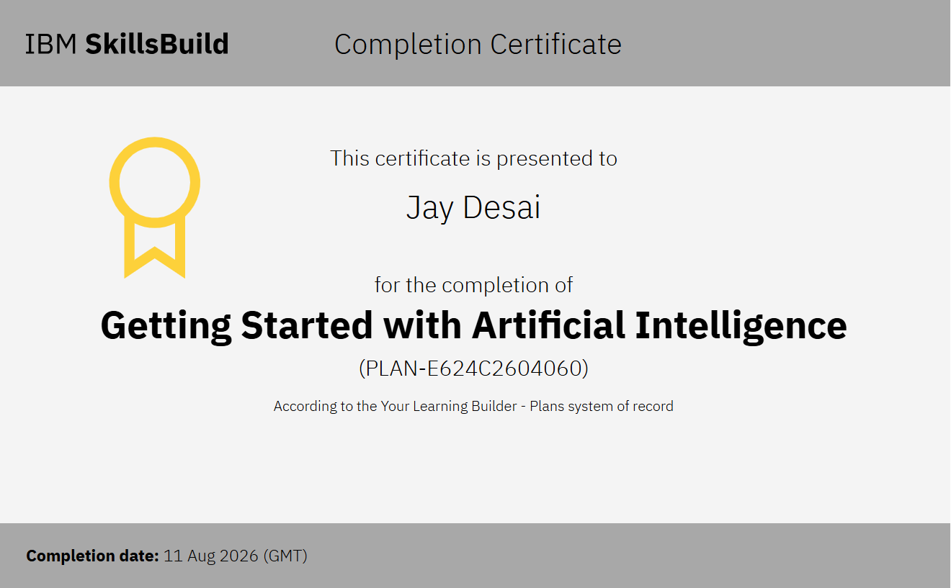
Certificates Earned:

Slide 15
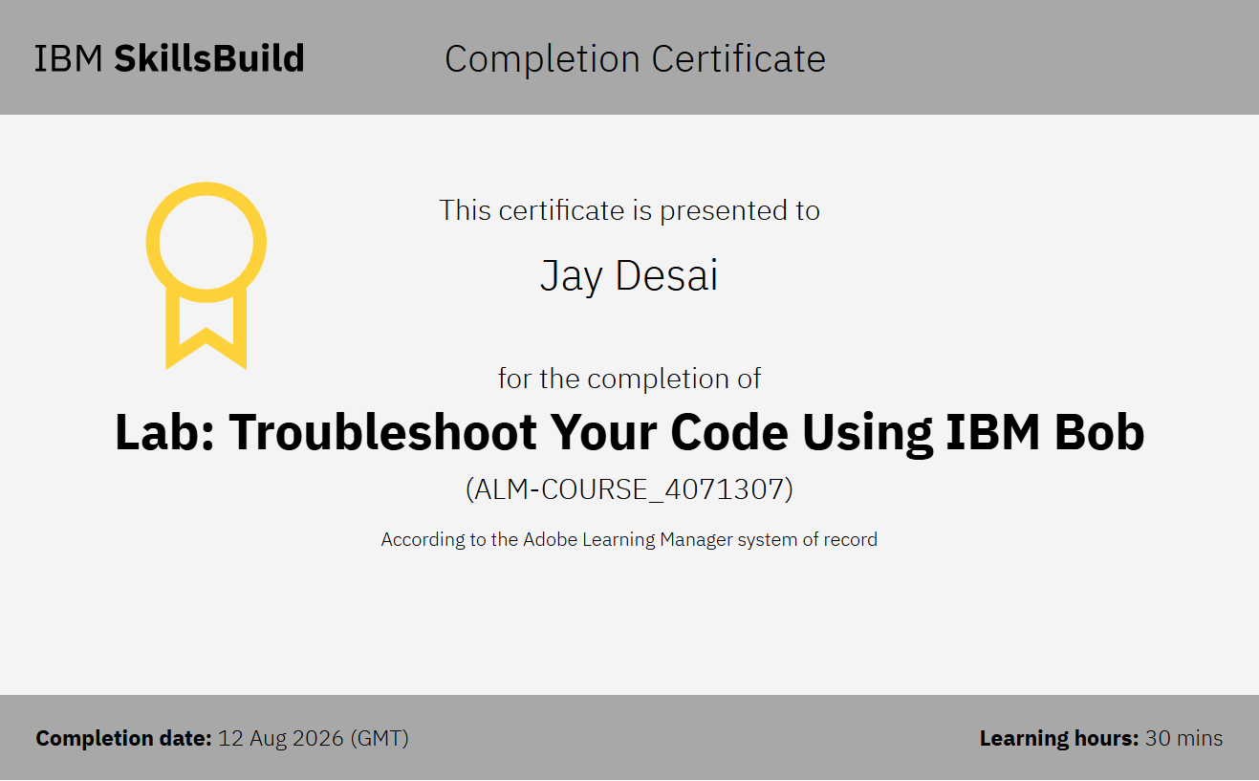
Certificate Earned:

Slide 16
THANK YOU!

