Slide 1

TeamDudley
Wednesday March 3
The Allstate
Intelligent Virtual Assistant
Challenge

Slide 2
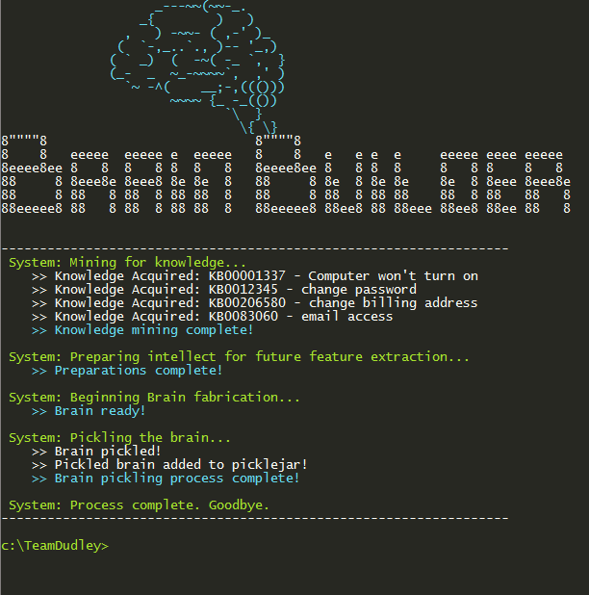
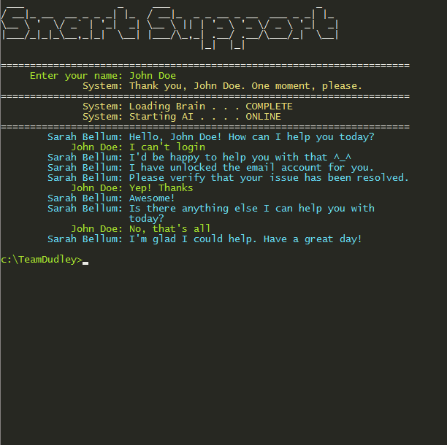
TeamDudley Brain Builder + Smart Support
TEAM MEMBERS
Andy Dudley
Joanna Zurawek

Slide 3
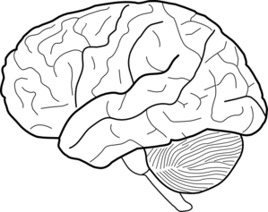



TeamDudley
Overview
Brain Builder
Smart Support
Parse text from KB articles
Generate word bank to compare against user input.
Determine useful information for each step and place in an standardized data structure.
The chat client
Match the client’s request with a relevant KB article
Walk user through each step, acquiring domain knowledge where applicable.
BRAIN

Slide 4

TeamDudley – Brain Builder + Smart Support
Brain Builder (Semantics)
“Verify that the customer is requesting a change to their billing address only or also their mailing address”
exists in
Domain Knowledge
BrainEntry
elif tagged_words[0][0] == 'Verify':
statement = []
questionType = None
if 'or' in words:
questionType = 'OPTION'
if 'also' in words:
step_type = 'or_also_bool'
else:
step_type = 'or_bool'
has
Named
Entity
added to
# Get everything from the first possessive on into a chunk
chunkGram = r"""Chunk: {<POS|PRP\$><.*>*<NN.?>+<.*>*<CC><.*>*<NN.?>+}"""
chunkParser = nltk.RegexpParser(chunkGram)
chunked = chunkParser.parse(tagged)
main_entities.extend(extractChunk(chunked))
step_type:
or_also_bool
Verify
statement:
Are you requesting a change to your billing address only or also your mailing address?
Domain Knowledge
is a conditional
Update
Named
Entity
has 2
Named
Entities
Confirm
or
<VB>
<noun entity>
exists in
has
has
If
First Word
Or
flags added to
Named
Entity
boolKnowledgeDict
also
not in
Verify
Or Also
has 2
billing_address_bool
Domain Knowledge
Resolve
contains
Bool Domain Knowledge
mailing_address_bool
Update
Action
flags added to
or_also_bool
is a
or_bool
yes_no
update_domain_knowledge
contains
Complicated If
Verify
Action
Named
Entity
flags added to
contains
contains
contains
relies on

Slide 5
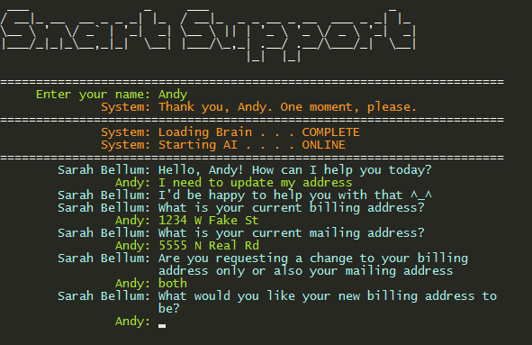
TeamDudley – Brain Builder + Smart Support
Smart Support (Chat Client)
Code used by brain to utilize the BrainEntry step developed in previous example.
Sets the Boolean variables in boolKnowledgeDict based on the user’s input.
elif step[1] == 'or_also_bool':
#######################################
# Ask user 'x only or also y' question
#######################################
# Get bool keys. These will be referenced later on by a conditional_update_domain_knowledge step
key0 = step[2][0][0]
key1 = step[2][1][0]
tellUser(step[0]) # Ask user "x only or also y" question.
input = tellBot() # get response
input_features = parseInput(input) # tokenize response
doBoth = getOrAlsoChoice(input_features, step[2][0][1], step[2][1][1]) # process response
try:
if doBoth:
brainEntry.boolKnowledgeDict[key0] = True
brainEntry.boolKnowledgeDict[key1] = True
else:
brainEntry.boolKnowledgeDict[key0] = True
brainEntry.boolKnowledgeDict[key1] = False
except:
print("ERROR: {} or {} not found in boolKnowledgeDict".format(key0, key1))
Cosine Similarity scores (index of score = index of respective KB article in brain:
Sanity Check… user’s input should 100% match itself.
Index of highest score is 2, so the closest matching KB article is in index 2 of the OrderedDictionary. The KB key of this article is returned and used to access the respective BrainEntry.

Slide 6
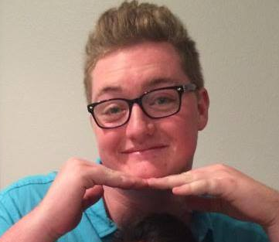
TeamDudley – Brain Builder + Smart Support
Test Results
Our Subject:
Does exactly what the KB articles say to do.
Wanted to update ONLY mailing address. Subject was impressed to see that rephrasing the step in the KB article enabled him to choose one, the other, or both.
“She said ‘hi’ back!”

Slide 7
TeamDudley – Brain Builder + Smart Support
What we learned
Awesome!
Natural Language Processing
Classifiers (Naïve Baise)
Chunking
Tagging
Dialogue acts
Parts of Speech
Machine Learning
Features
TF-IDF
Cosine Similarity

