Slide 1
Low-code careers
and future directions
Experiment 15
Kabilan S
1
Notes:
Introduce low-code as one approach to building business applications. This talk uses our insurance application to explain useful career skills. It makes no salary or employment guarantee. References: https://www.zoho.com/creator/training/ https://www.zoho.com/creator/certification.html

Slide 2
Career pathways
Application developer
Build forms, reports and controlled workflows
Integration developer
Connect services and handle failed requests
Process analyst or platform administrator
Define requirements, access rules and release checks
2
Notes:
These are illustrative role pathways, not a survey of vacancies. Explain that job titles vary between employers. A student can demonstrate each area with a concrete project artifact. Reference: https://www.zoho.com/creator/training/

Slide 3
Skills behind the platform
Data modelling
Related records, validation and accurate calculations
Deluge and APIs
Reusable functions, OAuth and error handling
Testing and governance
Independent user tests, audit review and recovery
3
Notes:
Explain why a drag-and-drop interface still requires engineering judgment. Our high-value review and reminder tests show the need for validation. Role separation and recovery testing remain areas to complete. References: https://www.zoho.com/creator/training/ https://help.zoho.com/portal/en/kb/creator/developer-guide/others/platform-performance/articles/platform-performance

Slide 4
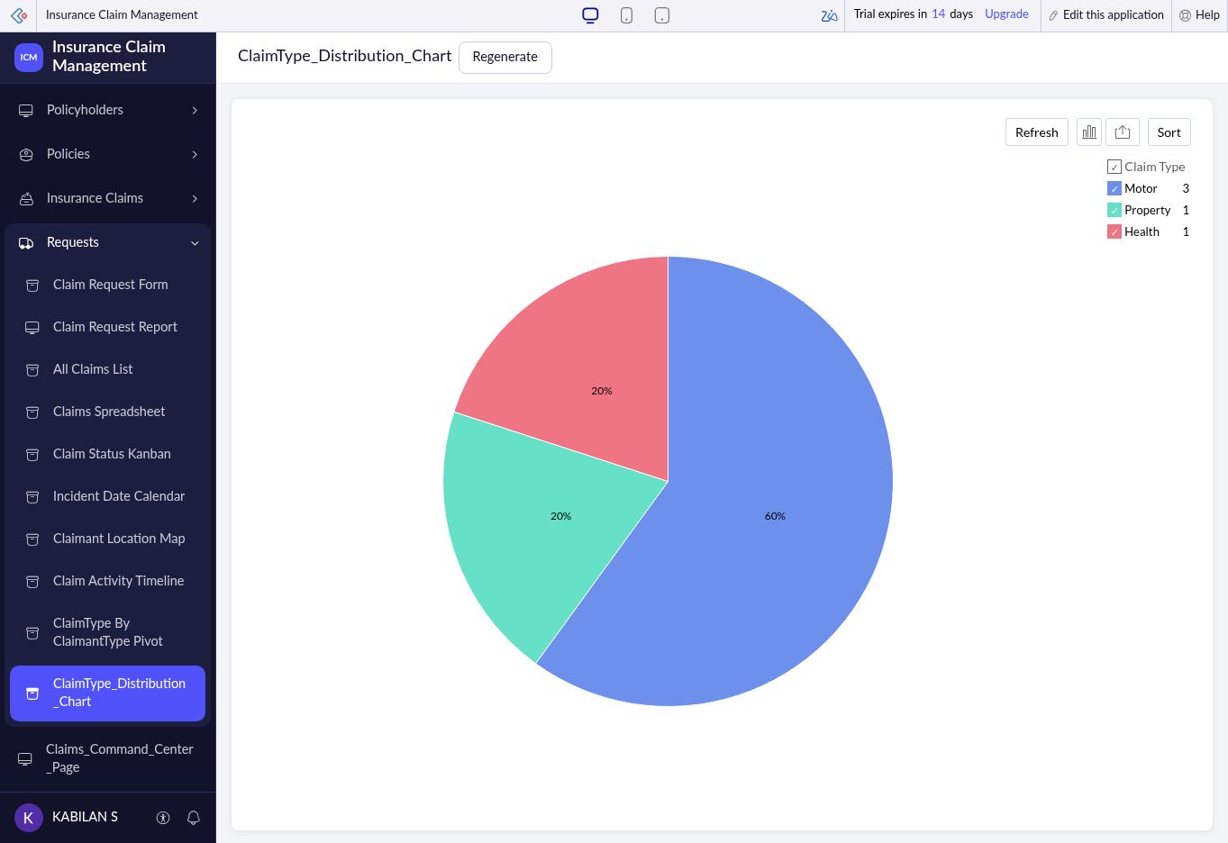
Portfolio evidence
Insurance Claim Management
Related forms and claim reports
Deluge workflows with test results
Clear labels for simulated payouts
A reproducible demo and stated limits
4
Notes:
The image is our previously captured live claim-type chart. It represents its capture-time records, not current totals. Explain one form relationship and one tested workflow. Do not claim real payout integration or a completed production release.

Slide 5
AI-assisted development
Current capability
Zia can assist with application design and scripts
Developer responsibility
Review the schema and verify generated logic
Observed lesson
Our earlier generation attempt failed validation
5
Notes:
Zia capabilities depend on configuration and availability. Our earlier Build Agent attempt reported validation errors, so successful generation is not claimed. Future judgment: AI assistance may reduce repetitive construction while increasing the importance of review. Reference: https://help.zoho.com/portal/en/kb/creator/developer-guide/operations/zia/articles/ai-capabilities-in-creator-powered-by-zia

Slide 6
Custom code and hybrid systems
Creator can support the operations interface
Forms, work queues and controlled review
Custom functions centralize business logic
One function can serve several workflow callers
External services need their own tests
Provider errors, duplicate requests and recovery
6
Notes:
This is an architectural recommendation drawn from the laboratory use case. A sequential payout simulation does not establish concurrent transaction safety. Reference: https://help.zoho.com/portal/en/kb/creator/developer-guide/others/platform-performance/articles/platform-performance https://help.zoho.com/portal/en/kb/creator/developer-guide/workflows/functions/articles/create-new-deluge-function

Slide 7
An eight-week learning plan
Weeks 1-2
Refine data modelling and Deluge validation
Weeks 3-4
Complete one authenticated service integration
Weeks 5-6
Test independent roles and stage a release
Weeks 7-8
Publish the case study and rehearse the demo
7
Notes:
This is a proposed personal learning plan. It is not completed training. Use the existing application as the portfolio project and close one verified gap at a time. Reference for learning options: https://www.zoho.com/creator/training/

Slide 8
Professional readiness
A useful portfolio shows how the app behaves
Explain a business requirement and its implementation
Demonstrate a passing test and a handled failure
State remaining gaps clearly
Use certification to support practical experience
8
Notes:
Conclude that certification can structure learning, while a runnable project and evidence help explain actual skills. Certification does not guarantee employment. Viva prompt: which role interests you most, and which project gap will you close next? Reference: https://www.zoho.com/creator/certification.html

