Slide 1

Ripple Developer Suit

Slide 2
Contents 1/3
Part 1 - Theory
Ripple developer suit overview
Ripple blockchain overview
Ripple consensus process

Slide 3
Contents 2/3
Part 2 Development
Overview of Ripple Development & Training Suit VM
How to get Ripple Development & Training Suit VM
Hello ripple world
Using Ripple Javascript library
Ripple APIs
Ripple-wallet client overview
Ripple jargon explained
XRP transfer demo
Multisigning demo
Messaging demo
Payment channel demo
Escrow demo
Sending check
Raw transaction demo
Dissecting ripple-client wallet webapp code

Slide 4
Contents 3/3
Part 3 – Ripple Products and services
Ripple Server (Rippled)
Services
xCurrent
xRapid
xVia
Ripple wallet (Gatehub)
Ripple charts (Xcharts)

Slide 5
Part 1 Theory

Slide 6
Part 1 /3
Part 1 - Theory
Ripple developer suit overview
Ripple blockchain overview
Ripple consensus process

Slide 8
Part 1 /3
Part 1 - Theory
Ripple developer suit overview
Ripple blockchain overview
What is Ripple ?
How it works
Ripple Vs other digital assets
Why Ripple?
Ripple consensus process

Slide 9
What is Ripple ?
Ripple is a real-time gross settlement system (RTGS), currency exchange and remittance network created by Ripple Labs Inc.
The underlying Ripple Transaction Protocol (RTXP) or Ripple protocol is built upon a distributed open source internet protocol and a consensus ledger.
The decentralized native digital asset powering the ledger is known as XRP.
The goal of Ripple is to make bank transactions more efficient and transparent – especially cross-border, inter-currency payments.
Source : wikipedia

Slide 10
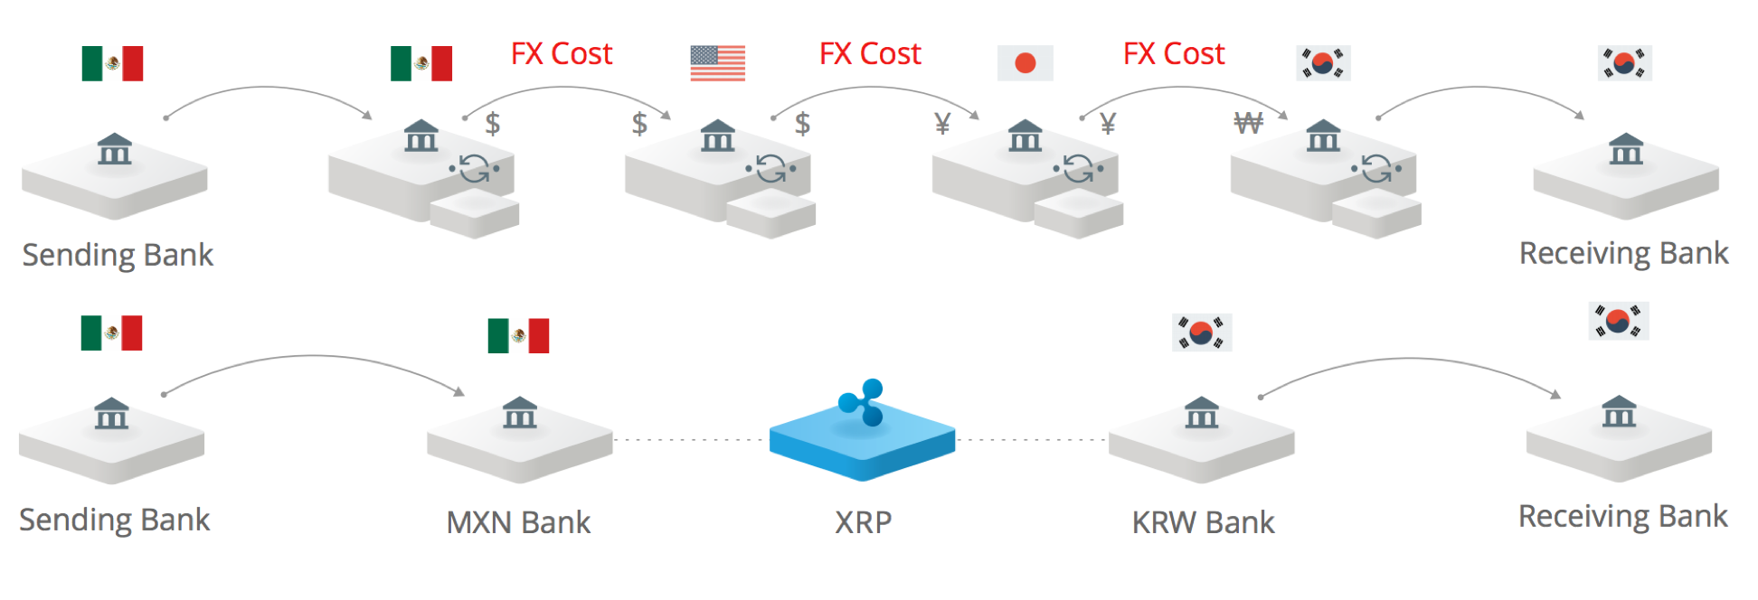
How it works
Source : coinman.co
Notes:
Tradition banking system is like snail mail of pre internet era
Each hop in the transaction results in FX cost
Ripple is to banking system what data is to internet
Just like internet is the network of transferring data, ripple is the network of transferring value

Slide 11
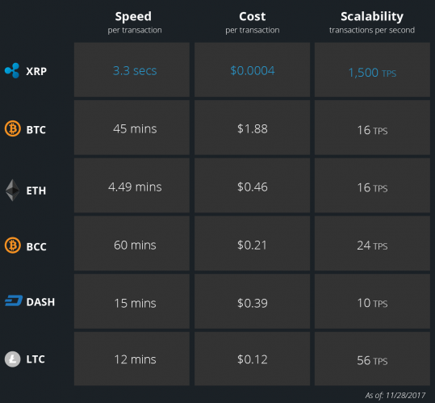
Ripple Vs other digital assets
Source : ripple.com

Slide 12
Why Ripple?
Banks – Capture new revenue
Payment providers – Expand reach
Corporates – Simplify payments
Exchanges – Turn up the volumes
You
Provide IT consulting
Provide IT implementations
Provide IT products and solutions
Notes:
The demand for IT companies and professionals familiar with Ripple will increase in the banking sector and adjacent industries. Many banking professionals are still working on understanding the blockchain itself, so they will need technical professionals to explain Ripple for them. These experts will also be needed to implement Ripple’s solutions and interfaces with legacy systems.

Slide 13
Part 1 /3
Part 1 - Theory
Ripple developer suit overview
Ripple blockchain overview
Ripple consensus process

Slide 14
Ripple consensus process
Consensus process is Ripples’s answer to avoid double spending problem.
The goal of consensus process is for all the servers in ripple network to agree on a set of transactions to apply to the Last Closed Ledger.
Ripple consensus process wiki https://wiki.ripple.com/Consensus_Graphic
Ripple consensus process video https://www.youtube.com/watch?v=pj1QVb1vlC0

Slide 15
Part 2 Development

Slide 16
Part 2 /3
Part 2 Development
Hello Ripple world
Using Ripple Javascript library
Ripple APIs
Ripple-wallet client overview
Ripple jargon explained
XRP transfer demo
Multisigning demo
Messaging demo
Payment channel demo
Escrow demo
Sending check
Raw transaction demo
Dissecting ripple-client wallet webapp code

Slide 17
Hello Ripple world
In this demo, you will understand the basic concept of Ripple Account and Address and how to access the same from the ledger (Ripple blockchain) using Javascript API.
An "Account" in the XRP Ledger represents a holder of XRP and a sender or receiver of transactions. The core elements of an account are:
An identifying address, such as rf1BiGeXwwQoi8Z2ueFYTEXSwuJYfV2Jpn
An XRP balance.
A sequence number, starting at 1 and increasing with each transaction sent from this account.
A history of transactions that affected this account and its balances.
One or more ways to authorize transactions, possibly including:
A master key pair intrinsic to the account. (This can be disabled but not changed.)
A "regular" key pair that can be rotated.
A signer list for multi-signing. (Stored separately from the account's core data.)

Slide 18
Contents 2/3
Part 2 Development
Hello Ripple world
Using Ripple Javascript library
Ripple APIs
Ripple-wallet client overview
Ripple jargon explained
XRP transfer demo
Multisigning demo
Messaging demo
Payment channel demo
Escrow demo
Sending check
Raw transaction demo
Dissecting ripple-client wallet webapp code

Slide 19
Using Ripple Javascript library
In this demo, you will be introduced to Ripple Javascript API.
The demo will showcase how to use the API library in web application to connect to Ripple blockchain network in a browser.
Once connected, the APIs will be used to get more information about the Ripple network.

Slide 20
Contents 2/3
Part 2 Development
Hello Ripple world
Using Ripple Javascript library
Ripple APIs
Ripple-wallet client overview
Ripple jargon explained
XRP transfer demo
Multisigning demo
Messaging demo
Payment channel demo
Escrow demo
Sending check
Raw transaction demo
Dissecting ripple-client wallet webapp code

Slide 21
Ripple APIs (1/3)
Diving into Ripple API
Connect to rippled
Query Ledger Data
Write Ledger Data (Transactions)

Slide 22
Ripple APIs (2/3)
Ripple transaction types
AccountSet Set options on an account.
CheckCancel Cancel a check.
CheckCash Redeem a check.
CheckCreate Create a check.
EscrowCancel Reclaim escrowed XRP.
EscrowCreate Create an escrowed XRP payment.
EscrowFinish Deliver escrowed XRP to recipient.
OfferCancel Withdraw a currency-exchange order.
OfferCreate Submit an order to exchange currency.
Payment Send funds from one account to another.
PaymentChannelClaim Claim money from a payment channel.
PaymentChannelCreate Open a new payment channel.
PaymentChannelFund Add more XRP to a payment channel.
SetRegularKey Add, remove, or modify an account's regular key pair.
SignerListSet Add, remove, or modify an account's multi-signing list.
TrustSet Add or modify a trust line.

Slide 23
Ripple APIs (3/3)
Ripple Payment transaction
A Payment transaction represents a transfer of value from one account to another.
Payment transaction demo
Create two new test accounts.
Invoke getAccountInfo() to check initial balance for each account.
Run payment_demo.js
Invoke getAccountInfo() to verify the updated balance of both accounts after payment transaction .
Verify the transaction hash.

Slide 24
Part 2 /3
Part 2 Development
Hello Ripple world
Using Ripple Javascript library
Ripple APIs
Ripple-wallet client overview
Ripple jargon explained
XRP transfer demo
Multisigning demo
Messaging demo
Payment channel demo
Escrow demo
Sending check
Raw transaction demo
Dissecting ripple-client wallet webapp code

Slide 25
Ripple-wallet client overview
Ripple wallet is used to manage your Ripple account and make transactions and other .
The wallet app included in the VM is for testing purpose only.
In real world, you will use available commercial wallets with adequate security measures.
The wallet app is web based and can be run by executing below command from the wallet’s home directory.
python –m SimpleHTTPServer
You can access the wallet at http://localhost:8000 in the VM

Slide 26
Part 2 /3
Part 2 Development
Hello Ripple world
Using Ripple Javascript library
Ripple APIs
Ripple-wallet client overview
Ripple jargon explained
XRP transfer demo
Multisigning demo
Messaging demo
Payment channel demo
Escrow demo
Sending check
Raw transaction demo
Dissecting ripple-client wallet webapp code

Slide 27
Ripple jargon explained
Account Information (info tab)
Domain
Transfer rate
Owner count
Signers/Signer list
Message key
Settings
Trust lines
Notes:
https://developers.ripple.com/accountroot.html
Domain - The domain that owns this account, as a string of hex representing the ASCII for the domain in lowercase.
Transfer rate : The fee to charge when users transfer this account's issued currencies, represented as billionths of a unit. Cannot be more than 2000000000 or less than 1000000000, except for the special case 0 meaning no fee.
Owner count : The number of objects this account owns in the ledger, which contributes to its owner reserve.
Signers/Signer list : The SignerList object type represents a list of parties that, as a group, are authorized to sign a transaction in place of an individual account. You can create, replace, or remove a SignerList using a SignerListSet transaction.
Message key:A public key that may be used to send encrypted messages to this account.
Settings: Settings for account level flags (refer https://developers.ripple.com/accountset.html#accountset-flags)

Slide 28
Ripple jargon explained
Payment
Destination tag
Memo
Patch search
Slippage
Send Max
Direct pay
Source tag
Invoice ID
Flags
NoDirectRipple
PartialPayment
LimitQuality

Slide 29
Part 2 /3
Part 2 Development
Hello Ripple world
Using Ripple Javascript library
Ripple APIs
Ripple-wallet client overview
Ripple jargon explained
XRP transfer demo
Multisigning demo
Messaging demo
Payment channel demo
Escrow demo
Sending check
Raw transaction demo
Dissecting ripple-client wallet webapp code

Slide 30
XRP transfer demo
Open two browser wallets (at port 8000 and 9000)
Create two test accounts
Configure two wallets with test accounts
Configure destination wallet with domain
Need to figure out how to use advance payment via ripplename or emailid
Notes:
Address1
rndxNdPEBKrxcwki8hCDXBLNoSyJPs9XBB
Secret
saDaKB3XjXCyV782vm93XALFBjqK3
#################33
Address2
rMhtWHjoweG7enKWe7ksU6geHnAV2JzmMT
Secret
spxYNyLgLMHPxerfApaEvffKGWy86
domain:example.com
email:account2@example.com

Slide 31
Contents 2/3
Part 2 Development
Hello Ripple world
Using Ripple Javascript library
Ripple APIs
Ripple-wallet client overview
Ripple jargon explained
XRP transfer demo
Multisigning demo
Messaging demo
Payment channel demo
Escrow demo
Sending check
Raw transaction demo
Dissecting ripple-client wallet webapp code

Slide 32
Multisigning use cases
N-factor Auth:
Store 2 or more keys on different devices, and require all the devices to sign each transaction.
M-of-N:
Give keys to multiple people, and require a majority of signers to sign each transaction.
Delegate a backup plan:
Designate a team of people who can send transactions for you by working together, in case you’re unavailable. Keep using single signatures for normal business.
Primary and Approvals:
Use the weights in your signer list to require a specific signer along with at least one other.

Slide 33
Payment Multisigning demo
Create 5 new test accounts (1 sender, 3 signers , 1 receiver)
Use the API call SignerListSet() to enable multisigning with signer accounts.
For this demo, the Signer list will consists of 3 signers with a quorum of 3 , first signer with a weight of 2 and remaining two signers with weight of 1.
The above configuration means the transaction must be signed by first signer and any one of the remaining two signers.
Sign payment transactions using signer’s secret key.
Combine signed transactions.
Submit signed transaction.
Confirm transaction.
Notes:
Reference :
https://developers.ripple.com/set-up-multi-signing.html
https://developers.ripple.com/send-a-multi-signed-transaction.html

Slide 34
Trustline Multisigning demo
Trustline is another type of Ripple transaction which establishes a trust line between two accounts using currencies like USD.
Use case:
An issuing gateway publishes its issuing address to customers.
A customer sends a TrustSet transaction to create a trust line from her XRP Ledger address to the gateway's issuing address.
This indicates that she is willing to hold a specific currency issued by the gateway, up to a specific numeric limit.
The gateway's issuing address sends a TrustSet transaction authorizing the customer's trust line.
The steps in this demo are almost identical to Payment Multisiging demo, except for step 3.
In step 3, instead of signing a Payment transaction, a Trustline transaction is signed.

Slide 35
Part 3 – Ripple Products and services

Slide 36
Ripple tools
Dev Tools https://developers.ripple.com/dev-tools-dev-tools.html

Slide 37
References

Slide 38
References
Ripple developer suit github repository - https://github.com/techlatest/rippledevelopersuit
Ripple developer portal
https://developers.ripple.com/
Ripple Javascript Library - https://github.com/ripple/ripple-lib
Ripple wallet app –
https://github.com/ripplerm/ripple-wallet
Multisigning
https://developers.ripple.com/set-up-multi-signing.html
https://developers.ripple.com/send-a-multi-signed-transaction.html
Ripple API Reference:
https://developers.ripple.com/rippleapi-reference.html

Slide 39
Thanks!

