Slide 1
Policies in AEM - தமிழ்

Slide 2
Policies
Content policies in AEM are template-level configurations for the template and its components. They define which components are available to a template or container and what styles or functions are available to a component.

Slide 3
Steps:
Install Java
Set JAVA_HOME in JDK path
Download Maven
Install Maven
Set Maven path in environmental Variable

Slide 4
Editable Template
Template Author | Admin
We can add component along with Content on Template
Template to page connections are dynamic
Template type to template connection are static

Slide 5
Content component - Reponsible for showing output of a particular area of the page . Its not responsible for an entire page. responsible only for smaller section
Page component - Giving entire page as an output. We can't drag and drop page component. Purpose to create page.
page component-> template -> page-> Resonsive grid or layout container ->Content component
page component ->Template type -> template->Page ->Resonsive grid or layout container ->Content component
Eitable template stored under config folder

Slide 6
Structure
Main page -> tools -> Configuration Browser ->Create -> select editable template option
Templates
Policies
Template Types

Slide 7
Template
initial
jcr:content
structure
policies
thumbnail.png

Slide 8
initial - Define component and Content available on page based on Template and its editable by author
structure -Define component and Content available on page based on Template and its Not editable by author
policies - Define what components allow this template or layout container

Slide 9
/conf/project/settings/wcm/template-type
/conf/global/settings/wcm/templat-type
/apps/setting/wcm/template-type
/libs/setting/wcm/template-type

Slide 10
Manage and optimize front-end assets like JS and CSS, ensuring efficient loading and resource organization for web applications.
100 Css → 1 Css.
6.3 and more version using under components
resources - 6.4 onwards (keep icons, images and fonts as per component specific)

Slide 11
<sly data-sly-use.clientLib="/libs/granite/sightly/templates/clientlib.html" data-sly-call="${clientLib.js @ categories='AEM62CSS.all'}"/>
or
Edit Template --> Page Policy --> Add categories in Clientlibs

Slide 12
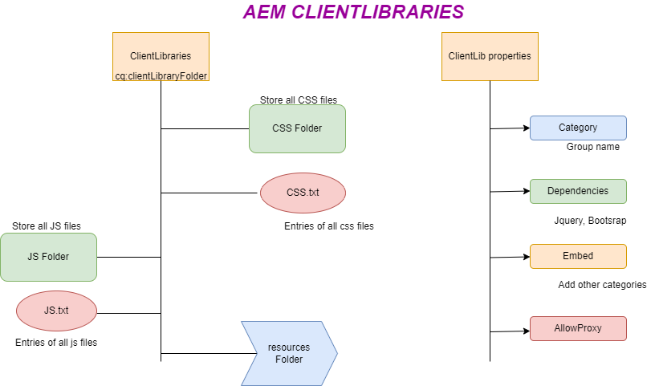

Slide 13
Static Template
Static templates are created by developers.
Stored in /apps directory of CRX.
After creating the page, any changers to the template will not affect the page.
Page Component -> Static Template -> Page.
static template is available for a long time but not recommended to use.

Slide 14
<div data-sly-resource="${'parsys' @resourceType = 'wcm/foundation/components/parsys'}"></div>
<sly data-sly-include="/libs/wcm/core/components/init/init.jsp"/>

Slide 15
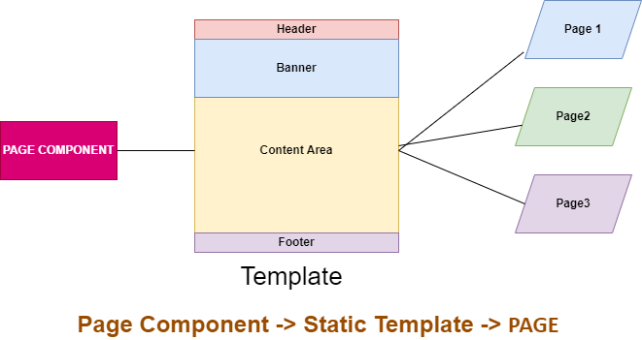
static template is available for a long time but not recommended to use.

Slide 16
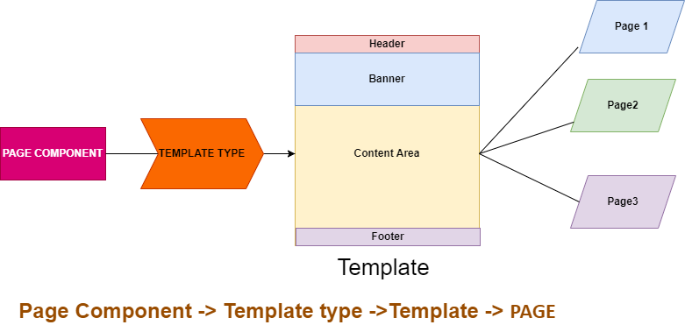
Editable Template

Slide 17
Static Template | Dynamic Template
Static templates are created by developers | Editable Templates can be created by template-authors.
Any update on existing template then its not reflect in already created pages to used on the template | Any update in template existing template then new changes are reflect in all the previous created pages.
Using design mode to store page design and add components in responsive grid. | Editable templates are using policies to store configuration.
Stored in /apps directory of CRX | Stored in /conf directory of CRX
Use static templates when you need strict control over page layouts and want to ensure a consistent design across your website. | Use dynamic templates when you want to provide content authors with the flexibility to create custom page layouts while still maintaining some level of control over branding and styling.

Slide 18
Content Component
Components are re-usable modules that implement specific application logic to render the content of our website.
/apps folder → New Project → component folder → Content folder → Create new component
Name , description, and group are need to provide info
Change .jsp to .html
Add respective HTML Code

Slide 19
Copy cq:dialog from
/libs/wcm/foundation/components/title/cq:dialog
/apps/core/wcm/components/title/v2/title/cq:dialog
3. Edit template and add policies in responsive grid.

Slide 20
Thanks for Watching. Like share subscribe

