Slide 2

Databricks Technical Meetup
Polly as the Show-Runner
for a Multi-Agent Databricks Coding Team
Topic
Live implementation with Omnigent on local Docker and Databricks Free Edition
Polly coordinates specialist agents to build, review, validate, and present a Databricks data product.
Presented By: Nitesh
Speaker Title: Data/ML Platform Solutions Architect
Event: Databricks Technical Meetup
Polly Multi-Agent Databricks Demo
01
Notes:
This replaces the dark version with a bright Databricks-branded title slide and visible metadata.
[Sources]
Databricks Omnigent docs: https://docs.databricks.com/aws/en/omnigent/
Databricks Free Edition docs: https://docs.databricks.com/aws/en/getting-started/free-edition
Databricks Free Edition limitations: https://docs.databricks.com/aws/en/getting-started/free-edition-limitations
Omnigent Polly docs: https://omnigent.ai/docs/use/builtin-agents/polly
Omnigent custom agents docs: https://omnigent.ai/docs/use/custom-agents
Omnigent collaboration docs: https://omnigent.ai/docs/collaborate
Databricks CLI authentication docs: https://docs.databricks.com/aws/en/dev-tools/cli/authentication
Q&A auditorium image generated with OpenAI image generation for this deck.

Slide 3
Databricks Technical Meetup
AI coding needs an operating model
Multiple coding agents are useful, but unmanaged handoffs create risk.
01
02
03
Context scatter
Review latency
Approval ambiguity
Prompts, decisions, and generated code end up across disconnected sessions.
Implementation moves quickly while architecture and governance lag behind.
Teams need a clear owner for what gets merged, run, and productionized.
Meetup thesis
Use Polly as the project manager that turns one Databricks requirement into delegated implementation, cross-agent review, validation, and a final report.
Polly Multi-Agent Databricks Demo
02
Notes:
Open the problem before introducing the tool.
[Sources]
Databricks Omnigent docs: https://docs.databricks.com/aws/en/omnigent/
Databricks Free Edition docs: https://docs.databricks.com/aws/en/getting-started/free-edition
Databricks Free Edition limitations: https://docs.databricks.com/aws/en/getting-started/free-edition-limitations
Omnigent Polly docs: https://omnigent.ai/docs/use/builtin-agents/polly
Omnigent custom agents docs: https://omnigent.ai/docs/use/custom-agents
Omnigent collaboration docs: https://omnigent.ai/docs/collaborate
Databricks CLI authentication docs: https://docs.databricks.com/aws/en/dev-tools/cli/authentication
Q&A auditorium image generated with OpenAI image generation for this deck.

Slide 4
Databricks Technical Meetup
Polly coordinates; specialist agents execute
The show-runner metaphor works because Polly keeps the workflow coherent.
Polly
ChatGPT / Codex
PySpark, SQL, notebook generation, validation
Receives high-level requirements
Architecture review, documentation, code quality
Claude
Breaks work into subtasks
Routes review and handoffs
Human presenter
Final approval, Databricks execution, production judgment
Summarizes outcomes
Polly Multi-Agent Databricks Demo
03
Notes:
Polly is supervisor/orchestrator; implementation and review happen in specialist agents.
[Sources]
Databricks Omnigent docs: https://docs.databricks.com/aws/en/omnigent/
Databricks Free Edition docs: https://docs.databricks.com/aws/en/getting-started/free-edition
Databricks Free Edition limitations: https://docs.databricks.com/aws/en/getting-started/free-edition-limitations
Omnigent Polly docs: https://omnigent.ai/docs/use/builtin-agents/polly
Omnigent custom agents docs: https://omnigent.ai/docs/use/custom-agents
Omnigent collaboration docs: https://omnigent.ai/docs/collaborate
Databricks CLI authentication docs: https://docs.databricks.com/aws/en/dev-tools/cli/authentication
Q&A auditorium image generated with OpenAI image generation for this deck.

Slide 5
Databricks Technical Meetup
The demo architecture stays simple
Local orchestration, Databricks execution, and a tested fallback notebook.
Presenter
Omnigent
Docker
Polly
Supervisor
Agent
Worktrees
Databricks
Free Edition
Polly Multi-Agent Databricks Demo
04
Notes:
Explain the split between local orchestration and Databricks execution.
[Sources]
Databricks Omnigent docs: https://docs.databricks.com/aws/en/omnigent/
Databricks Free Edition docs: https://docs.databricks.com/aws/en/getting-started/free-edition
Databricks Free Edition limitations: https://docs.databricks.com/aws/en/getting-started/free-edition-limitations
Omnigent Polly docs: https://omnigent.ai/docs/use/builtin-agents/polly
Omnigent custom agents docs: https://omnigent.ai/docs/use/custom-agents
Omnigent collaboration docs: https://omnigent.ai/docs/collaborate
Databricks CLI authentication docs: https://docs.databricks.com/aws/en/dev-tools/cli/authentication
Q&A auditorium image generated with OpenAI image generation for this deck.

Slide 6
Databricks Technical Meetup
The routing model gives Polly a contract
The YAML file turns a demo idea into repeatable delegation rules.
1
2
3
4
5
Intake
Decompose
Assign
Review
Validate
Capture story and constraints
Split data, ML, docs, tests
Match tasks to agents
Route findings back
Run checks and report
Routing model
polly-routing-model.yaml defines roles, agent strengths, workflow boundaries, conflict handling, and validation checks.
Polly Multi-Agent Databricks Demo
05
Notes:
This slide explains how to use the routing model YAML from the demo kit.
[Sources]
Databricks Omnigent docs: https://docs.databricks.com/aws/en/omnigent/
Databricks Free Edition docs: https://docs.databricks.com/aws/en/getting-started/free-edition
Databricks Free Edition limitations: https://docs.databricks.com/aws/en/getting-started/free-edition-limitations
Omnigent Polly docs: https://omnigent.ai/docs/use/builtin-agents/polly
Omnigent custom agents docs: https://omnigent.ai/docs/use/custom-agents
Omnigent collaboration docs: https://omnigent.ai/docs/collaborate
Databricks CLI authentication docs: https://docs.databricks.com/aws/en/dev-tools/cli/authentication
Q&A auditorium image generated with OpenAI image generation for this deck.

Slide 7
Databricks Technical Meetup
Agent assignments make the workflow transparent
The table gives attendees a clear view of ownership and output.
Workstream
Owner
Meetup output
Notebook scaffold
ChatGPT / Codex
Databricks Python notebook
Bronze / silver / gold
ChatGPT / Codex
PySpark transformations and views
Architecture review
Claude
Best-practice and risk findings
Conflict resolution
Polly
Documented decision and rationale
Final report
Polly
Build summary and next steps
Polly Multi-Agent Databricks Demo
06
Notes:
Structured comparison table for agent roles and outputs.
[Sources]
Databricks Omnigent docs: https://docs.databricks.com/aws/en/omnigent/
Databricks Free Edition docs: https://docs.databricks.com/aws/en/getting-started/free-edition
Databricks Free Edition limitations: https://docs.databricks.com/aws/en/getting-started/free-edition-limitations
Omnigent Polly docs: https://omnigent.ai/docs/use/builtin-agents/polly
Omnigent custom agents docs: https://omnigent.ai/docs/use/custom-agents
Omnigent collaboration docs: https://omnigent.ai/docs/collaborate
Databricks CLI authentication docs: https://docs.databricks.com/aws/en/dev-tools/cli/authentication
Q&A auditorium image generated with OpenAI image generation for this deck.

Slide 8
Databricks Technical Meetup
The live prompt starts as a product request
This keeps the demo grounded in a realistic Databricks build.
Polly
Break the story into tasks
Requirement intake prompt
Build a Databricks retail analytics notebook that ingests synthetic events, creates bronze/silver/gold views, trains a simple forecast model, validates outputs, and produces a final report.
Codex
Generate notebook code
Claude
Review architecture and quality
Databricks
Run approved notebook
Live-demo principle: generate and review live, but keep a tested notebook ready as the approved final candidate.
Polly Multi-Agent Databricks Demo
07
Notes:
This is the live presenter sequence.
[Sources]
Databricks Omnigent docs: https://docs.databricks.com/aws/en/omnigent/
Databricks Free Edition docs: https://docs.databricks.com/aws/en/getting-started/free-edition
Databricks Free Edition limitations: https://docs.databricks.com/aws/en/getting-started/free-edition-limitations
Omnigent Polly docs: https://omnigent.ai/docs/use/builtin-agents/polly
Omnigent custom agents docs: https://omnigent.ai/docs/use/custom-agents
Omnigent collaboration docs: https://omnigent.ai/docs/collaborate
Databricks CLI authentication docs: https://docs.databricks.com/aws/en/dev-tools/cli/authentication
Q&A auditorium image generated with OpenAI image generation for this deck.

Slide 9
Databricks Technical Meetup
The notebook is intentionally small and reliable
A lightweight data product keeps attention on orchestration, not setup friction.
10
3
1
5
synthetic events
bronze / silver / gold layers
simple ML section
validation checks
Notebook validation
What attendees should remember
display(demo_gold_daily_sales)
display(demo_validation_results)
assert demo_status == 'passed'
Polly connects planning, coding, review, execution evidence, and a final build summary.
Polly Multi-Agent Databricks Demo
08
Notes:
The notebook is the proof point and fallback artifact.
[Sources]
Databricks Omnigent docs: https://docs.databricks.com/aws/en/omnigent/
Databricks Free Edition docs: https://docs.databricks.com/aws/en/getting-started/free-edition
Databricks Free Edition limitations: https://docs.databricks.com/aws/en/getting-started/free-edition-limitations
Omnigent Polly docs: https://omnigent.ai/docs/use/builtin-agents/polly
Omnigent custom agents docs: https://omnigent.ai/docs/use/custom-agents
Omnigent collaboration docs: https://omnigent.ai/docs/collaborate
Databricks CLI authentication docs: https://docs.databricks.com/aws/en/dev-tools/cli/authentication
Q&A auditorium image generated with OpenAI image generation for this deck.

Slide 10
Databricks Technical Meetup
The review loop demonstrates enterprise discipline
The best moment is controlled disagreement, not code generation alone.
Implementation proposal
Review recommendation
Use managed Delta tables for a production-like lakehouse pattern.
Use temporary views for portability in Databricks Free Edition.
Polly resolves for the meetup: temp views live, Delta + Unity Catalog as the production hardening path.
Polly Multi-Agent Databricks Demo
09
Notes:
Conflict resolution makes Polly's coordination value tangible.
[Sources]
Databricks Omnigent docs: https://docs.databricks.com/aws/en/omnigent/
Databricks Free Edition docs: https://docs.databricks.com/aws/en/getting-started/free-edition
Databricks Free Edition limitations: https://docs.databricks.com/aws/en/getting-started/free-edition-limitations
Omnigent Polly docs: https://omnigent.ai/docs/use/builtin-agents/polly
Omnigent custom agents docs: https://omnigent.ai/docs/use/custom-agents
Omnigent collaboration docs: https://omnigent.ai/docs/collaborate
Databricks CLI authentication docs: https://docs.databricks.com/aws/en/dev-tools/cli/authentication
Q&A auditorium image generated with OpenAI image generation for this deck.

Slide 11
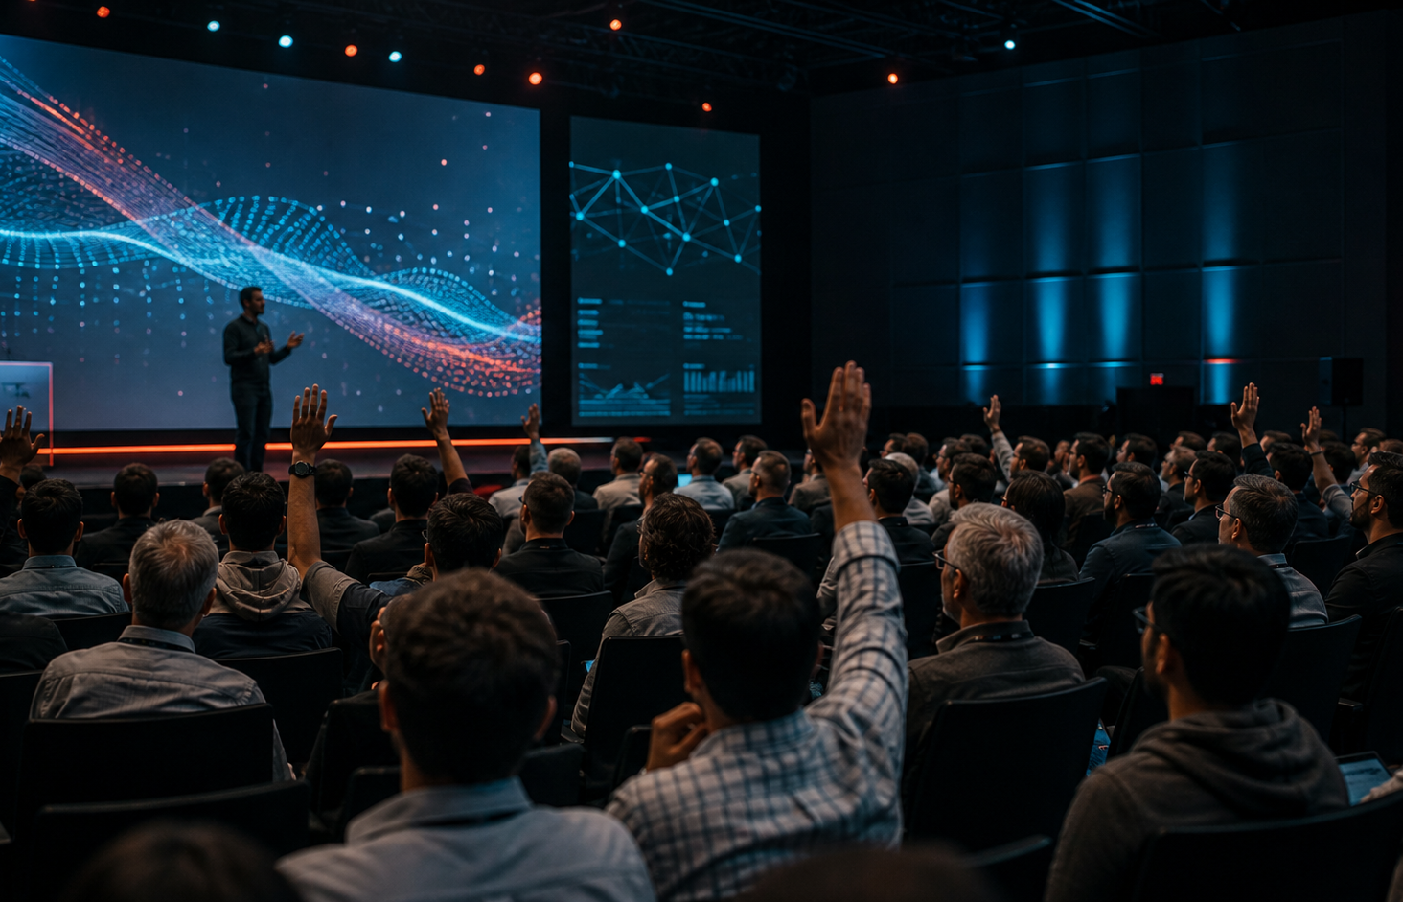
Databricks Technical Meetup
Interactive Q&A & Discussion
Let’s adapt the workflow to your Databricks environment.
Route it
Which agent should own architecture, testing, security, and production promotion?
Govern it
Where should approvals, policy checks, and access boundaries enter the workflow?
Scale it
How would this pattern change for Lakeflow, Unity Catalog, MLflow, or Asset Bundles?
OPEN DISCUSSION
Polly Multi-Agent Databricks Demo
10
Notes:
Dedicated Q&A slide with discussion prompts and auditorium visual.
[Sources]
Databricks Omnigent docs: https://docs.databricks.com/aws/en/omnigent/
Databricks Free Edition docs: https://docs.databricks.com/aws/en/getting-started/free-edition
Databricks Free Edition limitations: https://docs.databricks.com/aws/en/getting-started/free-edition-limitations
Omnigent Polly docs: https://omnigent.ai/docs/use/builtin-agents/polly
Omnigent custom agents docs: https://omnigent.ai/docs/use/custom-agents
Omnigent collaboration docs: https://omnigent.ai/docs/collaborate
Databricks CLI authentication docs: https://docs.databricks.com/aws/en/dev-tools/cli/authentication
Q&A auditorium image generated with OpenAI image generation for this deck.

