Slide 1

BOOTSTRAP
UMAIR AZMAT

Slide 2
HISTORY OF BOOTSTRAP
Bootstrap, originally named Twitter Blueprint, was developed by Mark Otto and Jacob Thornton at Twitter as a framework to encourage consistency across internal tools.
Before Bootstrap, various libraries were used for interface development, which led to inconsistencies and a high maintenance burden.
After a few months of development by a small group, many developers at Twitter began to contribute to the project as a part of Hack Week, a Hackathon-style week for the Twitter development team.
It was renamed from Twitter Blueprint to Bootstrap, and released as an open source project on August 19, 2011.
It has continued to be maintained by Mark Otto, Jacob Thornton, and a small group of core developers, as well as a large community of contributors

Slide 3
INTRODUCTION TO BOOTSTRAP
Build fast, responsive sites with Bootstrap
Quickly design and customize responsive mobile-first sites with Bootstrap, the world’s most popular front-end open source toolkit, responsive grid system, extensive prebuilt components, and powerful JavaScript plugins.

Slide 4
INTRODUCTION TO BOOTSTRAP
Free and open-source software (FOSS)
Free Software and open-source software
Anyone is Freely Licensed to use, copy, study, and change the software in any way
Source Code is openly shared so that people are encouraged to voluntarily improve the design of the software
A CSS framework is a library allowing for easier, more standards-compliant web design using the Cascading Style Sheet language.
Front-end web development is the development of the graphical user interface of a website, through the use of HTML, CSS, and JavaScript, so that users can view and interact with that website.

Slide 5
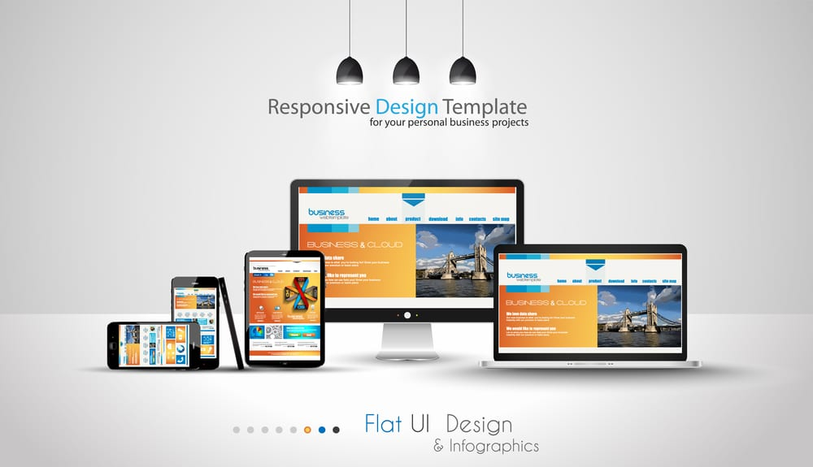

RESPONSIVE WEBSITES

Slide 6
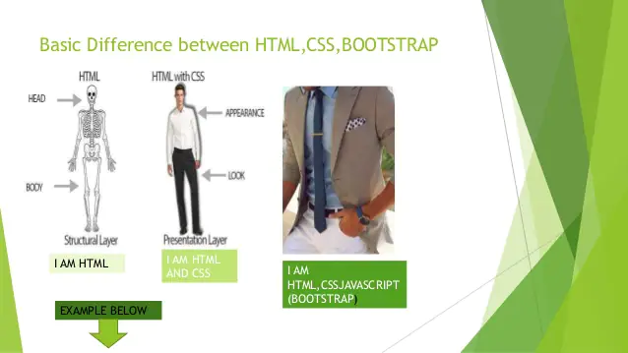
DIFFERENCE BETWEEN HTML,CSS & BOOTSTRAP

Slide 7
HOW TO USE BOOTSTRAP IN PROJECT
By using CDN
By pasting Starter Template
Download and then link to project
Install by npm

Slide 8
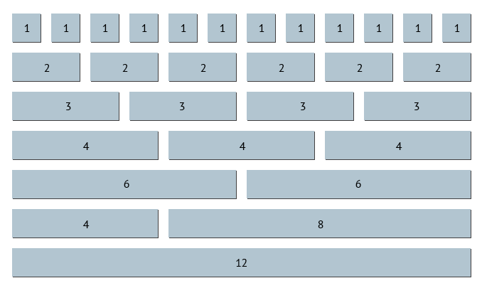
GRID SYSTEM

Slide 9
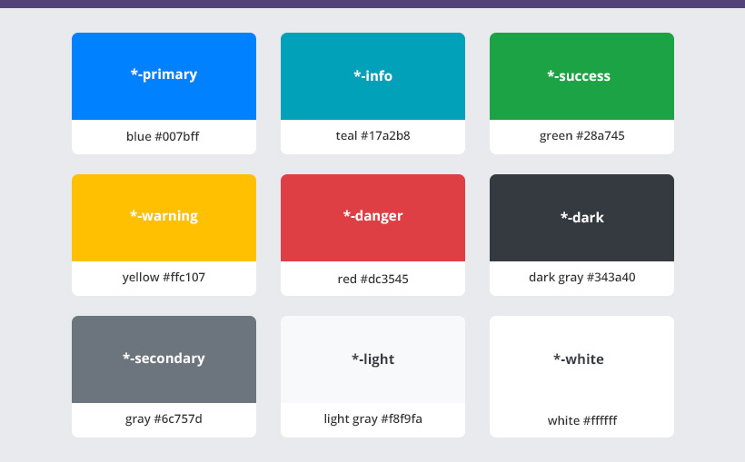
COLORS
Primary
Secondary
Success
Danger
Warning
Info
Light
Dark

Slide 10
BREAKPOINTS
Breakpoint | Class infix | Dimensions
X-Small | None | <576px
Small | sm | ≥576px
Medium | md | ≥768px
Large | lg | ≥992px
Extra large | xl | ≥1200px
Extra extra large | xxl | ≥1400px

Slide 11
COMPONENTS
Accordion
Alerts
Badge
Breadcrumb
Buttons
Button group
Card
Carousel
Close button
Collapse
Dropdowns
Popovers
Modal
Navs & tabs
Navbar
Offcanvas
Pagination
Placeholders
Progress
Scrollspy
Spinners
Toasts
Tooltips
List group

