Slide 1


Slide 2

Open Data Mapping of City Projects
“What The Heck, Denton?”

Slide 3

City-Why
Make the case for bonds
Lack of access to current information and opaque planning makes for higher levels of citizen complaints and negative engagement
How many complaints do you get based on lack of current information?

Slide 4
Citizen-Why
Citizens want to know why their street is flooding or poorly maintained, and does the city even know?
What's happening in my neighborhood?
What's happening along my commute?
Why am I stuck in traffic?!

Slide 5
What?
What projects are currently in process
Completed projects
Link points on the map to city documents (mentions, plans, changes)

Slide 6
How?
Regular uploads
UNT Library can help
(bonus: archiving)

Slide 7
How?
Pulls from various data sources
Funnel through single server with data conversion
Modern JavaScript app
Responsive Web

Slide 8
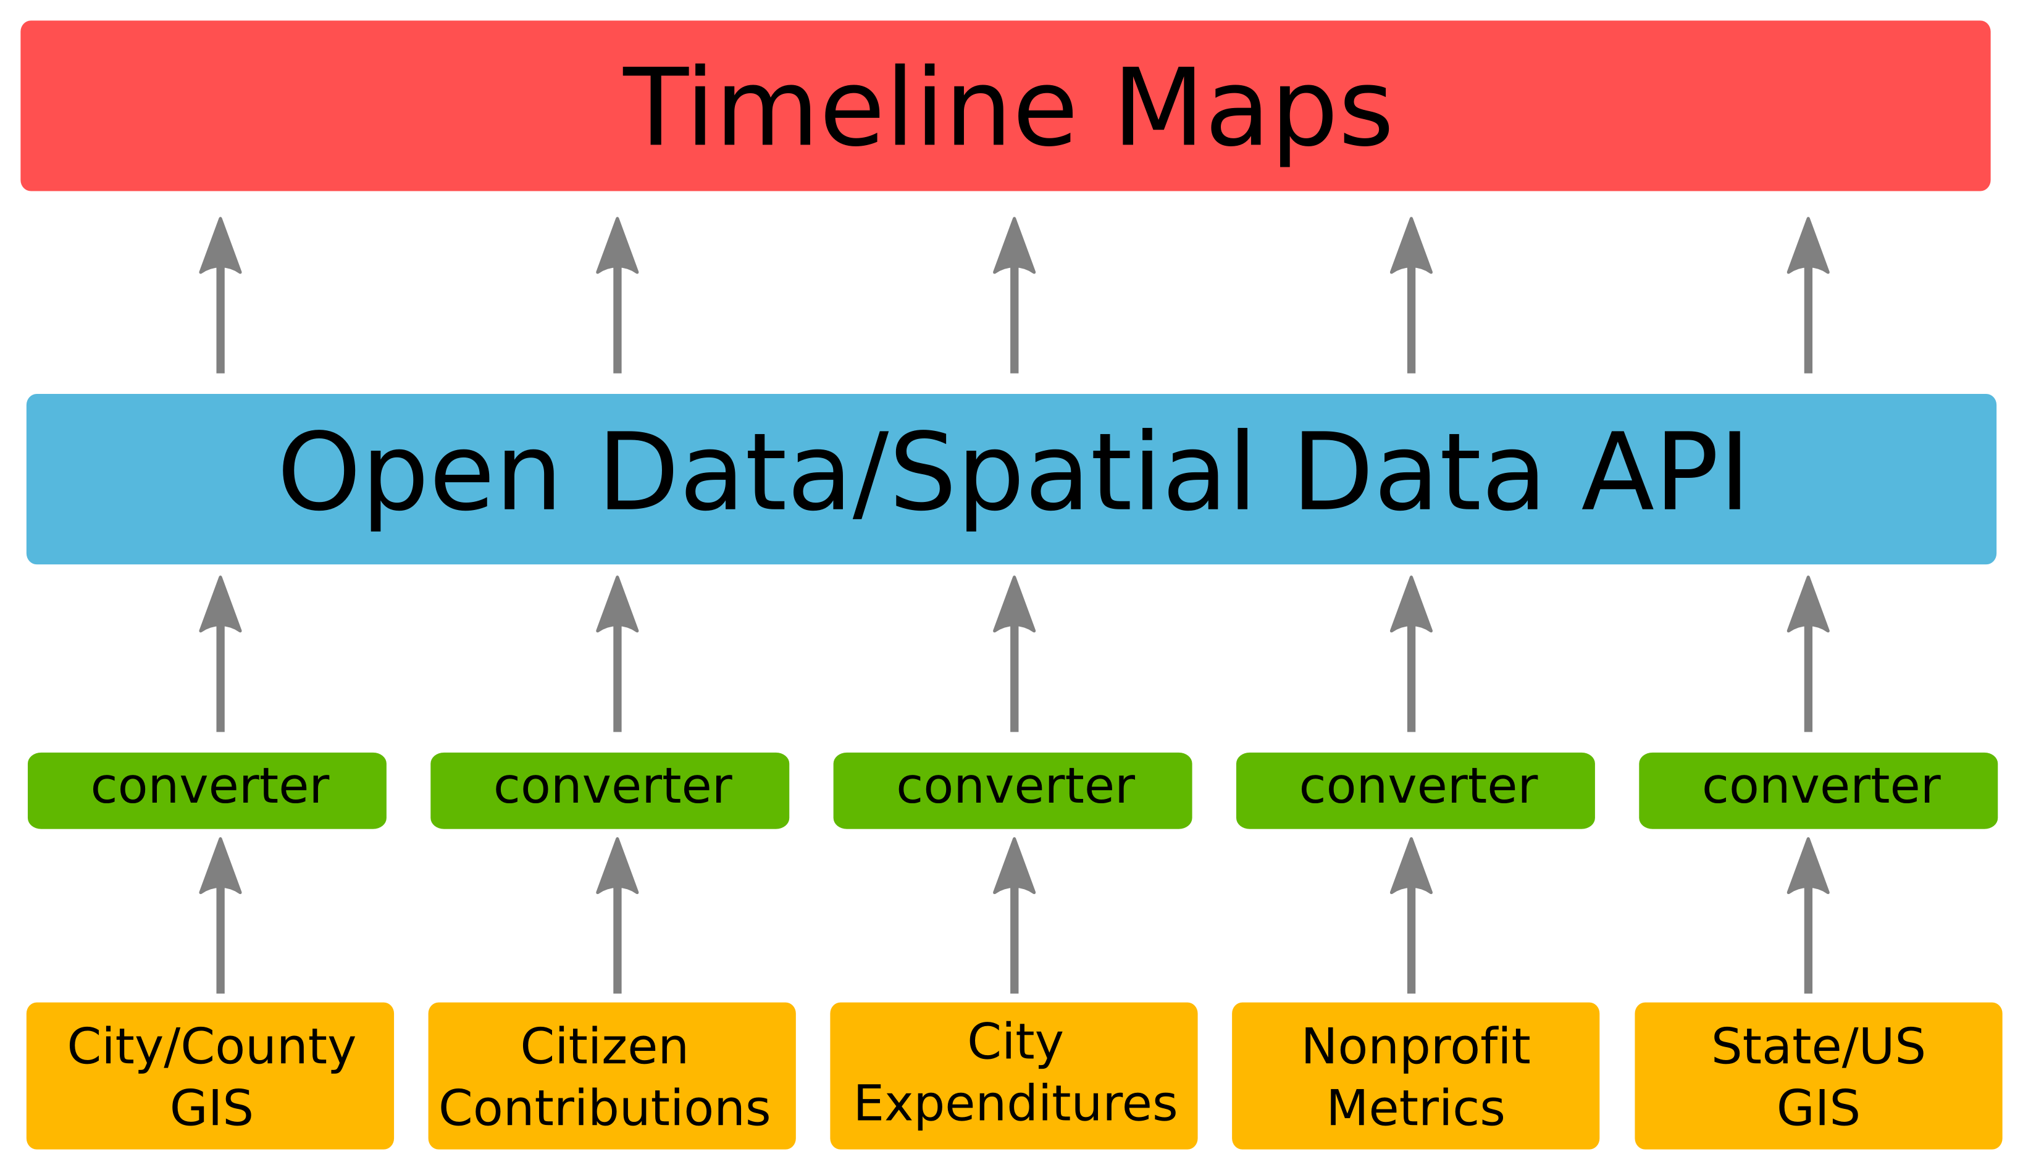
How?

