Slide 1
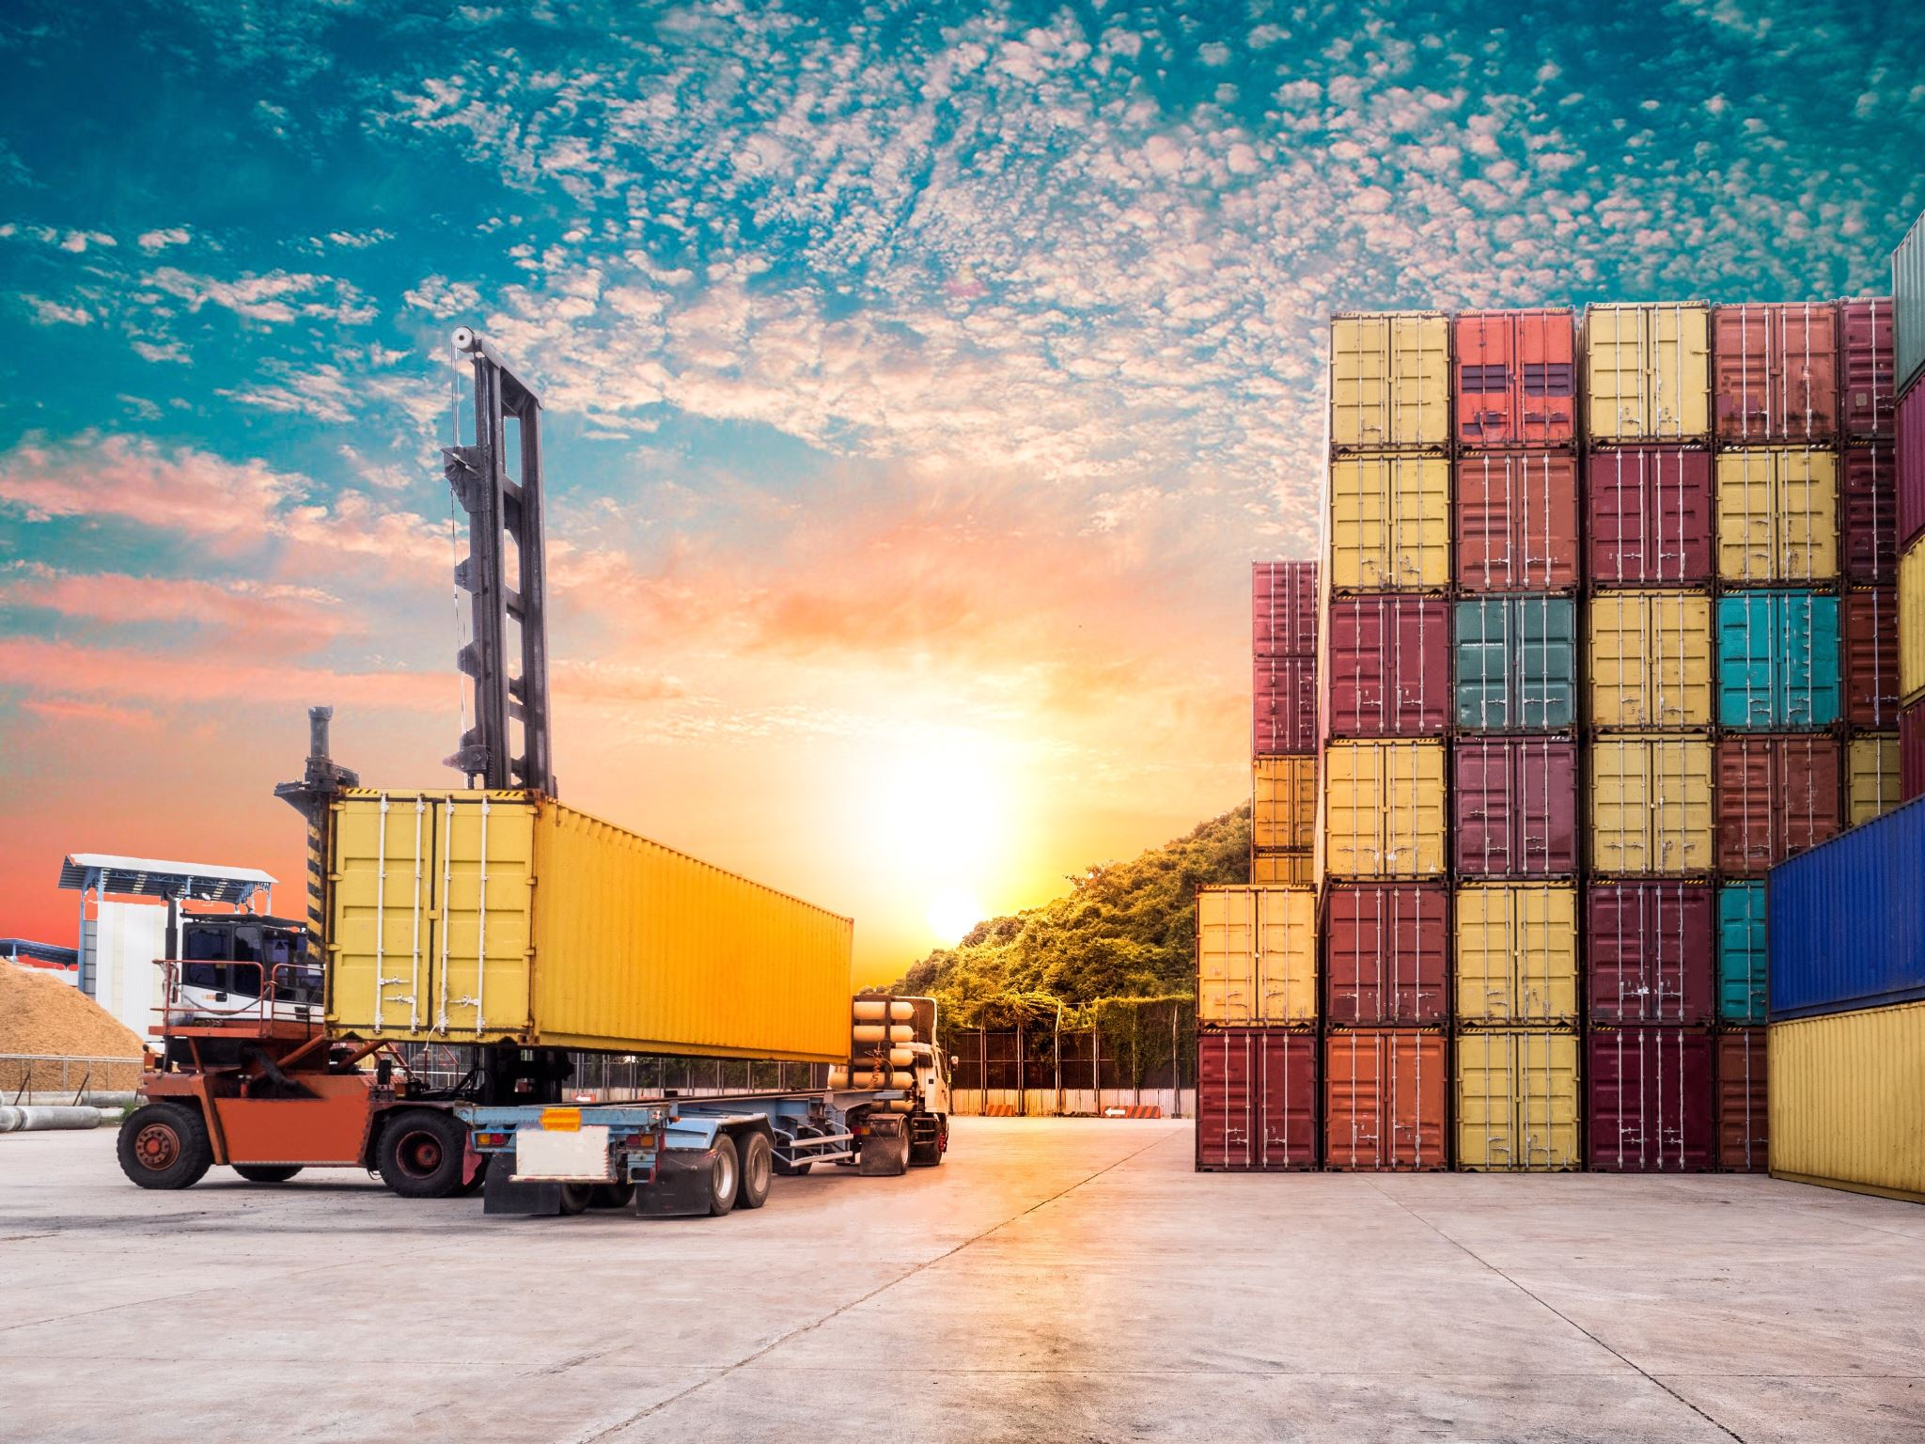
Docker internals

Slide 2
Virtual machines vs containers
Virtual machines (VMs) solved the problem of wasted physical hardware by allowing multiple isolated environments to run on a single physical server. However, VMs introduced a new bottleneck: operating system overhead. Containers originated to eliminate this overhead and optimize software delivery.
VMs use hypervisors. They are a layer of software (like VMware or VirtualBox) that sits on the physical host and creates/runs VMs. The hypervisor tricks the Guest OS into thinking it has its own dedicated CPU, RAM, and Network Card.
The Guest OS doesn't "know" it doesn't have hardware because it is programmed to interact with interfaces. As long as the Hypervisor provides the expected response to a CPU instruction or a driver request, the Guest OS continues to operate under the illusion that it owns the machine.
In Docker, this entire layer of trickery is removed. There is no Guest OS to fool, so there is no need for a hypervisor to intercept instructions, which is why containers have near-native performance.

Slide 3
Problems with VMs
The Bottleneck of Virtual Machines (Hypervisor Overhead)
VMs rely on a hypervisor to virtualize physical hardware. Because the hardware is virtualized, every VM requires its own complete, independent Guest Operating System (OS).
Resource Bloat: Running 10 isolated applications on a server using VMs requires running 10 full operating systems. Each OS consumes gigabytes of disk space and reserves significant RAM just to manage its own background system processes, leaving fewer resources for the actual applications.
Slow Boot Times: Booting a VM means executing a full OS boot sequence. This process takes minutes, making it highly inefficient to rapidly scale application instances up or down in response to real-time traffic spikes.
Portability Friction: VM images are massive files, often tens of gigabytes in size. Moving them between a developer's laptop, a testing environment, and production servers is slow and bandwidth-intensive.

Slide 4
The Perks of container
The Container Solution (OS-Level Virtualization)
Containers solve the resource duplication problem by abandoning hardware virtualization. Instead, they virtualize the Operating System itself.
A container packages only the application code, its runtime, system tools, and required libraries. It does not contain an OS kernel. Instead, all containers running on a machine share the single underlying Host OS kernel directly.

Slide 5
Definition - Kernal
The kernel is the core component of an operating system. It acts as the "bridge" or intermediary between the software (applications) and the hardware (CPU, memory, disk).
Resource Management: Applications cannot talk directly to hardware. If a program needs to save a file, it asks the kernel; the kernel then writes the data to the physical disk.
Memory Management: The kernel decides which application gets how much RAM and ensures one program doesn't overwrite another's memory space.
Process Scheduling: It determines which process gets to use the CPU at any given millisecond.
Logical takeaway: Every OS has exactly one kernel. In Docker, the container doesn't have its own kernel; it sends "system calls" directly to the host's kernel.

Slide 6
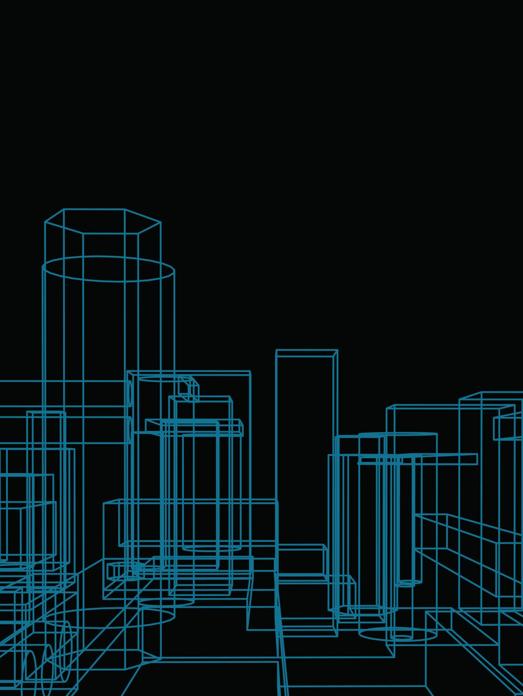
Understanding mechanics of isolation
In the architecture of a Virtual Machine (VM), hardware resources are partitioned into rigid, distinct sections. This can be compared to a large room containing 100 people that must be divided into ten groups. To achieve isolation, one could draw physical lines on the floor, creating ten separate enclosures. Each group is confined to its specific square footage, and the resources within those boundaries are strictly reserved for them. Because each section operates as an independent unit with its own floor space (the Guest OS), the groups are entirely decoupled from one another at the "ground" level.

Slide 7
Containers, conversely, utilizes namespaces to achieve isolation without physical partitioning. Using the same room of 100 people, instead of drawing lines on the floor, imagine giving every person a "chit" or a badge labeled with their team number. While everyone continues to stand on the same shared floor and breathe the same air (the shared Host OS Kernel), the badges dictate their "view" of the room. The system ensures that a person with a "Team 1" badge can only see and interact with others wearing the same badge.
The primary distinction lies in resource efficiency. In the VM example, a section of the floor remains occupied even if its team leaves; the hardware is "locked" to that VM. In the Docker example, because there are no physical walls, the people can move freely and use any available space in the room as needed, provided they only interact with their designated teammates. This allows containers to be significantly more lightweight and flexible than traditional virtual machines.

Slide 8

Namespaces and Cgroups - Magic of Linux kernel

Slide 9
In the Linux architecture, namespaces function as a layer of abstraction that wraps global system resources into virtualized instances. Their primary usage is to isolate runtime environments so that processes inside a container believe they have their own independent system.
It is critical to note that while namespaces handle the isolation of the runtime environment, they do not inherently isolate storage. Namespaces determine what a process can see in terms of the system's execution state, but they do not manage the physical data or disk images.

Slide 10
Namespaces create a private "view" for a process. When you run a container, namespaces isolate the following runtime components:
Process ID (pid): Provides an independent branching of process IDs. Inside the container, the main application runs as PID 1, completely unaware of the thousands of processes running on the host.
Network (net): Virtualizes the network stack, providing the container with its own private IP addresses, routing tables, and port ranges.
Interprocess Communication (ipc): Prevents processes in different containers from accessing each other’s shared memory or message queues.
Hostname (uts): Allows the container to have its own unique hostname and domain name, separate from the host system.
User (user): Maps user and group IDs inside the container to different IDs on the host, allowing a process to have "root" privileges inside the container while being a "non-privileged" user on the host.
Mount (mnt): This isolates the set of file system mount points seen by a group of processes. It allows a container to have its own root directory (/) and mount/unmount filesystems without affecting the host or other containers.

Slide 11

Cgroups - the walls of room
While namespaces define what a container can see, Control Groups (cgroups) define what a container can consume. They are the resource-management backbone of the Linux kernel, ensuring that a single container cannot monopolize system resources like CPU, memory, or disk I/O, which would otherwise lead to "noisy neighbor" syndrome and system instability.

Slide 12
Cgroups - continued
To keep track of usage, the cgroup mechanism maintains counters for every resource type. The kernel intercepts system calls—such as requests for memory allocation or CPU cycles—and updates the corresponding cgroup’s usage files in real-time. This allows tools like Docker to provide live statistics on how much CPU or memory a container is currently utilizing. Because these metrics are gathered directly at the kernel level, the tracking is extremely precise and carries very low overhead.
The combination of visibility limits and consumption limits is what makes containerization viable: namespaces and cgroups - magic of linux kernal.

Slide 13

Namespaces and cgroups define the runtime execution of a container. Now we will look into the static segment of containers and try to answer following questions. where does the file system come from, how does the storage of containers work, and how are they transferred?

Slide 14

The Blueprint - Images
We have now seen how Namespaces and Cgroups create the 'room' and set the 'rules' for our processes. But a room is useless if it is empty. To actually do work, the container needs a file system—it needs libraries, configuration files, and the application code itself. This is where Images come in. If Namespaces and Cgroups are the 'runtime environment,' then the Image is the frozen blueprint or the 'template' that fills that environment with life.

Slide 15
What is an image?
What exactly is an “image”?
An image is:
A read-only template that contains everything needed to run a program.
This includes:
Base OS files (like from Ubuntu)
Libraries
Dependencies
Your application code
Default configs
👉 Think of an image like a blueprint or snapshot of a filesystem.
Analogy
Image = class (blueprint)
Container = object (instance of that class)

Slide 16
Definition - filesystem
A filesystem is the method an operating system uses to organize, store, retrieve, and manage files on a storage device (like a hard disk, SSD, USB drive, etc.).
Think of a filesystem like a library catalog system — the books are data, and the catalog system tells you where each book is stored and how to find it.
What a filesystem actually does
A filesystem is responsible for:
Naming files
Organizing files into directories/folders
Storing file data on disk blocks
Keeping metadata (size, permissions, timestamps, owner)
Managing free space
Controlling access permissions
So when you open a file like: /home/user/file.txt the filesystem figures out where on the disk the actual data is stored and retrieves it.

Slide 17
How are images made and stored and transferred.
How are Images formed:When you build an image (typically via a Dockerfile), each instruction creates a new layer.
Layering: If your Dockerfile has a FROM ubuntu line, followed by RUN apt-get install python, and then COPY app.py, you have three distinct layers.
Copy-on-Write (CoW) Strategy: This is the core logic. When a layer needs to modify a file from a previous layer, it copies the file to the new layer and applies the changes there. The original file remains unchanged in the underlying layer.

Slide 18

How are the layers of image stored?
Docker uses a Content Addressable Storage system.
Layer IDs (Hashes): Each layer is identified by a SHA256 hash of its contents. If two different images both use the exact same Debian base layer, Docker only stores that layer once on your disk.
This avoids wastage of disk storage in storing the same os again and again for different containers.

Slide 19
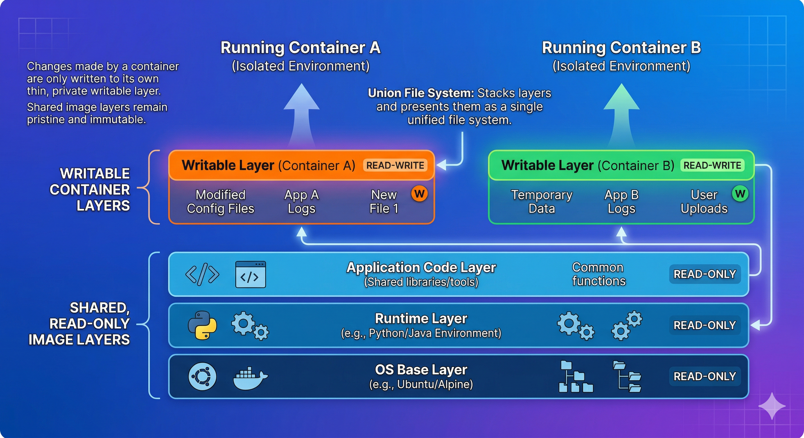
Sharing of base layers

Slide 20
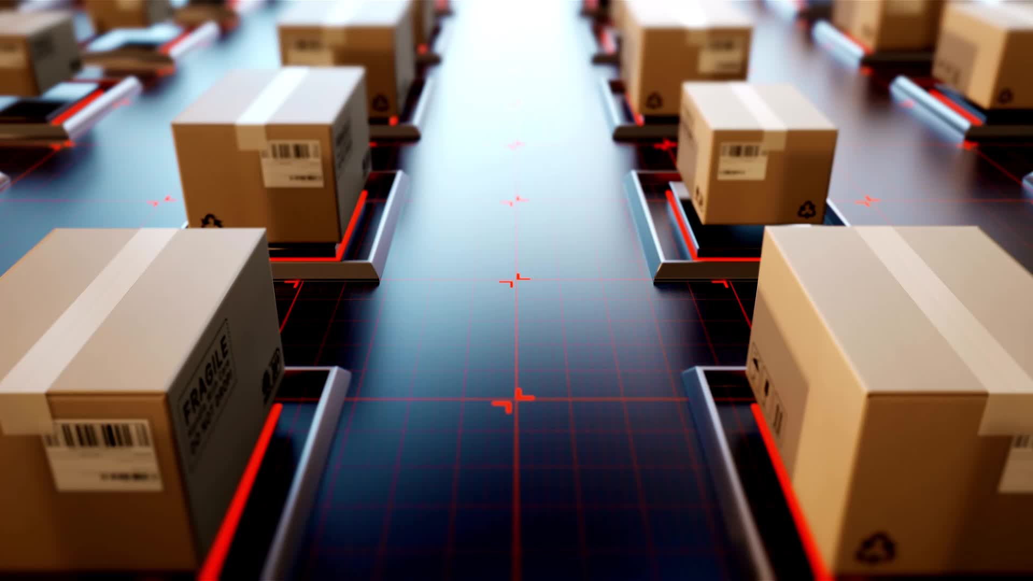
How the layers of images and containers interact? – THE MANIFEST
To understand how this works, you have to look at the Storage Driver (specifically Overlay2, which is the modern standard). It uses a concept called Union Mounting.
The "Pointer" Mechanism: The Manifest
Each image has a JSON file (the manifest) that lists the SHA256 hashes of the layers it needs.
When you start a container, Docker looks at the manifest, finds those layers in its local storage (the "Layer Store"), and "points" to them.
Physical Location: On a Linux system, these layers physically live in /var/lib/docker/overlay2/. If ten images use the same Ubuntu base layer, they all point to the exact same directory on your hard drive.

Slide 21
Union mounting and Copy-on-write: isolation with shared resources
Union mounting (the magic)
Copy-On-Write(isolation)
The Storage Driver creates a Merged View.
LowerDir: These are the read-only image layers.
UpperDir: This is the container's specific writable layer.
Merged: This is what the process inside the container actually sees.
When Container A looks for /bin/bash, the kernel looks in its UpperDir (writable layer). It’s not there. So, it looks "down" into the LowerDir (the image layer), finds it, and provides it.
Scenario: Container A wants to modify /etc/hosts (which exists in the read-only base layer).
The Action: Docker immediately copies /etc/hosts from the read-only layer up into Container A’s UpperDir (writable layer).
The Result: Container A modifies its own copy. Container B still looks "down" at the original file in the base layer and sees no changes.
This is why starting a container is nearly instantaneous. Docker doesn't copy the 200MB OS; it just creates a tiny, empty directory (the writable layer) and tells the kernel to "stack" it on top of the existing image layers.

Slide 22
What does transferring containers actually mean?
Container vs. Image Transfer
What you actually transfer: You transfer the Image, not the "Container.“
The Difference: A container is a running instance of an image. It consists of the read- only image layers plus a thin, "writable layer" on top.
In Practice: When you want to move your application, you push the image to a registry (like Docker Hub) and pull it elsewhere. If you have a running container with data written to its writable layer, that data is not included in the image transfer unless you explicitly commit that container into a new image.

Slide 23
Why can we not use zip files for transfer from one machine to other?

Slide 24
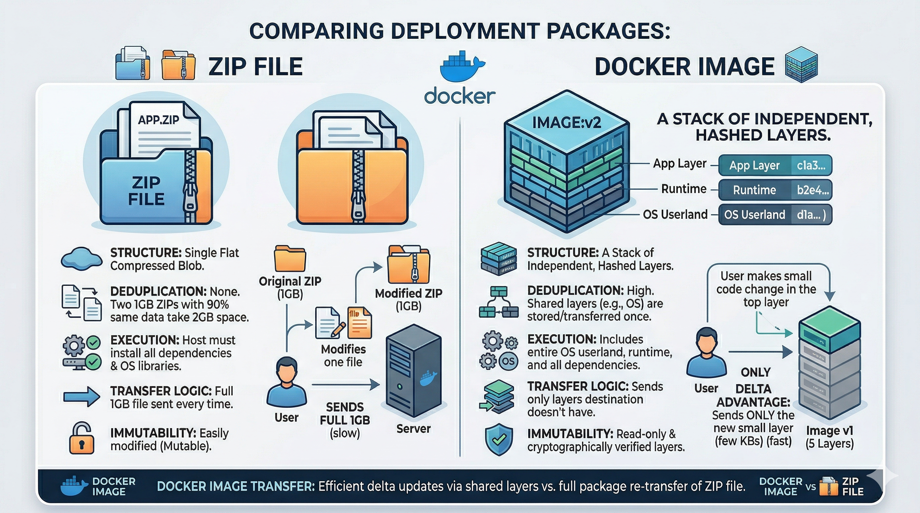

Slide 25
In case of zip file we need to install all the dependencies including the OS. But in the case of docker image we do not install the OS. WHY
You don't "install" the OS in a container because the image is essentially a snapshot of a pre-installed OS filesystem.
When you transfer a Docker image, you are transferring a directory structure that looks exactly like a fresh Linux install. When the container starts, Docker uses a Linux feature called chroot (change root) to tell the application: "The folder we just downloaded is now your entire world; your / (root) starts here." The application sees the Ubuntu files you transferred, uses the Ubuntu libraries you transferred, but executes its commands on the host's existing CPU and Kernel. This is why it is "lightweight" compared to a Virtual Machine, which would require installing a whole new Kernel.

Slide 26
More on docker vs zip
Zip file: “code only”
Docker file: “the entire room”
A ZIP file is typically a collection of your application code and perhaps some configuration files. It assumes the "ground" it lands on is already prepared.
Dependency Gap: If your code requires Python 3.10 and a specific version of a library (like OpenSSL), a ZIP file does not include those. You must manually install them on the destination machine.
OS Fragmentation: If you ZIP an application on Windows and try to run it on Linux, it will likely fail because the compiled binaries and system paths are different. The ZIP doesn't bring the operating system's environment with it.
A Docker image doesn't just contain your code; it contains the User Space of an Operating System.
What is User Space? When you see FROM ubuntu in a Dockerfile, you aren't installing a whole new Kernel (the core of the OS). You are grabbing the Ubuntu "User Space"—the libraries, package managers (apt), shell (bash), and file structures.
The Shared Kernel: Docker containers share the Host Kernel. Because almost all modern Linux distributions use a compatible Kernel, an "Ubuntu" container can run perfectly on a "Fedora" host. The container brings its own libraries ($libc$, etc.), so it doesn't care what is installed on the host.

Slide 27

Pulling an image from docker hub.
When you pull an image, the layers are stored in a specific directory managed by the Docker Engine. The exact location depends on your operating system and the storage driver being used.
1. Default Storage Locations
On most systems, Docker stores image layers in a root-protected directory:
Linux: /var/lib/docker/overlay2/
2. The Internal Structure
Within that /var/lib/docker/ directory, the data is organized into several sub-folders:
overlay2/: This is where the actual files and directories of the layers live. Each layer has its own subdirectory.
image/: This contains the metadata about the images, including the "manifests" that tell Docker which layer IDs belong to which image.
containers/: This stores configuration and log files for active or stopped containers.

Slide 28
What is docker hub?
Docker Hub
Docker Hub is a cloud-based service and the world's largest public library of container images. It serves as a central point where individuals and organizations can find, share, and store Docker images.
Public Repositories: Used for open-source projects (e.g., official images for Ubuntu, Nginx, or Postgres).
Private Repositories: Used by companies to store proprietary application images securely.

Slide 29
Definition - dockerfile
Dockerfile
A Dockerfile is a text document containing a sequence of instructions used to assemble a Docker image. It automates the environment setup by defining the base operating system, software dependencies, environment variables, and the specific commands to run the application.
Key Instructions:
FROM: Sets the base image (e.g., FROM python:3.9).
COPY: Transfers files from your local machine into the image.
RUN: Executes commands during the build process (e.g., installing packages).
CMD: Specifies the default command to run when the container starts.

Slide 30
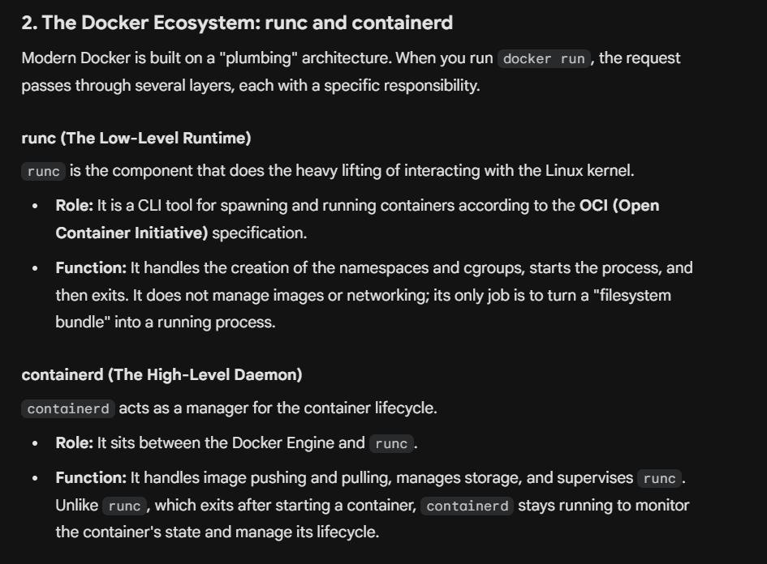
Runc and containerd

Slide 31
Thank you
By – Ayush Sharma

