Slide 1
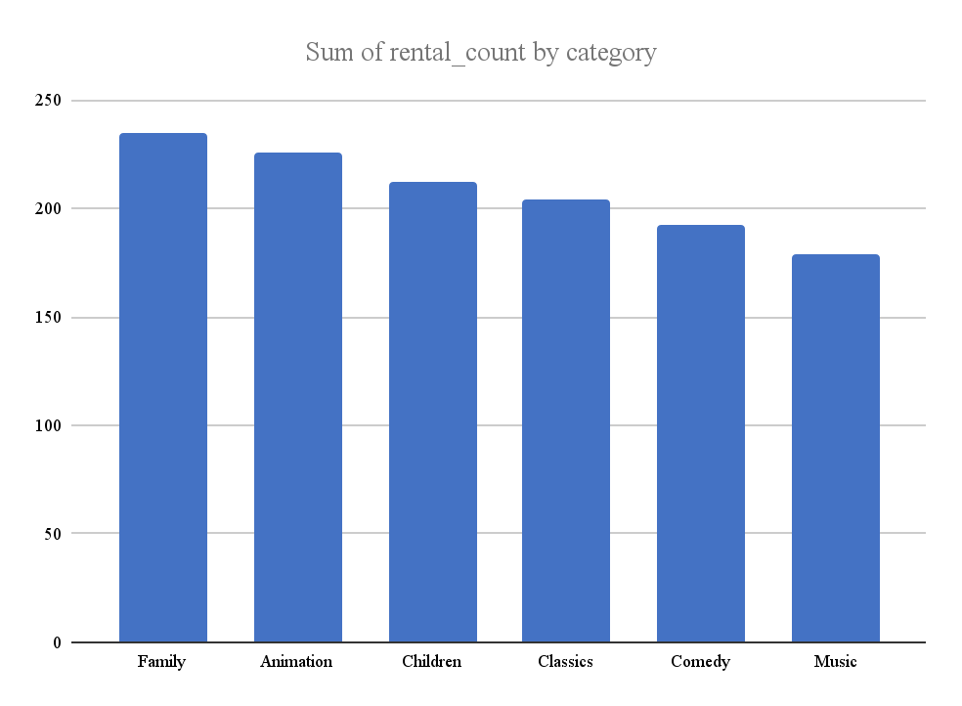
What film categories are most popular with families by rental count?
<visualization>
Film Categories from Greatest to Least
Family…………………………………. 235 rentals
Animation…………………………. 226 rentals
Children……………………………… 212 rentals
Classics………………………………. 204 rentals
Comedy………………………………. 192 rentals
Music……………………………………. 179 rentals
Notes:
WITH films as (
SELECT f.title AS film_name,
c.name AS category,
r.rental_ID AS rental
FROM film AS f
JOIN film_category as fc
USING (film_id)
JOIN category AS c
USING (category_id)
JOIN inventory AS i
ON f.film_id = i.inventory_id
JOIN rental AS r
ON i.inventory_id = r.inventory_id
WHERE c.name IN ('Animation', 'Children', 'Classics', 'Comedy', 'Family', 'Music')
)
SELECT film_name, category,
COUNT (*) as rental_count
FROM films
GROUP BY 1,2
ORDER BY 2;

Slide 2
<title>
<visualization>
<description>

Slide 3
<title>
<visualization>
<description>

Slide 4
<title>
<visualization>
<description>

