Slide 1
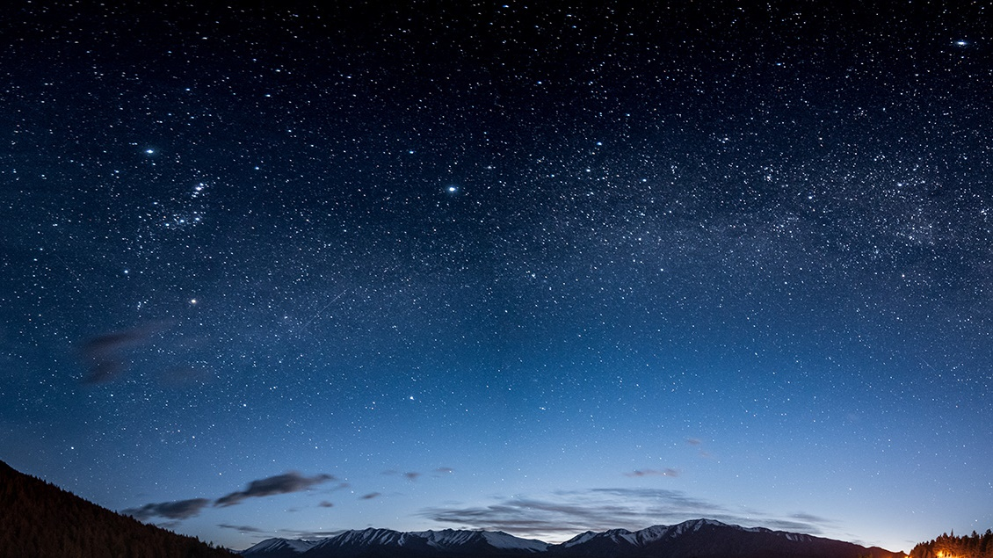
Environmental sound classification
Moinak chakraborty
Sayma sultana

Slide 2
Problem Specification
2000 labeled sounds of 5 major categories: animal, natural soundscape, human sound, interior and exterior sound.
Each sound-clip of 5s , in ".wav" form
Classify into 50 classes
Animal | Natural | Human | Interior | Urban
Cow | Thunderstorm | Footstep | Clock tick | Car horn
Dog | Rain | Laughing | Can opening | Helicopter
Cat …. | Wind... | Clapping... | Door knock... | Firework...

Slide 3
Motivation
"Enhancement of Urban Sound Classification Using Various Feature Extraction Techniques ", Afshankaleem, I. Santi Prabha, IJRTE, 2019
Classification of environmental sounds using different techniques

Slide 4
Sound Features
MFCC: Mel frequency cepstral coefficient
Chromagram : Tonal content of an audio or image signal in a condensed form
Melspectrogram: Acoustic time-frequency representation of a sound or image
Tonnetz: Traditional harmonic relationship
Spectral Contrast: Shows spectral peak, the spectral valley, and their difference in each frequency subband

Slide 5
Sound Feature (MFCC)
Taking Fourier transform of audio signal
Use triangular overlapping windows to map power on Mel scale
Take logarithmic of the power of the frequencies
Take Discrete Cos Transform
MFCC amplitude Spectrum

Slide 6
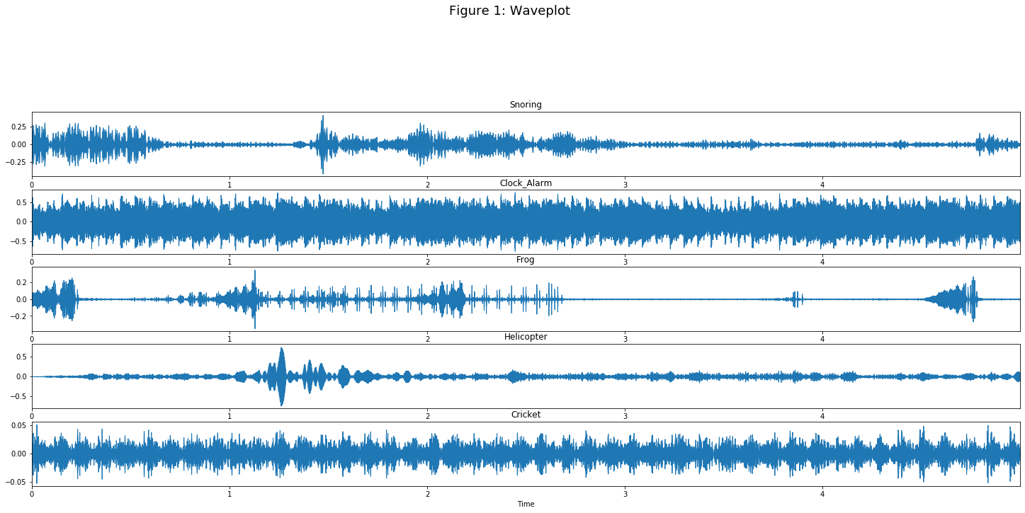
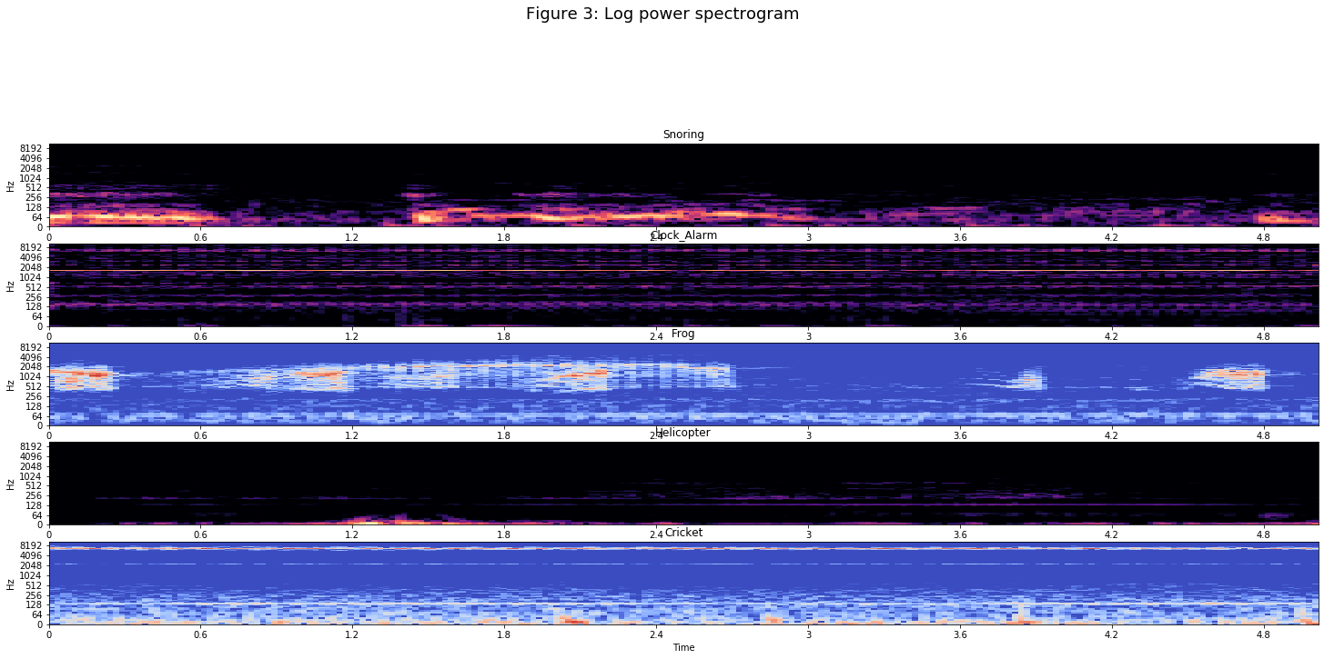
Feature Extraction
Wave Plot
Log power Spectogram

Slide 7
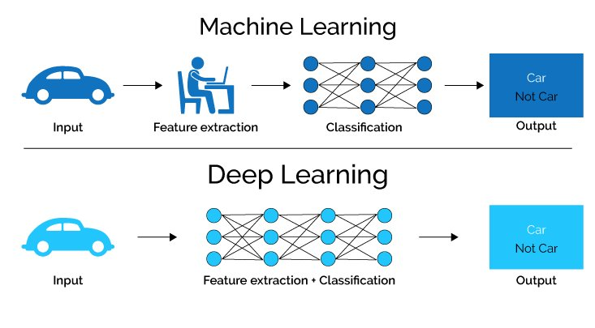
Difference between Classical ML and Deep Learning

Slide 8
Basic Example of Neural Network

Slide 9
Machine Learning System
Data processing: Generate power spectograms from audio clips, extracting sound features
Training model with extracted features
Important libraries: Librosa, matplotlib, sklearn, tensorflow
Algorithm: Neural network , CNN, RNN

Slide 10
Neural Network Model
Number of layer : 2
Number of class : 50
Number of epoch : 2000 - 6000
Learning rate: 0.001 - 0.00001

Slide 11
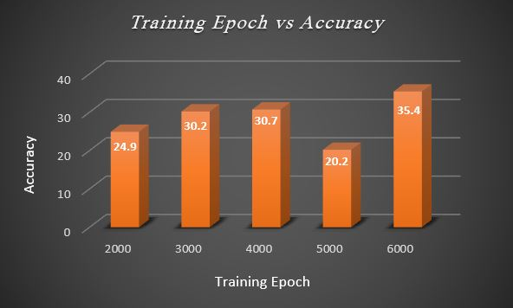
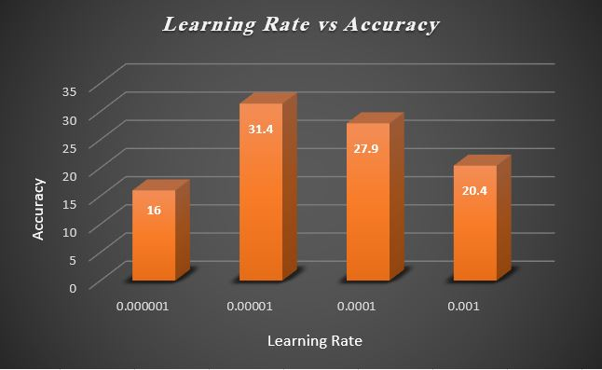
Comparative Result

Slide 12
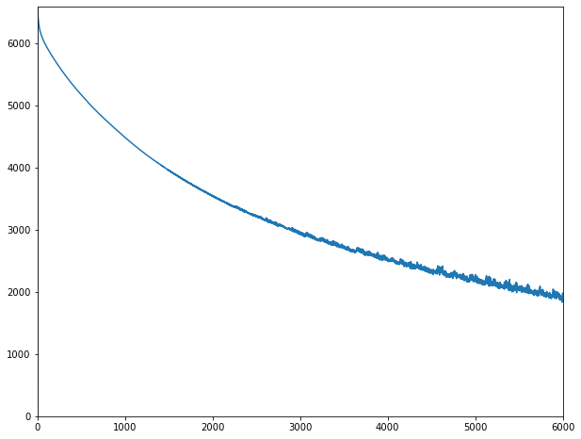
Result
Training epoch = 6000, learning rate = 0.00001
Runtime : ~20 min
Accuracy : 31.4%
Precision : 31.37%
Cost
Training epoch

Slide 13
Future work
We will use Recurrent Neural Network (RNN), Convolutional Neural Network(CNN) and check how RNN will work in compared to CNN , NN
We will do feature engineering and select best features and apply above algorithms.

Slide 14

Thank You!

