Slide 1
Software Testing

Slide 2
Introduction & Fundamentals
What is Quality?
What is Software Testing?
Why testing is necessary?
Who does the testing?
What has to be tested?
When is testing done?
How often to test?
What is cost of Quality?
What are Testing Standards?

Slide 3
What is Quality?
    Quality is “fitness for use” - (Joseph Juran)
    Quality is “conformance to requirements” - (Philip B. Crosby)
    Quality of a product or service is its ability to satisfy the needs and expectations of the customer

Slide 4
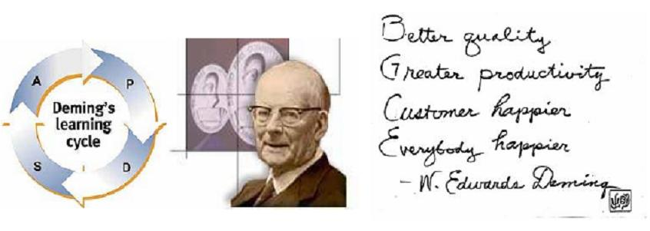
Deming’s Learning Cycle of Quality

Slide 5
Deming’s Learning Cycle of Quality
“Inspection with the aim of finding the bad ones and throwing them out is too late, ineffective and costly.
Quality comes not from inspection but improvement of the process.”
Dr. W. Edwards Deming Founder of the Quality Evolution

Slide 6
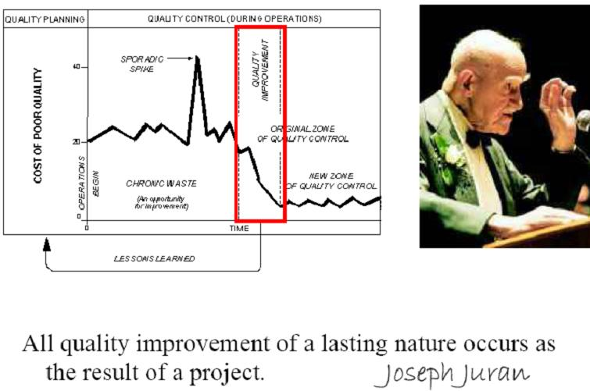
Juran’s Perception of Quality

Slide 7
Most Common Software problems
    Incorrect calculation
    Incorrect data edits & ineffective data edits
    Incorrect matching and merging of data
    Data searches that yields incorrect results
    Incorrect processing of data relationship
    Incorrect coding / implementation of business rules
    Inadequate software performance

Slide 8
    Confusing or misleading data
    Software usability by end users &
    Obsolete Software
    Inconsistent processing
    Unreliable results or performance
    Inadequate support of business needs
    Incorrect or inadequate interfaces
    with other systems
    Inadequate performance and security controls
    Incorrect file handling

Slide 9
Objectives of testing
Executing a program with the intent of finding an error.
To check if the system meets the requirements and be executed successfully in the Intended environment.
To check if the system is “ Fit for purpose”.
To check if the system does what it is expected to do.

Slide 10
Objectives of testing
A good test case is one that has a probability of finding an as yet undiscovered error.
A successful test is one that uncovers a yet undiscovered error.
A good test is not redundant.
A good test should be “best of breed”.
A good test should neither be too simple nor too complex.

Slide 11
Objective of a Software Tester
Find bugs as early as possible and make sure they get fixed.
To understand the application well.
Study the functionality in detail to find where the bugs are likely to occur.
Study the code to ensure that each and every line of code is tested.
Create test cases in such a way that testing is done to uncover the hidden bugs and also ensure that the software is usable and reliable

Slide 12
VERIFICATION & VALIDATION
Verification - typically involves reviews and meeting to evaluate documents, plans, code, requirements, and specifications. This can be done with checklists, issues lists, walkthroughs, and inspection meeting.
Validation - typically involves actual testing and takes place after verifications are completed.
Validation and Verification process continue in a cycle till the software becomes defects free.

Slide 13
TESTABILITY
        Operability
        Observe-ability
        Controllability
        Decomposability
        Stability
        Understandability

Slide 14
Software Development Process Cycle
Plan
Action
Do
Check

Slide 15
PLAN (P): Device a plan. Define your objective and determine the strategy and supporting methods required to achieve that objective.
DO (D): Execute the plan. Create the conditions and perform the necessary training to execute the plan.
CHECK (C): Check the results. Check to determine whether work is progressing according to the plan and whether the results are obtained.
ACTION (A): Take the necessary and appropriate action if checkup reveals that the work is not being performed according to plan or not as anticipated.

Slide 16
QUALITY PRINCIPLES
Quality - the most important factor affecting an organization’s long-term performance.
Quality - the way to achieve improved productivity and competitiveness in any organization.
Quality - saves. It does not cost.
Quality - is the solution to the problem, not a problem.

Slide 17
Cost of Quality
Prevention Cost
Amount spent before the product is actually built. Cost incurred on establishing methods and procedures, training workers, acquiring tools and planning for quality.
Appraisal cost
Amount spent after the product is built but before it is shipped to the user. Cost of inspection, testing, and reviews.

Slide 18
Failure Cost
Amount spent to repair failures.
Cost associated with defective products that have been delivered to the user or moved into production, costs involve repairing products to make them fit as per requirement.

Slide 19
Quality Assurance | Quality Control
A planned and systematic set of activities necessary to provide adequate confidence that requirements are properly established and products or services conform to specified requirements. | The process by which product quality is compared with applicable standards; and the action taken when non-conformance is detected.
An activity that establishes and evaluates the processes to produce the products. | An activity which verifies if the product meets pre-defined standards.

Slide 20
Quality Assurance | Quality Control
Helps establish processes. | Implements the process.
Sets up measurements programs to evaluate processes. | Verifies if specific attributes are in a specific product or Service
Identifies weaknesses in processes and improves them. | Identifies defects for the primary purpose of correcting defects.

Slide 21
Responsibilities of QA and QC
QA is the responsibility of the entire team. | QC is the responsibility of the tester.
Prevents the introduction of issues or defects | Detects, reports and corrects defects
QA evaluates whether or not quality control is working for the primary purpose of determining whether or not there is a weakness in the process. | QC evaluates if the application is working for the primary purpose of determining if there is a flaw / defect in the functionalities.

Slide 22
Responsibilities of QA and QC
QA improves the process that is applied to multiple products that will ever be produced by a process. | QC improves the development of a specific product or service.
QA personnel should not perform quality control unless doing it to validate quality control is working. | QC personnel may perform quality assurance tasks if and when required.

Slide 23
SEI – CMM
Software Engineering Institute (SEI) developed Capability Maturity Model (CMM)
CMM describes the prime elements - planning, engineering, managing software development and maintenance
CMM can be used for
        Software process improvement
        Software process assessment
        Software capability evaluations

Slide 24
The CMM is organized into five maturity level
Initial
Level 1
Disciplined Process
Repeatable
Level 2
Standard Consistence Process
Defined
Level 3
Predictable Process
Managed
Level 4
Continuous Improvement Process
Optimizing
Level 5

Slide 25
SOFTWARE DEVELOPMENT LIFE CYCLE (SDLC)
Phases of SDLC
        Requirement Specification and
        Analysis
        Design
        Coding
        Testing
        Implementation
        Maintenance

Slide 26
Requirement Specification
and Analysis
User Requirement
Specification (USR)
Software Requirement
Specification (SRS)

Slide 27
Design
The output of SRS is the input of design phase.
Two types of design -
    High Level Design (HLD)
    Low Level Design (LLD)

Slide 28
High Level Design (HLD)
List of modules and a brief description of each module.
Brief functionality of each module.
Interface relationship among modules.
Dependencies between modules (if A exists, B exists etc).
Database tables identified along with key elements.
Overall architecture diagrams along with technology details.

Slide 29
Low Level Design (LLD)
Detailed functional logic of the module, in pseudo code.
Database tables, with all elements, including their type and size.
All interface details.
All dependency issues
Error message listings
Complete input and outputs for a module.

Slide 30
The Design process
Breaking down the product into independent modules to arrive at micro levels.
2 different approaches followed in designing –
    Top Down Approach
    Bottom Up Approach

Slide 31
Top-down approach

Slide 32
Bottom-Up Approach

Slide 33
Coding
Developers use the LLD document and write the code in the programming language specified.
Testing
The testing process involves development of a test plan, executing the plan and documenting the test results.
Implementation
Installation of the product in its operational environment.

Slide 34
Maintenance
After the software is released and the client starts using the software, maintenance phase is started.
3 things happen - Bug fixing, Upgrade, Enhancement
Bug fixing – bugs arrived due to some untested scenarios.
Upgrade – Upgrading the application to the newer versions of the software.
Enhancement - Adding some new features into the existing software.

Slide 35
SOFTWARE LIFE CYCLE MODELS
        WATERFALL MODEL
        V-PROCESS MODEL
        SPIRAL MODEL
        PROTOTYPE MODEL
        INCREMENTAL MODEL
        EVOLUTIONARY DEVELOPMENT MODEL

Slide 36
Project Management
        Project Staffing
        Project Planning
        Project Scheduling

Slide 37
Project Staffing
Project budget may not allow to utilize
highly – paid staff.
Staff with the appropriate experience may not be available.

Slide 38
Project Planning
Plan | Description
Quality plan | Describes the quality procedures and standards used in a project.
Validation plan | Describes the approach, resources and schedule used for system validation.
Configuration management plan | Describes the configuration management procedures and structures to be used.
Maintenance plan | Predicts the maintenance requirements of the system/ maintenance costs and efforts required.
Staff development plan | Describes how the skills and experience of the project team members will be developed.

Slide 39
Project Scheduling
Bar charts and Activity Networks
Scheduling problems

Slide 40
RISK MANAGEMENT
        Risk identification
        Risk Analysis
        Risk Planning
        Risk Monitoring

Slide 41
Risk | Risk type | Description
Staff turnover | Project | Experienced staff will leave the project before it is finished.
Management change | Project | There will be a change of organizational management with different priorities.
Hardware unavailability | Project | Hardware which is essential for the project will not be delivered on schedule.
Requirements change | Project & Product | There will be a larger number of changes to the requirements than anticipated.

Slide 42
Risk | Risk type | Description
Specification delays | Project & Product | Specifications of essential interfaces are not available on schedule.
Size under estimate | Project & Product | The size of the system has been under estimated.
CASE tool under performance | Product | CASE tools which support the project do not perform as anticipated.
Technology change | Business | The underlying technology on which the system is built is superseded by new technology.
Product competition | Business | A competitive product is marketed before the system is completed.

Slide 43
Configuration Management
PC version
Mainframe version
VMS version
Initial system
Workstation version
DEC version
Unix version
Sun version

Slide 44
Configuration Management (CM)
Standards
CM should be based on a set of standards,
which are applied within an organization.

Slide 45
CM Planning
Documents, required for future system
maintenance, should be identified and included
as managed documents.
It defines the types of documents to be
managed and a document naming scheme.

Slide 46
Change Management
Keeping and managing the changes and
ensuring that they are implemented in the most
cost-effective way.

Slide 47
Change Request form
A part of the CM planning process
  Records change required
  Change suggested by
  Reason why change was suggested
  Urgency of change
  Records change evaluation
  Impact analysis
  Change cost
  Recommendations(system maintenance staff)

Slide 48
VERSION AND RELEASE MANAGEMENT
Invent identification scheme for system versions and plan when new system version is to be produced.
Ensure that version management procedures and tools are properly applied and to plan and distribute new system releases.

Slide 49
Versions/Variants/Releases
Variant An instance of a system which is functionally identical but non – functionally distinct from other instances of a system.
Versions An instance of a system, which is functionally distinct in some way from other system instances.
Release An instance of a system, which is distributed to users outside of the development team.

Slide 50
SOFTWARE TESTING LIFECYCLE - PHASES
        Requirements study
        Test Case Design and Development
        Test Execution
        Test Closure
        Test Process Analysis

Slide 51
Requirements study
Testing Cycle starts with the study of client’s requirements.
Understanding of the requirements is very essential for testing the product.

Slide 52
Analysis & Planning
    Test objective and coverage
    Overall schedule
    Standards and Methodologies
    Resources required, including necessary training
    Roles and responsibilities of the team members
    Tools used

Slide 53
Test Case Design and Development
      Component Identification
      Test Specification Design
      Test Specification Review
Test Execution
      Code Review
      Test execution and evaluation
      Performance and simulation

Slide 54
Test Closure
      Test summary report
      Project De-brief
      Project Documentation
Test Process Analysis
Analysis done on the reports and improving the application’s performance by implementing new technology and additional features.

Slide 55
DIFFERENT LEVELS OF TESTING

Slide 56
Testing Levels
Unit testing
Integration testing
System testing
Acceptance testing

Slide 57
Unit testing
The most ‘micro’ scale of testing.
Tests done on particular functions or code modules.
Requires knowledge of the internal program design and code.
Done by Programmers (not by testers).

Slide 58
Unit testing
Objectives | To test the function of a program or unit of code such as a program or module To test internal logic To verify internal design To test path & conditions coverage To test exception conditions & error handling
When | After modules are coded
Input | Internal Application Design Master Test Plan Unit Test Plan
Output | Unit Test Report

Slide 59
Who | Developer
Methods | White Box testing techniques Test Coverage techniques
Tools | Debug Re-structure Code Analyzers Path/statement coverage tools
Education | Testing Methodology Effective use of tools

Slide 60
Incremental integration testing
  Continuous testing of an application as and when a new functionality is added.
  Application’s functionality aspects are required to be independent enough to work separately before completion of development.
  Done by programmers or testers.

Slide 61
Integration Testing
  Testing of combined parts of an application to determine their functional correctness.
  ‘Parts’ can be
    code modules
    individual applications
    client/server applications on a network.

Slide 62
Types of Integration Testing
        Big Bang testing
        Top Down Integration testing
        Bottom Up Integration testing

Slide 63
Integration testing
Objectives | To technically verify proper interfacing between modules, and within sub-systems
When | After modules are unit tested
Input | Internal & External Application Design Master Test Plan Integration Test Plan
Output | Integration Test report

Slide 64
Who | Developers
Methods | White and Black Box techniques Problem / Configuration Management
Tools | Debug Re-structure Code Analyzers
Education | Testing Methodology Effective use of tools

Slide 65
System Testing
Objectives | To verify that the system components perform control functions To perform inter-system test To demonstrate that the system performs both functionally and operationally as specified To perform appropriate types of tests relating to Transaction Flow, Installation, Reliability, Regression etc.
When | After Integration Testing
Input | Detailed Requirements & External Application Design Master Test Plan System Test Plan
Output | System Test Report

Slide 66
Who | Development Team and Users
Methods | Problem / Configuration Management
Tools | Recommended set of tools
Education | Testing Methodology Effective use of tools

Slide 67
Systems Integration Testing
Objectives | To test the co-existence of products and applications that are required to perform together in the production-like operational environment (hardware, software, network) To ensure that the system functions together with all the components of its environment as a total system To ensure that the system releases can be deployed in the current environment
When | After system testing Often performed outside of project life-cycle
Input | Test Strategy Master Test Plan Systems Integration Test Plan
Output | Systems Integration Test report

Slide 68
Who | System Testers
Methods | White and Black Box techniques Problem / Configuration Management
Tools | Recommended set of tools
Education | Testing Methodology Effective use of tools

Slide 69
Acceptance Testing
Objectives | To verify that the system meets the user requirements
When | After System Testing
Input | Business Needs & Detailed Requirements Master Test Plan User Acceptance Test Plan
Output | User Acceptance Test report

Slide 70
Who | Users / End Users
Methods | Black Box techniques Problem / Configuration Management
Tools | Compare, keystroke capture & playback, regression testing
Education | Testing Methodology Effective use of tools Product knowledge Business Release Strategy

Slide 71
TESTING METHODOLOGIES AND TYPES

Slide 72
Testing methodologies
Black box testing
White box testing
Incremental testing
Thread testing

Slide 73
Black box testing
  No knowledge of internal design or code required.
  Tests are based on requirements and functionality
White box testing
Knowledge of the internal program design and code required.
Tests are based on coverage of code statements,branches,paths,conditions.

Slide 74
BLACK BOX - TESTING TECHNIQUE
Incorrect or missing functions
Interface errors
Errors in data structures or external database access
Performance errors
Initialization and termination errors

Slide 75
Black box / Functional testing
Based on requirements and functionality
Not based on any knowledge of internal
design or code
Covers all combined parts of a system
Tests are data driven

Slide 76
White box testing / Structural testing
Based on knowledge of internal logic of an
application's code
Based on coverage of code statements,
branches, paths, conditions
Tests are logic driven

Slide 77
Functional testing
  Black box type testing geared to functional requirements of an application.
  Done by testers.
System testing
  Black box type testing that is based on overall requirements specifications; covering all combined parts of the system.
End-to-end testing
  Similar to system testing; involves testing of a complete application environment in a situation that mimics real-world use.

Slide 78
Sanity testing
  Initial effort to determine if a new software version is performing well enough to accept it for a major testing effort.
Regression testing
  Re-testing after fixes or modifications of the software or its environment.

Slide 79
Acceptance testing
  Final testing based on specifications of the end-user or customer
Load testing
  Testing an application under heavy loads.
  Eg. Testing of a web site under a range of loads to determine, when the system response time degraded or fails.

Slide 80
Stress Testing
  Testing under unusually heavy loads, heavy repetition of certain actions or inputs, input of large numerical values, large complex queries to a database etc.
  Term often used interchangeably with ‘load’ and ‘performance’ testing.
Performance testing
  Testing how well an application complies to performance requirements.

Slide 81
Install/uninstall testing
  Testing of full,partial or upgrade install/uninstall process.
Recovery testing
  Testing how well a system recovers from crashes, HW failures or other problems.
Compatibility testing
  Testing how well software performs in a particular HW/SW/OS/NW environment.

Slide 82
Exploratory testing / ad-hoc testing
  Informal SW test that is not based on formal test plans or test cases; testers will be learning the SW in totality as they test it.
Comparison testing
  Comparing SW strengths and weakness to competing products.

Slide 83
Alpha testing
  Testing done when development is nearing
  completion; minor design changes may still be made as a result of such testing.
Beta-testing
  Testing when development and testing are essentially completed and final bugs and problems need to be found before release.

Slide 84
Mutation testing
  To determining if a set of test data or test cases is useful, by deliberately introducing various bugs.
  Re-testing with the original test data/cases to determine if the bugs are detected.

Slide 85
White Box - Testing

Slide 86
White Box - testing technique
All independent paths within a module have been exercised at least once
Exercise all logical decisions on their true and false sides
Execute all loops at their boundaries and within their operational bounds
Exercise internal data structures to ensure their validity

Slide 87
Loop Testing
This white box technique focuses on the validity of loop constructs.
4 different classes of loops can be defined
      simple loops
      nested loops
      concatenated loops
      Unstructured loops

Slide 88
Other White Box Techniques
Statement Coverage – execute all statements at least once
Decision Coverage – execute each decision direction at least once
Condition Coverage – execute each decision with all possible outcomes at least once
Decision / Condition coverage – execute all possible combinations of condition outcomes in each decision.
Multiple condition Coverage – Invokes each point of entry at least once.
Examples ……

Slide 89
Statement Coverage – Examples
Eg. A + B
If (A = 3) Then
B = X + Y
End-If
While (A > 0) Do
    Read (X)
    A = A - 1
End-While-Do

Slide 90
Decision Coverage - Example
If A < 10 or A > 20 Then
B = X + Y
Condition Coverage – Example
A = X
If (A > 3) or (A < B) Then
B = X + Y
End-If-Then
While (A > 0) and (Not EOF) Do
Read (X)
A = A - 1
End-While-Do

Slide 91
Incremental Testing
A disciplined method of testing the interfaces between unit-tested programs as well as between system components.
Involves adding unit-testing program module or component one by one, and testing each result and combination.

Slide 92
Two types of Incremental Testing
Top-down – testing form the top of the module hierarchy and work down to the bottom. Modules are added in descending hierarchical order.
Bottom-up – testing from the bottom of the hierarchy and works up to the top. Modules are added in ascending hierarchical order.

Slide 93
Testing Levels/ Techniques | White Box | Black Box | Incre- mental | Thread
Unit Testing | X
Integration Testing | X |  | X | X
System Testing |  | X
Acceptance Testing |  | X

Slide 94
Major Testing Types
  Stress / Load Testing
  Performance Testing
  Recovery Testing
  Conversion Testing
  Usability Testing
  Configuration Testing

Slide 95
Stress / Load Test
Evaluates a system or component at or beyond
the limits of its specified requirements.
Determines the load under which it fails and
how.

Slide 96
Performance Test
  Evaluate the compliance of a system or component with specified performance requirements.
  Often performed using an automated test tool to simulate large number of users.

Slide 97
Recovery Test
  Confirms that the system recovers from expected or unexpected events without loss of data or functionality.
Eg.
Shortage of disk space
Unexpected loss of communication
Power out conditions

Slide 98
Conversion Test
  Testing of code that is used to convert data from existing systems for use in the newly replaced systems

Slide 99
Usability Test
  Testing the system for the users to learn and use the product.

Slide 100
Configuration Test
  Examines an application's requirements for pre-existing software, initial states and configuration in order to maintain proper functionality.

Slide 101
SOFTWARE TESTING LIFECYCLE - PHASES
        Requirements study
        Test Case Design and Development
        Test Execution
        Test Closure
        Test Process Analysis

Slide 102
Requirements study
Testing Cycle starts with the study of client’s requirements.
Understanding of the requirements is very essential for testing the product.

Slide 103
Analysis & Planning
    Test objective and coverage
    Overall schedule
    Standards and Methodologies
    Resources required, including necessary training
    Roles and responsibilities of the team members
    Tools used

Slide 104
Test Case Design and Development
      Component Identification
      Test Specification Design
      Test Specification Review
Test Execution
      Code Review
      Test execution and evaluation
      Performance and simulation

Slide 105
Test Closure
      Test summary report
      Project Documentation
Test Process Analysis
Analysis done on the reports and improving the application’s performance by implementing new technology and additional features.

Slide 106
TEST PLAN
Objectives
To create a set of testing tasks.
Assign resources to each testing task.
Estimate completion time for each testing task.
Document testing standards.

Slide 107
A document that describes the
  scope
  approach
  resources
  schedule
…of intended test activities.
Identifies the
  test items
  features to be tested
  testing tasks
  task allotment
  risks requiring contingency planning.

Slide 108
Purpose of preparing a Test Plan
Validate the acceptability of a software product.
Help the people outside the test group to understand ‘why’ and ‘how’ of product validation.
A Test Plan should be
  thorough enough (Overall coverage of test to be conducted)
  useful and understandable by the people inside and outside the test group.

Slide 109
Scope
The areas to be tested by the QA team.
Specify the areas which are out of scope (screens,
database, mainframe processes etc).
Test Approach
Details on how the testing is to be performed.
Any specific strategy is to be followed for
testing (including configuration management).

Slide 110
Entry Criteria
Various steps to be performed before the start of a test i.e. Pre-requisites.
E.g.
  Timely environment set up
  Starting the web server/app server
  Successful implementation of the latest build etc.
Resources
List of the people involved in the project and their designation etc.

Slide 111
Tasks/Responsibilities
Tasks to be performed and responsibilities assigned to the various team members.
Exit Criteria
Contains tasks like
Bringing down the system / server
Restoring system to pre-test environment
Database refresh etc.
Schedule / Milestones
Deals with the final delivery date and the various milestones dates.

Slide 112
Hardware / Software Requirements
Details of PC’s / servers required to install the
application or perform the testing
Specific software to get the application
running or to connect to the database etc.
Risks & Mitigation Plans
List out the possible risks during testing
Mitigation plans to implement incase the risk
actually turns into a reality.

Slide 113
Tools to be used
List the testing tools or utilities
Eg.WinRunner, LoadRunner, Test Director, Rational Robot, QTP.
Deliverables
Various deliverables due to the client at various
points of time i.e. Daily / weekly / start of the
project end of the project etc.
These include test plans, test procedures, test
metric, status reports, test scripts etc.

Slide 114
References
      Procedures
      Templates (Client specific or otherwise)
      Standards / Guidelines e.g. Qview
      Project related documents (RSD, ADD, FSD etc).

Slide 115
Annexure
Links to documents which have been / will be used in the course of testing
Eg. Templates used for reports, test cases etc.
Referenced documents can also be attached here.
Sign-off
Mutual agreement between the client and the QA
Team.
Both leads/managers signing their agreement on the Test Plan.

Slide 116
Good Test Plans
Developed and Reviewed early.
Clear, Complete and Specific
Specifies tangible deliverables that can be inspected.
Staff knows what to expect and when to expect it.

Slide 117
Good Test Plans
Realistic quality levels for goals
Includes time for planning
Can be monitored and updated
Includes user responsibilities
Based on past experience
Recognizes learning curves

Slide 118
TEST CASES
Test case is defined as
A set of test inputs, execution conditions and expected results, developed for a particular objective.
Documentation specifying inputs, predicted results and a set of execution conditions for a test item.

Slide 119
Specific inputs that will be tried and the procedures that will be followed when the software tested.
Sequence of one or more subtests executed as a sequence as the outcome and/or final state of one subtests is the input and/or initial state of the next.
Specifies the pretest state of the AUT and its environment, the test inputs or conditions.
The expected result specifies what the AUT should produce from the test inputs.

Slide 120
Good Test Plans
Developed and Reviewed early.
Clear, Complete and Specific
Specifies tangible deliverables that can be inspected.
Staff knows what to expect and when to expect it.

Slide 121
Good Test Plans
Realistic quality levels for goals
Includes time for planning
Can be monitored and updated
Includes user responsibilities
Based on past experience
Recognizes learning curves

Slide 122
Test Cases
Contents
  Test plan reference id
  Test case
  Test condition
  Expected behavior

Slide 123
Good Test Cases
Find Defects
Have high probability of finding a new defect.
Unambiguous tangible result that can be inspected.
Repeatable and predictable.

Slide 124
Good Test Cases
Traceable to requirements or design documents
Push systems to its limits
Execution and tracking can be automated
Do not mislead
Feasible

Slide 125
Defect Life Cycle
What is Defect?
    A defect is a variance from a desired product attribute.
Two categories of defects are
    Variance from product specifications
    Variance from Customer/User
    expectations

Slide 126
Variance from product specification
Product built varies from the product specified.
Variance from Customer/User specification
A specification by the user not in the built product, but something not specified has been included.

Slide 127
Defect categories
Wrong
The specifications have been implemented incorrectly.
Missing
A specified requirement is not in the built product.
Extra
A requirement incorporated into the product that was not specified.

Slide 128
Defect Log
Defect ID number
Descriptive defect name and type
Source of defect – test case or other source
Defect severity
Defect Priority
Defect status (e.g. New, open, fixed, closed, reopen, reject)

Slide 129
Date and time tracking for either the most recent status change, or for each change in the status.
Detailed description, including the steps necessary to reproduce the defect.
Component or program where defect was found
Screen prints, logs, etc. that will aid the developer in resolution process.
Stage of origination.
Person assigned to research and/or corrects the defect.

Slide 130
Severity Vs Priority
Severity
Factor that shows how bad the defect is and the impact it has on the product
Priority
  Based upon input from users regarding which defects are most important to them, and be fixed first.

Slide 131
Severity Levels
Critical
Major / High
Average / Medium
Minor / low
Cosmetic defects

Slide 132
Severity Level – Critical
An installation process which does not load a component.
A missing menu option.
Security permission required to access a function under test.
Functionality does not permit for further testing.

Slide 133
Runtime Errors like JavaScript errors etc.
Functionality Missed out / Incorrect Implementation (Major Deviation from Requirements).
Performance Issues (If specified by Client).
Browser incompatibility and Operating systems incompatibility issues depending on the impact of error.
Dead Links.

Slide 134
Severity Level – Major / High
Reboot the system.
The wrong field being updated.
An updated operation that fails to complete.
Performance Issues (If not specified by Client).
Mandatory Validations for Mandatory Fields.

Slide 135
Functionality incorrectly implemented (Minor Deviation from Requirements).
Images, Graphics missing which hinders functionality.
Front End / Home Page Alignment issues.
Severity Level – Average / Medium
Incorrect/missing hot key operation.

Slide 136
Severity Level – Minor / Low
Misspelled or ungrammatical text
Inappropriate or incorrect formatting (such as text font, size, alignment, color, etc.)
Screen Layout Issues
Spelling Mistakes / Grammatical Mistakes
Documentation Errors

Slide 137
Page Titles Missing
Alt Text for Images
Background Color for the Pages other than Home page
Default Value missing for the fields required
Cursor Set Focus and Tab Flow on the Page
Images, Graphics missing, which does not, hinders functionality

Slide 138
Test Reports
8 INTERIM REPORTS
Functional Testing Status
Functions Working Timeline
Expected Vs Actual Defects Detected Timeline
Defects Detected Vs Corrected Gap Timeline
Average Age of Detected Defects by type
Defect Distribution
Relative Defect Distribution
Testing Action

Slide 139
Functional Testing Status Report
Report shows percentage of the functions that are
      Fully Tested
      Tested with Open defects
      Not Tested

Slide 140
Functions Working Timeline
Report shows the actual plan to have all
functions verses the current status of the
functions working.
Line graph is an ideal format.

Slide 141
Expected Vs. Actual Defects Detected
Analysis between the number of defects being
generated against the expected number of
defects expected from the planning stage.

Slide 142
Defects Detected Vs. Corrected Gap
A line graph format that shows the
Number of defects uncovered verses the
number of defects being corrected and
accepted by the testing group.

Slide 143
Average Age Detected Defects by Type
Average days of outstanding defects by its
severity type or level.
The planning stage provides the acceptable
open days by defect type.

Slide 144
Defect Distribution
Shows defect distribution by function or module and the number of tests completed.
Relative Defect Distribution
Normalize the level of defects with the
previous reports generated.
Normalizing over the number of functions or
lines of code shows a more accurate level of
defects.

Slide 145
Testing Action
Report shows
  Possible shortfalls in testing
  Number of severity-1 defects
  Priority of defects
  Recurring defects
  Tests behind schedule
….and other information that present an accurate testing picture

Slide 146
METRICS
2 Types
Product metrics
Process metrics

Slide 147
Process Metrics
Measures the characteristic of the
        methods
        techniques
        tools

Slide 148
Product Metrics
Measures the characteristic of the documentation and code.

Slide 149
Test Metrics
User Participation = User Participation test time Vs. Total test time.
Path Tested = Number of path tested Vs. Total number of paths.
Acceptance criteria tested = Acceptance criteria verified Vs. Total acceptance criteria.

Slide 150
Test cost = Test cost Vs. Total system cost.
Cost to locate defect = Test cost / No. of defects located in the testing.
Detected production defect = No. of defects detected in production / Application system size.
Test Automation = Cost of manual test effort / Total test cost.

Slide 151
CMM – Level 1 – Initial Level
The organization
Does not have an environment for developing
and maintaining software.
At the time of crises, projects usually stop using all planned procedures and revert to coding and testing.

Slide 152
CMM – Level 2 – Repeatable level
Effective management process having established which can be
Practiced
Documented
Enforced
Trained
Measured
Improvised

Slide 153
CMM – Level 3 – Defined level
Standard defined software engineering and
management process for developing and
maintaining software.
These processes are put together to make a
coherent whole.

Slide 154
CMM – Level 4 – Managed level
Quantitative goals set for both software products and processes.
The organizational measurement plan involves
determining the productivity and quality for all
important software process activities across all
projects.

Slide 155
CMM – Level 5 – Optimizing level
Emphasis laid on
Process improvement
Tools to identify weaknesses existing in their
processes
Make timely corrections

Slide 156
Cost of Poor Quality
Total Quality Costs represent the difference
between the actual (current) cost of a product
or service and what the reduced cost would be
if there were no possibility of substandard
service, failure to meet specifications, failure
of products, or defects in their manufacture.
Campanella, Principles of Quality Costs

Slide 157
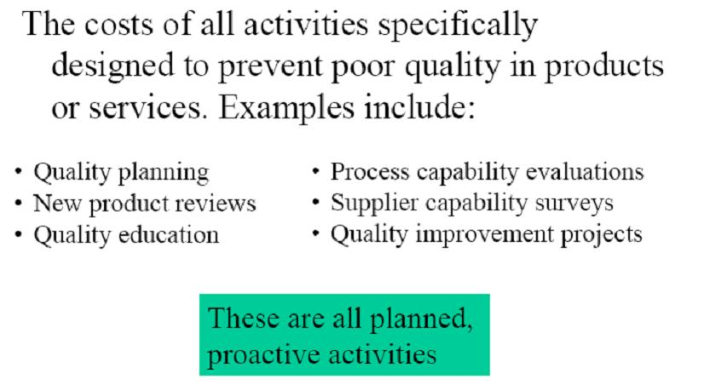
Prevention of Poor Quality

Slide 158


Slide 159
COQ Process
1. Commitment
2. COQ Team
3. Gather data (COQ assessment)
4. Pareto analysis
5. Determine cost drivers
6. Process Improvement Teams
7. Monitor and measure
8. Go back to step 3
Generally
Missing

Slide 160
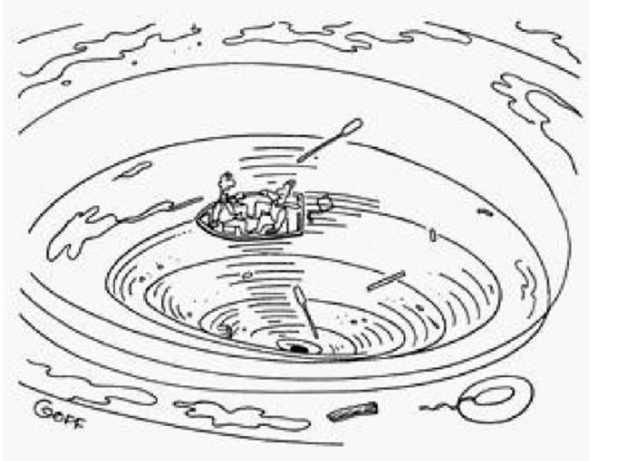
“Wished I had understood that Cost of Quality stuff better”

Slide 161
TESTING STANDARDS
External Standards
Familiarity with and adoption of industry test standards from organizations.
Internal Standards
Development and enforcement of the test standards that testers must meet.

Slide 162
IEEE STANDARDS
Institute of Electrical and Electronics Engineers designed an entire set of standards for software and to be followed by the testers.

Slide 163
IEEE – Standard Glossary of Software Engineering Terminology
IEEE – Standard for Software Quality Assurance Plan
IEEE – Standard for Software Configuration Management Plan
IEEE – Standard for Software for Software Test Documentation
IEEE – Recommended Practice for Software Requirement Specification

Slide 164
IEEE – Standard for Software Unit Testing
IEEE – Standard for Software Verification and Validation
IEEE – Standard for Software Reviews
IEEE – Recommended practice for Software Design descriptions
IEEE – Standard Classification for Software Anomalies

Slide 165
IEEE – Standard for Software Productivity metrics
IEEE – Standard for Software Project Management plans
IEEE – Standard for Software Management
IEEE – Standard for Software Quality Metrics Methodology

Slide 166
Other standards…..
ISO – International Organization for Standards
Six Sigma – Zero Defect Orientation
SPICE – Software Process Improvement and Capability Determination
NIST – National Institute of Standards and Technology

Slide 167
Thank You

