Slide 1
HTML
By
Nagendra

Slide 2
Why HTML?
An military experiment-ARPAnet
An Way to exchange information with multimedia and in structured way.
HTML made way to distributed documents in servers can access from any where.

Slide 3
How it works
Client
Browser
Server
HTTP
W3C controls all standards

Slide 4
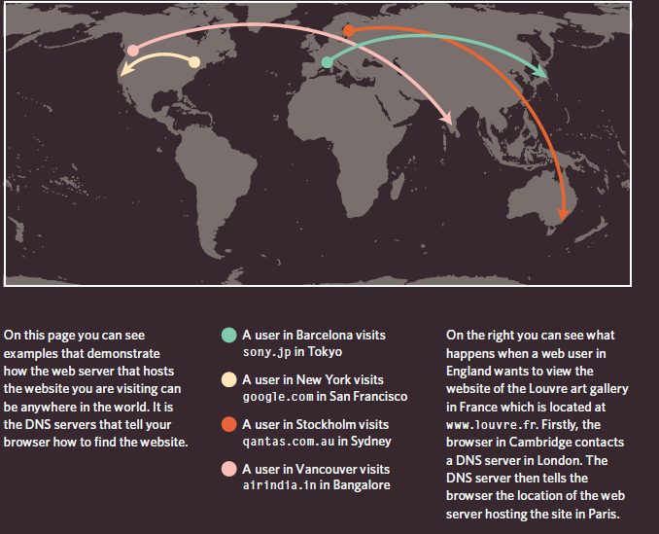
How it works

Slide 5
Tools
Any word processor
Notepad
Notepadd++

Slide 6
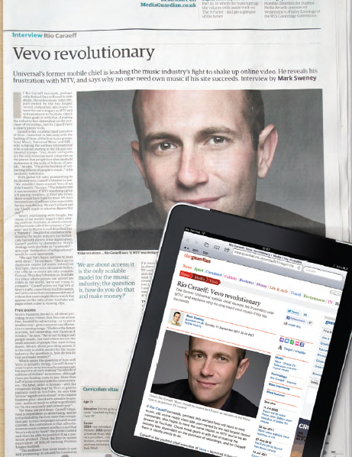
Anatomy

Slide 7
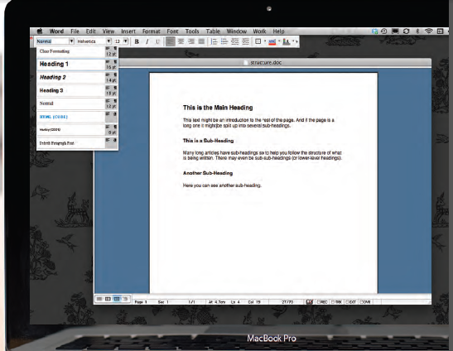
Anatomy
The use of headings and subheadings in any document often reflects a hierarchy of information.

Slide 8
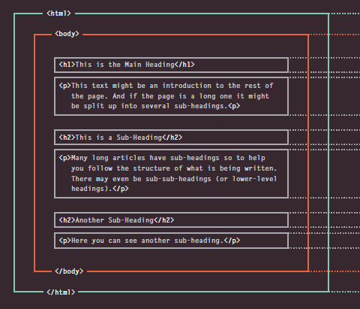
Anatomy
HTM L describes the Structure of Pages

Slide 9
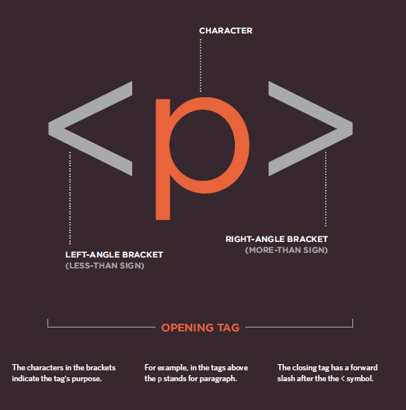
Closure look into tag

Slide 10
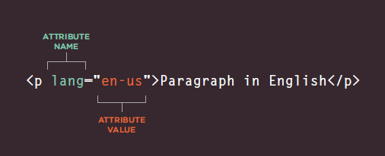
Attributes
Attributes tells more about elements

Slide 11
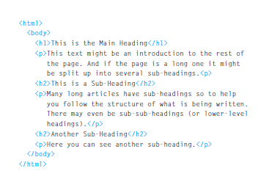
Create our own web page

