Slide 1
HTML
By
Nagendra
On 03/11/2016

Slide 2
Recap?
Semantic elements
List

Slide 3
Images
An images can speak thousand words
Can add an image –logo ,photograph , or chart
Will discuss
How to include an image
How to Pick right format
How to Pick right size
Optimize to load faster

Slide 4
Images
Great can make a difference
Sets tone
Things to remember
Relevant
Convey information
Convey the right mood
Be instantly recognisable
Fit the colour palette

Slide 5

Images
Better keep your all related images in single folder
<img> -
src
title
alt

Slide 6
Images
Height & Width
Align (not supported in HTML5)
Tools to edit image
Photoshop
Fireworks
Pixelmator
PaintShop Pro
Paint.net

Slide 7
Images – Choose right format
JPEG
GIF
PNG
Pixels should match with width & height you specify in the web

Slide 8
Images – Choose right format
JPEG
GIF
PNG
Pixels should match with width & height you specify in the web
Can reduce size
Increase size
croping

Slide 9
Images – Resolution
Images created for the web should be saved at
a resolution of 72 ppi (368kb). The higher the resolutionof the image, the larger the size of the file.
Vector Images
SVG

Slide 10
Images – Transparency
GIF - straight edges and it is 100% transparent
PNG - straight edges and it is 100% transparent
PNG not supported in IE6

Slide 11
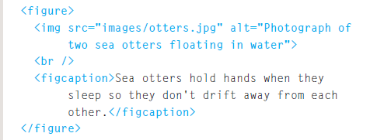
Images – Figure and Figure Caption
<figure>
<figcaption>

Slide 12
Images – Figure and Figure Caption
<figure>
<figcaption>

Slide 13
Links
Defining feature of the web
Links b/w pages within site or b/w sites
Links to open another window
Links to email

Slide 14
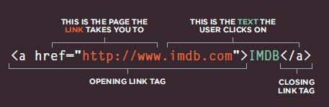
Links
<a>
Absolute & relative

Slide 15
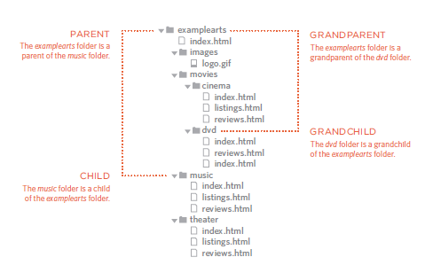
Links

Slide 16
Links
<a href="mailto:xyz@example.org">Email Jon</a>
<a href="http://www.imdb.com" target="_blank"> Internet Movie Database</a> (opens in new window)

Slide 17
Links to within same page

Slide 18
Summary
Semantic elements
List

