Slide 1
HTML
on
On 05/11/2016

Slide 2
Recap?
Images
Links

Slide 3
Table
Most of the data in our real world is represented in tabular manner like train time table, inventory etc.
To represent complex data with axis.
What we learn
How to create table
More realistic table
Nested tables

Slide 4
Table- Basic table
<table>
<tr>
<td>
Example
<th>
example

Slide 5
Table- Basic table
<table>
<tr>
<td>
Example
<th>
example

Slide 6
Table- Advanced table
How to span cells
How to Span rows
<tbody>
<thead>
<tfoot>
<caption>

Slide 7
Table- other attributes
Width
cellpadding
cellspacing
border
bgcolor

Slide 8
Table- nested tables & others
text-align
Table with list

Slide 9

FORMS

Slide 10
FORMS
Traditionally Form is a printed document placeholder to enter data
It enables us collect data from users
It may be simple search box or complex one

Slide 11
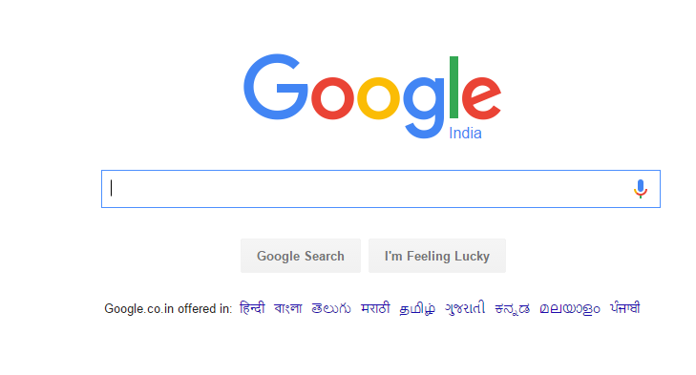
FORMS

Slide 12
FORMS
We learn
How to create form
Different Controls
New HTML5 controls

Slide 13
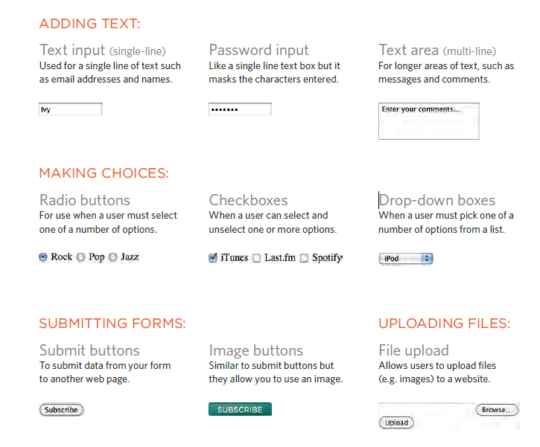

FORMS

Slide 14
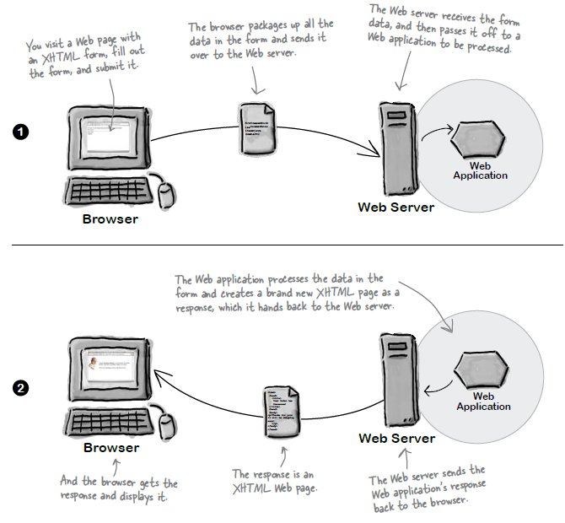
FORMS - Work

Slide 15
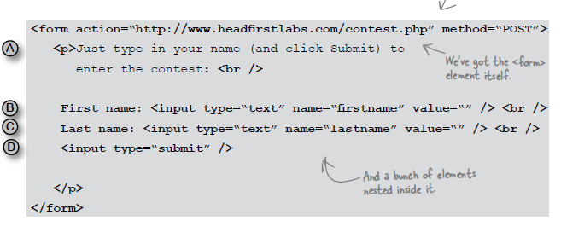
FORMS

Slide 16
FORMS
<form action=“url” action=“method” >
all controls goes here
</form>
More about action
More about methods available
GET Vs POST

Slide 17
What can go in the form
Textinput
<input type=“text” name=“myName” size=“10px” maxlength=“250”/>
Password
<input type=“password”/>
Text Area
<textarea name=“comments” cols=“10” rows=“10”> Enter somthing</..>

Slide 18
What can go in the form
Radio Button
<input type=“radio” name=“gender” value=“M” checked=“checked”/>Male
Checkbox
<input type=“checkbox” name=“hobby” value=“Movies” checked=“checked”/>Movies

Slide 19
What can go in the form
Selectbox
<select name=“device”>
<option value=“desktop”>Desktop</option>
<option value=“tablet”>Tablet</option>
<option value=“mobile”>Mobile</option>
</select>
Selectbox
<select name=“device” size=“2” multiple=“multiple”>
<option value=“desktop” selected=“selected”>Desktop</option>
<option value=“tablet”>Tablet</option>
<option value=“mobile”>Mobile</option>
</select>

Slide 20
What can go in the form
Textinput
<input type=“file” name=“pic” />
Multipart request
Submit
<input type=“submit” name=“hh” value=“submitBtn”/>
Image
<input type=“image” src=“...” width=“” height=“” />

Slide 21
What can go in the form
Button
<input type=“button” />
Hidden
<input type=“hidden” name=“hidenType”/>
Label
<label for=“xyz”>xyz</label>

Slide 22
Grouping from controls
fieldset
<fieldset>
<legend>Contact details</legend>
.......
<fieldset>

Slide 23
HTML5 – Form Validations
Why we need client side validation
required attribute to input controls
placeholder attribute
Date
<input type=“date” name=“dob” />
Email
<input type=“email” name=“email” />
Url
<input type=“url” name=“blog” />

Slide 24
HTML5 – Form Elements
Search box
<input type=“search” name=“search” />
Telephone
<input type=“tel” name=“tel” patttern =“” />

Slide 25
Summary
Semantic elements
List

