Slide 1
HTML
on
On 05/11/2016

Slide 2
Recap?
Tables
Forms

Slide 3
Block & Inline elements
Elements which always starts in the new line are Block Level Elements.
Few examples of block level elements are <p>,<div>,<h1>,<img> etc
Elements which always starts in the same line are Inline Elements
<b>,<em>,<span> etc

Slide 4
DIV Vs P Vs Span
<div> groups the elements – common styling.
<p> used more of content display
<span> groups inline elements.

Slide 5
What are different versions of Html
HTML V 2.0 released Nov 1995
HTML 3.2 released 1997
HTML 4 released 1997 by adding many input controls
XHTML1.0 released 1999 ( using xml)
Strict XHTML 1.0
Transitional XHTML 1.0
XHTML1.0 Frameset
HTML 5 released 2012

Slide 6
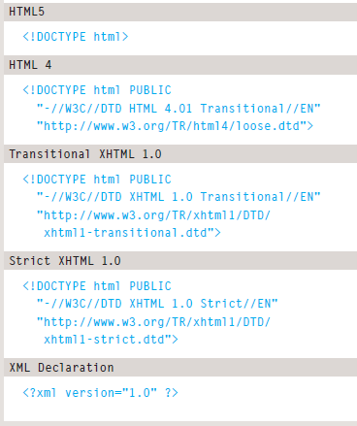
What is doctype

Slide 7
Iframe
<iframe>
src
width
height

Slide 8
Iframe
<iframe>
src
width
height
Scrolling & seamless
Frameborder

Slide 9
frameset
Frameset
<frameset cols="25%,*,25%"> <frame src="frame_a.htm"> <frame src="frame_b.htm"> <frame src="frame_c.htm"> </frameset>

Slide 10
Meta –information about your page
pragma – prevent the page to cache
expires

Slide 11
Meta –information about your page
What is Meta
Not visible to user but needed
description
keywords
Robots
Author
Pragrma
Expires

Slide 12
Summary
Block & Inner elements
Meta
Iframes
Doctype usage

