Slide 1
HTML
on
On 08/11/2016

Slide 2
Recap?
Block level & Inline elements
Meta
Iframes

Slide 3
What are polyfills
Polyfill is a shim for a browser API
Examples

Slide 4
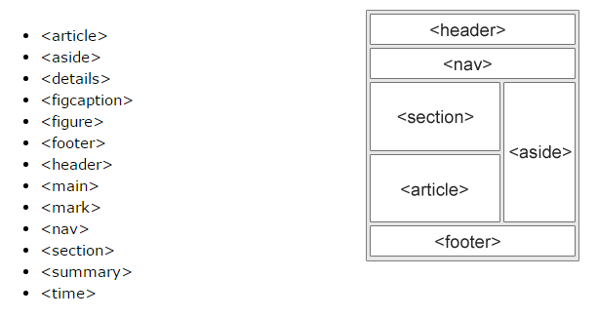
HTML5 –Sementic Elements

Slide 5
Cont..
Articles can be nested with section vice versa
Articles can be nested with articles
Section can be nested with articles

Slide 6
Attach flash/applet etc

Slide 7
Video & audio

Slide 8
Examples

