Slide 1
CSS
on
On 09/11/2016

Slide 2
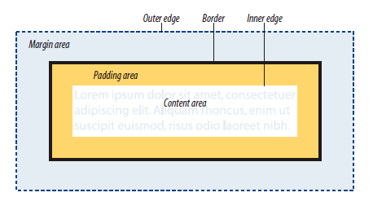
Box model-Thinking inside box

Slide 3
Box model
To set own width and height rather content
Width
Height
% relative to the parent
em based on text
min-width & max-width
min-height & max-height
In px,%,em

Slide 4
Box model
padding
margin
border-top-width (border-width ) – thin,medium,thick
Border-style (border-top-style) : solid | dotted | dashed | groove | double | ridge | inset | outset | hidden / none

Slide 5
Box model
border-color (border-top-color )
border – width thickness color
box-sizing: content-box|border- box|initial|inherit
text-align
vertical-align

Slide 6
Box model
display – inline | block | inline-block | none | hidden | visible
border-image :url
box-shadow : horizontal offset' 'vertical offset' 'blur distance' 'spread distance' color inset | none
box-shadow :6px 6px #666;
Border-radius – CSS3

Slide 7
Box model
overflow – visible | hidden | scroll| auto | inherit
text-overflow: clip|ellipsis|string|initial|inherit
float : left | right | none | inherit
position : static | relative | absolute | fixed | inherit
z-index : number | auto | inherit

