Slide 1
CSS
on
On 09/11/2016

Slide 2
Bootstrap
Most popular front end framework for faster and easier responsive web development.
Save time
Responsive features
Consistent design
Easy to use
Compatible with all browser
Open source

Slide 3
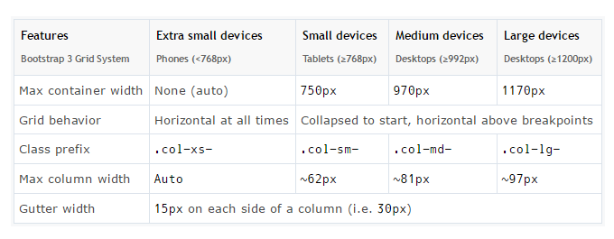
Bootstrap

Slide 4
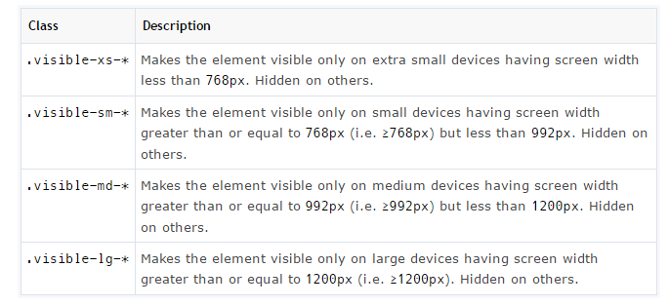
Bootstrap

Slide 5
Bootstrap

