Slide 1
CSS
on
On 09/11/2016

Slide 2
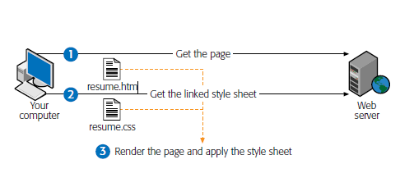
Why & What is CSS
Cascading Style Sheets (CSS) is a language.
Can define style rules –can change appearance

Slide 3
How style sheet works
Create HTML Document
Create styles for elements
Attach styles to HTML doc

Slide 4
CSS -Advantages
Ideal world HTML defines only structure & CSS gets look and positioning.
Precise type & layout controls
Less work
More Maintainable site
One place changes
Reliable browser support

Slide 5
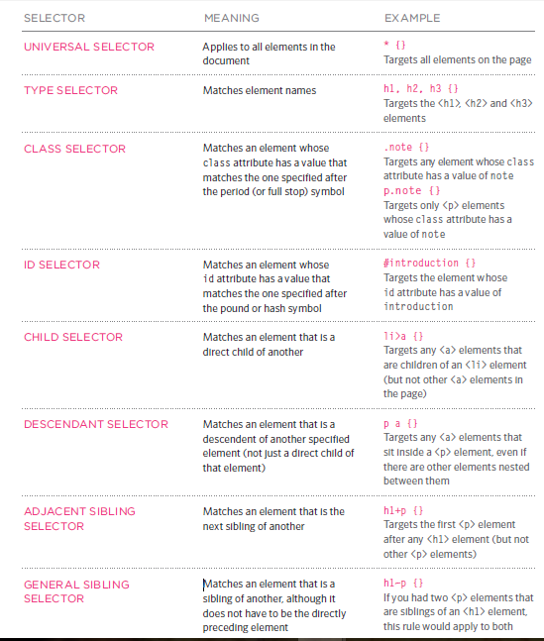
CSS selectors

Slide 6
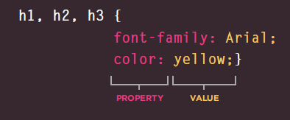
CSS- Property & value

Slide 7
Different ways of applying styles
Using Inline styles
<h1 style=“color:white”> Test</h1>
Using Inner styles
<style type=“text/css”>
h1{
color:red
}
<style>
Using External style sheet
<link href="css/styles.css" type="text/css"
rel="stylesheet" />

Slide 8
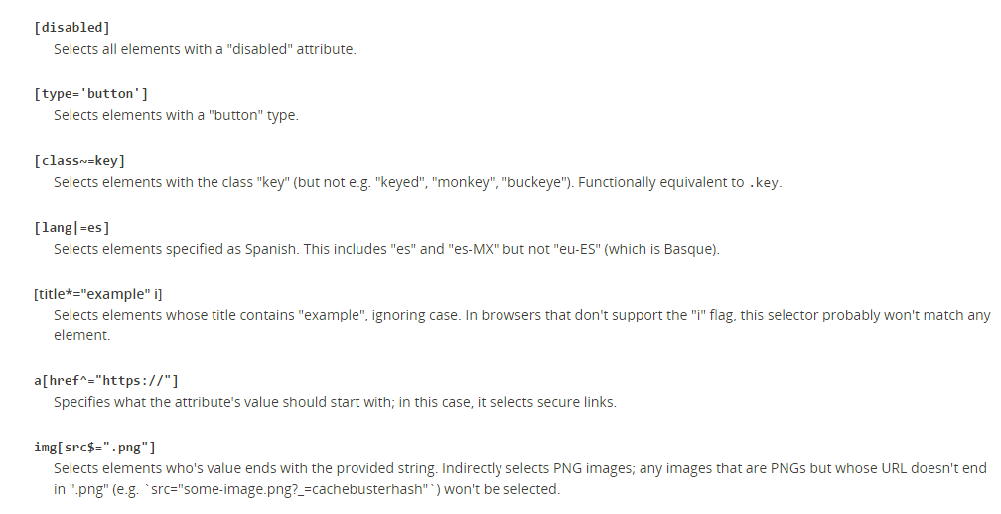

Slide 9
