Slide 1
CSS
on
On 10/11/2016

Slide 2
inheritance & Precedence
Browsers
Users
External File
Inner
Inline
!important by author
!important by User

Slide 3
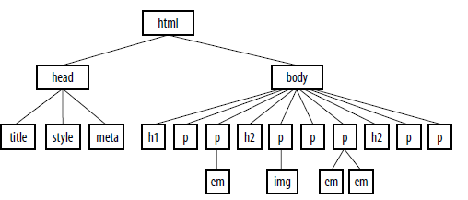
inheritance & Precedence

Slide 4
inheritance & Precedence
Conflicts
Use of !important
Rule order

Slide 5
Formatting text
font-family
font-size (length unit | percentage | xx-small | x-small | small | medium | large | x-large | xx-large |smaller | larger | inherit)
Units
em,px,ex etc
font-weight-normal | bold | bolder | lighter | 100 | 200 | 300 | 400 | 500 | 600 | 700 | 800 | 900 |inherit

Slide 6
Formatting text
font-style (normal | italic | oblique | inherit)
font (font-style font-weight font-variant font-size/line-height font-family| inherit)
text-align (left | right | center | justify | inherit)
text-decoration (none | underline | overline | line-through | blink)

Slide 7
Formatting text
text-transform (none | capitalize | lowercase | uppercase | inherit)
letter-spacing (length measurement | normal | inherit)
word-spacing(length measurement | normal | inherit)
text-shadow(‘horizontal offset’ ‘vertical offset’ ‘blur radius’ ‘color’ | none) – CSS3

Slide 8
Formatting text
vertical-align(baseline | sub | super | top | text-top | middle |textbottom | bottom | percentage | length | inherit)
white-space (normal | pre | nowrap | pre-wrap | pre-line | inherit)
Visibility(visible | hidden | collapse | inherit)
text-direction(Values: ltr | rtl |inherit)

