Slide 1
What and How to help when disaster happens?

Slide 2
Our Solution: Using Drone and Artificial Intelligence
Drone will get the coordinates of the Disaster Location Coordinates(DLC).
It will fly there by travelling distance from current coordinate to DLC.
Detect Victims by its camera.
Drop Aid Packets to Victims.

Slide 3
How it will help under the hood?
Web client sends Disaster Location Coordinates to Raspberry PI zero
Raspberry PI zero sends those coordinates to Arduino based flight controller
And then Arduino will calculate which direction to travel, with what speed and distance.
The drone will reach the Disaster Location Coordinate.

Slide 4
Camera which is integrated with Raspberry PI Zero will identify victims using OpenCV (Python implementation) full body detection algorithm.
Person’s picture with identification, along with GPS coordinate sends back to the web client.
Drop Aid Packet at the location Coordinates.

Slide 5
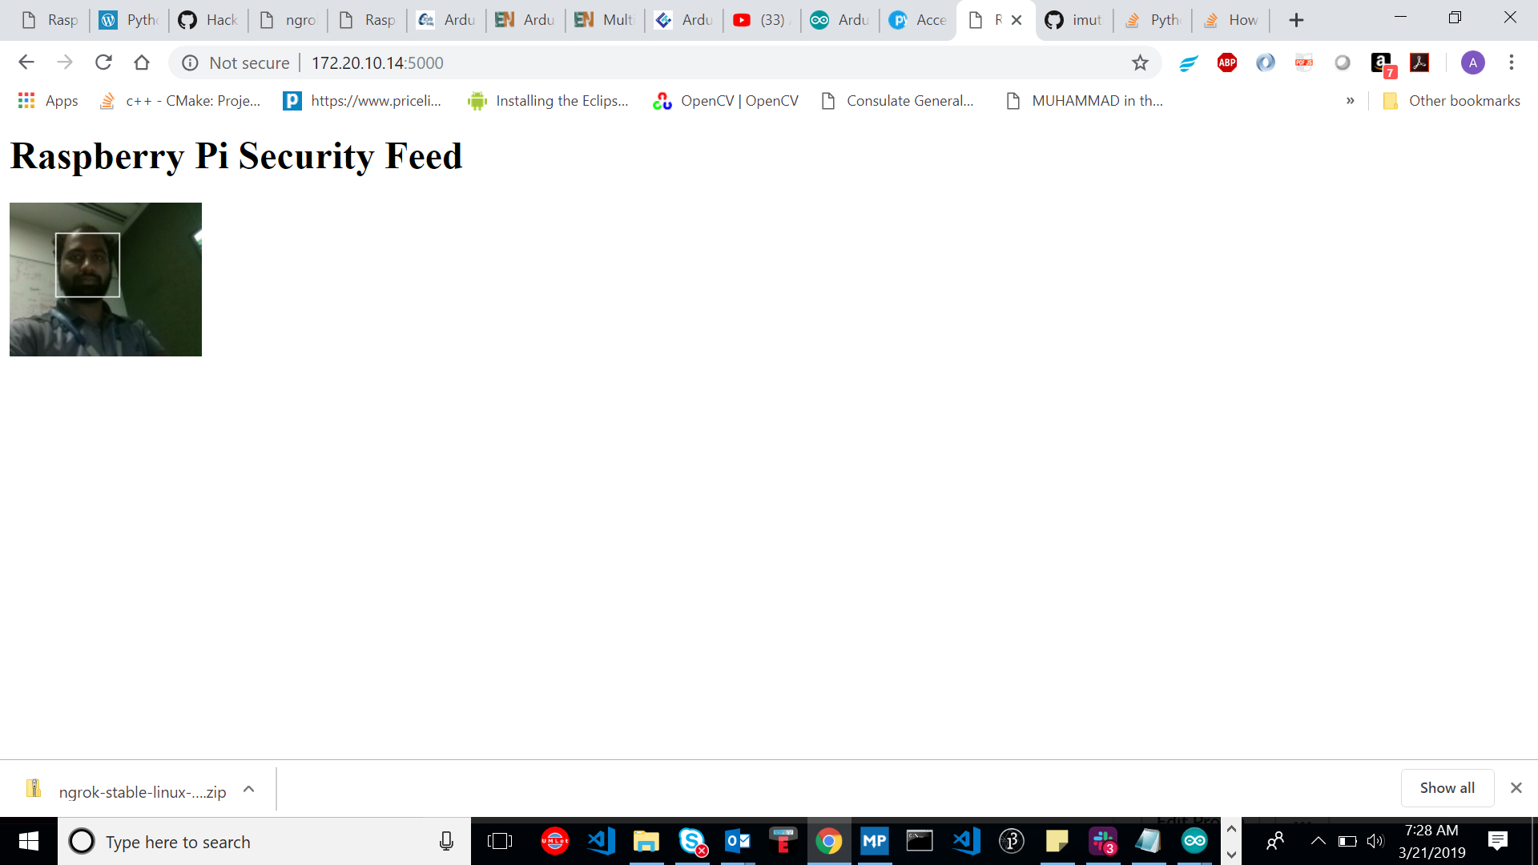
This is our Face Recognition

Slide 6
Future proposals
Identify if the Person is Dead or Alive by detecting heartbeat.
Drone will be able to detect victims at Night by using Night Vision camera.
Identify person’s heat radiation using sensors.
An army of drones can be deployed for different tasks for efficiency and quicker response time

Slide 7
Business Model
The Rescue Bots can be used to search and identify victims when a disaster strikes due to their size and ease of maneuverability. The bots can also report the status of the victim as in is the victim alive and if he/she is injured. Furthermore, the bots can give rise to a database of information which the government and interested parties can use to plan further.

Slide 8
Technology/Tools Used
OpenCV Computer Vision Library – Python Implementation
Raspbian OS for Raspberry PI Zero
Arduino IDE
Python 2.7
Vim Editor
VS Code
GitHub Client

Slide 9
Hardware
Arduino Nano
Raspberry PI Zero
PI Camera
GPS Module
Ultrasonic Proximity Sensor
Quad X Copter
Lipo Battery
Mini Servo Motor
Voltage Regulator
Gyro Sensor
Barometer
Magnetometer

Slide 10
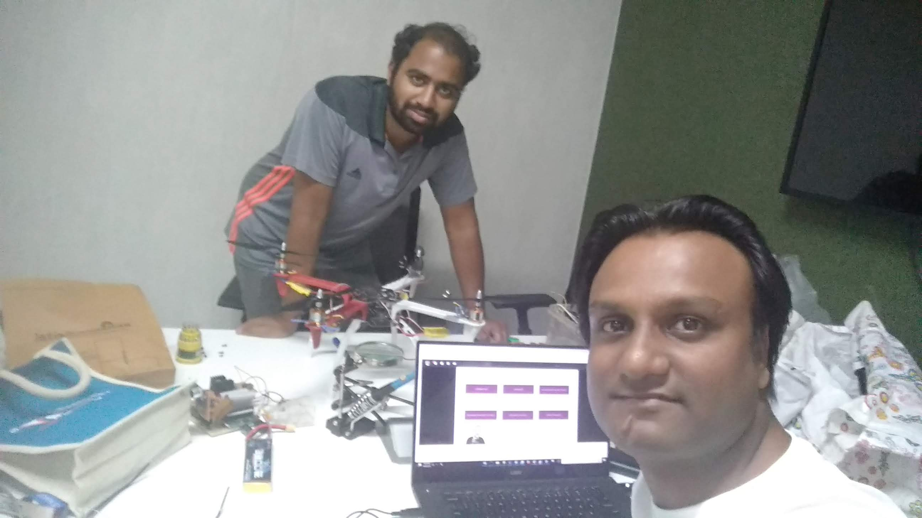
Thank You

