Slide 1
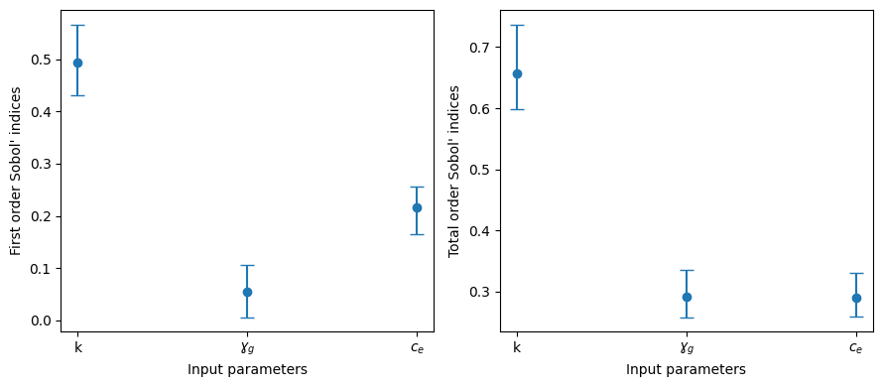
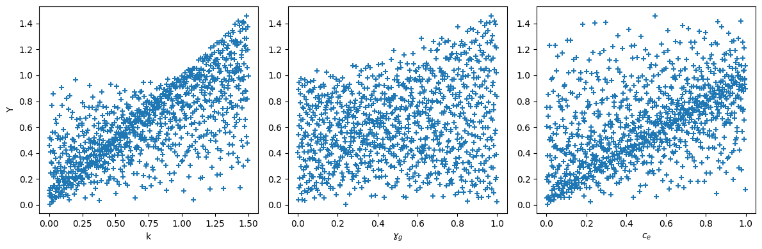
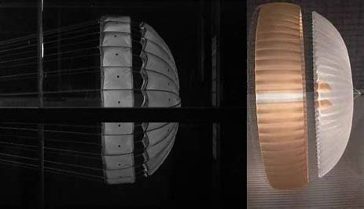
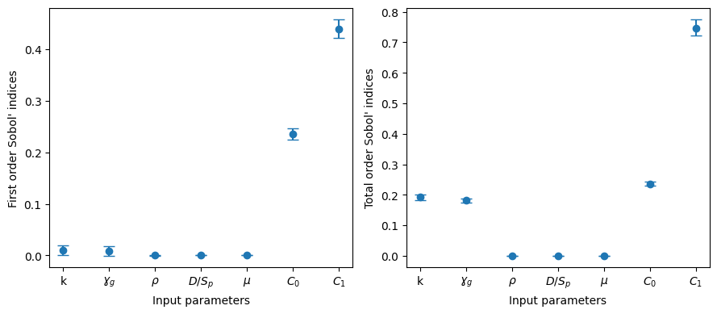
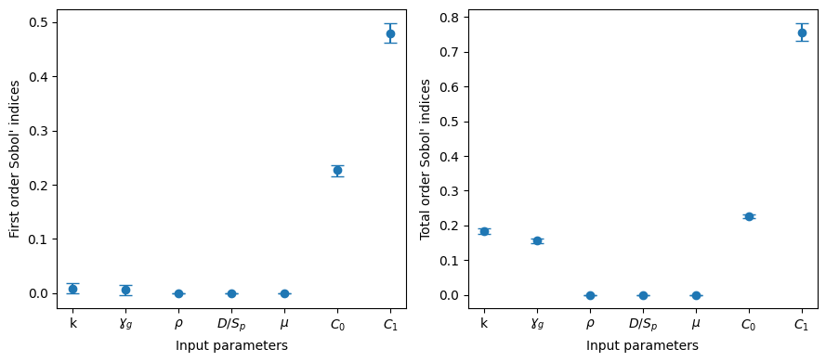
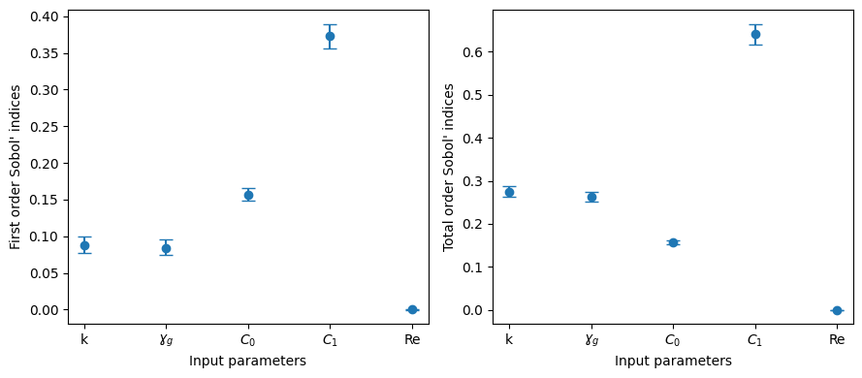

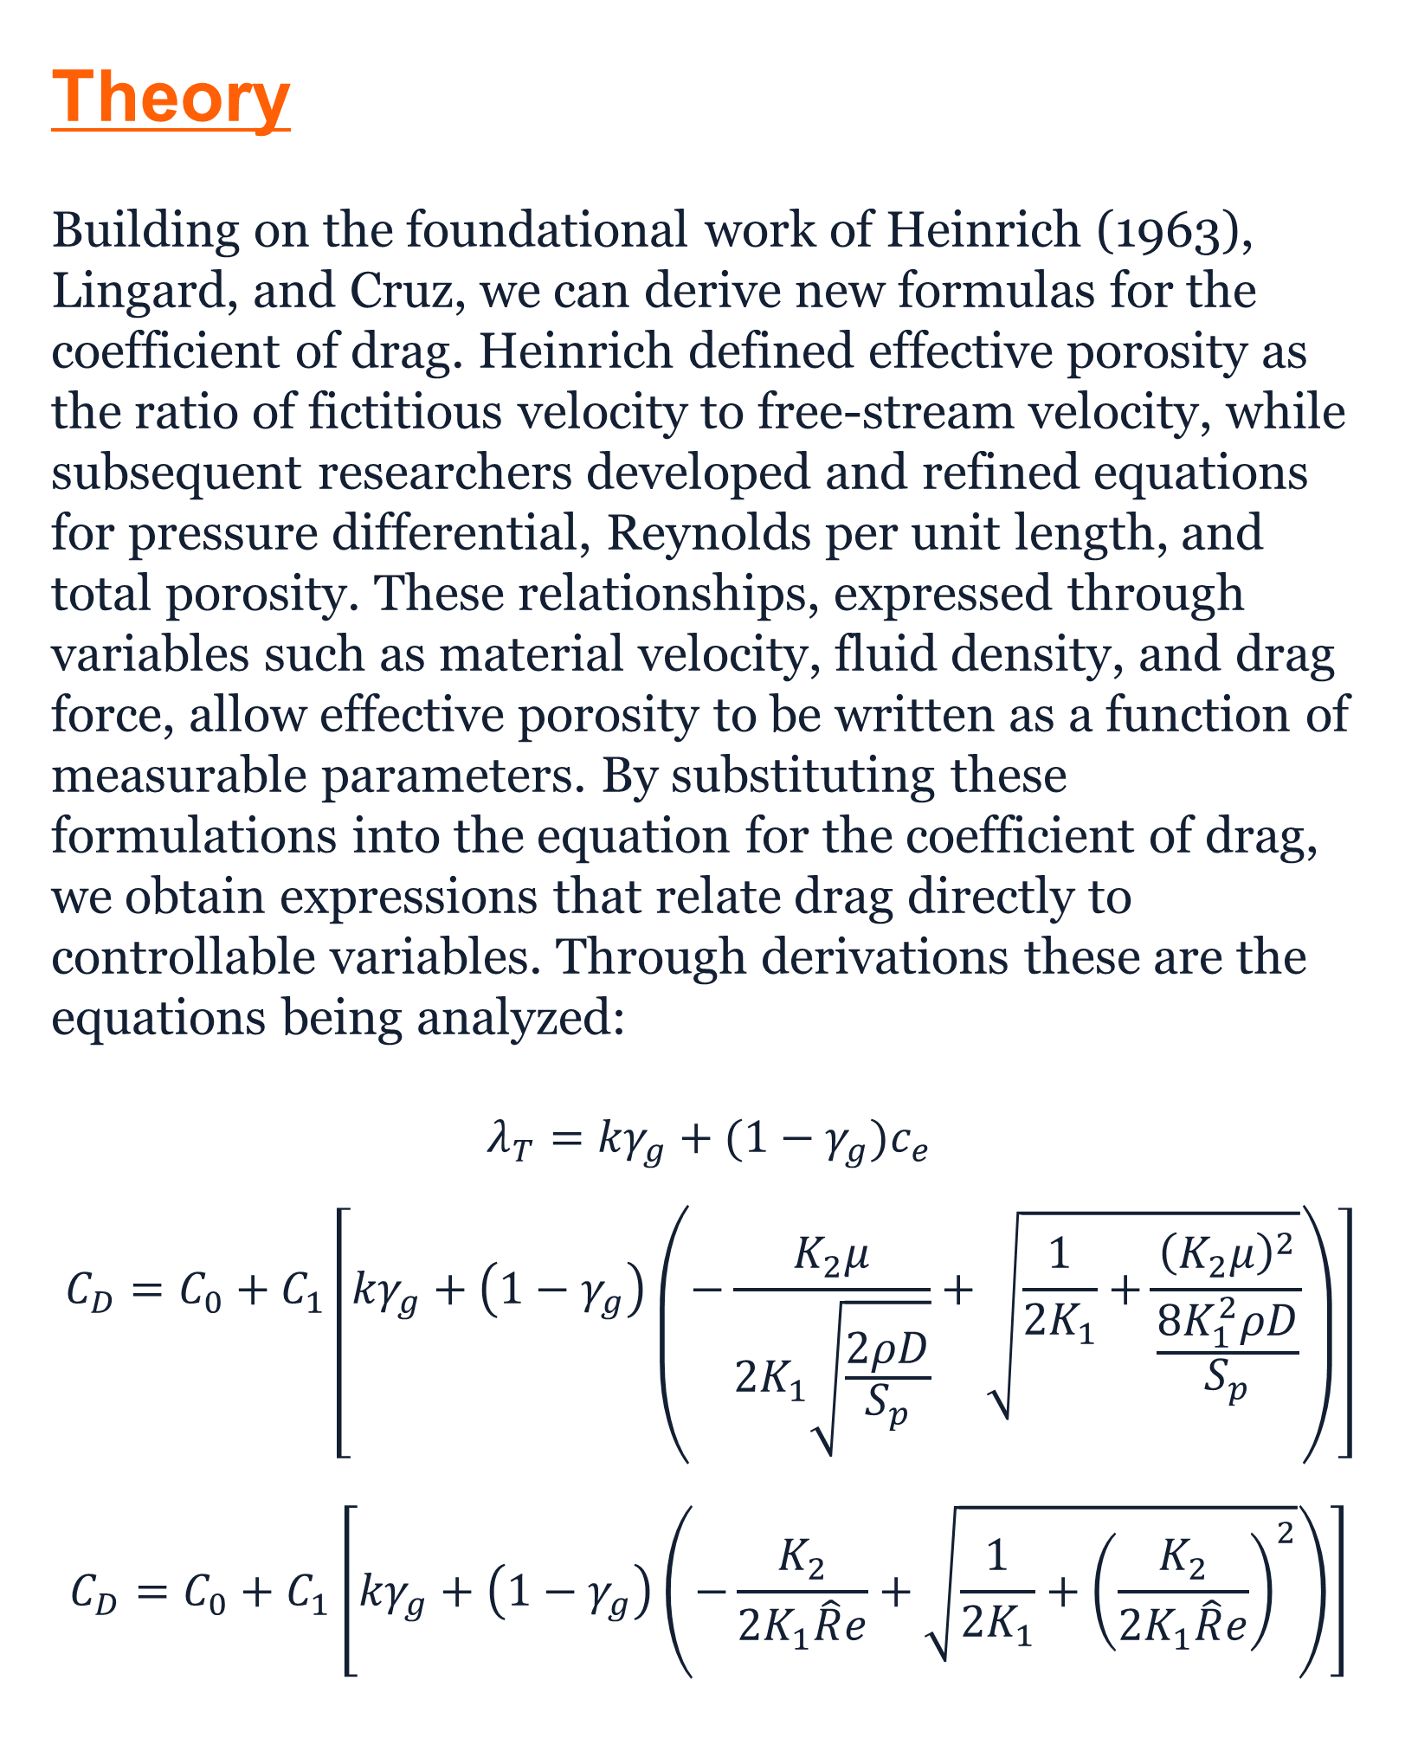
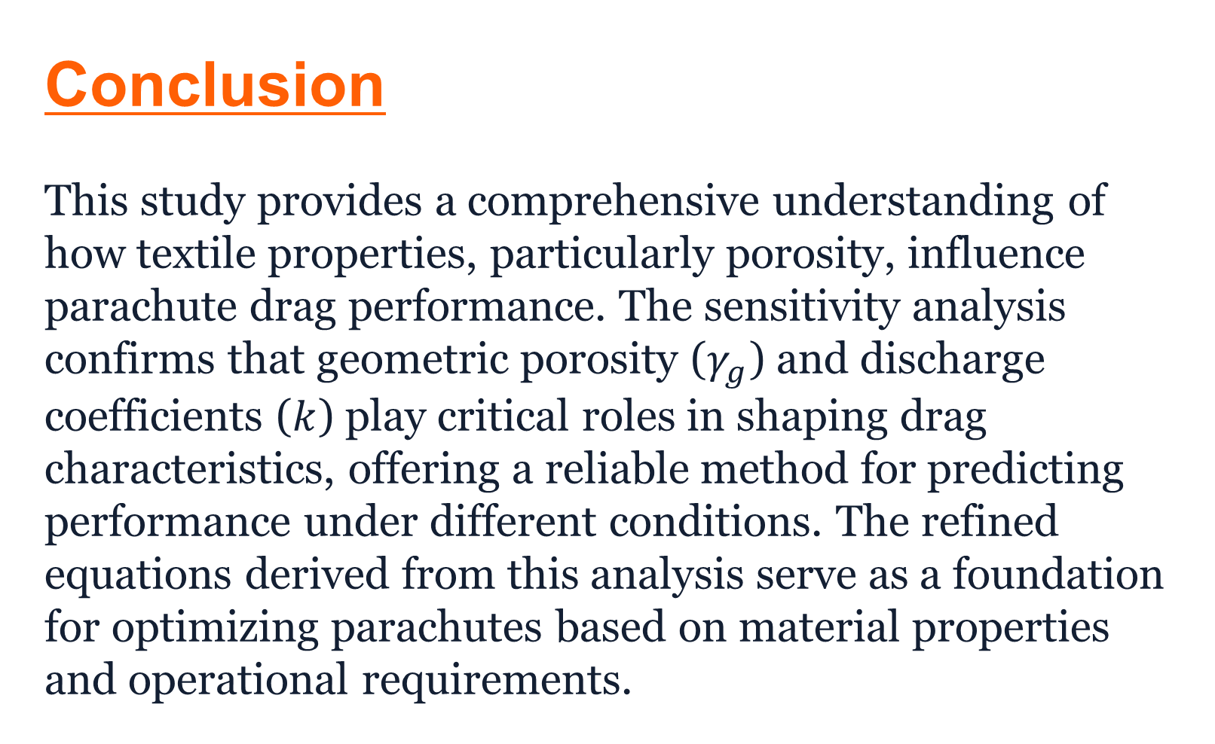
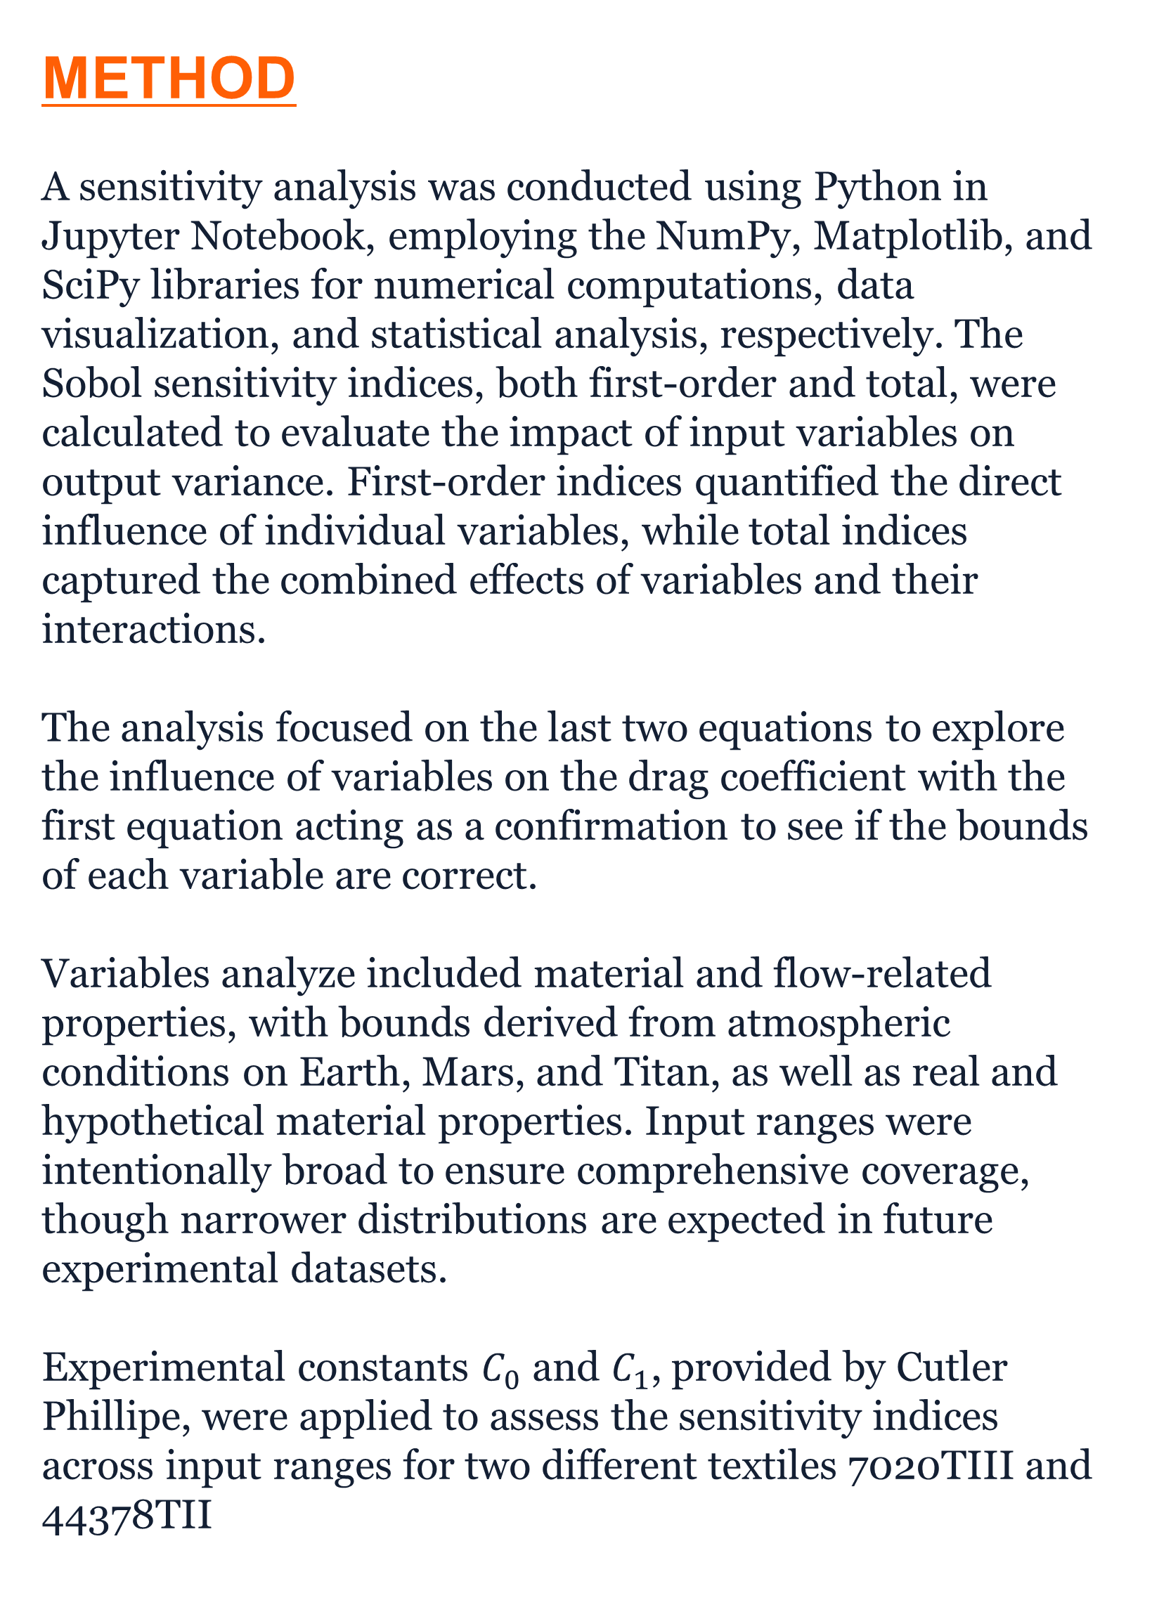
Computational Permeability Sensitivity of Parachutes
Rishabh Srinivas, Cutler Phillipe Department of Aerospace Engineering, College of Engineering, University of Illinois at Urbana-Champaign
INTRODUCTION
Parachutes generate drag force by trapping air under the textile, counteracting gravity and lowering terminal velocity. Drag force is directly proportional to the drag coefficient of the parachute, surrounding air density, velocity, and cross-sectional area.
Parachute performance is heavily dependent on the textile's properties and the parachute's design. The microstructure of the textile, particularly its porosity, plays a significant role. Material strain in parachutes occurs when the parachute textile is subjected to constant or varying pressures over time, causing gradual deformation in its physical structure. Over time, these changes can reduce the parachute’s performance by affecting its air permeability and flexibility.
Determining whether strain over time affects parachutes is significant as it can help answer some constants in calculating the coefficient of drag change rather than remaining constant.
Theory
Building on the foundational work of Heinrich (1963), Lingard, and Cruz, we can derive new formulas for the coefficient of drag. Heinrich defined effective porosity as the ratio of fictitious velocity to free-stream velocity, while subsequent researchers developed and refined equations for pressure differential, Reynolds per unit length, and total porosity. These relationships, expressed through variables such as material velocity, fluid density, and drag force, allow effective porosity to be written as a function of measurable parameters. By substituting these formulations into the equation for the coefficient of drag, we obtain expressions that relate drag directly to controllable variables. Through derivations these are the equations being analyzed: $$λ_{T}={kγ}_{g}+{(1−γ_{g})c}_{e}$$
$$C_{D}=C_{0}+C_{1}\left[{kγ}_{g}+\left(1−γ_{g}\right)\left(−\frac{K_{2}μ}{2K_{1}\sqrt{\frac{2ρD}{S_{p}}}}+\sqrt{\frac{1}{2K_{1}}+\frac{{\left(K_{2}μ\right)}^{2}}{\frac{8K_{1}^{2}ρD}{S_{p}}}}\right)\right]$$
$$C_{D}=C_{0}+C_{1}\left[{kγ}_{g}+\left(1−γ_{g}\right)\left(−\frac{K_{2}}{2K_{1}\hat{R}e}+\sqrt{{\frac{1}{2K_{1}}+\left(\frac{K_{2}}{2K_{1}\hat{R}e}\right)}^{2}}\right)\right]$$
Results
Sensitivity Analysis Highlights
Porosity and Drag Coefficient:
Effective porosity (𝑐_𝑒) and geometric porosity (𝛾_𝑔) significantly influence total porosity (𝜆_𝑇), which determines the drag coefficient (𝐶_𝐷).
Supports Heinrich's theory emphasizing Reynolds and Mach numbers in air permeability.
Key Findings from Sobol Indices:
Discharge coefficient (𝑘) plays a dominant role in drag effects.
Minor impacts from dynamic viscosity (𝜇) and fluid density (𝜌).
Material Strain and Porosity Evolution:
Observed consistent changes in Sobol indices for materials 44378TII and 7020TIII.
Demonstrates how small porosity changes can cause significant drag variations.
Reynolds Per Unit Length:
Enhances sensitivity analysis, showcasing the critical role of the discharge coefficient in scaling drag.
First Order and Total Order Indices for First Equation
Distribution of Points for Each Variable for First Equation
Conclusion
This study provides a comprehensive understanding of how textile properties, particularly porosity, influence parachute drag performance. The sensitivity analysis confirms that geometric porosity ($γ_{g}$) and discharge coefficients ($k$) play critical roles in shaping drag characteristics, offering a reliable method for predicting performance under different conditions. The refined equations derived from this analysis serve as a foundation for optimizing parachutes based on material properties and operational requirements.
METHOD
A sensitivity analysis was conducted using Python in Jupyter Notebook, employing the NumPy, Matplotlib, and SciPy libraries for numerical computations, data visualization, and statistical analysis, respectively. The Sobol sensitivity indices, both first-order and total, were calculated to evaluate the impact of input variables on output variance. First-order indices quantified the direct influence of individual variables, while total indices captured the combined effects of variables and their interactions.
The analysis focused on the last two equations to explore the influence of variables on the drag coefficient with the first equation acting as a confirmation to see if the bounds of each variable are correct.
Variables analyze included material and flow-related properties, with bounds derived from atmospheric conditions on Earth, Mars, and Titan, as well as real and hypothetical material properties. Input ranges were intentionally broad to ensure comprehensive coverage, though narrower distributions are expected in future experimental datasets.
Experimental constants $C_{0}$ and $C_{1}$, provided by Cutler Phillipe, were applied to assess the sensitivity indices across input ranges for two different textiles 7020TIII and 44378TII
Wind Tunnel Testing on Parachutes
First Order and Total Order Indices for Second Equation for Textile 44378 TII
AIM
The project aims to conduct a comprehensive sensitivity analysis of parachute textiles, focusing on how microstructural and permeability factors influence the drag coefficient of a hypothetical parachute with key components being:
Computational Simulations: Utilizing Jupyter Lab to model and analyze the system of equations linking textile properties to parachute performance.
Data Visualization: Creating visual representations to effectively interpret simulation results.
Verification Process: Initially testing the system with hypothetical data, followed by analysis using experimental data from wind tunnel tests.
Time-Dependent Factors: Examining how material strain and porosity evolution over time affect the drag coefficient.
Experimental Integration: Complementing computational analyses with real-world experimental data to enhance understanding of parachute performance.
Future Research
Dynamic Behavior Analysis: Investigate how material fatigue and environmental stresses over time influence textile porosity and drag
Impact of Airflow Conditions: Study the effects of varying airflow conditions and textile modifications on drag coefficient predictions
Real-World Data Integration: Validate models using data from multiple parachute deployments to enhance accuracy.
Mission-Specific Designs: Use findings to develop designs optimized for specific mission profiles.
First Order and Total Order Indices for Second Equation for Textile 7020 TIII
Captions set in a serif style font such as Times, 18 to 24 size, italic style.
Duis autem vel eum iriure dolor in hendrerit in vulputate velit esse molestie consequat.
First Order and Total Order Indices for Third Equation for Textile 7020 TIII

