Slide 1
TechniView
PURPOSE
LeetCode-style interview practice, tied to coursework
PROJECT GOAL
Create a web-based learning platform
for technical interview questions.
FALL DESIGN PRESENTATION / NOVEMBER 4, 2026
Notes:
Speaker: Derek Corniello | Target: 12 seconds. TechniView ties technical interview practice to coursework. Students solve Python questions online and instructors can assign and review work.

Slide 2
TECHNIVIEW / DESIGN CHECKPOINT
The Team Behind TechniView
TEAM CONTACTS
Derek Corniello corniedj@mail.uc.edu Backend + runner
Ryan Sippy sippyrd@mail.uc.edu Frontend
Jason Bellerjeau bellerjn@mail.uc.edu Data + database
Faculty advisor: Dr William Hawkins III
TECHNIVIEW / NOVEMBER 4, 2026
02
Notes:
Speaker: Ryan Sippy | Target: 15 seconds. Derek leads backend, runner, and deployment; Ryan leads frontend and course workflows; Jason leads data, catalog, and analytics. Our faculty advisor is Dr William Hawkins III.

Slide 3
TECHNIVIEW / DESIGN CHECKPOINT
Project Abstract
TechniView links technical interview practice to coursework in one platform, giving students a structured way to prepare alongside class assignments.
The 150-problem TechniView Trail sequences Python problems by technique and prerequisite, helping students choose what to practice next.
Students submit code, see per-test feedback, and track progress across practice and assigned work.
Professors build sets, publish dated assignments, and review class analytics to spot where students struggle.
React, FastAPI, MySQL, and an isolated go-judge runner power the platform. CI checks code, integration, and production images.
A voluntary pilot pairs a usability survey with de-identified activity data to study learning and engagement; IRB requirements govern collection and sharing.
TECHNIVIEW / NOVEMBER 4, 2026
03
Notes:
Speaker: Jason Bellerjeau | Target: 40 seconds. TechniView brings interview practice into courses. The TechniView Trail groups Python problems by technique and prerequisites. Students submit code and see case feedback; instructors assign work and review analytics. React, FastAPI, MySQL, and a separate go-judge runner power the system. Our research plan combines a voluntary pilot, a usability survey, and de-identified activity data to examine learning and engagement, subject to IRB requirements.

Slide 4
TECHNIVIEW / DESIGN CHECKPOINT
User Stories and System Design
USER STORIES
CURRENT SYSTEM DESIGN
Student: practice interview problems online.
Students /
professors
React
web app
FastAPI
app workers
MySQL
app data
Professor: build sets, assign work, track results.
Isolated
go-judge
TechniView Trail, assignments, grading, progress.
References: US-01, US-02, US-03, REQ-01, REQ-02, REQ-03, REQ-04, NFR-02
TECHNIVIEW / NOVEMBER 4, 2026
04
Notes:
Speakers: Derek Corniello and Ryan Sippy | Target: 45 seconds. Derek: Students practice interview questions and see feedback; professors curate sets and assign them. The TechniView Trail recommends technique pools as prerequisites are met. Ryan: React calls FastAPI, which stores course data in MySQL. App workers send code to isolated go-judge and return results.

Slide 5
TECHNIVIEW / DESIGN CHECKPOINT
Major Project Constraints
Cost: Free with existing campus hosting.
Security: Student signup/access restricted; runner isolated.
Privacy: Follow FERPA for course data.
Quality: Verify accessibility, load, and uptime.
References: CON-01, CON-02, REQ-05, NFR-02, NFR-03, NFR-04
TECHNIVIEW / NOVEMBER 4, 2026
05
Notes:
Speaker: Ryan Sippy | Target: 25 seconds. Campus hosting can make platform cost free when the institution already provides app and runner infrastructure. Student signup and access must be limited to enrolled students, while faculty access is provisioned separately. Submitted code runs on an isolated runner. Course data must follow FERPA; accessibility and capacity still need verification.

Slide 6
TECHNIVIEW / DESIGN CHECKPOINT
Project Progress
Python solutions and reference cases checked.
Backend API tests cover core workflows.
Frontend tests cover student and instructor views.
Integration checks use MySQL and go-judge.
Sandbox tests exercise real submissions.
Production images build in CI.
TECHNIVIEW / NOVEMBER 4, 2026
06
Notes:
Speaker: Jason Bellerjeau | Target: 35 seconds. We have run Python solution and reference-case checks, backend API tests, frontend tests, and integration checks with MySQL and go-judge. Integration exercises real submissions and sandbox limits. CI also builds production images. Deployed end-to-end tests remain a next step.

Slide 7
TECHNIVIEW / DESIGN CHECKPOINT
Expected End-of-Term Accomplishments
Test deployed workflows end to end.
Run a voluntary pilot after IRB review.
Share study findings at Expo.
References: CON-03, CON-04, NFR-01, NFR-03
TECHNIVIEW / NOVEMBER 4, 2026
07
Notes:
Speaker: Derek Corniello | Target: 35 seconds. By term end, we plan to test deployed student and instructor workflows through the isolated runner. We also plan a voluntary pilot, subject to IRB and consent requirements. We will analyze de-identified activity and usability survey responses and share findings at Expo.

Slide 8
TECHNIVIEW / DESIGN CHECKPOINT
Division of Work
Derek: backend, runner, deployment.
Ryan: frontend, course workflows.
Jason: schema, catalog, analytics.
TECHNIVIEW / NOVEMBER 4, 2026
08
Notes:
Speakers: Derek Corniello, Ryan Sippy, and Jason Bellerjeau | Target: 25 seconds. Derek owns backend, runner, and deployment. Ryan owns frontend and course workflows. Jason owns schema, problem catalog, and analytics. We share integration and testing.

Slide 9
TECHNIVIEW / DESIGN CHECKPOINT
Expected Expo Demo
Student solves Python; sees test results.
TechniView Trail suggests the next technique.
Professor publishes sets and assignments.
Research findings show pilot results.
Recordings/screenshots: shown and ready as fallback.
References: US-01, US-03, REQ-01, REQ-04, CON-03, CON-04
TECHNIVIEW / NOVEMBER 4, 2026
09
Notes:
Speakers: Derek Corniello, Ryan Sippy, and Jason Bellerjeau | Target: 63 seconds. Derek: Show a student solving Python, seeing case results, and following the TechniView Trail. Ryan: Show a professor publishing a set and reviewing course analytics. Jason: Present research findings from the voluntary pilot, if IRB and consent requirements are met. Prepared recordings and screenshots will be shown alongside the live demo and serve as fallback.

Slide 10
TECHNIVIEW / DESIGN CHECKPOINT
Questions?
TECHNIVIEW / NOVEMBER 4, 2026
10
Notes:
Speaker: Derek Corniello | Target: 5 seconds. Invite questions. Total planned talk: 300 seconds. Recording plan: all three present in PowerPoint; target 5 minutes. Derek posts deck and recording links in the team spreadsheet. The demo recording and screenshots are prepared for Expo.

Slide 11
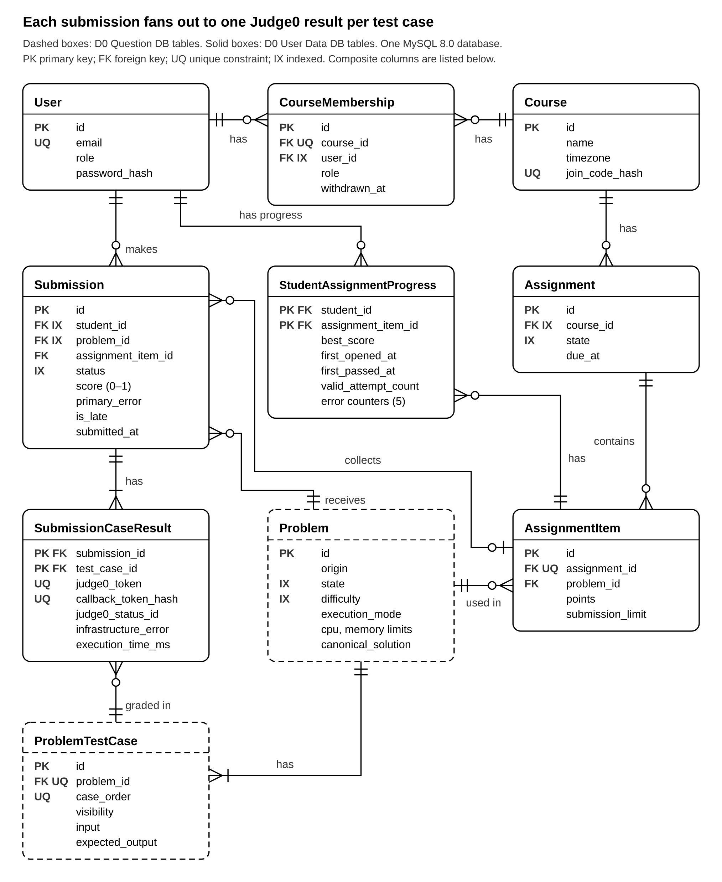
TECHNIVIEW / DESIGN CHECKPOINT
D1 Data Model | Backup
HISTORICAL DESIGN REFERENCE
TECHNIVIEW / NOVEMBER 4, 2026
11
Notes:
Speaker: Derek Corniello | Target: 0 seconds, backup only.\nD1 is the repository’s historical data model. Use this slide only if the panel asks about the original schema.\nSource: docs/design/D1_Detailed_Design.md; docs/design/images/D1_Data_Model.png.

Slide 12
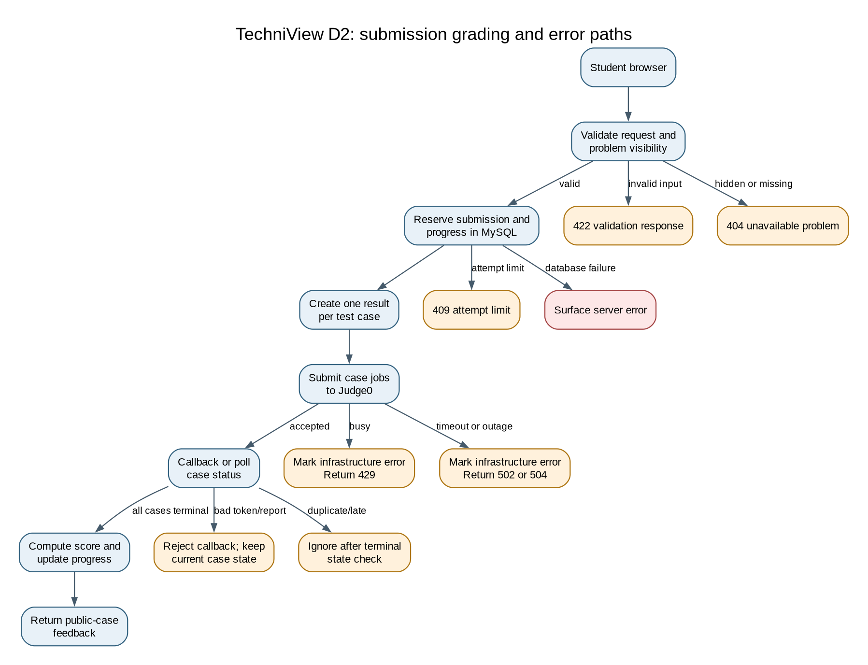
TECHNIVIEW / DESIGN CHECKPOINT
D2 Grading Flow | Backup
HISTORICAL DESIGN REFERENCE
TECHNIVIEW / NOVEMBER 4, 2026
12
Notes:
Speaker: Derek Corniello | Target: 0 seconds, backup only.\nD2 documents the historical grading and failure paths. The current deployment uses standalone go-judge on a separate runner VM.\nSource: docs/design/D2_Detailed_Design.md; docs/design/images/D2_Grading_Error_Paths.png; docs/runner-decision.md.

Slide 13
TECHNIVIEW / DESIGN CHECKPOINT
AI Use Acknowledgment
AI was used to assist with slide style and formatting.
The team is responsible for the technical content and claims.
TECHNIVIEW / NOVEMBER 4, 2026
13
Notes:
Backup only, 0 seconds. AI was used to assist with slide style and formatting. The team is responsible for the technical content and claims.

