Slide 1
BTS – MBDS
Big Data Infrastructure
A2: MongoDB and DataBricks
Ennio Maldonado
18 February, 2021

Slide 2
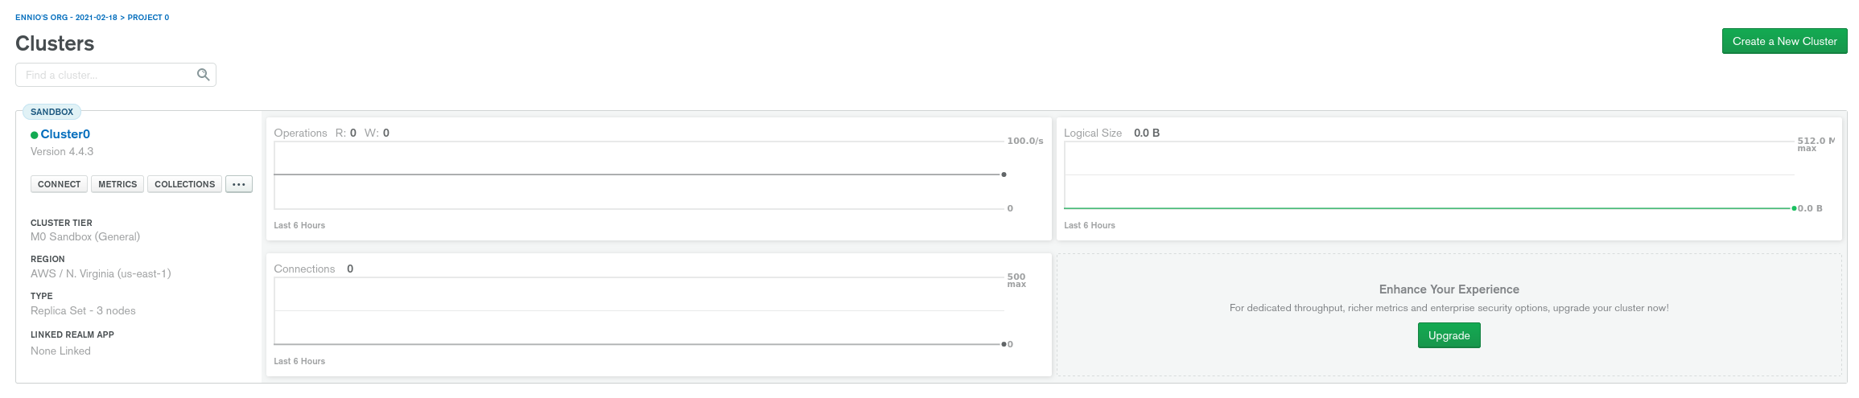
MongoDB
MongoDB cluster creation

Slide 3
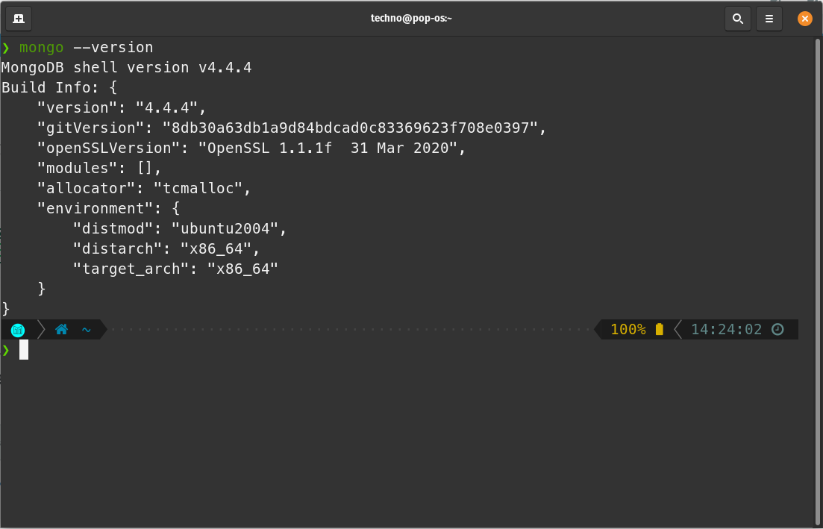
MongoDB
Installed mongodb shell tool

Slide 4
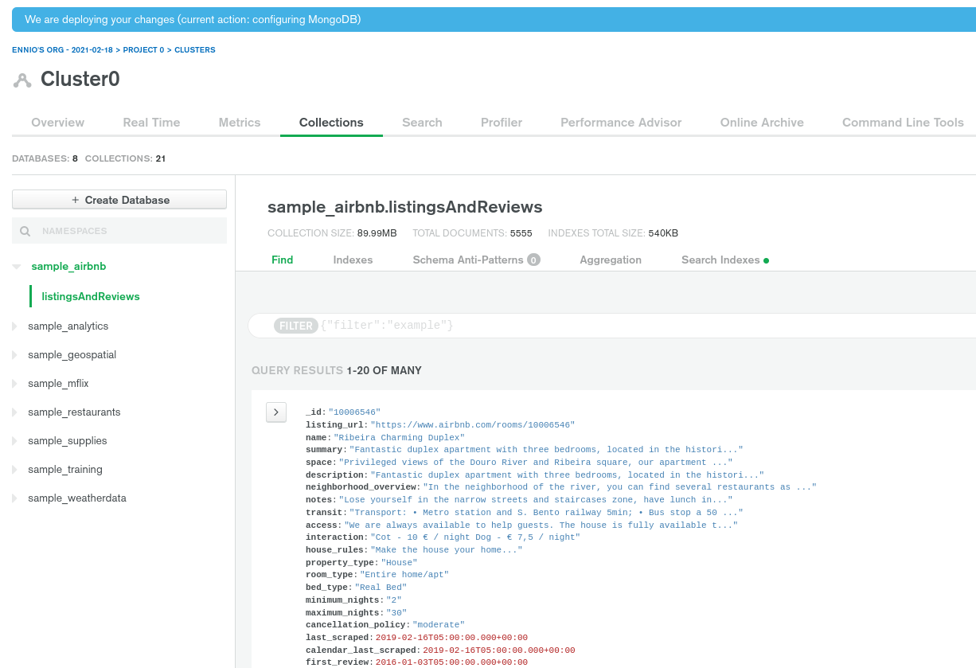
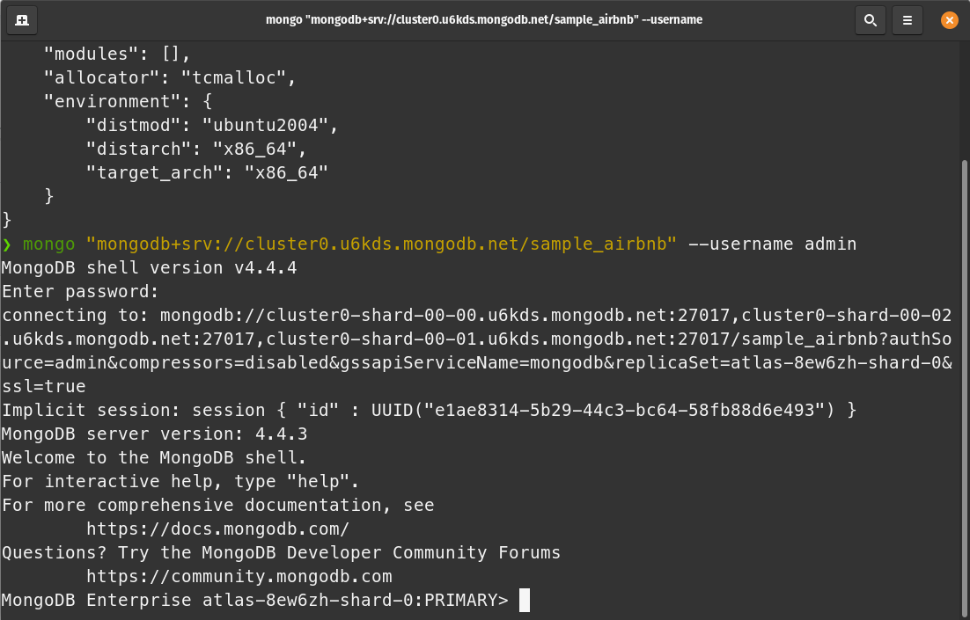
MongoDB
Loaded sample data_set from mongodb for testing connection.

Slide 5
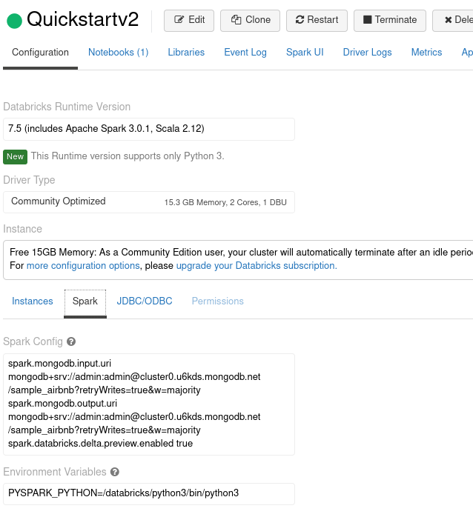
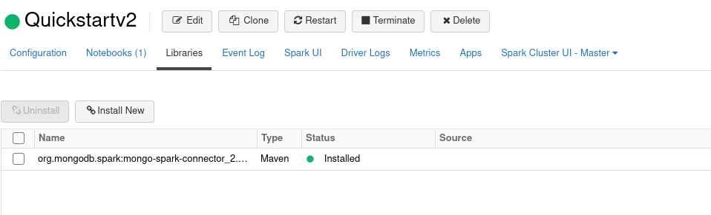
MongoDB on DataBricks
Connect MongoDB to DataBricks followed this guide:
https://docs.databricks.com/data/data-sources/mongodb.html

