Slide 1
BTS – MBDS
Big Data Infrastructure
A3: AWS - DynamoDB
Ennio Maldonado
03 March, 2021

Slide 2
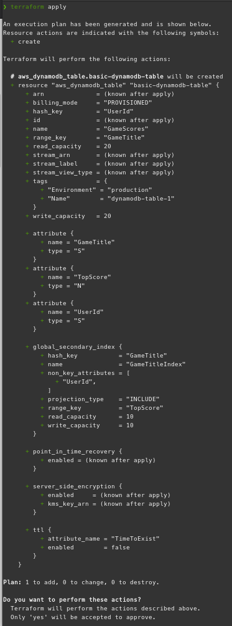
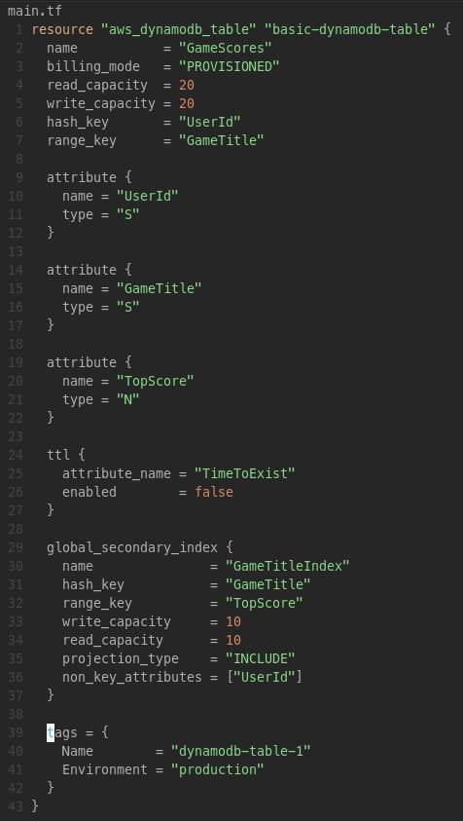
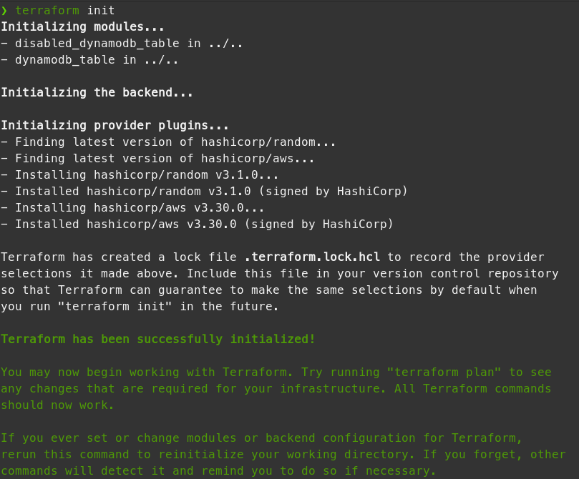
DynamoDB – Example Table
Terraform script
Terraform Apply ––>
Terraform Init

Slide 3
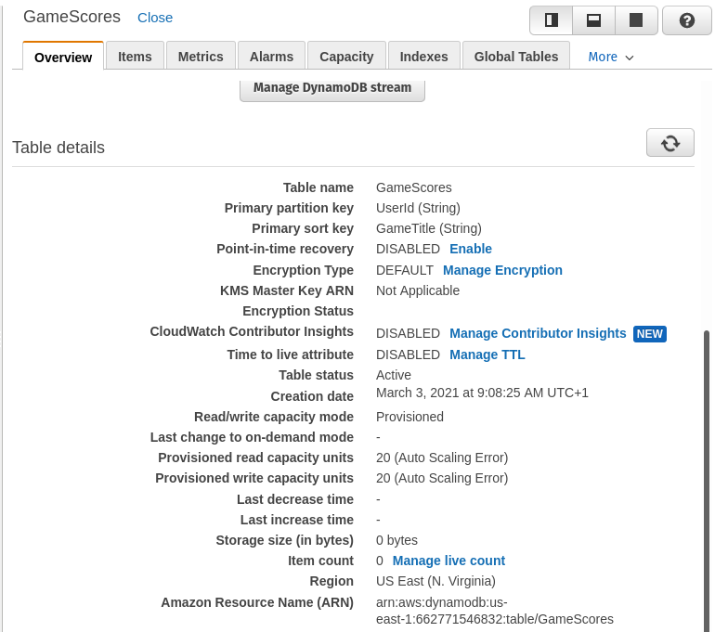
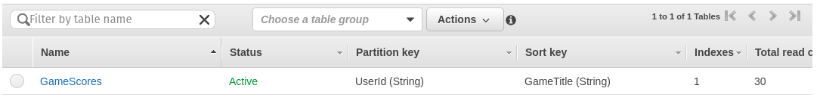
DynamoDB – Example Table
Terraform Output:
Confirmed creation on DynamoDB dashboard
Added a record to the table

Slide 4
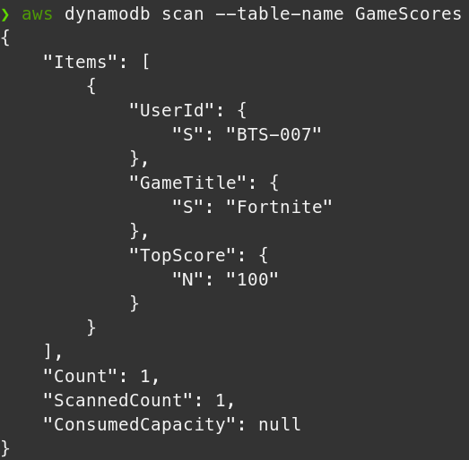
DynamoDB – Querying

Slide 5
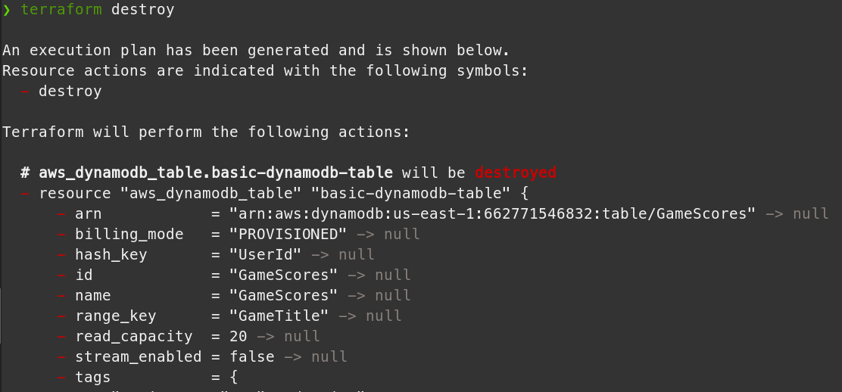
DynamoDB – Deleting resources

Slide 6
DynamoDB vs MongoDB
MongoDB is more flexible are not vendor locked in, you can use anywhere, whereas DynamoDB is AWS exclusive.
Other than that both are NoSQL databases for cloud services, and should eb about the same performance wise.

