Slide 1
BTS – MBDS
Big Data Infrastructure
A4: Install Docker & Python
Ennio Maldonado
04 March, 2021

Slide 2

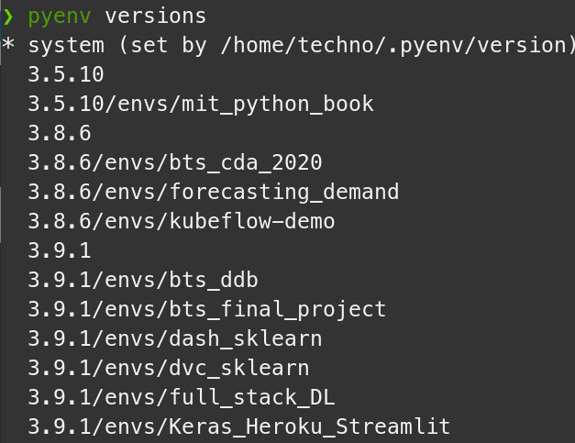
1. Install Docker and Python
Docker CE
Python venv

