Slide 1
BTS – MBDS
Big Data Infrastructure
A5: AWS - EC2
Ennio Maldonado
23 March, 2021

Slide 2
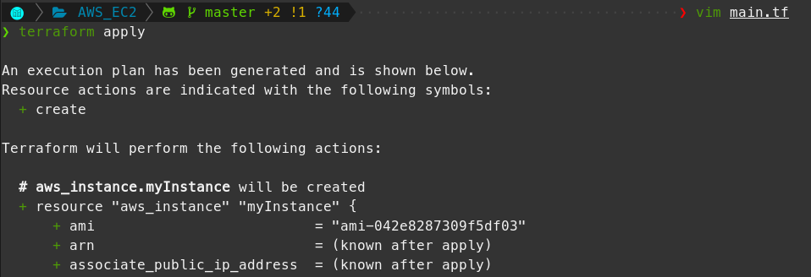
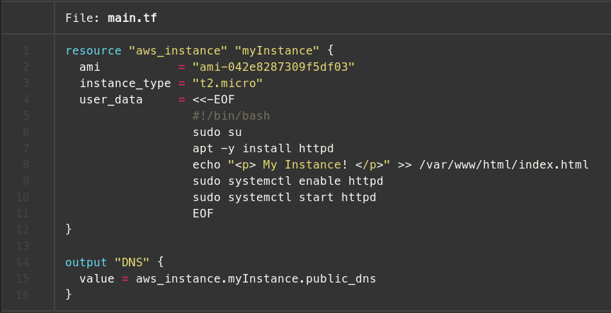
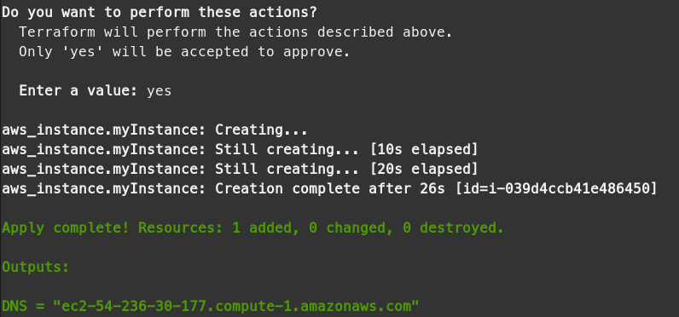
1. Install Docker and Python
Terraform yml file
Terraform apply

Slide 3
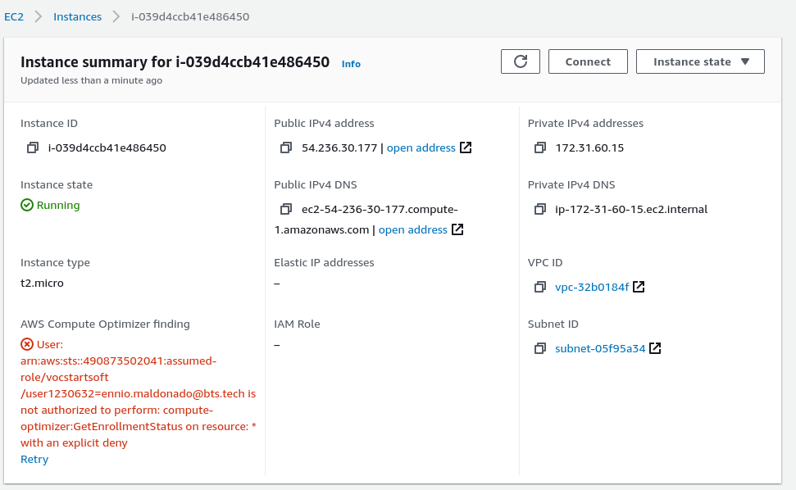
1. AWS -EC2
AWS – EC2 Dashboard

