Slide 1
BTS – MBDS
Big Data Infrastructure
A6: AWS – SQL
1: SQL – n-n relation
2: Neo4j sandbox
Ennio Maldonado
23 March, 2021

Slide 2
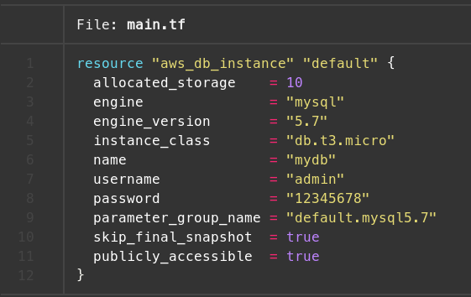
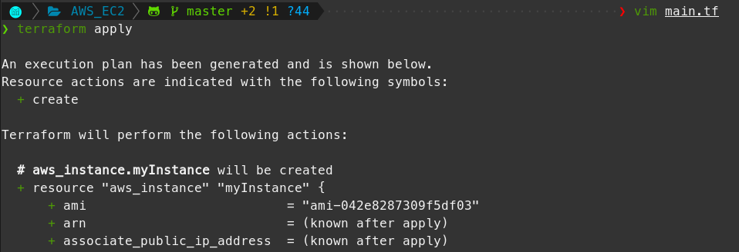
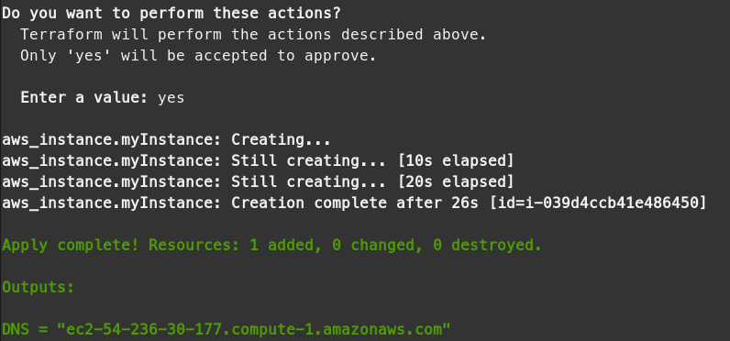
1. SQL – n-n relation
Terraform yml file
Terraform apply

Slide 3
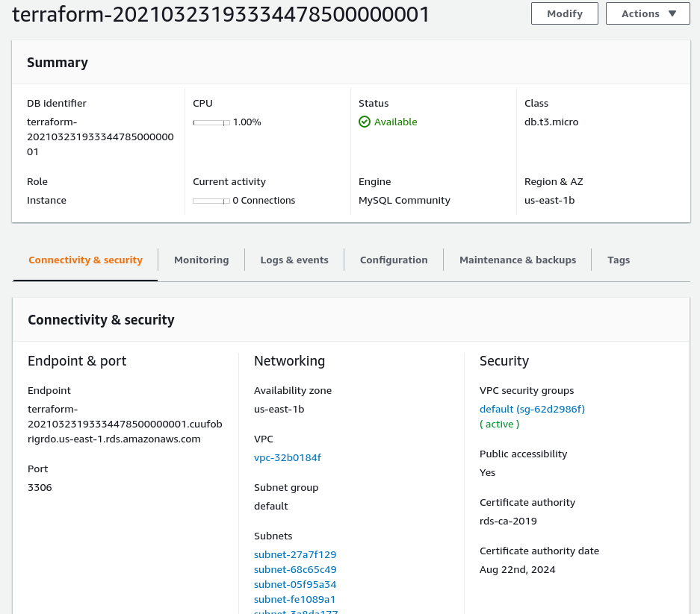
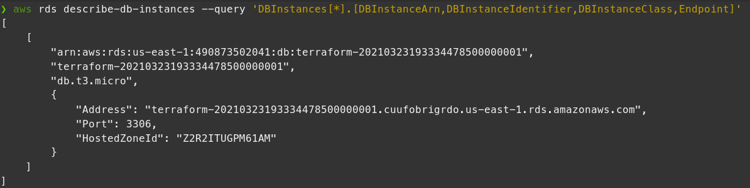
1. SQL – n-n relation
AWS DB instance
AWS cli - describe

Slide 4
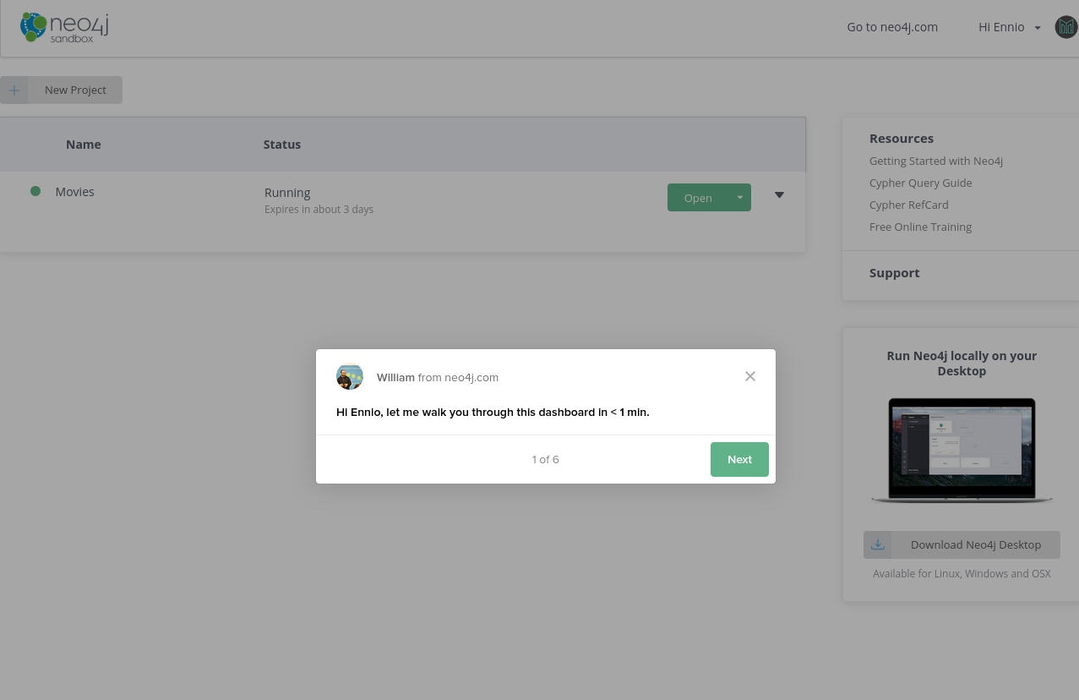
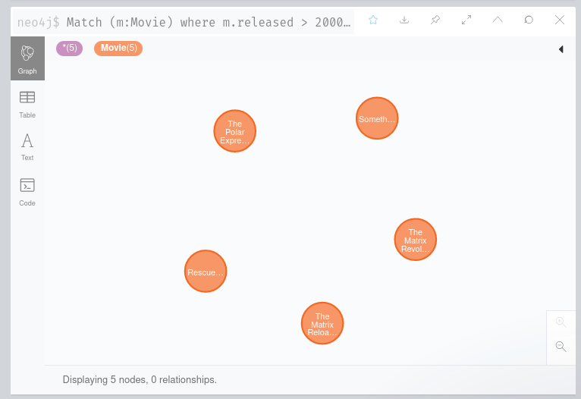
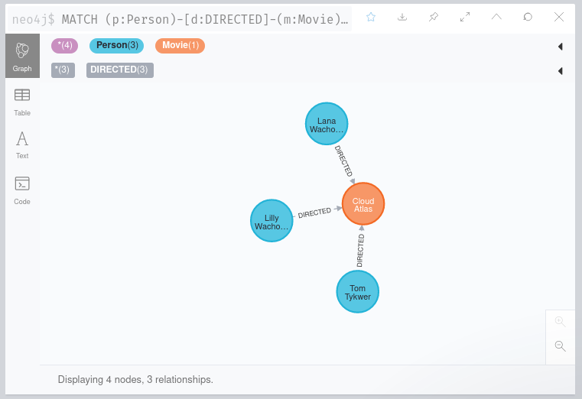
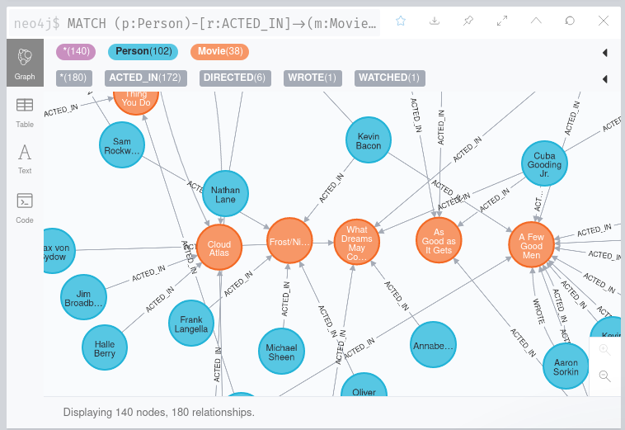
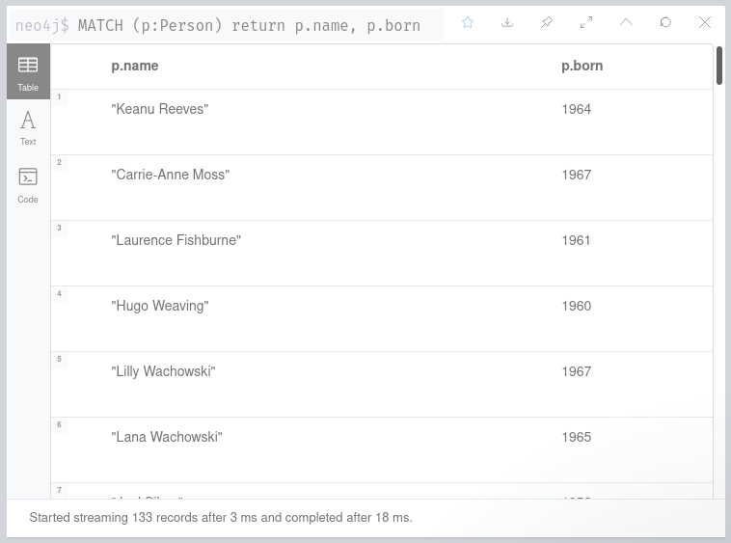
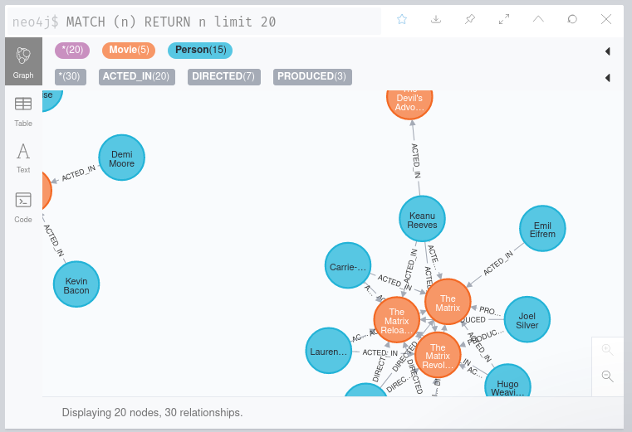
2. NEO4J - Sandbox

