Slide 1
BTS – MBDS
Big Data Infrastructure
A7: Cassandra Column DB
Ennio Maldonado
04 March, 2021

Slide 2
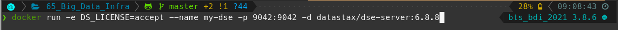
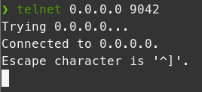
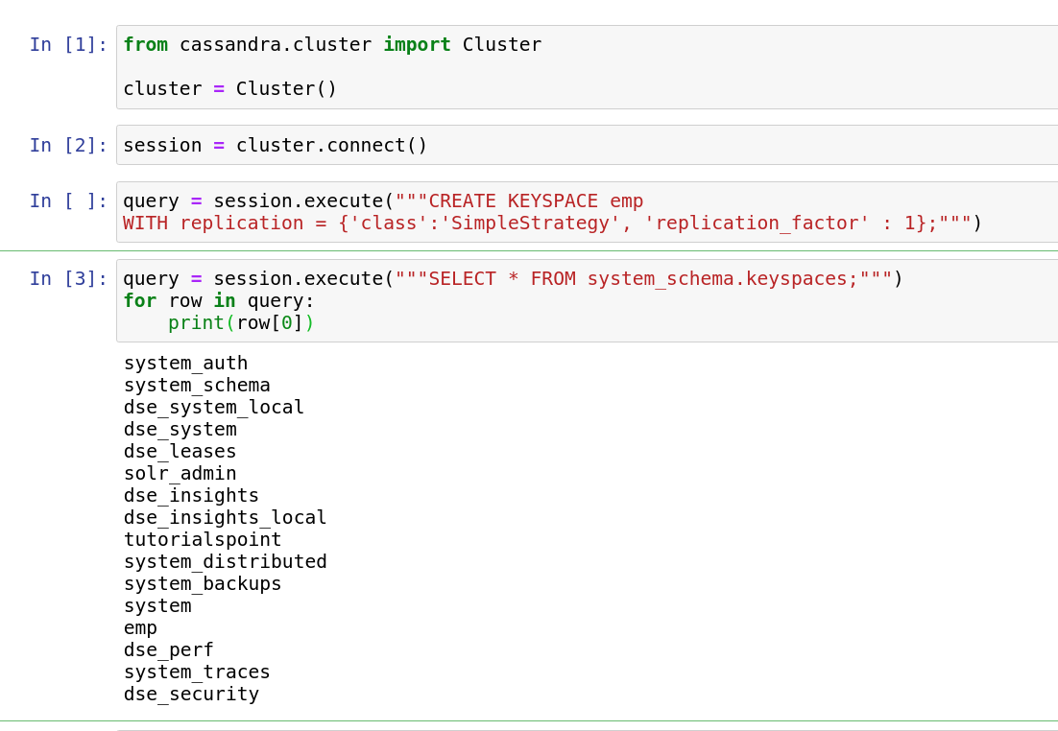
1. Cassandra Column DB
Docker Run
Testing connection to server
Testing in Python - create keyspace

Slide 3
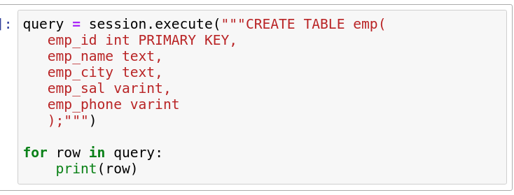
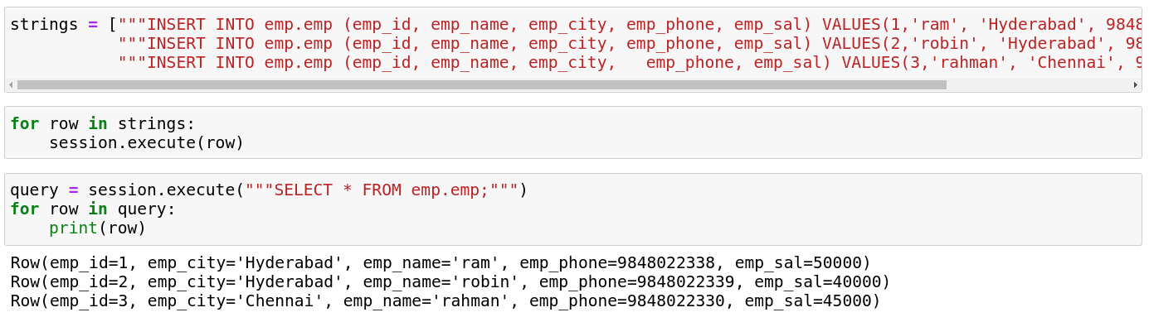
1. Cassandra Column DB
Create table
Add data points and query it

