Slide 1
QuizRT
August 14, 2018

Slide 2

Introduction
Design
Architecture
Microservices Walkthrough
Technologies Used
Demo
Backlogs
Questions?

Slide 3
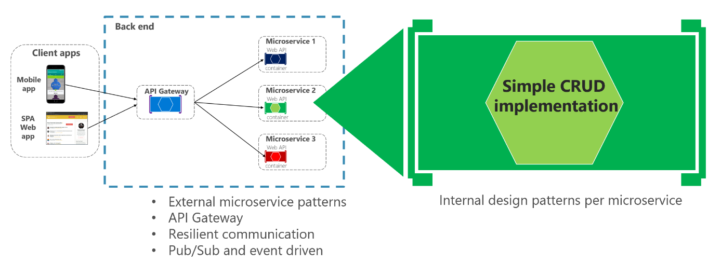

Design:
Question Manger
Social
Game Engine

Slide 4
Flow Diagram:

Slide 5
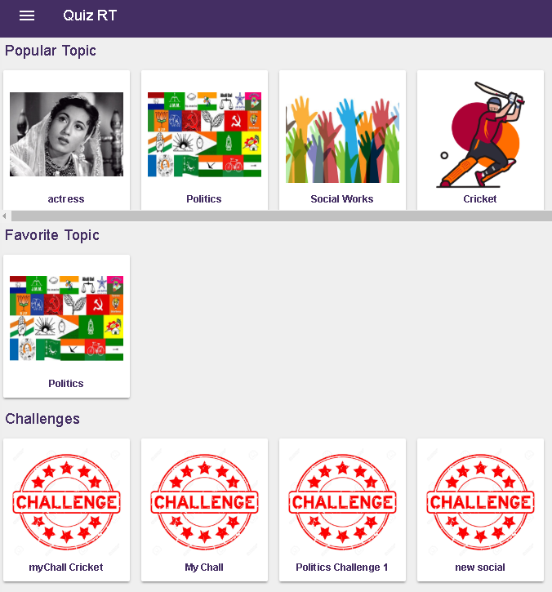
Social Microservice:
Authentication
Dashboard
Topics
Play Game
Play Challenges
Leaderboard
Friends & Chat

Slide 6
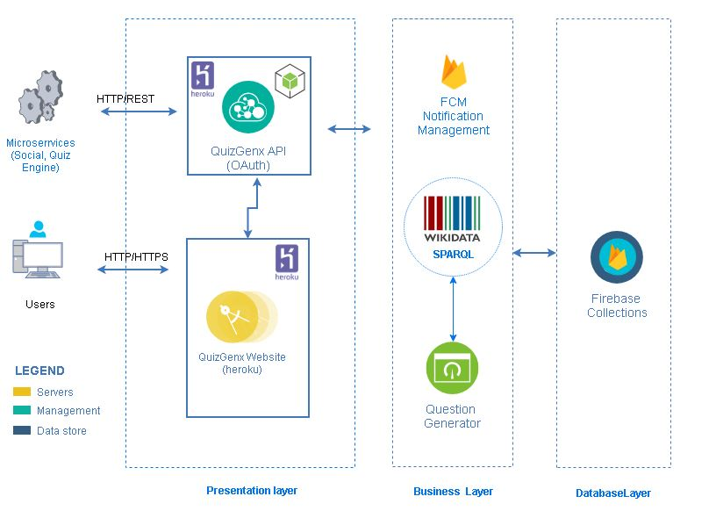
Question Generator Microservice:
Generation of Questions
Topic Management
Question Management
Compromise

Slide 7
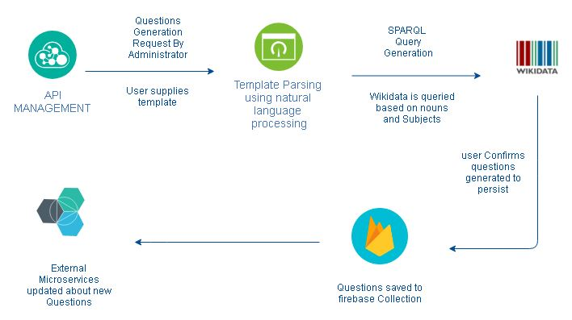
Question Generation Flow :

Slide 8
Game Engine Microservice:
Authenticated web socket connections
Multiplayer game supported – more than two players
Single player challenges support
Duplex connections and no TCP connection leaks
Score board Generation– based on time based algorithms
History of recent and ongoing games/challenges

Slide 9


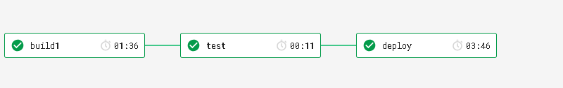
Code Quality:
ESLint using AirBnb
All Microservices are independent
Separation of View/Controller/Services/State
Circle CI Implementation

Slide 10
















Technologies Used:

Slide 11


Slide 12
Thank You !!

